Slide 1
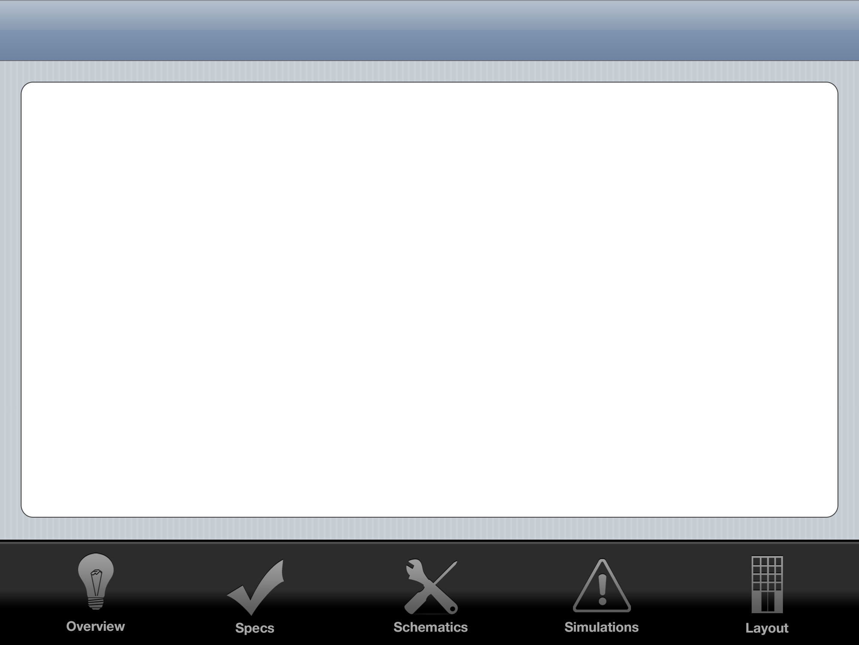
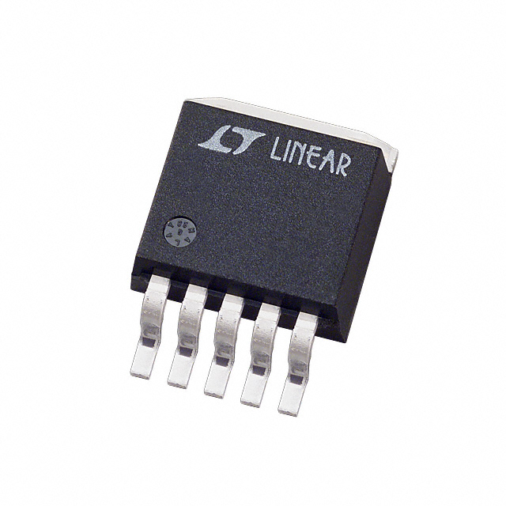
LDO Regulator
John O’Hollaren

Slide 2
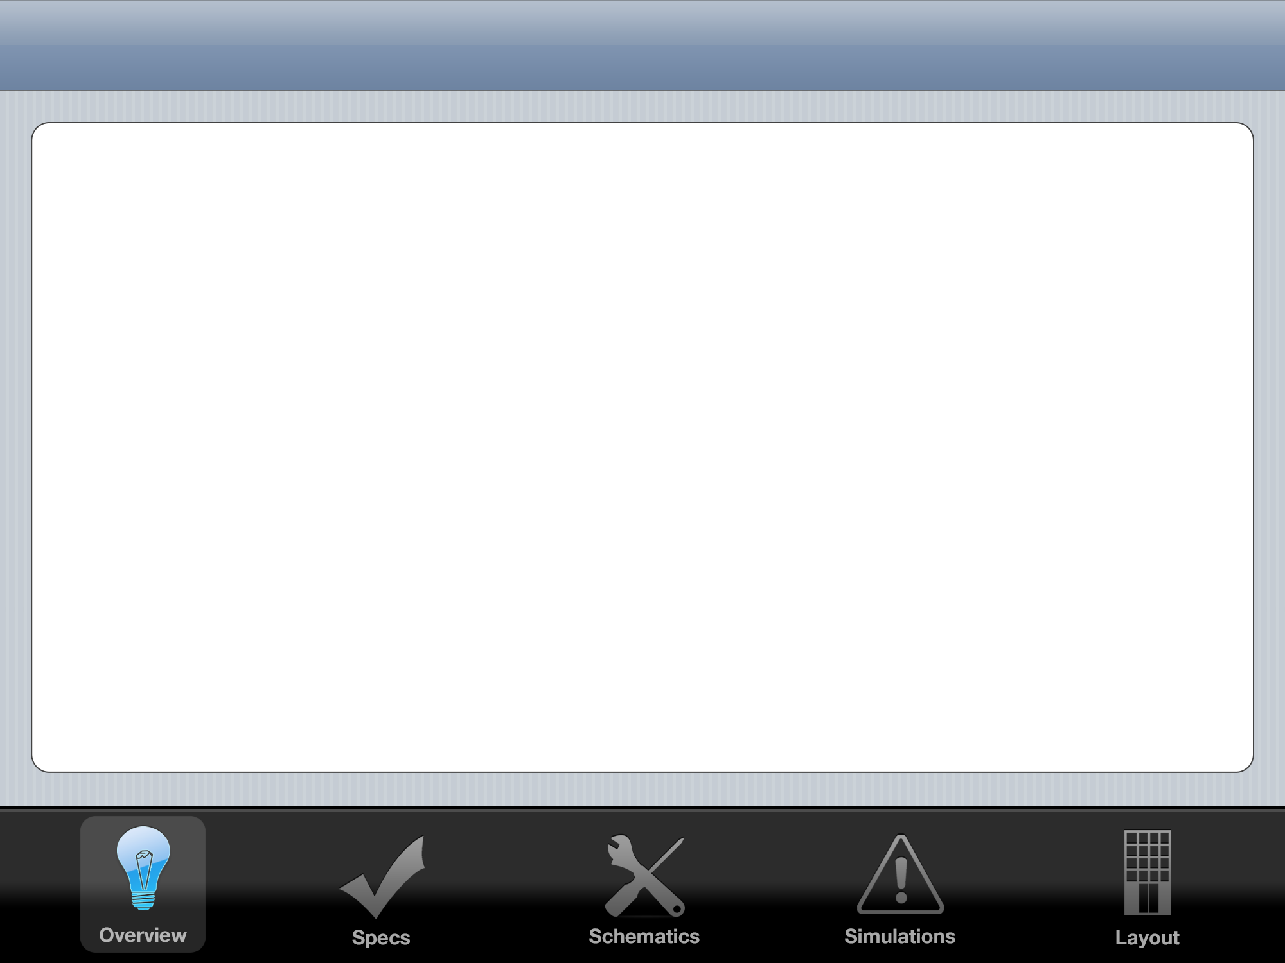


Linear Regulator Overview
Standard
Quasi-LDO
LDO
High Dropout
Stability not a problem
Medium Dropout
Stability a concern
Low Dropout
Stability is a big problem
ESR ‘Tunnel of Death’

Slide 3
Black Box I/O Diagram
LDO
Regulator
VIN
GND
5 Volt VOUT
10 Volt VDD
GND
-10 Volt VSS
1.3 Volt VBIAS

Slide 4
Control System

Slide 5
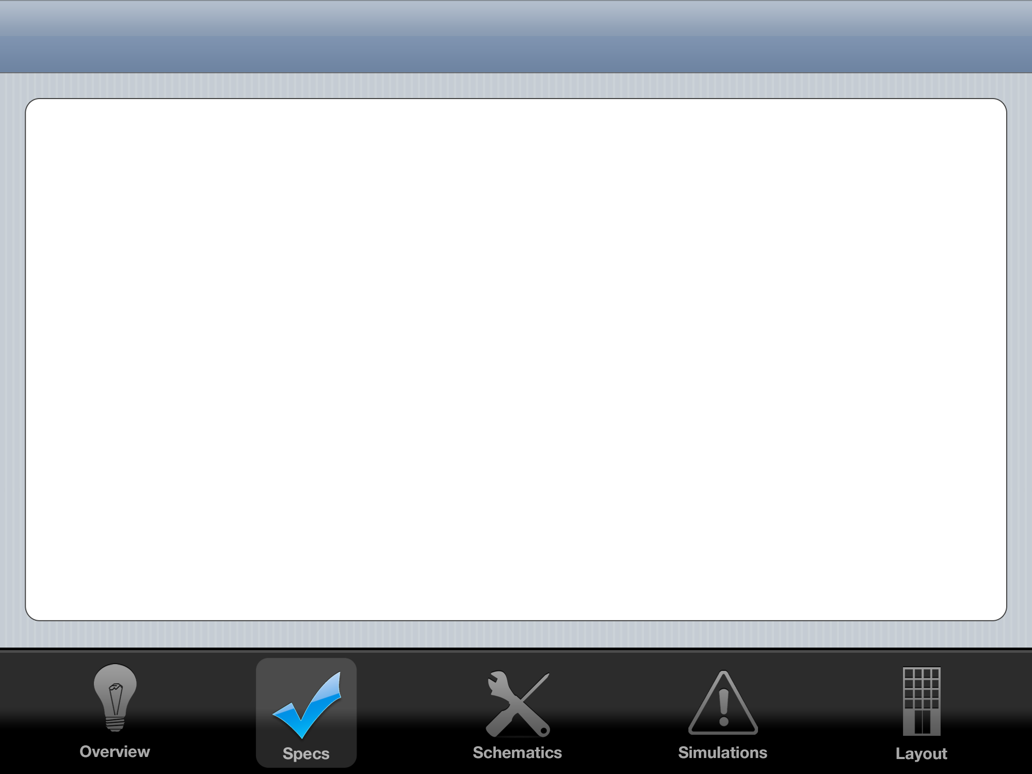

System Spec Goals
 | My LDO | Linear Technology LT1529
Drop Out
Settling Time
PWR Consumption
Area

Slide 6
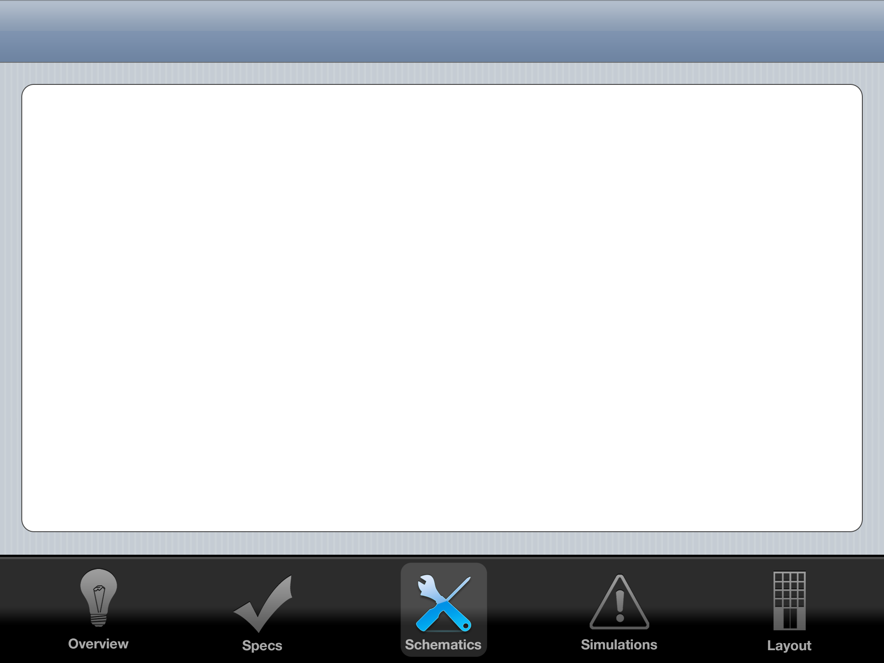

Slide 7
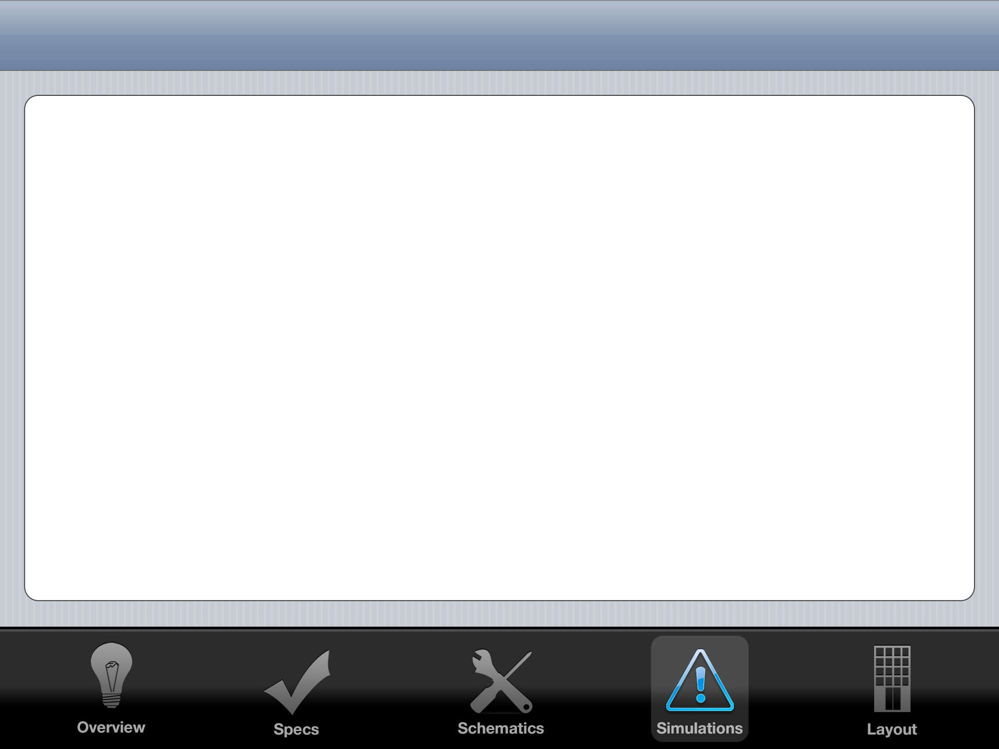

Slide 8
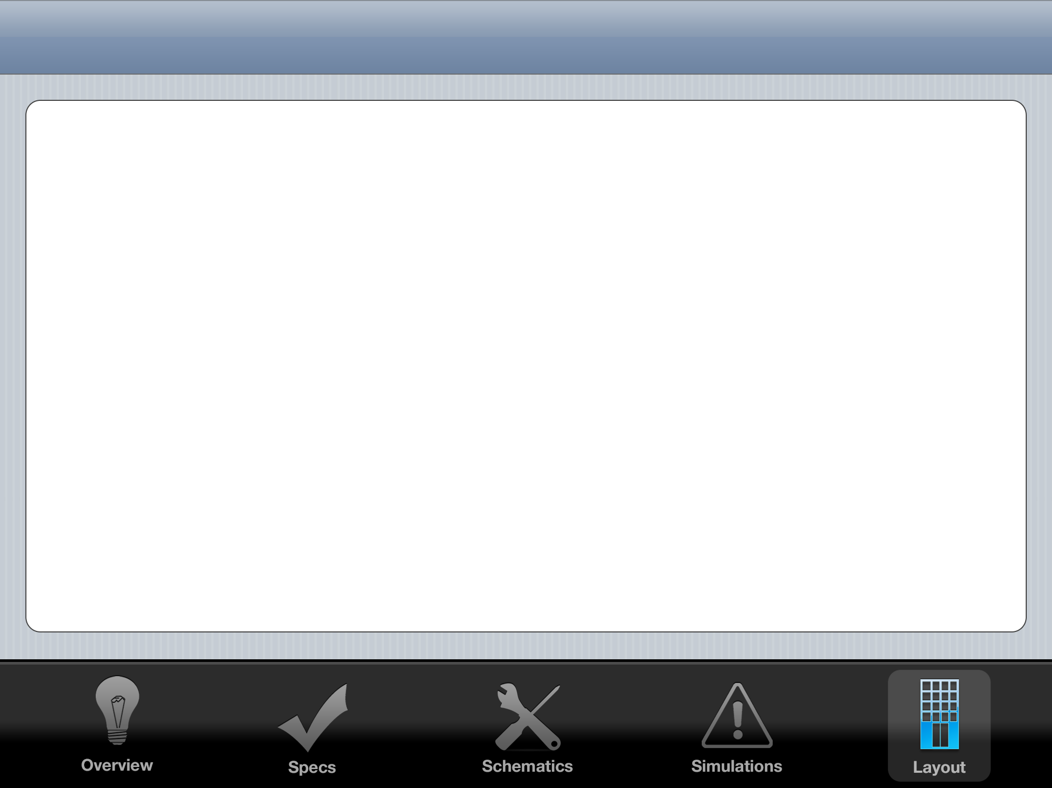

Slide 9
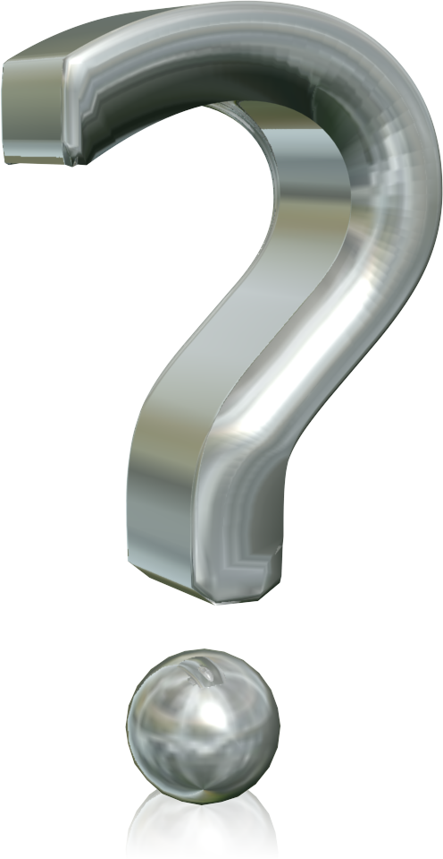
Thank You

