Slide 1

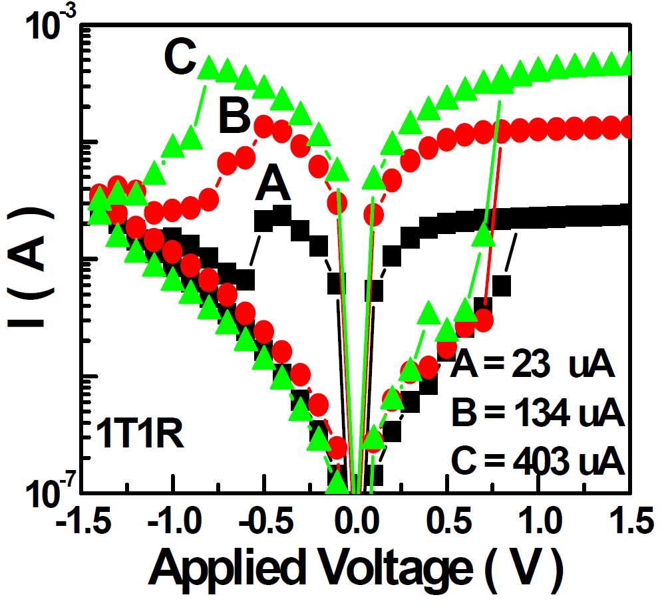
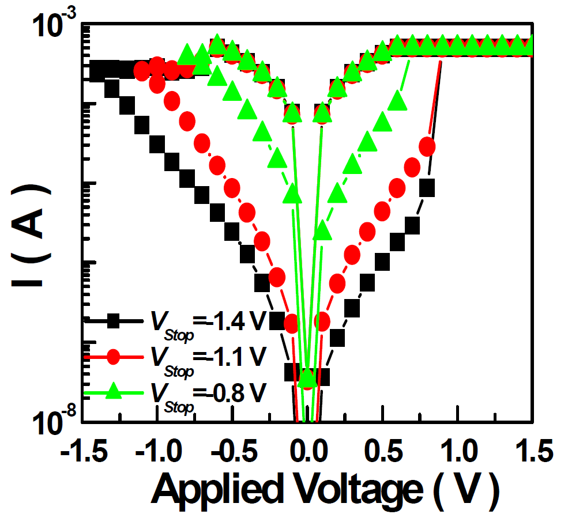
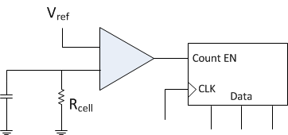
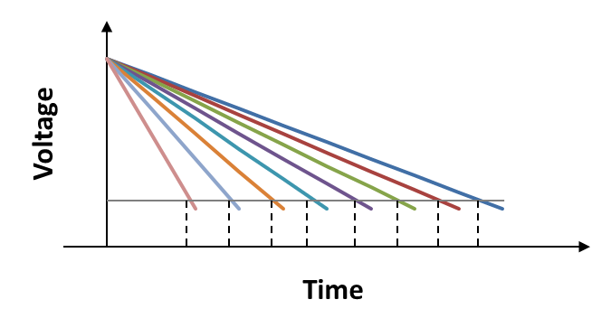
Cong Xu
Pennsylvania State University
Mentors: Naveen Muralimanohar, Norm Jouppi
Major: Computer Science and Engineering
Graduation Year: 2014
Design Implications of High-Density Multilevel Resistive Memories
Background
Write operation
Crosspoint resistive memory features 4F² cell size
Combining multilevel cell (n bits/cell) further reduces cell size to 4/n F² (typical values of n are 2,3)
Demonstrated in some material systems
Targets may be different (disk, flash or main memory)
Read-write-verify is required to constrain resistance distribution
Two opposite programming directions (different mechanisms)
  (a) Control SET Current -> Diameter or # of conductive filaments -> LRS resistance
  (b) Control RESET Voltage -> Length of ruptured CFs -> HRS resistance
Verify
Verify
Verify
Resistance
Initial state
RESET
RESET Pulse
…
Intermediate states
Write pulse amplitude
SET to intermediate states
Material | TiO_{x} | TaO_{x} | HfO_{x} | WO_{x} | CuO_{x}
# of levels reported | 5 | 4 | 5 | 8 | 5
R_{on}/R_{off} | > 1000 | > 1000 | > 100 | > 10 | > 100
MLC endurance | > 10⁶ | > 10⁷ | > 10⁵ | > 10⁴ | N/A
Other pros | Fast speed | Small I_{RESET} | Fast speed | Self-converging | Compatibility
Other cons | - | Large V_{RESET} | - | Read disturb | Large I_{SET}
Programming Approach (a)
Adjust V_{gate} of selector transistor to control I_{SET}
I_{SET} sweeps large range
PV of transistors has impact on I_{SET}
Programming Approach (b)
Adjust V_{RESET}
Voltage drop affects
HRS variation > LRS variation (more iterative steps)
Read operation
Read circuitry abstraction
  Single reference ADC VS Multiple references sensing
  Singe reference ADC: use counter to count the discharge time
  Multiple references sensing (MRS): use encoder to encode the outputs of SAs
Reprinted from [2]
Hybrid programming schemes
  Deploy PA(a) when writing to higher resistance states (i.e. “00”, “01”)
  Deploy PA(b) when writing to lower resistance states (i.e. “10”, “11”)
  Potentially save programming time and energy
A simplified example of programming flow
  Save unnecessary SET operations
I_{cell}
I_{ref1}
I_{ref2}
I_{ref3}
Data
Check target state
The same?
No
Target state belongs to the group of lower resistance states?
No
First a complete RESET operation and then Deploy PA(a) iteratively
Read noise margin
  decreases as array size increases due to sneak leakage and voltage drop [1]
  must be guaranteed with the considerations of PV and stochastic switching
  Solution to sneak leakage problem: two-step read operation
    1st step: read background current (I_{background})and latch it
    2nd step: read total current and subtract I_{background} from it
    Identify the state of the selected cell based on the amplitude of current difference
    Overhead: extra latches, subtractors
  Solution to voltage drop problem: localized reference cells
    Localized reference cells can minimize the impact of voltage drop
    Multiple reference bitlines per group are needed for MRS (increase effective array size)
    Overhead: additional reference cells, bitlines and SAs
[1] Dimin Niu, Cong Xu, Naveen Muralimanohar, Norm Jouppi and Yuan Xie. Design Trade-Offs for Low-Power, High Density Cross-Point Resistive Memory. International Symposium on Low Power Electronics and Design (ISLPED), 2012
[2] H. Y. Lee, etc. Low Power and High Speed Bipolar Switching with A Thin Reactive Ti Buffer Layer in Robust HfO2 Based RRAM. International Electron Devices Meeting (IEDM), 2008
Read cell state
Yes
Yes
Write saved
Cell state equals the lowest resistance state?
No
Perform a complete SET operation
Deploy PA(b) iteratively
Yes
SET operation saved
Voltage-time dilemma suggests
  Increase t_{RESET} (pulse width) instead of V_{RESET} to achieve the same resistance state
  However, ΔV_{RESET} leads to exponential increasing of t_{RESET}
45nm 1MB Marco Metrics
Other issues
Gnd
 | 1T1R-SLC | 1T1R-MLC | Xpoint-SLC | Xpoint-MLC
# bits/cell | 1 | 2 | 1 | 2
Cell Size (F²) | 6 | 3 | 4 | 2
Array Size | 512*512 | 512*512 | 256*256 | 128*128
Area (mm²) | 0.207 | 0.118 | 0.129 | 0.079
Read Delay (ns) | 8.12 | Model under development (MUD)
Read Energy (pJ) | 20.5
Write Delay (ns) | 6.68 | 107 | 11.3 | MUD
Write Energy (pJ) | 111 | 446 | 173
Cost analysis
ECC
Wear-leveling
Data mapping
Adaptive SLC/MLC
V_{read}
Gnd
Gnd
I_{read}
I_{ref}s
Notes:
Presentation Title

