Slide 1
VLSI 2 Project 3
20-bit Dynamic Multiplier
Corey Olson and Nate McVicar

Slide 2
Features
Fully Dynamic Multiplier
  Primarily optimized for delay
Modified Booth Encoding
2 Stage Compression
Carry Select adder for final 10 bits
  Implemented using 3 10-bit Spanning trees

Slide 3
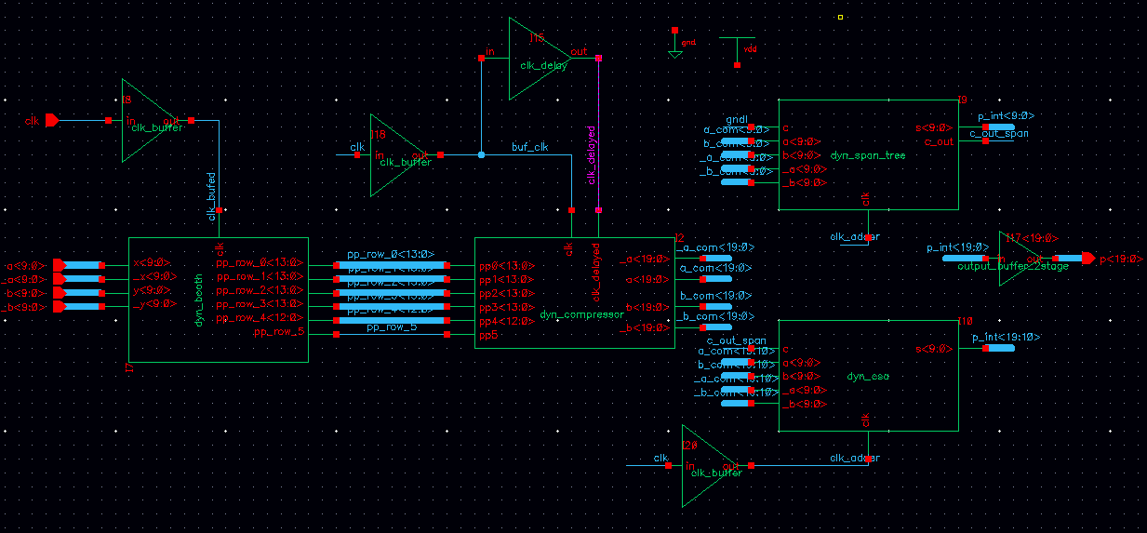
Top Level

Slide 4
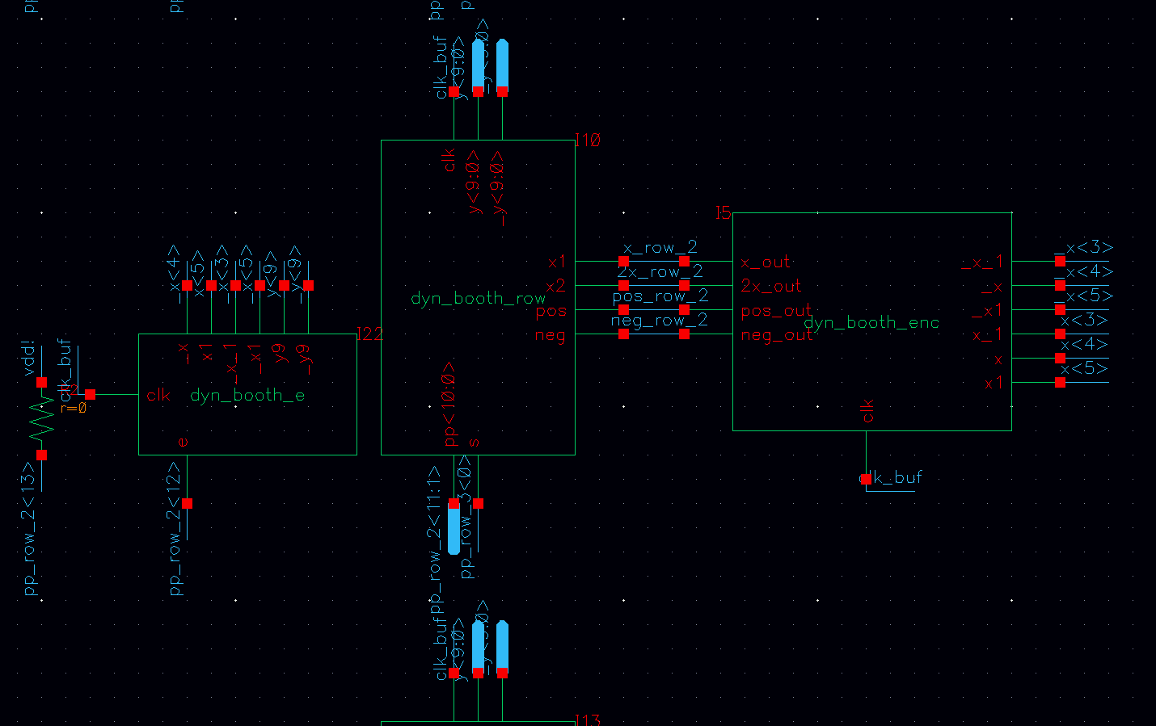
Booth Encoder

Slide 5
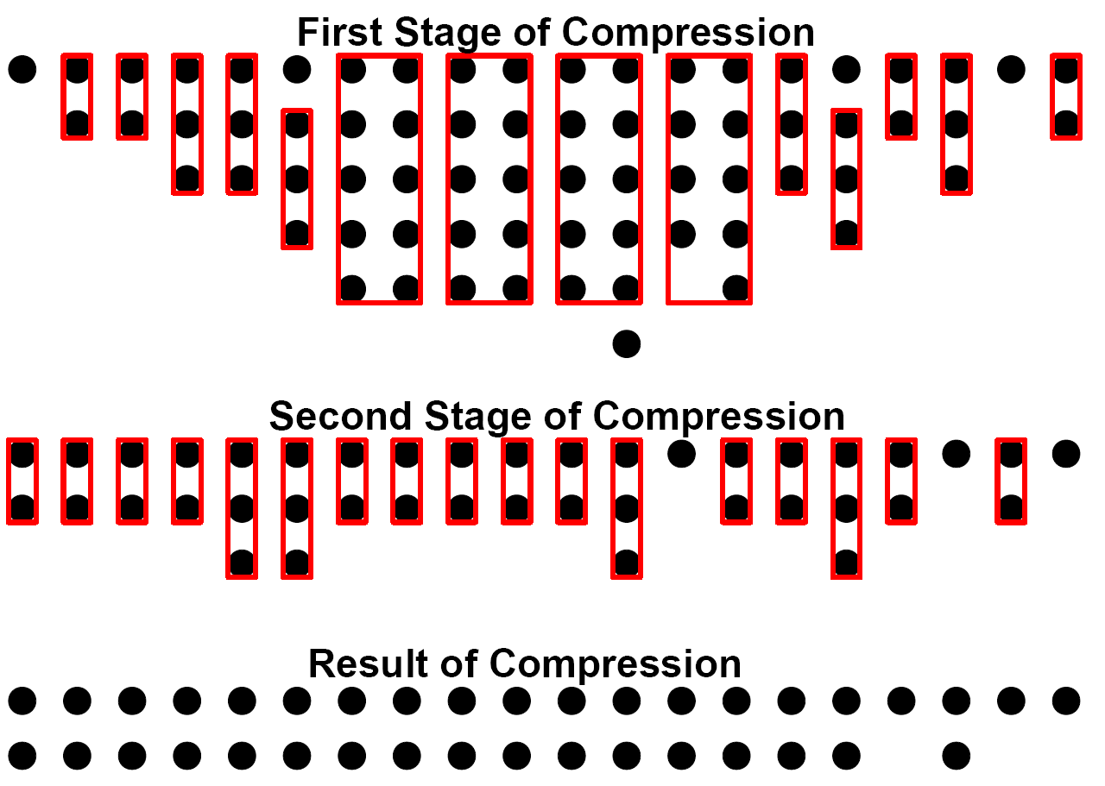
Compression Architecture

Slide 6
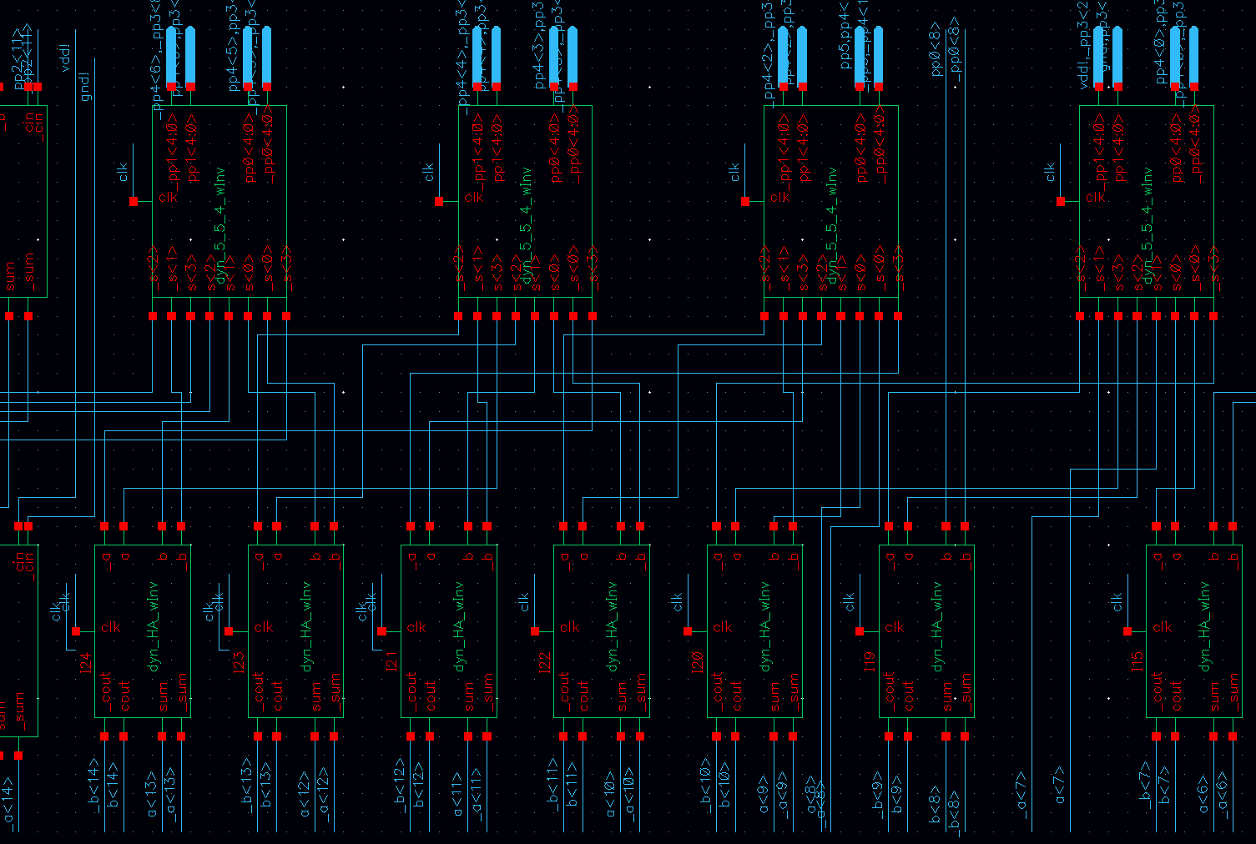
Compression

Slide 7
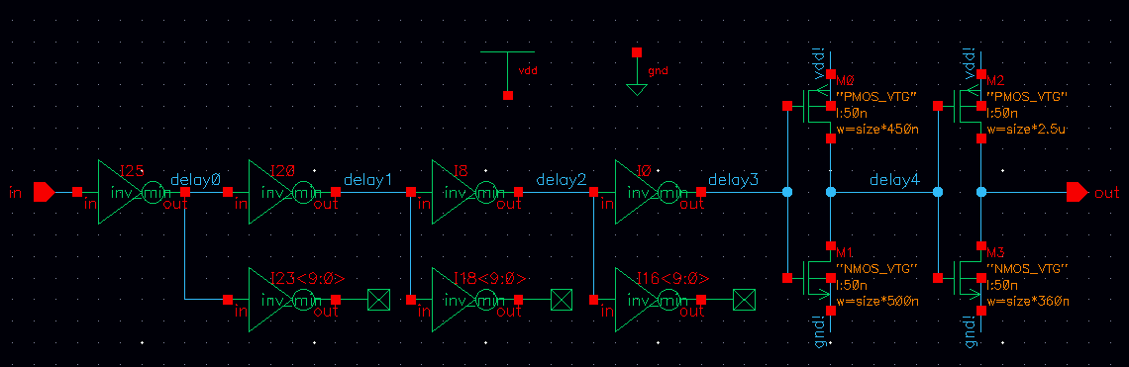
Clock Delay Line

Slide 8
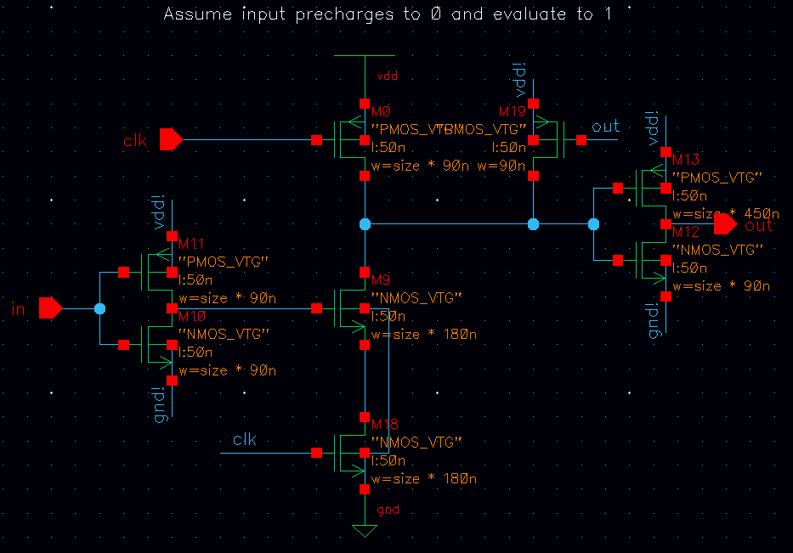
Dynamic Inverter

Slide 9
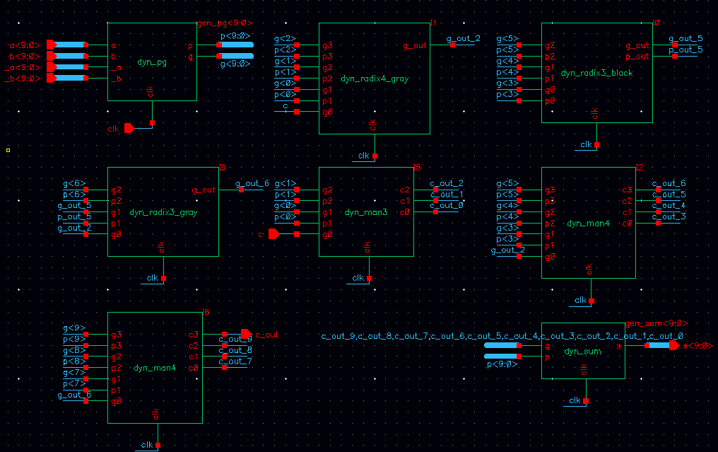
Spanning Tree Adder

Slide 10
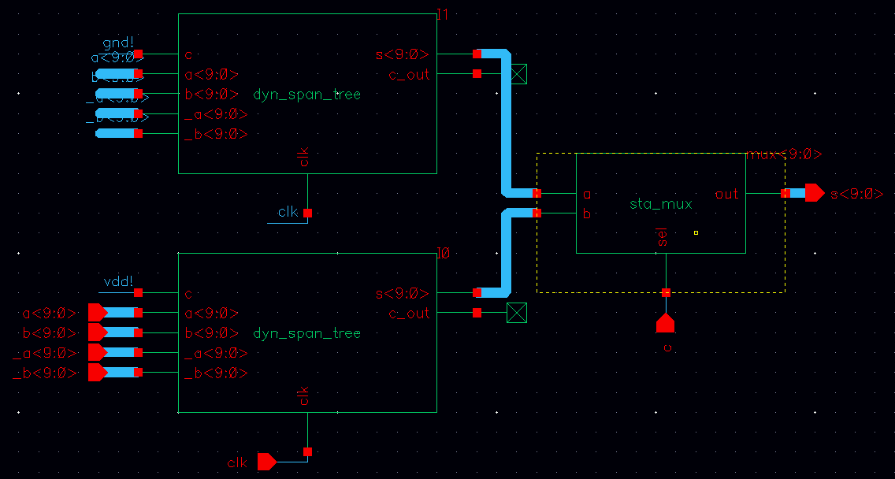
Carry Select

Slide 11
Testing
Module Level Testing
  Adder
  Compression
  Booth Encoder
System Level Testing
  Random Test Vectors
  Worst Case Delay Test Vectors

Slide 12
Performance
Delay ~ 940ps
  Clock Buffer = 100ps
  Booth = 400ps
  Compression = 200ps
  Adder = 240ps
Power
  4.55 pJ / instruction

Slide 13
Lessons Learned
Dynamic = HARD and FAST (theoretically)
  Simple design is typically better
  Problems with inverted inputs
Carry Select Adder
  Delay profile must be matched perfectly

Slide 14
Questions?

