Slide 1
BRI's Impact on Kazakhstan–China Trade Balance:
The Role of Strategic Mineral Exports
Nikar Omirbek
Final Dissertation Defense | 2026
Evidence from an Annual Bilateral Time-Series Analysis, 2000–2023

Slide 2
Presentation Overview
• The Puzzle — what the data shows at face value
• Research Question & Theory
• Data & Analytical Pipeline
• Regression Analysis & Multicollinearity Resolution
• Main Finding: TWFE Difference-in-Differences
• Robustness & Limitations
• Conclusions & Policy Implications

Slide 3
The Puzzle: BRI Was Supposed to Help Kazakhstan
After BRI launched (2013), Kazakhstan's trade position with China deteriorated — despite record mineral exports.
+94.3%
+24.3%
+29.2%
−37.8%
Imports from China (post-BRI avg.)
Exports to China (post-BRI avg.)
Mineral exports (post-BRI avg.)
Trade surplus (post-BRI avg.)
2023 — First-ever bilateral trade DEFICIT with China: −$2.01 billion
Imports $16.77bn vs Exports $14.76bn | Record mineral exports in the same year
Core question: Did mineral wealth provide any real leverage — or did asymmetric interdependence dominate?

Slide 4
Research Question & Theoretical Framework
Research Question
How did the post-BRI period change the relationship between Kazakhstan's strategic mineral exports and its bilateral trade balance with China?
Theoretical Framework: Asymmetric Interdependence
Kazakhstan
China
Prediction
Needs China as primary buyer
Multiple mineral suppliers globally
BRI deepens the relationship
Limited alternative markets
Diversified import sources
Import surge outpaces exports
Concentrated mineral export basket
200× larger economy
Mineral revenues insufficient
→ High dependence
→ Low dependence on KZ
→ Balance deteriorates

Slide 5
Data & Analytical Pipeline
Dataset
Reproducible GitHub Pipeline
• Annual bilateral panel: 2000–2023 (n = 24)
• IMF DOTS — bilateral exports & imports
• World Bank WDI — GDP, exchange rates
• UN Comtrade — HS-level mineral exports
• Kazakhstan Bureau of National Statistics — cross-validation
• 6 partner countries: CHN, RUS, DEU, UZB, TUR, USA
• 36 Python scripts — fully automated
• Data collection → cleaning → analysis → figures
• Every table and chart generated by code
• Version-controlled, publicly accessible
• All results reproducible from raw data
Validation: BNS-scraped figures vs panel
2023 exports: 0.3% discrepancy | 2023 imports: 0.1% discrepancy
Both well within the <10% validation threshold ✓

Slide 6
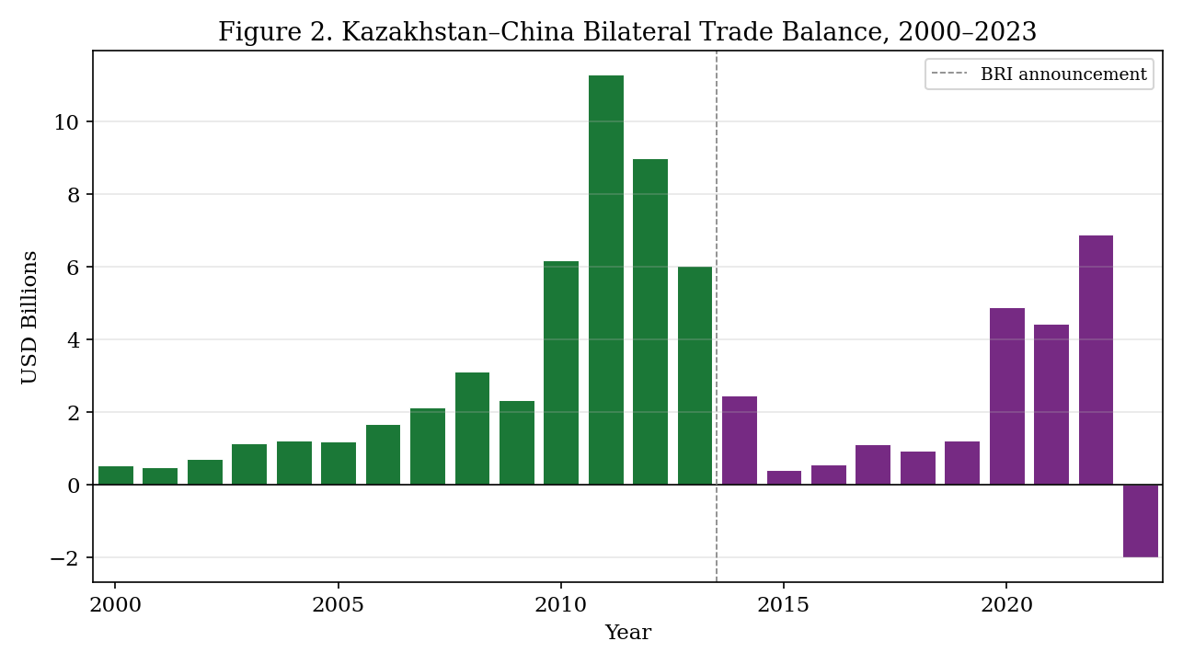
Trade Balance Over Time (2000–2023)
The 2023 deficit is the first in recorded Kazakhstan–China trade history. A decade-long deterioration, not a single-year shock.

Slide 7
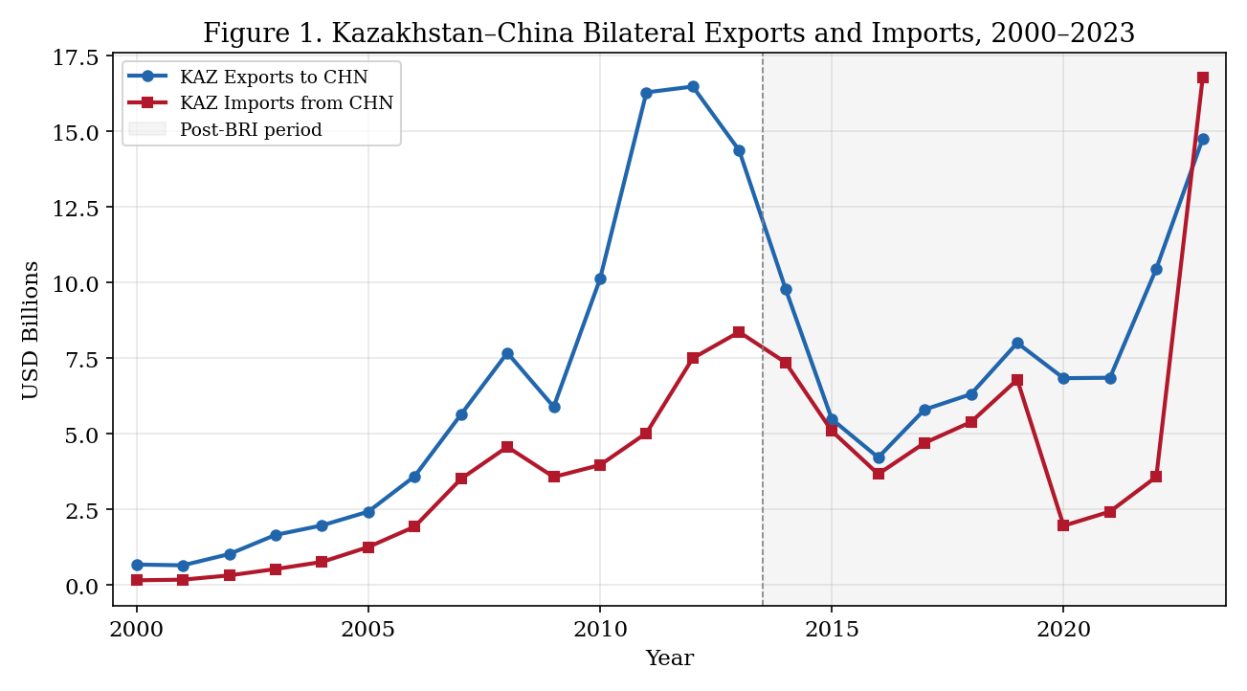
Import-Side Deepening: The Primary Mechanism
• Imports nearly quadrupled post-BRI
• Export growth modest (+24%)
• Mineral exports +29% — insufficient
• Import-side deepening is the primary mechanism of deterioration

Slide 8
Empirical Strategy
Method
What it does
Purpose
OLS Regression (HAC s.e.)
Tests whether post-BRI × minerals interaction is negative
Primary coefficient of interest
Multicollinearity Resolution
GDP levels → GDP growth rates VIF: 236 → 10.4
Scheme B = primary specification
288-Spec Grid
Vary mineral measure, lags, estimator, BRI proxy
Robustness to specification choice
Leave-One-Out
Remove each year; test coefficient stability
Identifies influential observations
Influence Diagnostics
Cook's distance, leverage, studentised residuals
Flags 2023 as extreme outlier
TWFE DiD
Kazakhstan vs 5 control partners Partner + year fixed effects
Primary causal identification
Synthetic Control
Pre-period counterfactual trajectory
Complementary causal check

Slide 9
Multicollinearity: Problem & Resolution
Original model used log(KZ GDP) + log(CN GDP) as separate regressors. Both trend upward nearly every year → near-perfect collinearity.
Scheme A (Pre-revision)
Scheme B (Primary ✓)
Scheme C (Robustness)
Variables:
Variables:
Variables:
log(KZ GDP) log(CN GDP)
d.log(KZ GDP) d.log(CN GDP)
log(CN/KZ GDP) ratio
Max VIF:
236.3
Max VIF:
10.4
Max VIF:
33.4
❌ Severe
✓ Meets threshold
⚠ Improved; not ideal
Scheme B is the primary specification: GDP growth rates are stationary, theoretically justified, and achieve VIF = 10.4.

Slide 10
Regression Results: Post-BRI × Minerals Interaction
Key coefficient: Post-BRI × Mineral Exports (β₃)
Specification
N
Interaction β
HAC SE
p-value
Max VIF
A: GDP levels (pre-rev)
24
−3.220
1.043
0.002
236.3
B: GDP growth ✓ primary
23
−2.489
0.974
0.011
10.4
B: excl. 2022–2023
21
−0.012
0.283
0.966
10.4
B: excl. 2023 only
22
+0.065
0.239
0.785
10.4
C: Gravity ratio
24
−2.419
1.131
0.033
33.4
C: excl. 2022–2023
22
+0.102
0.432
0.813
33.4
⚠ The interaction disappears when 2022–2023 are excluded → result is fragile. Primary evidence comes from the DiD (next slide).

Slide 11
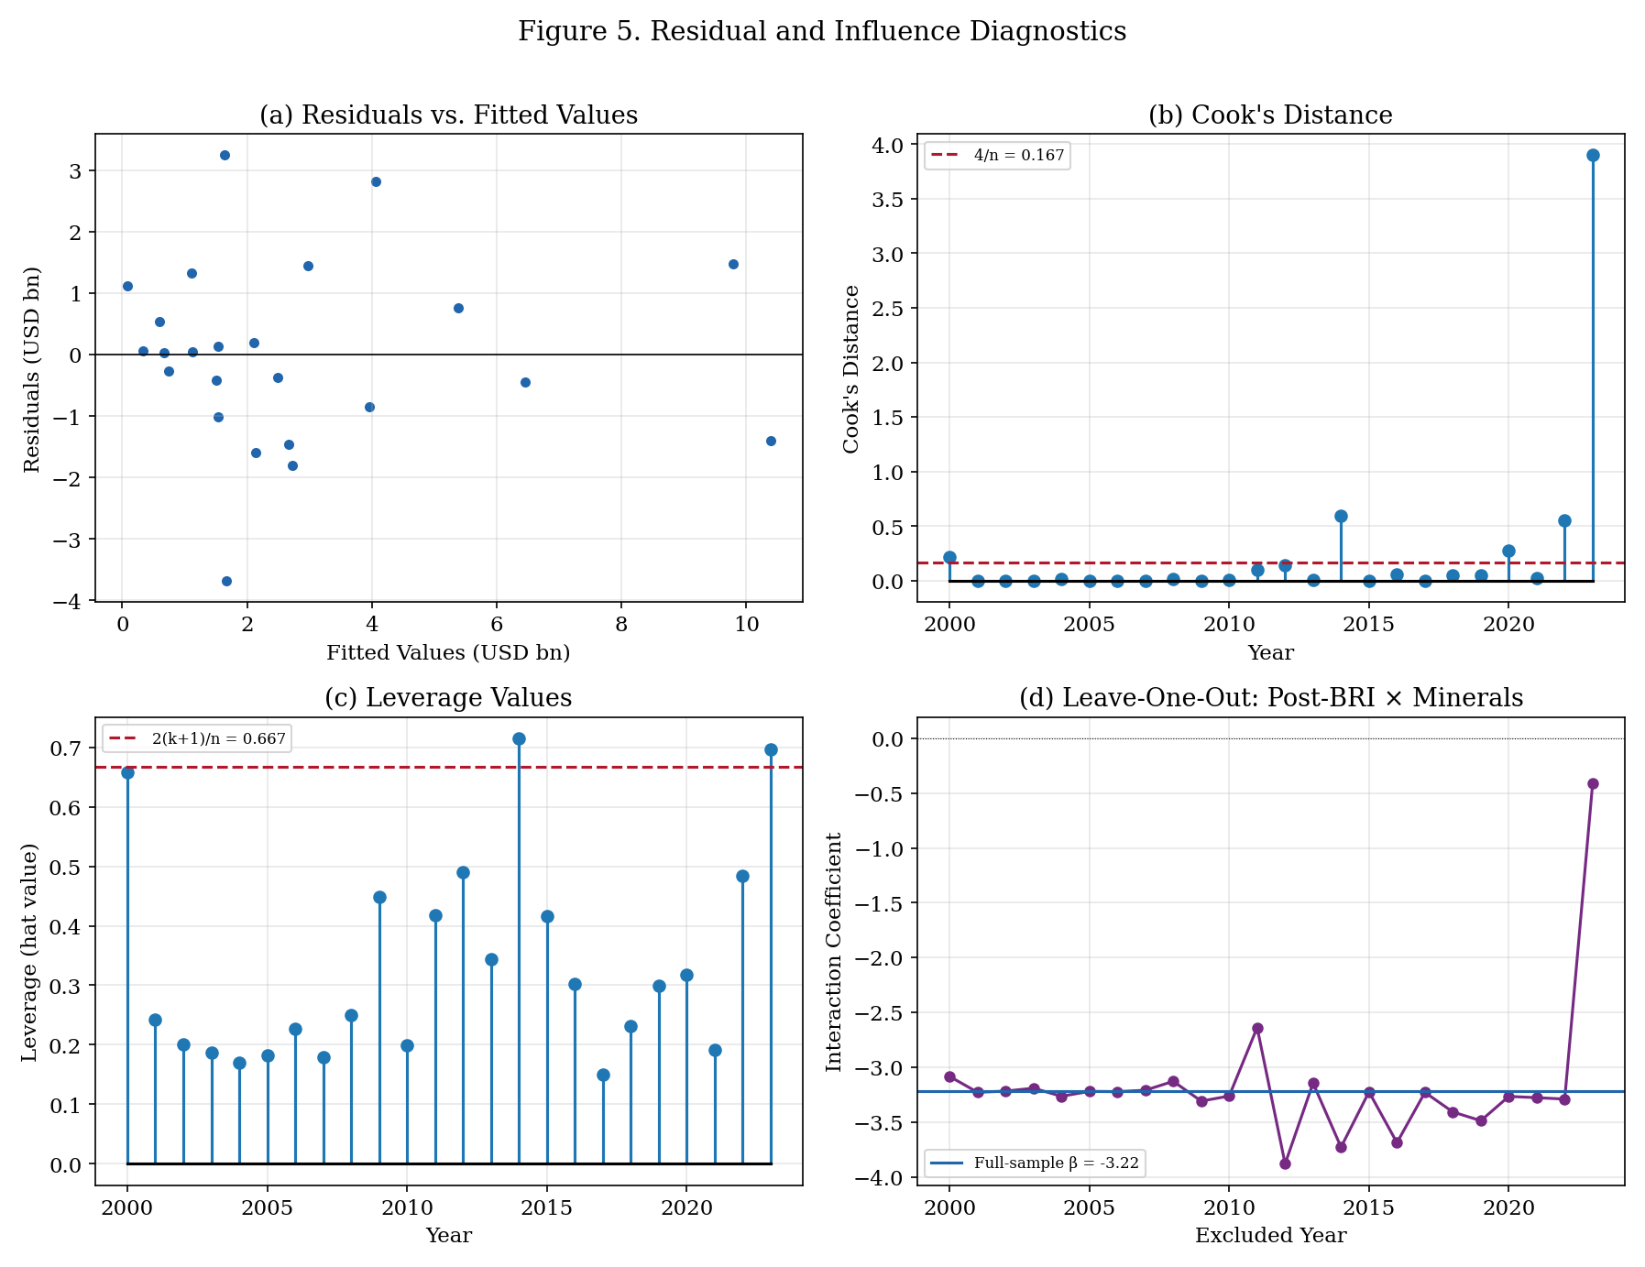
Influence Diagnostics: The Role of 2023
2023
Cook's D = 3.90 23× the threshold (4/n = 0.167)
• Excluding any year except 2023 → interaction stays negative & significant
• Excluding 2023 alone → interaction loses significance
• R² jumps from 0.765 → 0.960 when 2023 removed
• This is reported transparently in the paper

Slide 12
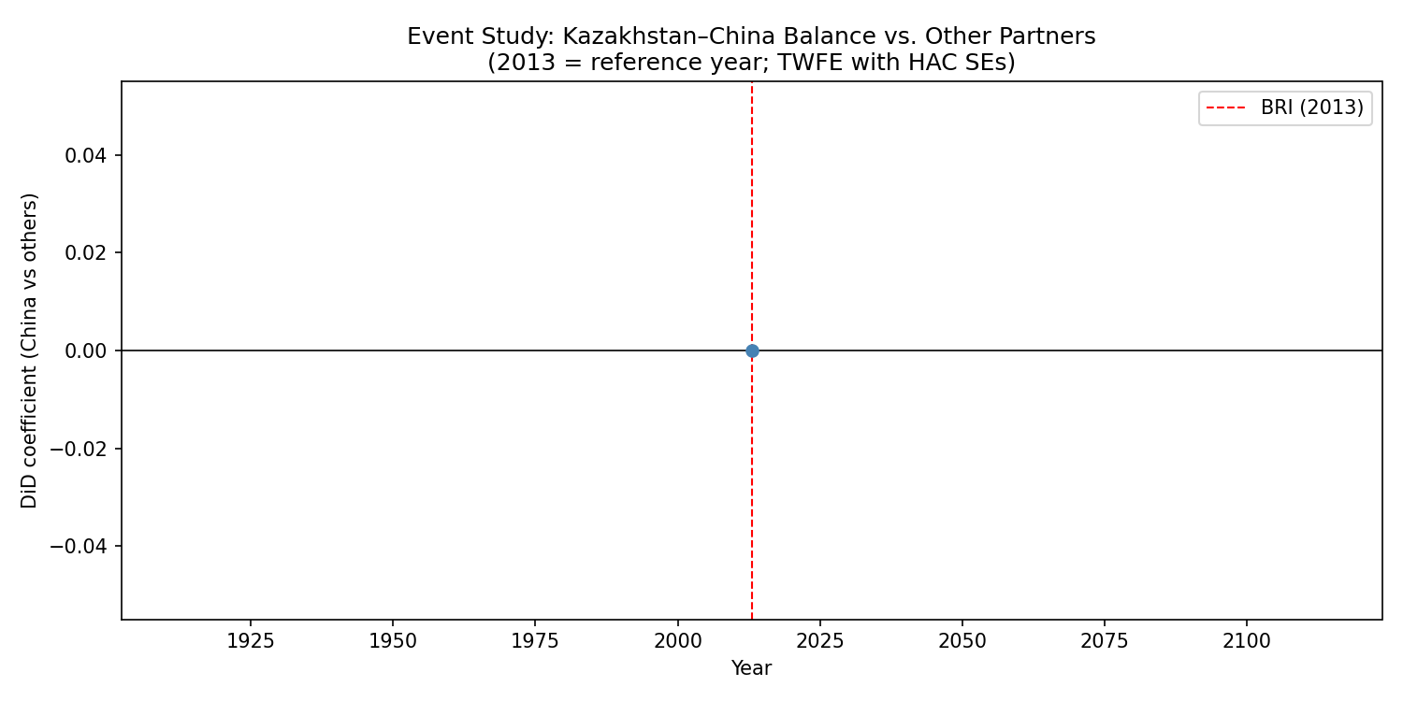
Main Finding: TWFE Difference-in-Differences
Is the deterioration China-specific, or a global trend?
Design: Stack Kazakhstan + 5 control partners (RUS, DEU, UZB, TUR, USA) → 144 obs. | Partner FE + Year FE | HAC s.e.
DiD Coefficient
What this means:
−0.305
• Kazakhstan's balance ratio fell ~30.5 pp more than control partners post-2013
• After controlling for all common time trends and partner-level differences
• Not driven by oil prices, global macro, or general China trade patterns
• → The deterioration is CHINA-SPECIFIC
p = 0.0002 | HAC SE = 0.083
China vs Russia only:
DiD = −0.151 (p = 0.008) — robust to most similar partner comparison
✓ This is the strongest identification result in the paper.

Slide 13
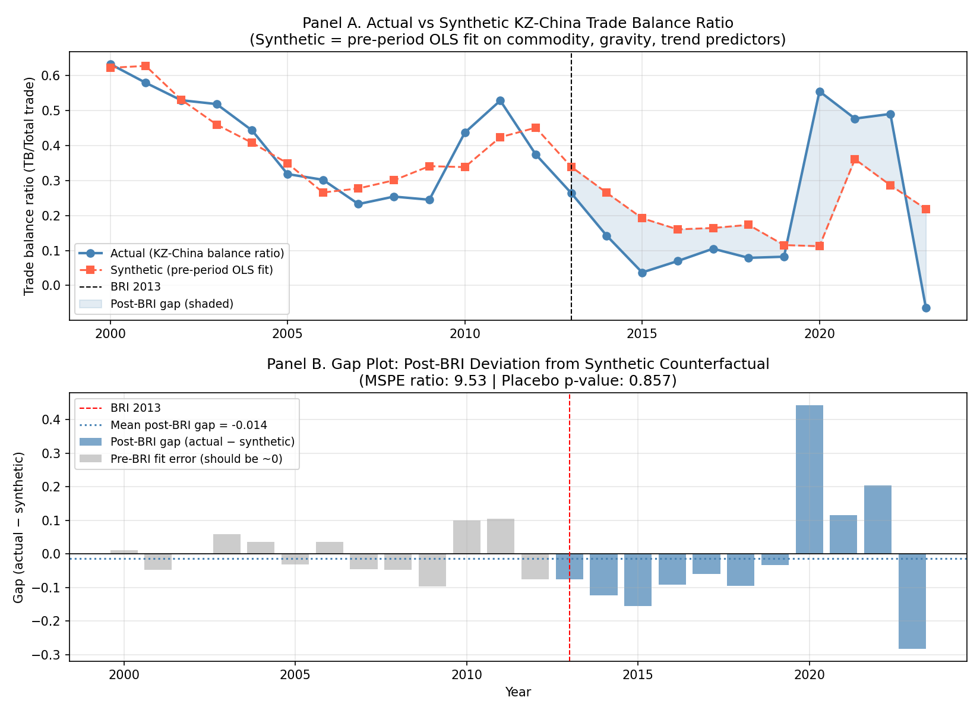
Synthetic Counterfactual: What If BRI Hadn't Happened?
• Pre-period (2000–2012) dynamics used to project a synthetic counterfactual
• Gap negative in 8 of 11 post-BRI years
• MSPE ratio = 9.53 (post-period 9× harder to fit)
• Consistent direction with DiD
• Not statistically significant alone → treated as complementary evidence

Slide 14
Evidence Summary: Triple-Concordance Assessment
All methods point in the same direction (deterioration). Strength varies.
Method
Direction
p-value
Notes
Regression (Scheme B primary)
Negative (−2.49)
p = 0.011
Driven by 2022–23; fragile
⚠
Regression (Scheme C robustness)
Negative (−2.42)
p = 0.033
Same fragility pattern
⚠
TWFE DiD — China vs all partners
Negative (−0.305)
p = 0.0002
China-specific; strongest ID
✓✓
TWFE DiD — China vs Russia
Negative (−0.151)
p = 0.008
Robust to similar partner
✓
Synthetic control gap
Negative (−0.014)
p = 0.857
Consistent direction; not significant
→
Sanctions robustness excl 22–23
Insignificant
p = 0.966
Alternative channel cannot be ruled out
⚠
Conclusion: Evidence is strongly consistent with asymmetric interdependence deepening post-BRI. Causal attribution to BRI specifically requires caution.

Slide 15
Limitations: What This Study Cannot Establish
Cannot claim
Can claim
• BRI caused the trade balance deterioration
• The regression interaction is a stable structural parameter
• The 2022–2023 import surge is purely BRI-driven (sanctions parallel-import channel exists)
• Mineral-specific effects can be fully isolated from energy-export dynamics (HS-27 data unavailable)
• The post-BRI trade balance deterioration is China-specific (TWFE DiD, p = 0.0002)
• Strategic mineral export growth did not offset the import-side surge
• The pattern is strongly consistent with asymmetric interdependence theory
• The methodology is transparent, reproducible, and diagnostically honest

Slide 16
Policy Implications
Kazakhstan is not a unique case — findings are relevant to all resource-rich BRI partners.
1
Monitor trade balance composition
Aggregate trade volume growth can mask a deteriorating bilateral position.
2
Track import-side dependence
94% import growth signals deepening structural reliance on Chinese goods.
3
Prioritise value-added export upgrading
Raw mineral exports are price-sensitive and insufficient to offset import surges.
4
Evaluate 2023 as a structural inflection
First-ever deficit may mark a new regime — not a one-time statistical anomaly.
5
Diversify export destinations
Concentration risk in a single large buyer amplifies asymmetric vulnerability.

Slide 17
Conclusions
Descriptive finding
Imports +94% vs exports +24%. Trade surplus fell 37.8%. First deficit in 2023.
Regression finding
Negative post-BRI × minerals interaction (β = −2.49, p = 0.011) — but fragile to exclusion of 2022–2023.
Strongest finding
TWFE DiD: Kazakhstan's balance deteriorated 30.5 pp more than control partners (p = 0.0002). Deterioration is China-specific.
Interpretation
Strongly consistent with asymmetric interdependence. Mineral wealth insufficient to offset China's import-capacity advantage.
Broader relevance
Applicable to all resource-rich BRI partner economies facing structural asymmetry with China as their dominant trading partner.
Transparent methodology • Reproducible pipeline • Honest reporting of fragility

Slide 18
Thank You
Questions & Discussion
Key number to remember: DiD = −0.305 (p = 0.0002) — China-specific
Nikar Omirbek | 2026
Full pipeline: github.com/omirbeknikar-ship-it/dissertation-final

