Slide 1
The Belt and Road Initiative and the Kazakhstan–China Trade Balance
Sources of the Post-2013 Swing and the Role of Strategic Mineral Exports, 2005–2024
Nikar Omirbek
Master's thesis | Registered topic: BRI's Impact on Kazakhstan–China Trade Balance: The Role of Strategic Mineral Exports
UN Comtrade (both reporters), World Bank WDI, AidData GCDF 3.0

Slide 2
What Happened
Kazakhstan's goods trade with China, China-reported data
+3.5
−3.9
−12.0
15.5
Balance 2013, USD bn
Balance 2019, USD bn
Balance 2024, USD bn
Swing, USD bn
• 2013→2019: balance −7.4 bn; energy exports to China −7.6 bn; imports flat
• 2019→2024: balance −8.2 bn; imports from China +15.2 bn; metals and ores exports +5.6 bn
• Oil fell from 62% to 22% of exports to China; metals and ores rose from 36% to 67%
• Kazakhstan's own 2020–2022 partner data omit copper, zinc, aluminium and machinery: China's mirror data are used
Tables 6.1, 6.2, 4.3. The BRI was announced in Astana on 7 September 2013.

Slide 3
Why the Trade Balance, and What It Does Not Measure
• A bilateral deficit is not a loss: imports can be investment, cheaper goods or transit
  – 47% of the 2019–2024 import rise is machinery, electrical equipment and vehicles
  – BRI rail transit earns Kazakhstan service revenue, which goods-trade data do not record
• So the balance is treated as an accounting summary, not a welfare measure
• Why study it anyway?
  – It is the outcome named in the registered topic and in public debate
  – It is an identity: explaining it forces an account of every export and import
  – It is where the contribution of strategic minerals can be measured

Slide 4
Puzzle and Research Question
• The swing coincides with the BRI, but before-and-after comparisons cannot separate the BRI from:
  – shocks to all of Kazakhstan's trade (the 2014–2016 commodity collapse)
  – shocks to all of China's regional trade (post-2022 re-routing)
Is the post-2013 swing in Kazakhstan's trade balance with China distinctive to the Kazakhstan–China relationship, and are its distinctive components consistent with the mechanisms through which the BRI was expected to operate, in particular through strategic mineral exports?
• Two comparisons, reported side by side: vs Kazakhstan's other partners; vs China's other regional partners
• Claims graded: A context | B consistent with a BRI mechanism | C causal (not claimed)

Slide 5
BRI Mechanisms and What Would Count as Evidence
Mechanism | Predicts | Inconsistent if | Uninformative if
M1 Connectivity, market access | China-specific rise in agri-food and new exports; KZ-specific import rise from 2015 | Rise began earlier and did not accelerate; imports rise only after 2022 and regionally | Change too small to detect
M2 Resource finance | China-specific rise in energy and strategic minerals after Chinese finance | China-specific fall; gains long after finance | Timing depends on base year
N0 Common shocks | No China-specific change | Large components in either comparison
• Positive BRI trade effects in the literature: trade costs −1.5 to −2.8% in BRI economies (de Soyres et al. 2019); trade up to +4.1% (Baniya et al. 2020); ex-post gains for ASEAN (Foo et al. 2020) and for European exporters via rail (Mau & Seuren 2023)
• These measure trade volume or costs on average; this thesis measures one pair's balance and composition. Effects of a few per cent are undetectable here

Slide 6
Three Kinds of Evidence, Kept Separate
Kind | What it shows | Used for
Accounting decomposition | Which flows moved (identity) | Table 6.2
Comparison-adjusted components | Distinctiveness vs a benchmark; not causal, not an upper bound on BRI | Tables 6.3, 6.3b, 6.4, 6.10b
Statistical tests (PPML triple difference, event study, trend break) | Whether China-specific export changes exceed noise, and when they began | Tables 6.7–6.9, 6.12
• Safeguards: four product groups fixed in advance; Holm correction; 300 random chapter sets; power reported; every comparison over 16 base/end-year combinations
• Checks: all tables regenerated from raw files; main model re-estimated independently; 29 manuscript figures reconciled with tables
• Disclosure: several analyses were added after seeing earlier results (§3.3)

Slide 7
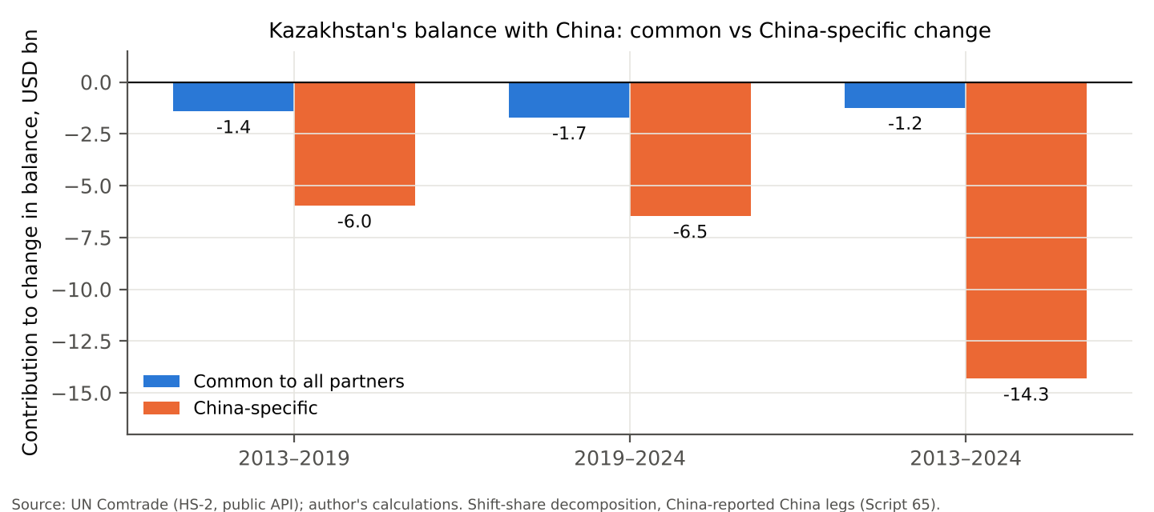
Result 1: Most of the Swing Is China-Specific from Kazakhstan's Side
Compared with Kazakhstan's trade with its other partners
52–92%
China-specific share, 16 base/end combinations
71%
With averaged endpoints (2011–13 → 2023–24)
• Largest part: imports from China after 2019 (+8 to +15 bn)
• 92% is the maximum (2013 base = oil peak)
• Distinctiveness, not causation
Tables 6.3, 6.3b. Shift-share: trade with China benchmarked against the same product's trade with the rest of the world.

Slide 8
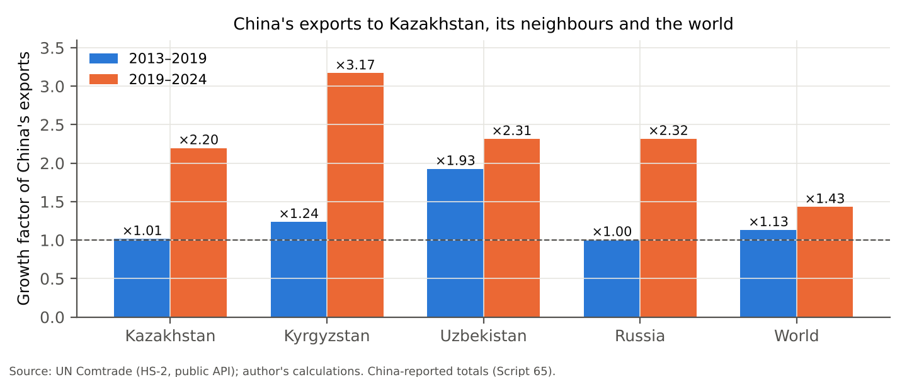
Result 2: The Import Rise Is Regional from China's Side
China's exports to Kazakhstan compared with its exports to Russia and Central Asia
• vs every neighbour comparator, weighting and base year: at most +0.7 bn Kazakhstan-specific by 2023–24 (under 3% of imports); usually negative
• Holds with and without Russia
• vs the world: +5.5 to +8.8 bn
• Timing: mostly 2022–2024; in 2013–2019 China's exports to Kazakhstan grew less than to the world
• Caveats: neighbours are BRI members; post-2022 re-routing affects comparators
Table 6.10b; China-reported data on both sides.

Slide 9
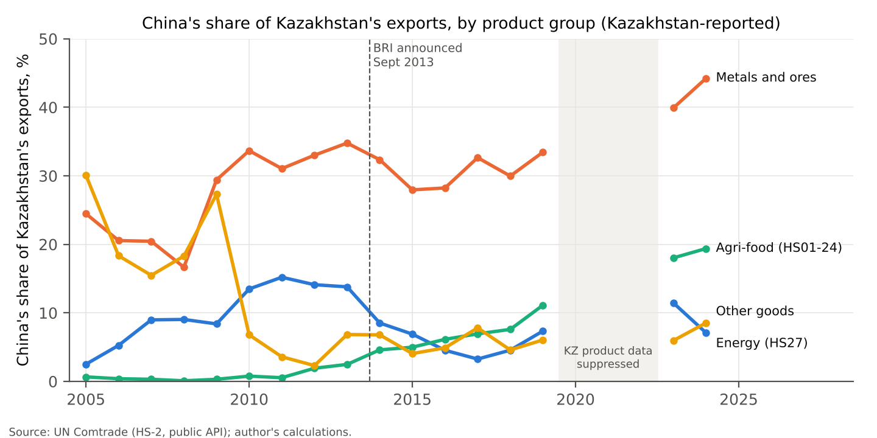
Result 3: Which Exports Changed Towards or Away from China?
Group (China-specific) | 2013→24, bn | Grid range
Energy | −4.9 | −4.9 to +2.4
Strategic minerals | +3.4 | +1.8 to +6.7
Agri-food | +0.8 | +0.7 to +0.9
Other | +0.5 | +0.3 to +0.5
• Oil: China-specific fall concentrated in 2014; opposite to M2
• Minerals: positive in every specification; timing depends on base year
• PPML: agri-food ×11.7 (robust); metals +39% only with 2023–24
Tables 6.4, 6.6, 6.7.

Slide 10
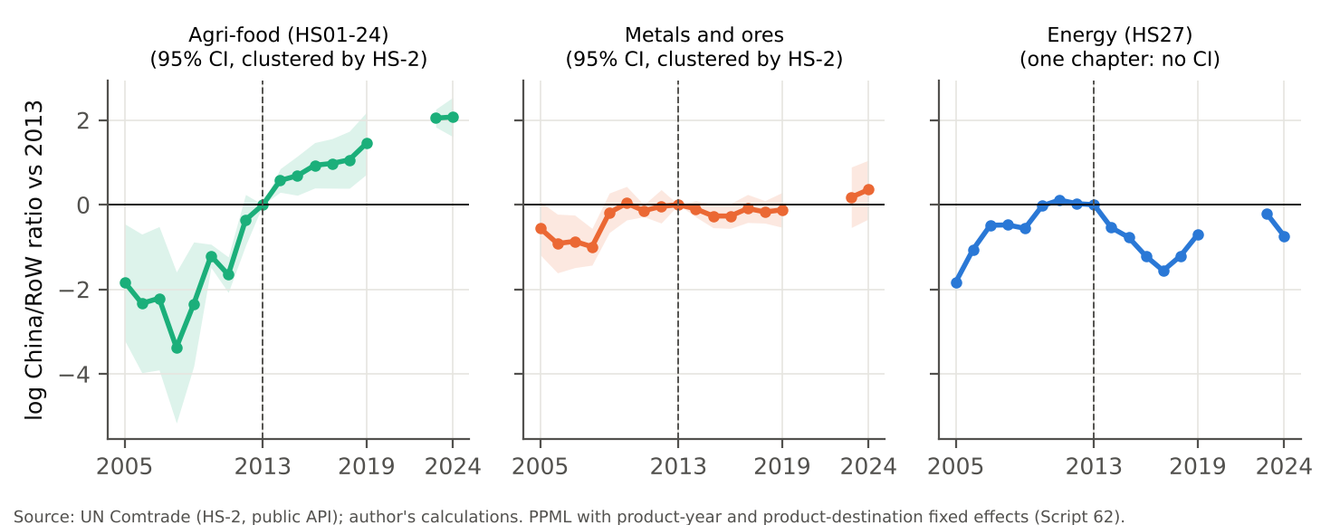
Result 4: Did Anything Change When the BRI Began?
• Agri-food: rising from 2008; trend 0.54 → 0.17 log points/yr; no acceleration (one-sided p = 0.99)
• Survives Holm (p < 0.001) and beats all 300 random chapter sets
• 'Slowdown' fails Holm (0.059): not relied on
• Metals: no detectable acceleration (p = 0.87); test could miss < 0.16/yr
• Energy: one chapter, no inference
Tables 6.8, 6.9, 6.12.

Slide 11
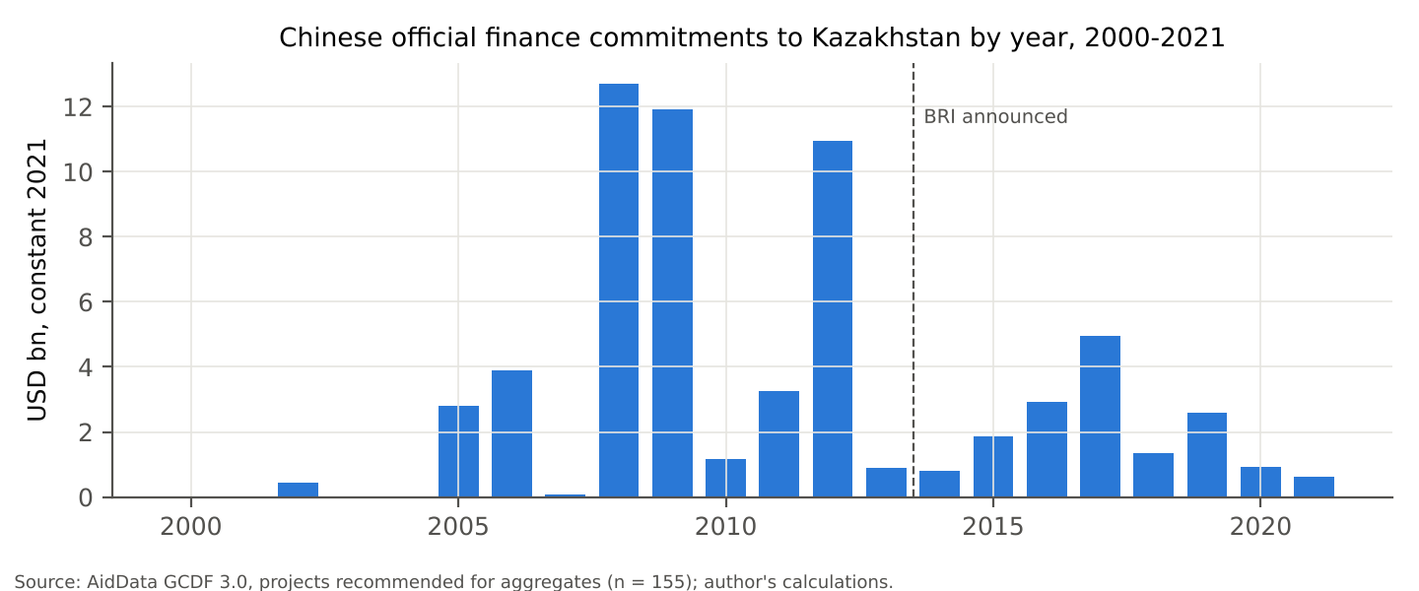
Result 5: What Did the BRI Consist of in Kazakhstan?
• Chinese official finance: 48.1 bn in 2000–2013 vs 16.0 bn in 2014–2021 (constant 2021 USD)
• Pre-2013: gas pipeline, oil companies, copper mines
• Post-2013: roads, border checkpoints; Khorgos dry port (2015)
• No agricultural project recorded
• Agri-food followed access and logistics, not finance
Table 6.13; AidData GCDF 3.0, 155 projects recommended for aggregates.

Slide 12
Synthesis: Each Component Against BRI Mechanisms
Component | vs KZ partners | vs China's neighbours | Timing | Verdict
Imports from China | +14.1 bn (+8.1 to +14.7) | Not distinctive | 2022–2024 | Not distinctive; timing inconsistent with M1
Energy exports | −4.9 bn | n/a | 2014 | Inconsistent with M2
Strategic minerals | +3.4 bn (+1.8 to +6.7) | n/a | Base-dependent | Offsets part of swing; timing not BRI-specific
Agri-food | +0.8 bn | n/a | From 2008; no acceleration | Consistent in products, not timing
Other, extensive margin | +0.5 bn | n/a |  | Absence of evidence
• No large component shows distinctiveness + predicted sign + post-2013 timing
Table 6.14.

Slide 13
Strategic Minerals and Two-Sided Dependence
2024 | China's share of KZ exports | KZ's share of China's imports
Ores (HS 26) | 80.2% | 1.8%
Copper (HS 74) | 64.1% | 3.8%
Zinc (HS 79) | 50.3% | 28.1%
Inorganic chem. incl. uranium (HS 28) | 32.4% | 8.9%
• Minerals offset part of the swing in every specification
• Dependence mostly runs from Kazakhstan to China
• Uranium reverses it: ~2/3 of China's natural uranium imports came from Kazakhstan (2023; Pan 2024)
• Dependence ≠ vulnerability: China's share of KZ refined copper exports fell 65.4% → 49.1% (Jan–Nov 2024 vs 2025; Astana Times 2026)
Tables 6.4, 7.1.

Slide 14
What These Results Do and Do Not Say About the BRI
Type of finding | Examples
Evidence inconsistent with a mechanism | Oil fell (vs M2); imports rose late and regionally (vs M1); agri-food did not accelerate (vs M1 timing)
Absence of evidence | Extensive margin; other goods; metals trend; effects below ~0.16–0.39 log points/yr
Evidence of no effect | None: transit services unobserved; small average effects undetectable
• Limitations: no causal identification; base-year sensitivity (reported as ranges); comparators affected by re-routing; HS-2 aggregation; imports as totals; energy one chapter; merchandise only

Slide 15
Conclusion and Policy Implications
• The swing is China-specific from Kazakhstan's side, regional from China's side
• None of its large components has the timing or direction BRI mechanisms predict
• Strategic minerals offset part of it; agri-food is the one BRI-consistent channel (products, not timing)
• BRI: A (context) supported; B for agri-food in products and channel only; C not claimed
• Policy: do not read the deficit as a BRI failure or a loss; monitor by component against two benchmarks; keep phytosanitary access and border processing efficient; reconcile national trade statistics

Slide 16
Backup: Robustness Grid
China-specific share of the swing, China-reported China legs
Base \ End | 2019 | 2023 | 2024 | 2023–24 avg
2011–13 avg | 58% | 64% | 77% | 71%
2012 | 52% | 57% | 71% | 65%
2013 | 81% | 82% | 92% | 88%
2014 | 71%* | 56% | 83% | 73%
• * of a swing of only −0.9 bn
• Kazakhstan-reported China legs, 2013→2024: 92%
• Main PPML re-estimated as weighted binomial logit: identical point estimates
Table 6.3b; Script 67.

