Slide 1
IPL Visualization
By
Onkar Suryawanshi

Slide 2
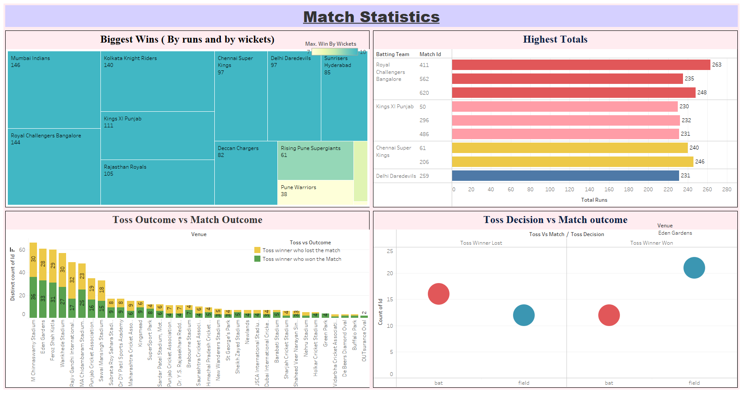

Slide 3
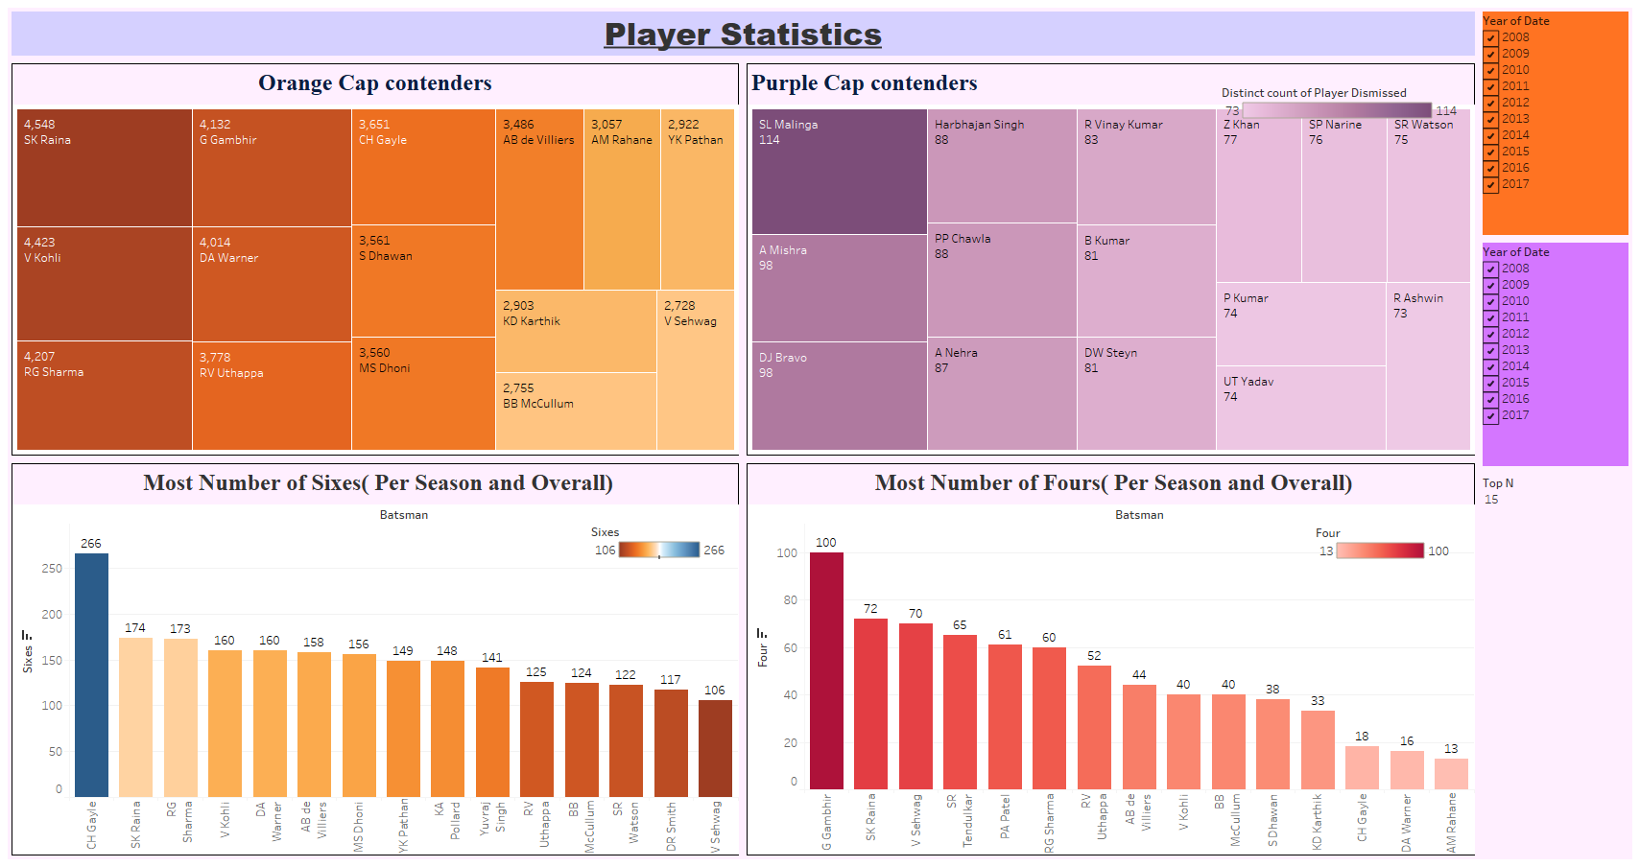

Slide 4
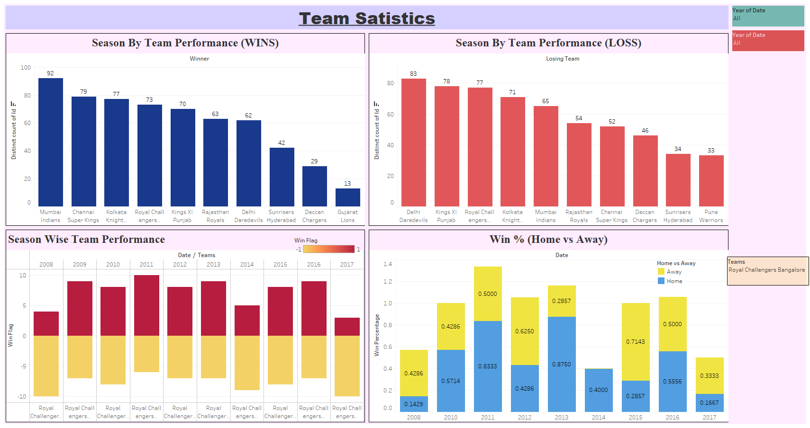

Slide 5
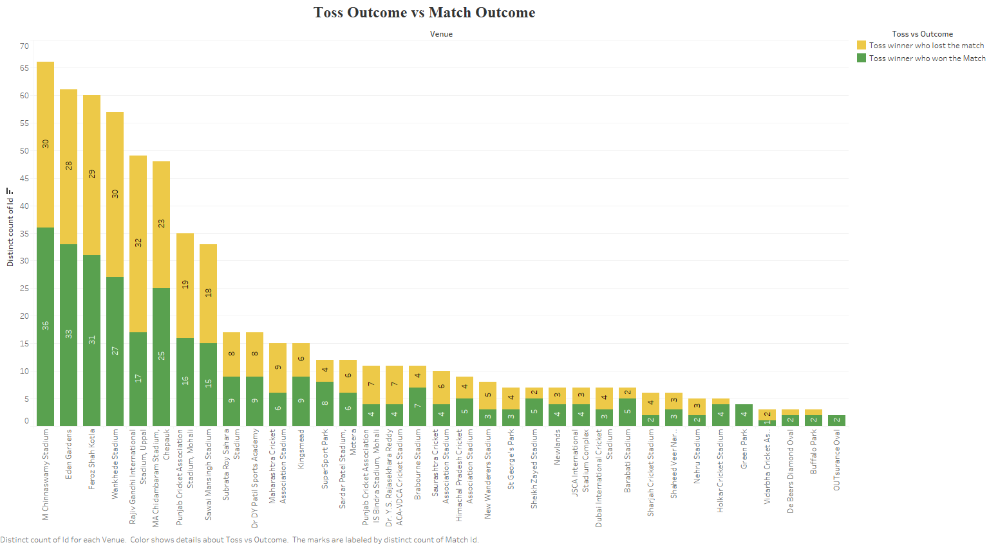

Slide 6
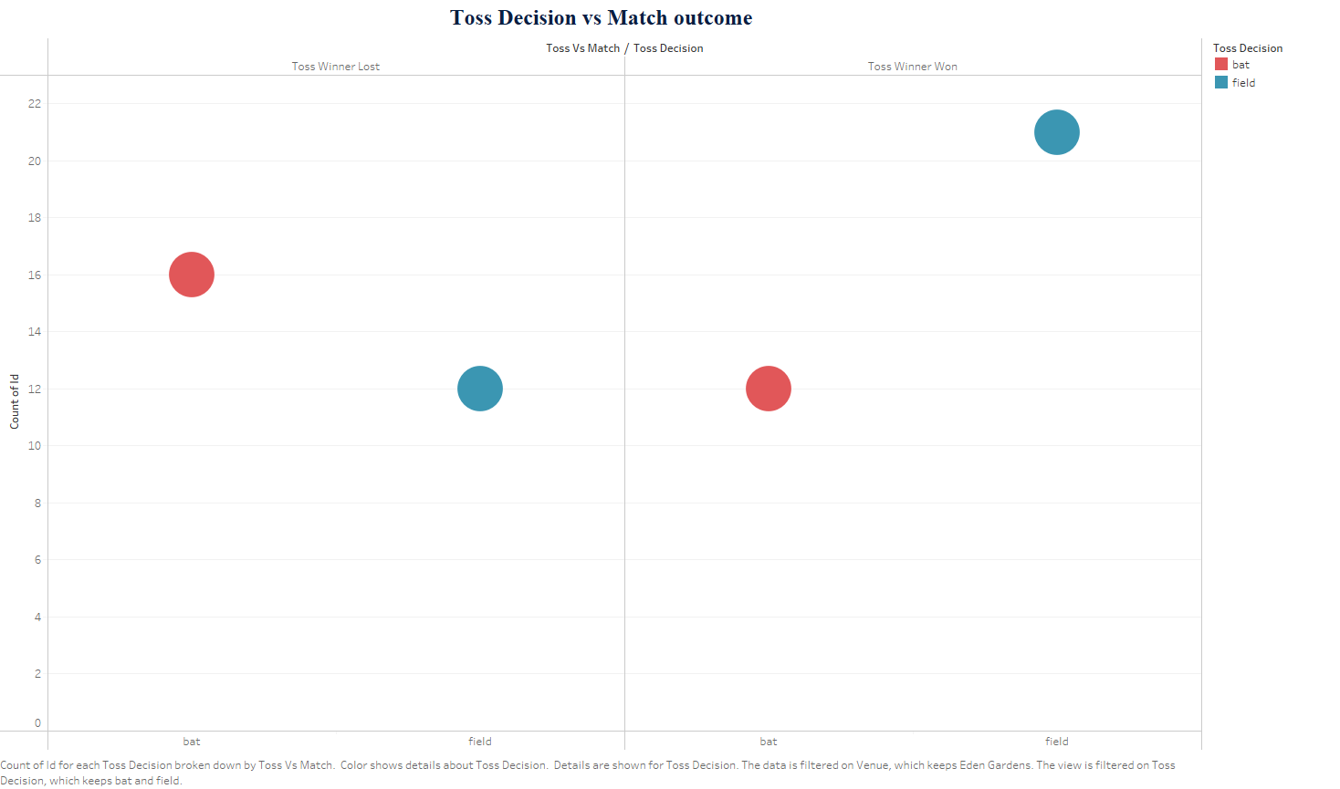

Slide 7
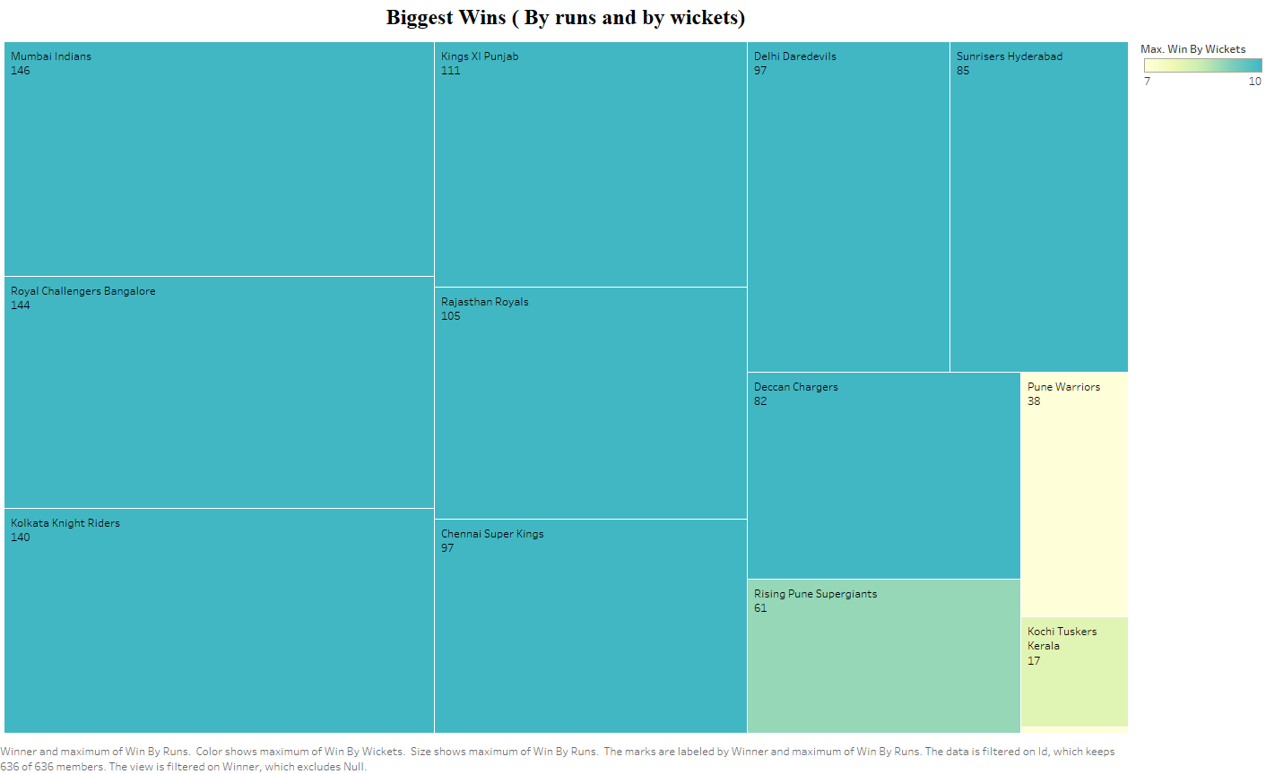

Slide 8
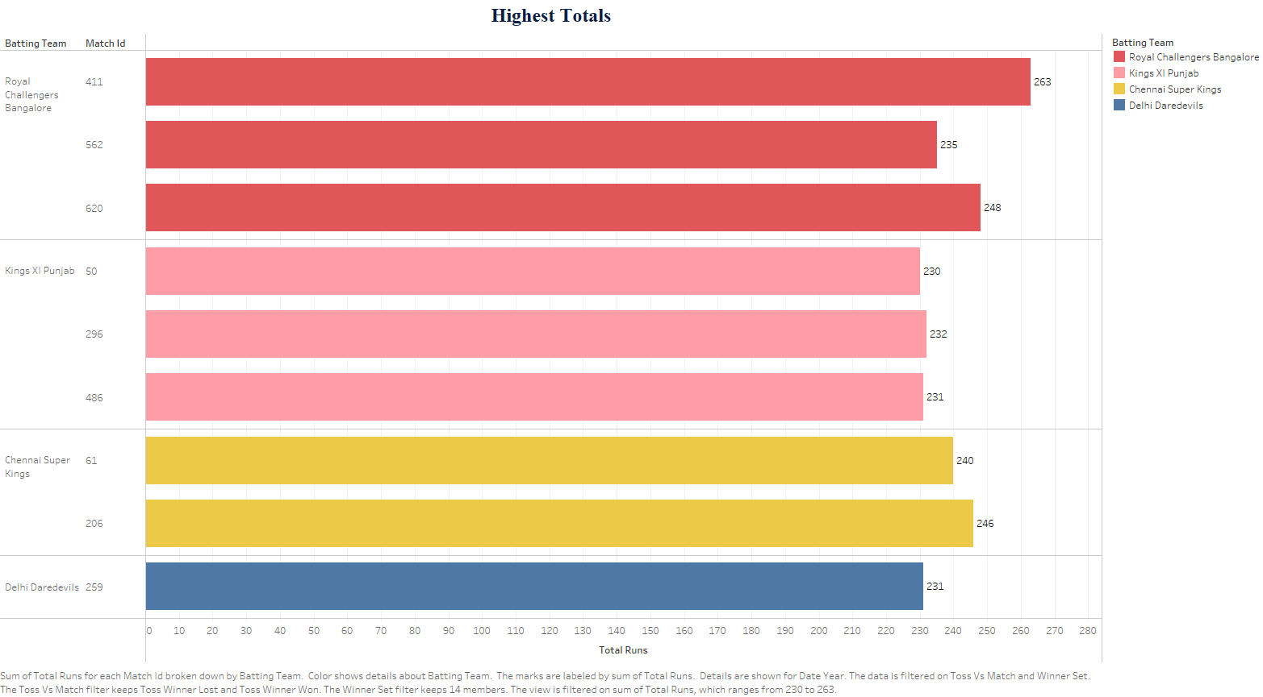

Slide 9
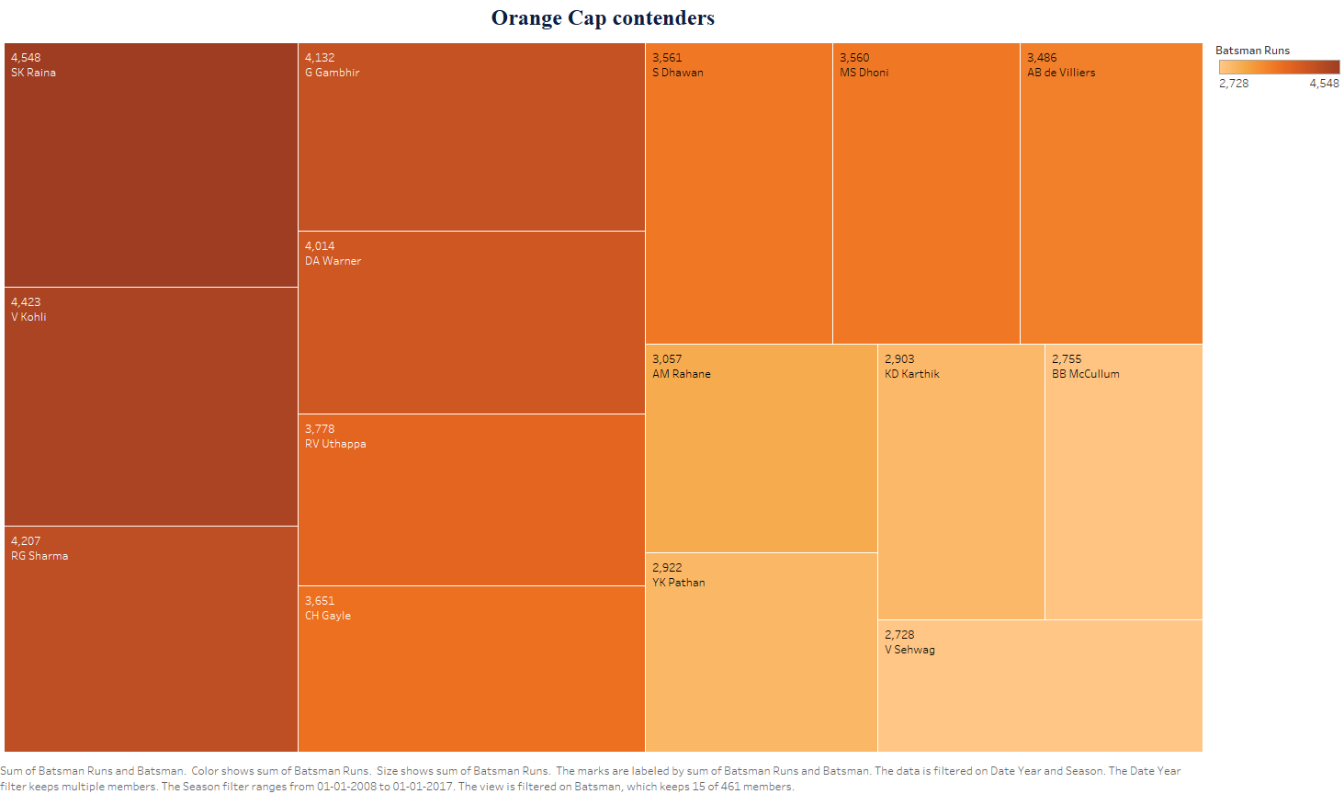

Slide 10
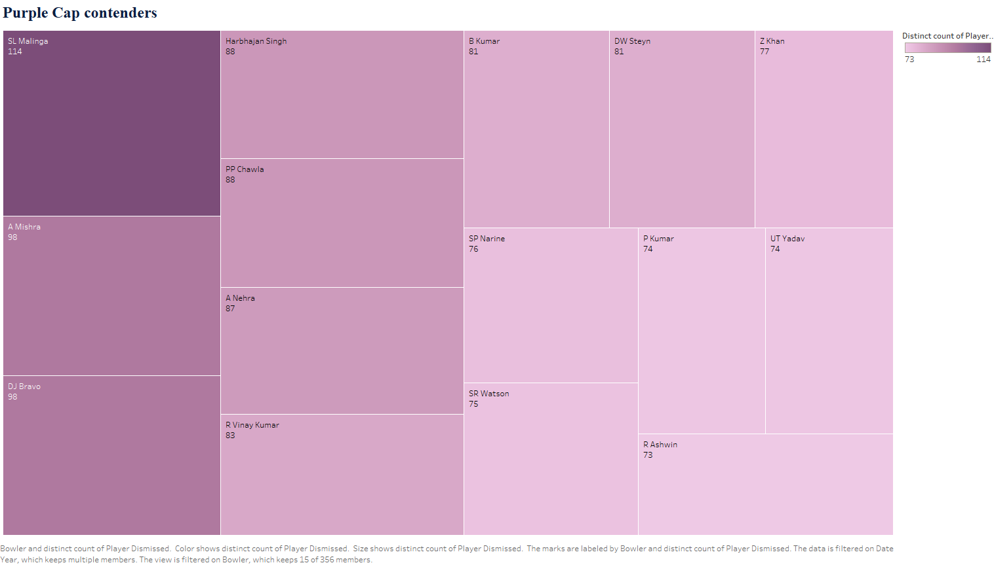

Slide 11
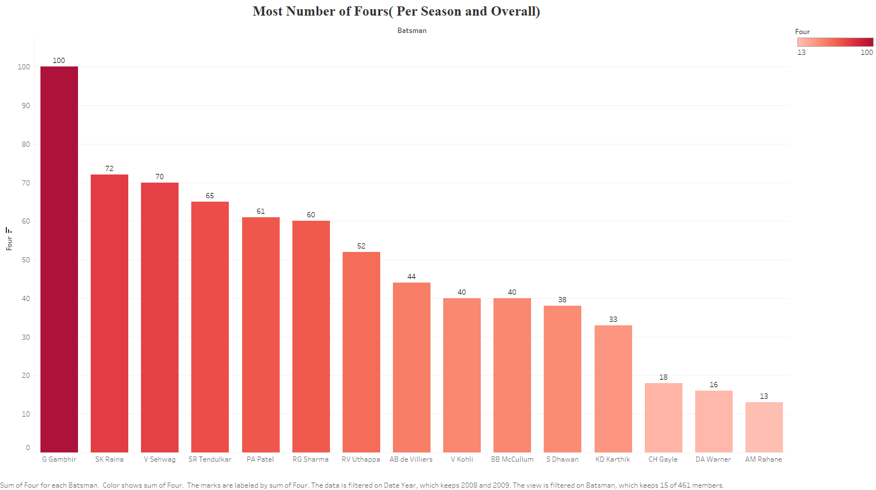

Slide 12
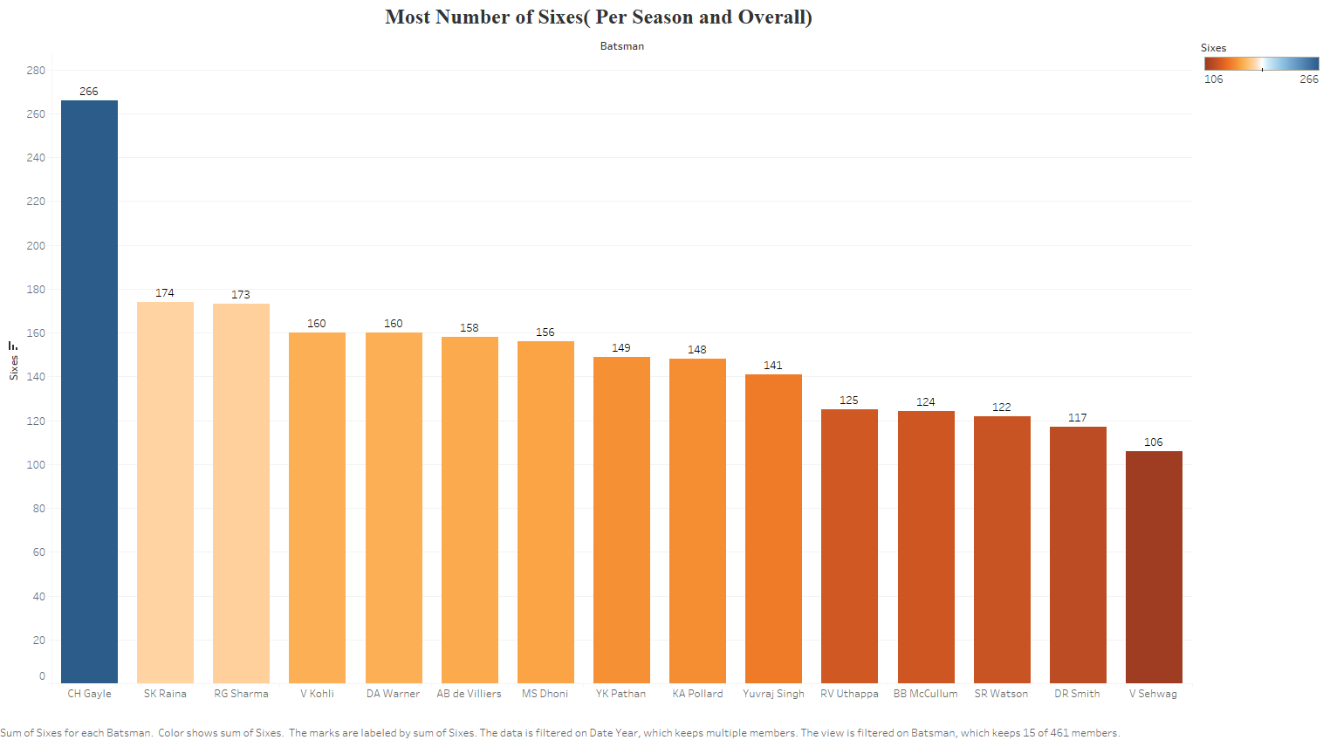

Slide 13
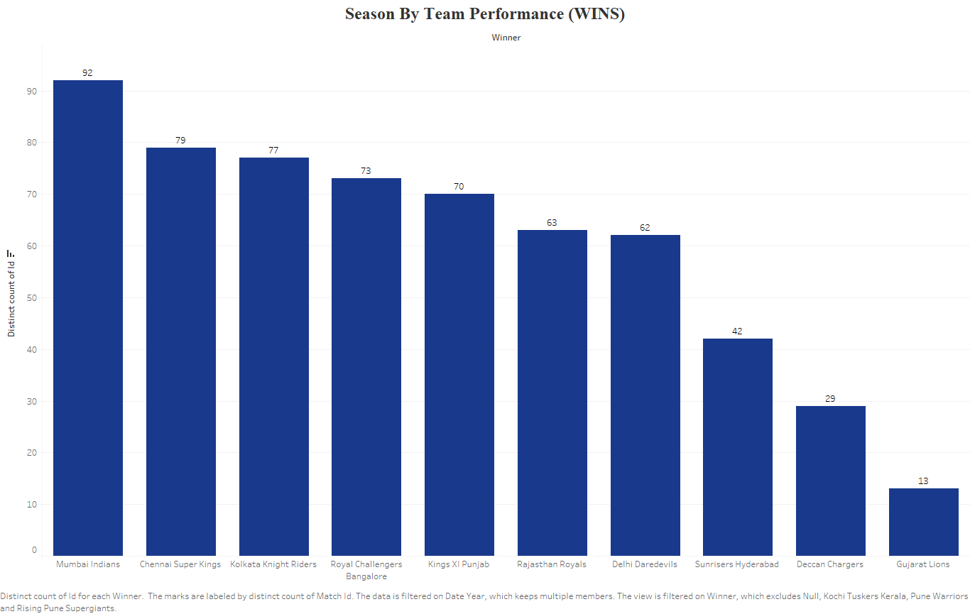

Slide 14
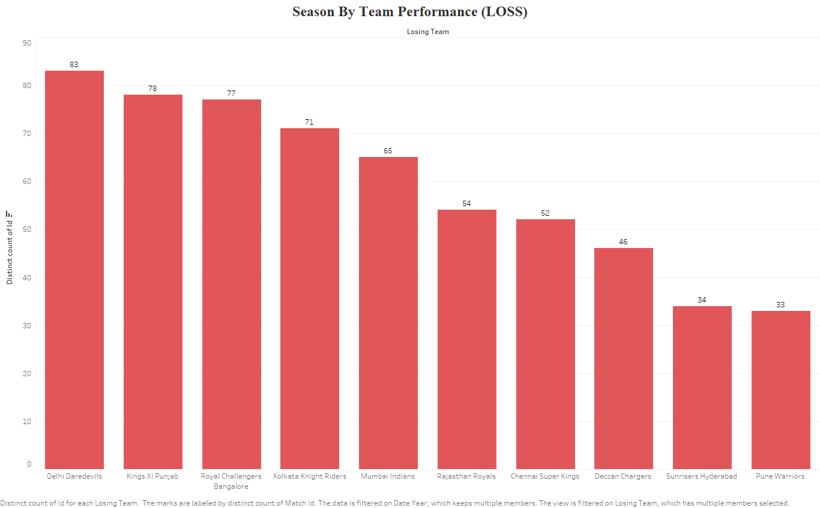

Slide 15
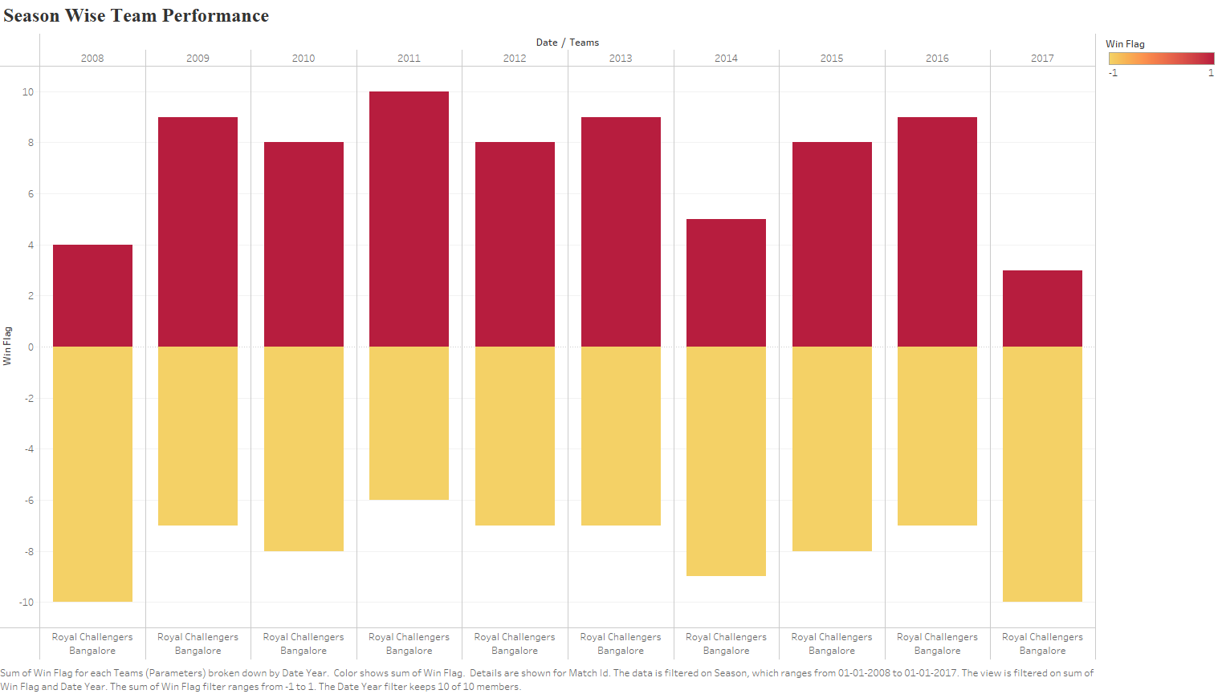

Slide 16
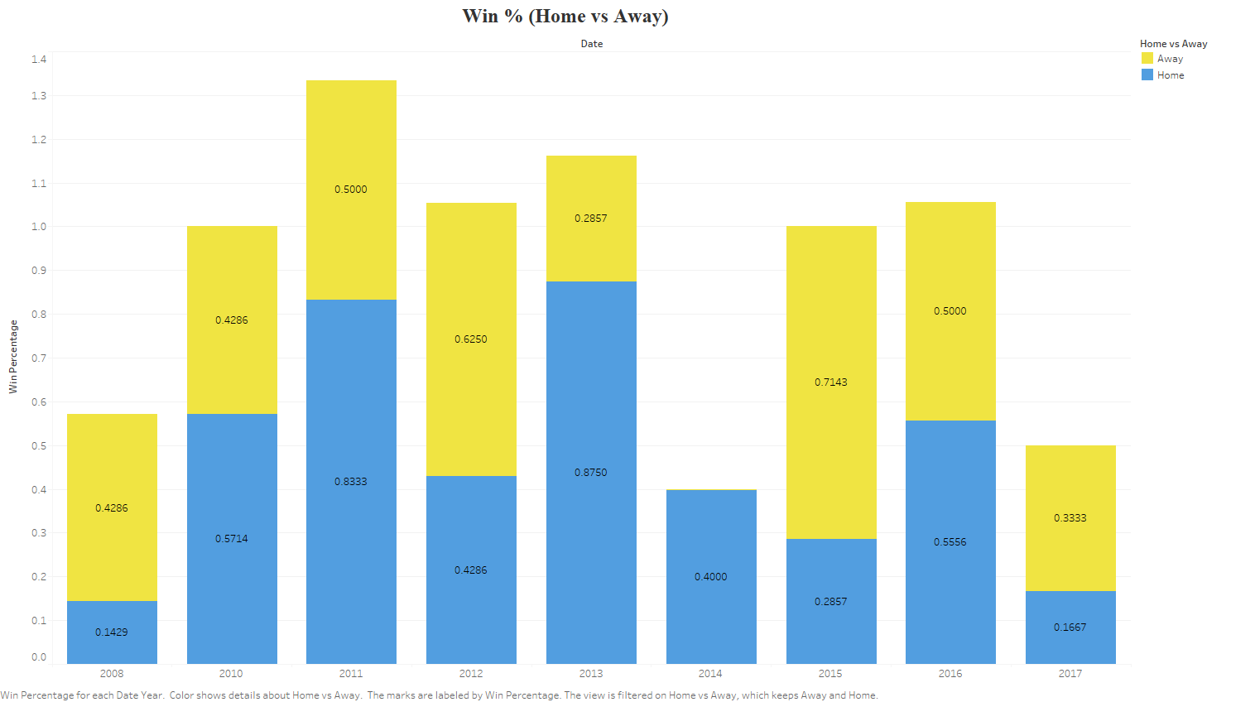

Slide 17
Summary
As we can see Mumbai Indians & Chennai has won the highest number of matches.
Royal Challengers Bangalore has the highest number of totals.
S.K Raina & Virat Kohli has scored highest number of runs.
SL Malinga, A Mishra & DJ Bravo has taken highest number of wickets.
CH Gayle has hit highest number of sixes.
G Gambhir has hit highest number of fours.
The winning percentage is more on matches played on Home Ground.

