Slide 1
MatoshriGPT AI-Powered Campus Assistant
Shrihari Kasar Utkarsha Kakulte Ishwari Gamne
Om Jagzap Sanika Tambat
Trainee :
K. Suryawanshi (mam)
Guide :
C. Dahale (sir)

Slide 2
Table of contents
02
03
04
01
05
06
Problem Statement
Methodology
Architecture
Introduction
07
08
Results
Applications
Conclusion
References

Slide 3
Introduction
A chatbot named MatoshriGPT is created that utilises AI to support both students and faculty to provide quick, accurate responses to issues related to their campus.
The chatbot is created using Flask, RapidFuzz, and Sentence Transformers and is focused more on processing the questions and giving the appropriate information.
Data is pulled in from the college's website and other materials to ascertain accuracy and relevance.

Slide 4
Problem Statement
One of the problems that either students or lecturers face is having information on the campus.
All traditional methods (emails, queries) are time-consuming and inefficient.
The reason that brought about automated intelligent real time assistant for fast and accurate feedback.
Objective of the Project :
To build a chatbot that gives quick correct info about the campus.
Boost answer precision using fuzzy matching and meaning-based comparisons.
Make users happier by creating easy-to-use interactions.

Slide 5



Methodology
TECHNOLOGIES USED:
APPROACH:
We gather and clean up data from the college website.
We put in place better fuzzy matching and keyword fallback methods.
We make the response time faster and more accurate.

Slide 6
System Architecture Overview
The brainwork happens with a Flask API doing the NLP heavy lifting. RapidFuzz isn't far behind with its close-but-not-quite matching skill. Plus, Sentence Transformers work magic finding stuff that kind of means the same.
Users type their questions using a web setup with code bits like HTML, CSS, and JS.
MatoshriGPT
Where do all these questions and answers live? In a Dataset. It's super good at keeping and dishing out all that chatter.
Then when it's time to hit back with an answer, our Chatbot frontend takes the stage.

Slide 7
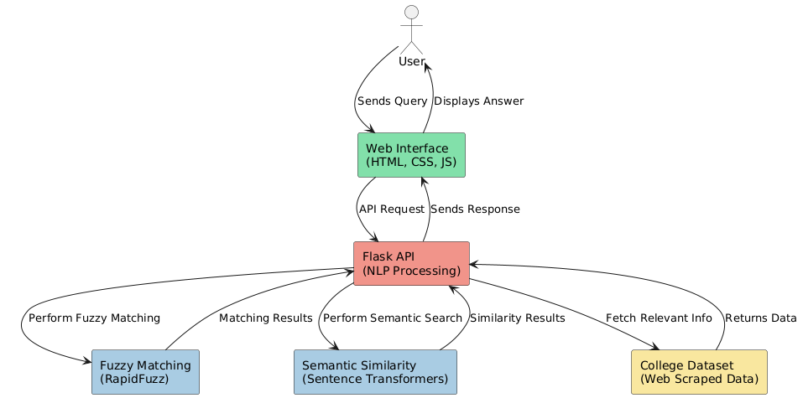

Slide 8
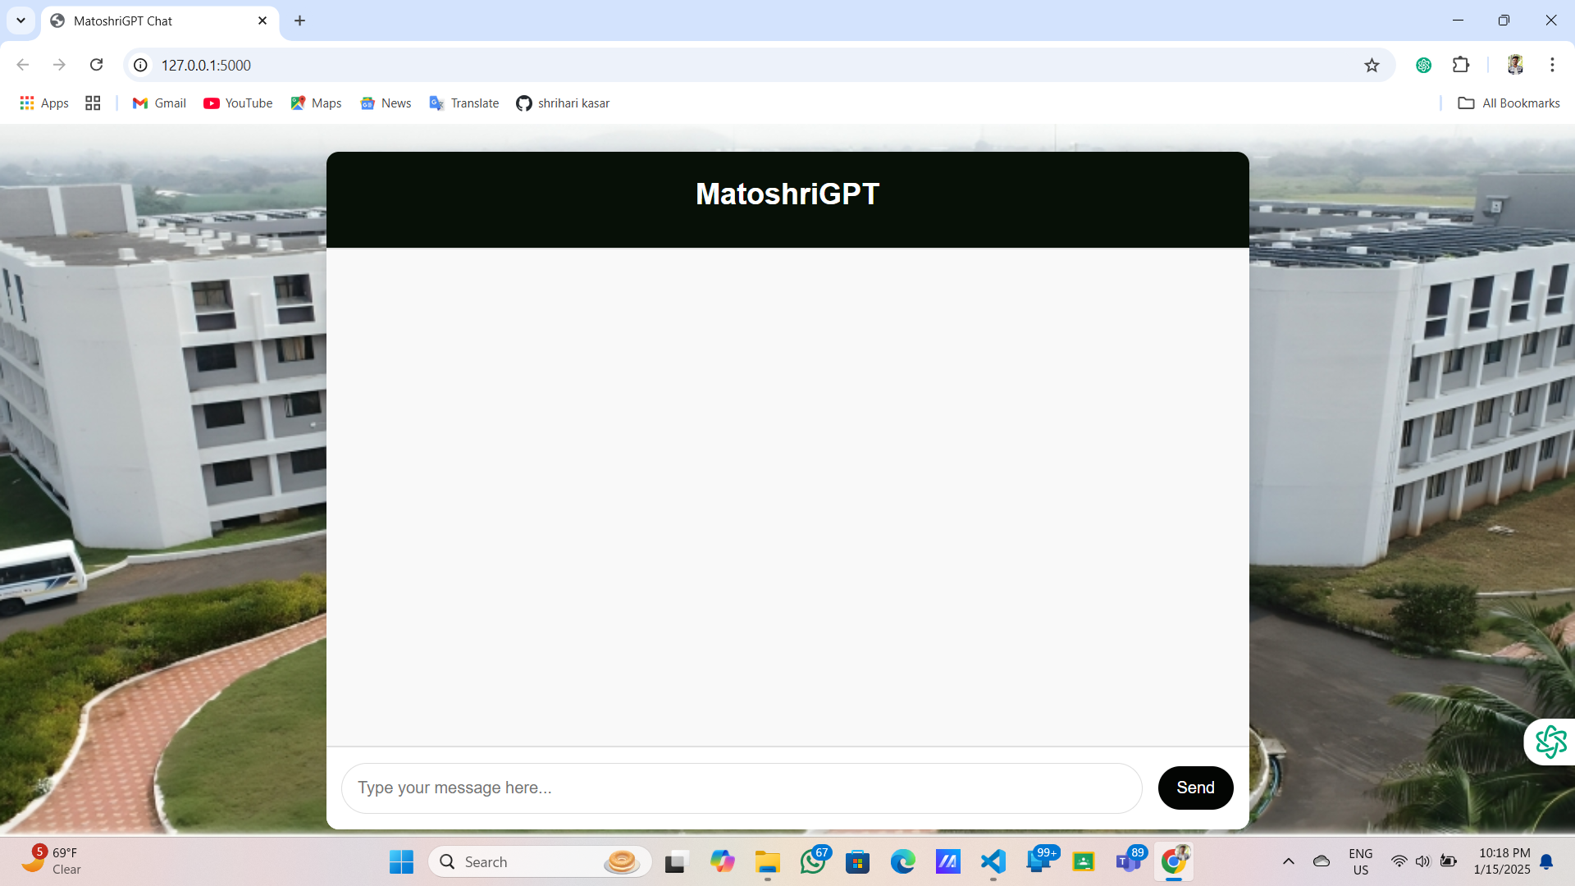
Results

Slide 9
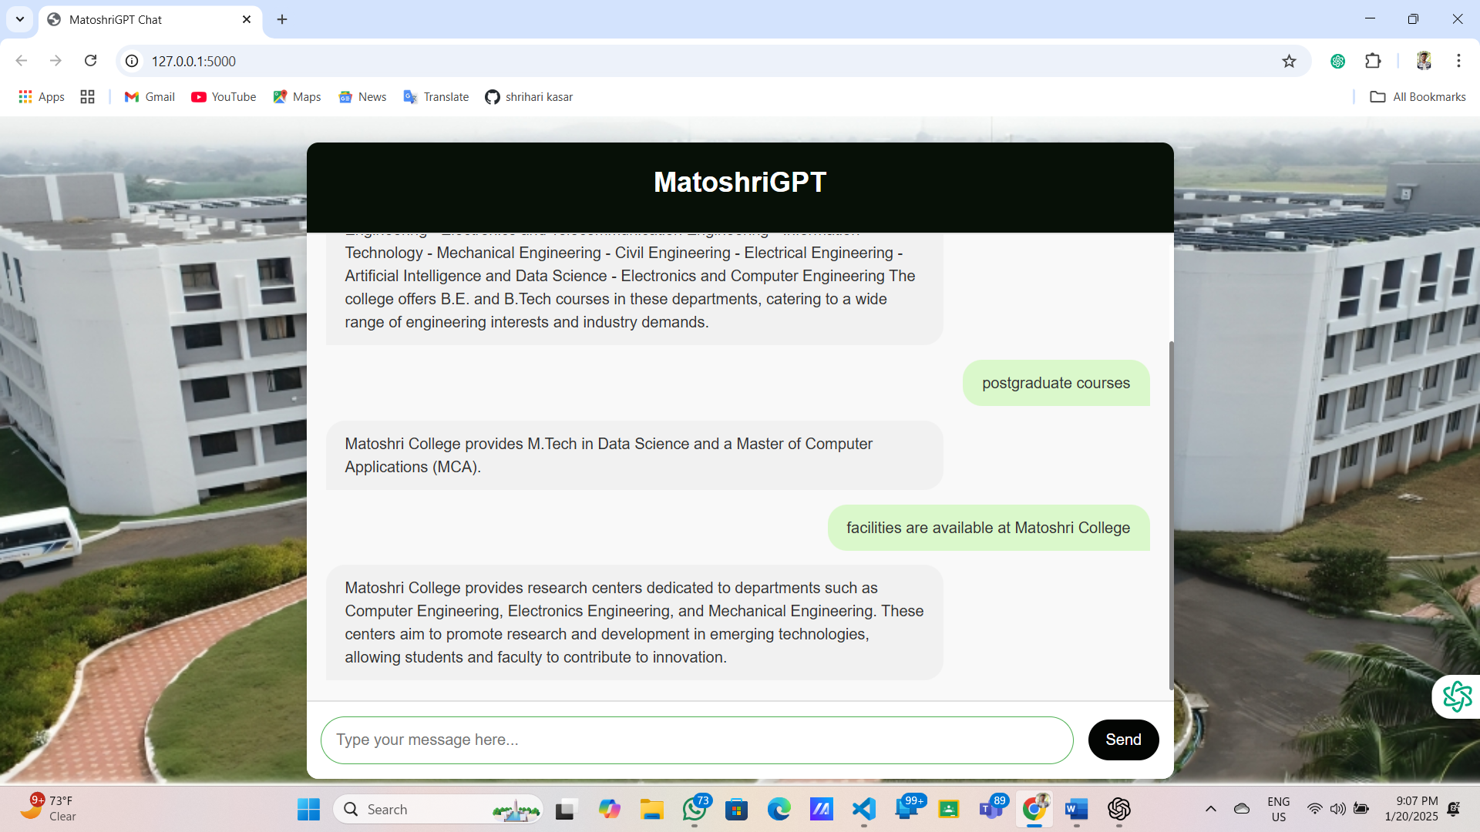

Slide 10
Applications
Students
Check out exam times, class info, and cost stuff
MatoshriGPT ChatBot Applications
Teachers
Grab academic tools fast.
College
Ditch the boring same old questions.

Slide 11
Conclusion
MatoshriGPT makes college life more fun giving you answers prompt.
This thing shows us AI can do some cool stuff at schools.
I bet soon we'll be chatting with it and blabbing away in various languages.
Future Scope:
MatoshriGPT will assist student's faculty and visitors with queries related to admissions academic's events and facilities.
Ensures 24/7 access to campus information anytime anywhere. AI-powered personalized interactions for Improved Operator Encounter.
Continuous learning for Improved Answer Precision.
Google Maps integration for real-time campus navigation and directions.
Provides better accessibility and convenience for all Operators.

Slide 12
01
02
Matoshri College Website
TensorFlow
https://engg.matoshri.edu.in/
https://www.tensorflow.org/api_docs/python/tf/all_symbols
References
03
04
Google Colab
PYTHON Libraries and Frameworks
https://colab.research.google.com/
https://www.geeksforgeeks.org/libraries-in-python/

Slide 13
Thank you

