Slide 1
A
CASE STUDY (E- COMMERCE PROJECT)
ON
ONLINE CAB BOOKING
SUBMITTED BY
Online Taxi
GROUP NO. BE-07
SR | ENROLLMENT | NAME | IDNO | EXAM NO
1 | 20BCA04149 | PATEL DIVY DINESHBHAI | 20B029 | 015138
2 | 20BCA04262 | TAPODHAN DHRUV JAYESHKUMAR | 20B069 | 015238
3 | 20BCA04268 | UPADHYAY RAJAN CHIRAGKUMAR | 20B072 | 015243
4 | 20BCA04302 | SHINDE GANESH ARUNBHAI | 20B057 | 015271
SUBMITTED TO
BHOLABHAI PATEL COLLEGE OF COMPUTER STDUIES
GANDHINAGAR
[1]
BPCCS, GANDHINAGAR

Slide 2
Online Taxi
Certificate
I hereby certify that following group members
1. PATEL DIVY DINESHBHAI
2. TAPODHAN DHRUV JAYESHBHAI
3. UPADHYAY RAJAN CHIRAGKUMAR
4. SHINDE GANESH ARUNBHAI
Have completed the case study (E-commerce Project) on Online CAB BOOKING. E-commerce technology-2 ( BCA - 509 (B) ) subject available at BCA Semester - V and It is part of syllabus, approved by KSV, Gandhinagar with the specialization in E-Commerce.
Place: Gandhinagar
Date: (Project in charge)
[2]
BPCCS, GANDHINAGAR

Slide 3
Zero Level DFD
Customer
Login
Req Ride
Choose Des
Online Cab Booking
0
Manage Car & Cus
Admin
Manage Booking
Manage Report
Login/Reg
Drop off
Pick up
Find Customer
Driver

Slide 4
First Level DFD
1
Reg/
Login
Reg/Login
Reg Details
Reg Information
Reg/Login
2
Booking
Admin
Booking info
Choose Destination/
Customer
Sel Car Type
Give payment
3
Payment
Driver
Payment info
Res Payment &
Feedback

Slide 5
Second Level DFD
Registration
Reg details
Registration
Reg details
1. 1
Save reg det
Reg Info
Save reg det
Reg
Customer db
Verify
Admin
Confirm
Driver db
Login
Verify
1. 2
Confirm
Login Info
Login
Username /
Password
Username /
Password
Driver
Customer
Forgot/
Password
1. 3
Forgot Password
Enter new Password
Forgot Password
Enter new Password
Update Pass db
Updated Password

Slide 6
Booking
2. 1
Car/Taxi details
Apply Car
Select car type
Select car type
Admin
2. 2
Booking
Select date-time/start ride
Pickup cus
Customer
Driver
Choose destination
Give Profile
Driver Profile
Drop off
Booking Details
Booking db
2. 3
Cancel Details
Cancel
Customer Cancel ride

Slide 7
Payment
3. 1
Online
Receive online Payment
Payment Information
Pay details
Payment db
Admin db
Pay details
3. 2
Payment status
Offline
Customer
Give offline pay
Receive Payment offline
Driver
3. 3
Feedback
Give feedback
Accept feedback

Slide 8
Data Dictionary
Customer Table
No | Field Name | Data type | Field Length | Constraint | Description | Example
1 | Cust_id | Integer | 10 | Primary Key | Customer’s Special id | 1001
2 | Cust_name | Varchar | Max | Not null | Cusomter’s name | Rajan
3 | Cust_mail | Varchar | Max | Not null | Customer’s mail | rajan760li@gmail.com
4 | Cust_pass | Varchar | Max | Not null | Customer’s Password | Rajan123#@
5 | Datetime | Varchar | Max | Not null | Date Time | 23/10/2023

Slide 9
Data Dictionary
Driver Table
No | Field Name | Data type | Field Length | Constraint | Description | Example
1 | Driver_id | Integer | 10 | Primary Key | Driver’s Special id | 1001
2 | Driver_name | Varchar | Max | Not null | Driver’s name | Jayvir
3 | Driver_mail | Varchar | Max | Not null | Driver’s mail | jayvir11@gmail.com
4 | Driver_pass | Varchar | Max | Not null | Driver’s Password | Jayvir5525
5 | Driver_contact | Integer | 10 | Not null | Driver’s Phone no. | 9256324100
6 | Driver_License | Varchar | Max | Not null | Driver’s License no. | GJ0920211452369
7 | Driver_Car name | Varchar | Max | Not null | Driver’s Car name | Maruti Eeco
8 | Driver_Car number plate | Varchar | Max | Not null | Driver’s Car number | GJ09BB1235

Slide 10
Data Dictionary
Booking Table
No | Field Name | Data type | Field Length | Constraint | Description | Example
1 | Booking_id | Integer | 10 | Primary Key | booking’s Special id | 0010
2 | Cust_id | Integer | 10 | Foreign Key | Customer’s Special id | 1001
3 | Cust_name | Varchar | Max | Not null | Cusomter’s name | Rajan
4 | Driver_id | Integer | 10 | Foreign Key | Driver’s Special id | 1001
5 | Driver_name | Varchar | Max | Not null | Driver’s name | Jayvir
6 | Booking_info | Varchar | Max | Not null | Booking’s information | Where to - destination
7 | Ride_cost | Integer | 10 | Not null | Riding’s Cost | 400 rs

Slide 11
Data Dictionary
Payment Table
No | Field Name | Data type | Field Length | Constraint | Description | Example
1 | Payment_id | Integer | 10 | Primary Key | Payment’s Special id | 0001
2 | Cust_id | Integer | 10 | Foreign Key | Customer’s Special id | 1001
3 | Cust_name | Varchar | Max | Not null | Cusomter’s name | Rajan
4 | Payment_info | Varchar | Max | Not null | Payment’s information | 400 rs
5 | Payment_status | Varchar | Max | Not null | Payment’s Status | Complete / Pending

Slide 12
Data Dictionary
Admin Table
No | Field Name | Data type | Field Length | Constraint | Description | Example
1 | Admin_id | Integer | 10 | Primary Key | Admin’s Special id | 1001
2 | Admin_name | Varchar | Max | Not null | Admin’s name | Rajan
3 | Cust_id | Integer | 10 | Foreign Key | Customer’s Special id | 1001
4 | Driver_id | Integer | 10 | Foreign Key | Driver’s Special id | 1001
5 | Payment_id | Integer | 10 | Foreign Key | Payment’s Special id | 0001

Slide 13
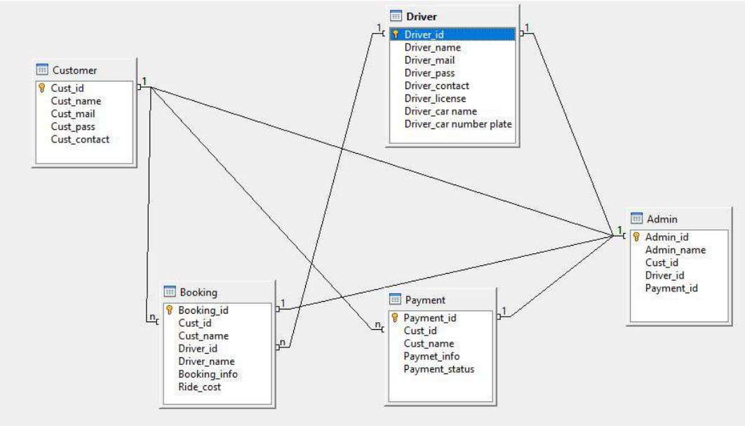
ER DIAGRAM

Slide 14
Screen Layout
Customer
Customer-Registration
Username
Mobile Number
E-mail Address
Create Password
Confirm Password
Send OTP
Enter OTP
Sign Up

Slide 15
Screen Layout
Driver
Driver-Registration
Username
Mobile Number
E-mail Address
Create Password
Confirm Password
License Number
Car Name
Car number plate
Send OTP
Enter OTP
Sign Up

Slide 16
Screen Layout
Login page
Login
Username
Password
Login
Forgot Password
Don’t have an account ? Sign up

Slide 17
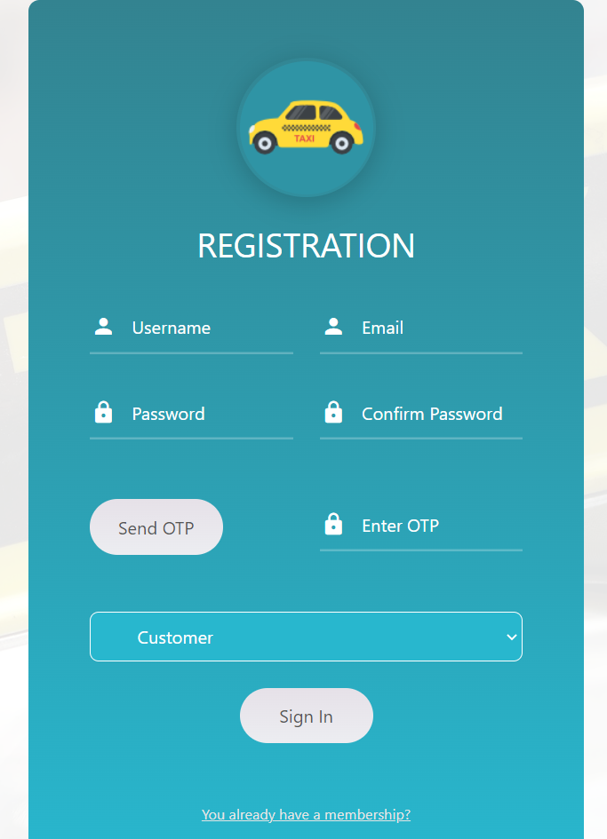
Customer Registration page

Slide 18
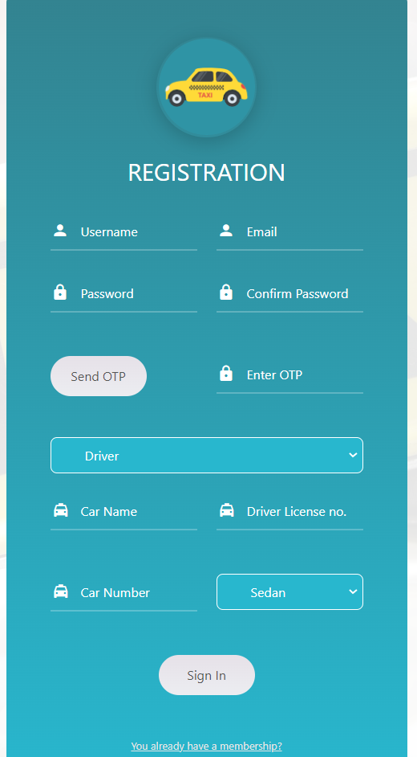
Driver Registration page

Slide 19
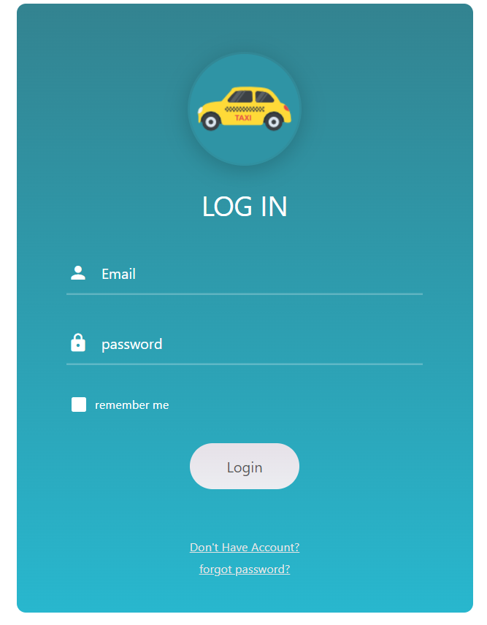
Login page

Slide 20
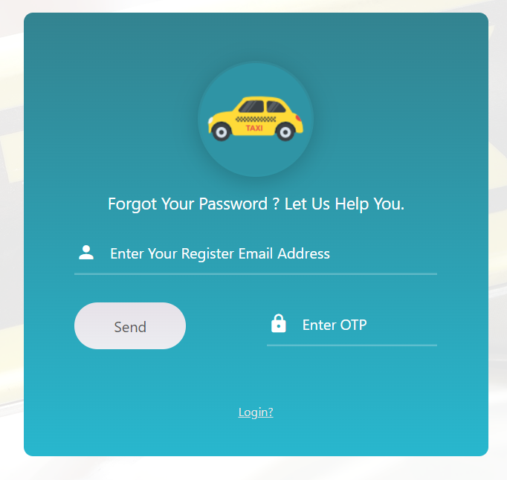
Forgot Password page

