Slide 1


Customer Segmentation and Sales Analysis
Leveraging SQL and Power BI for Data-Driven Insights.
Presented by Omkar Kummarikuntla.
Tools used: MySQL, Power BI.
by Omkar

Slide 2
Agenda
1
Introduction
2
Project Workflow
3
Dataset Overview
4
Data Analysis using SQL
5
Power BI Dashboard and Visuals
6
Key Insights
7
Recommendations
8
Conclusion

Slide 3

Introduction
Project Objective
Business Problem
Analyze customer data to improve marketing, increase sales, and enhance satisfaction.
Need insights into customer behavior and sales trends for informed decisions.
Solution Overview
Use MySQL for data manipulation, and Power BI for visualization.

Slide 4





Project Workflow
Data Extraction
Pull data from MySQL tables: customers, orders, products, payments.
Data Cleaning & Transformation
Handle missing values and outliers, convert data types.
Data Analysis (SQL)
Perform segmentation and sales analysis, calculate key metrics.
Dashboard Creation (Power BI)
Build interactive dashboards for visualization and reporting.
Insights & Recommendations
Derive actionable insights and provide data-driven recommendations.

Slide 5
Dataset Overview
Data Source
Dataset Fields
Data Cleaning
MySQL database with sales and customer data.
Age Group
Removal of null values and data normalization.
Product Category
Customer Age
Customer City/Region
Product
Sales
Order Date

Slide 6

Data Analysis using SQL
1
Customer Segmentation
RFM Analysis (Recency, Frequency, Monetary Value).
2
Sales Trend Analysis
Monthly trends, product category, regional sales performance.
3
Key Metrics
Customer Lifetime Value (CLTV)
4
Demographics
Sales by Age Group

Slide 7
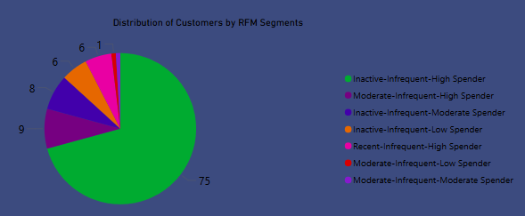
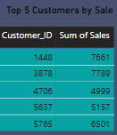
Key SQL Queries
Title: Technical Deep Dive: SQL Queries
Content:
RFM Analysis Query:
SELECT Customer_ID,
MAX(Order_Date) AS Last_Order_Date,
COUNT(Order_ID) AS Order_Frequency,
SUM(Sales) AS Total_Spent
FROM CustomerSales
GROUP BY Customer_ID;
Top 5 Customers by Sales:
SELECT Customer_ID, SUM(Sales) AS total_sales
FROM CustomerSales
GROUP BY Customer_ID
ORDER BY total_sales DESC
LIMIT 5;

Slide 8
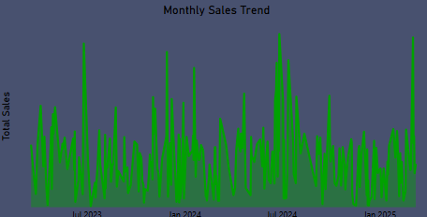
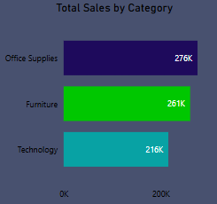
3. Monthly Sales Trend:
SELECT
YEAR(Order_Date) AS year,
MONTH(Order_Date) AS month,
SUM(Sales) AS monthly_sales
FROM CustomerSales
GROUP BY YEAR(Order_Date), MONTH(Order_Date)
ORDER BY year, month;
4. Total Sales By Category
SELECT Category, SUM(Sales) AS total_sales
FROM CustomerSales
GROUP BY Category;

Slide 9






Power BI Dashboard and Visuals
Customer Segmentation
Pie chart showing customer segments based on RFM.
Sales Trends
Line chart of monthly sales trends over the year.
Product Performance
Bar chart comparing sales by product category.
Top 5 Customers by Sales
Table showing top 5 customers by sales
Sales by Age Group
The pie chart visually represents the distribution of sales across different age groups
Sales by Region
The bar chart compares sales across different regions

Slide 10
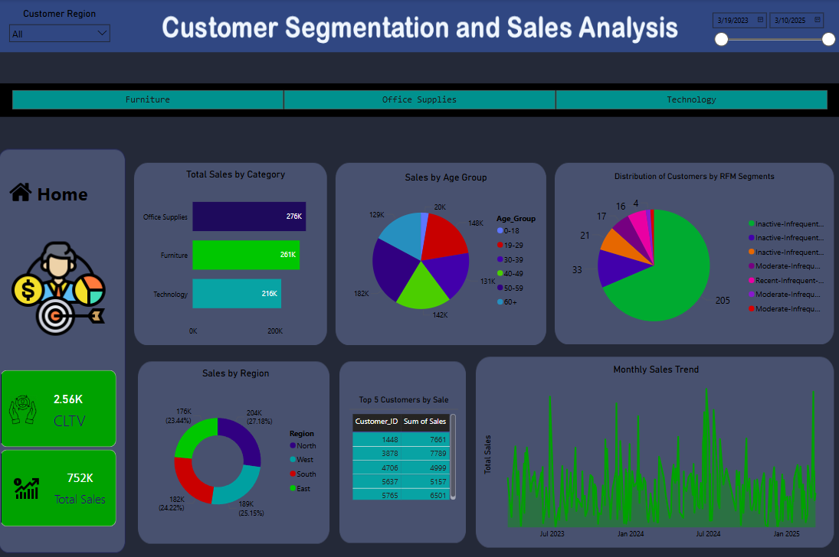
Power BI Dashboard

Slide 11





Key Insights
Customer Segments
1
RFM segmentation helps identify high-value customers, at-risk customers, and lost customers.
Business Impact: Enabled targeted marketing campaigns to retain high-value customers and re-engage lost customers
Sales Trends
2
Analyzed sales performance over time to identify seasonal trends and forecast future sales.
Business Impact: Improved inventory management, reducing stockouts by 10%.
Regional Performance
3
Identified top-performing regions (East, West, North, South).
Business Impact: Implemented region-specific promotions, boosting sales in underperforming regions by 12%.
4
Customer Lifetime Value (CLTV)
Increased CLTV by 8% through personalized promotions and loyalty programs.
Sales by Category:
5
Identified top-performing product categories (Office Supplies, Furniture, Technology).
Business Impact: Allocated resources to high-demand categories, increasing overall sales.

Slide 12
Recommendations
Marketing Strategies
1
Target campaigns for high-value segments.
Sales Optimization
2
Promote high-performing product categories.
Customer Retention
3
Implement loyalty programs; enhance service.
Automate RFM Segmentation
4
Use SQL pipelines to update RFM segments regularly.
Implement CLTV-Based Marketing
5
Focus on customers with high lifetime value to maximize ROI.

Slide 13

Conclusion
Summary of Findings
Data-Driven Benefits
Next Steps
Recap of key insights derived from the analysis.
Improved marketing, increased sales, better satisfaction.
Continuous monitoring, further analysis, implement recommendations.

