Slide 1

Name of Project
ROCK-PAPER-SCISSOR
GAME
Name of the student - Roll Number
1. OMKAR KASTURE-1216
2. HIMANSHU MOHITE-1217
3. RAJ KATE-1204
4. SARTHAK GHOLAP-1223
5. JANHAVI GUNDAWAR-1210
Class: FIRST YEAR Division: L Batch: L1

Slide 2
Abstract
The object of the rock-paper-scissor python project is to build a game for a single player that plays with a computer, anywhere, and anytime. This project is base on the rules that:
rock blunts scissors so rock wins
scissors cut the paper so scissors win
paper cover rock so paper wins
This project is build using tkinter, random modules, pygame library and the basic concept of python.
Tkinter is a standard GUI library which is one of the easiest ways to build a GUI application.
random module use to generate random numbers
Pygame library is used to play audios
In this python project, players have to choose any one from rock, paper, and scissors. Then click on the play button will show the result of the game.

Slide 3
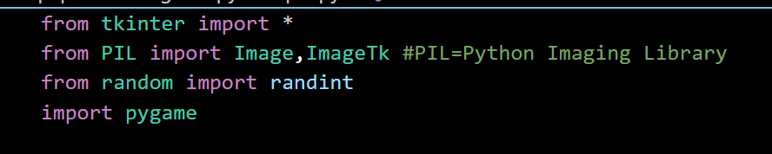
FLOW Of Program
These are the step to build a rock-paper-scissors game using python:
Import required libraries
Initialize window
Create all labels
Define all required functions
Main code i.e. checking winner
Define buttons
Importing libraries and modules:

Slide 4
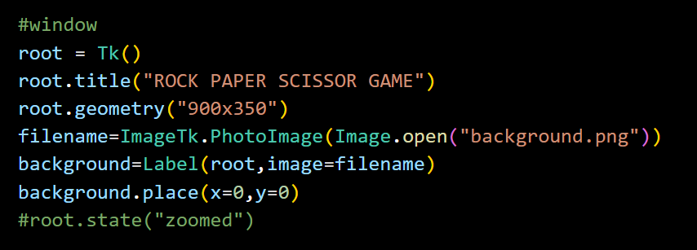
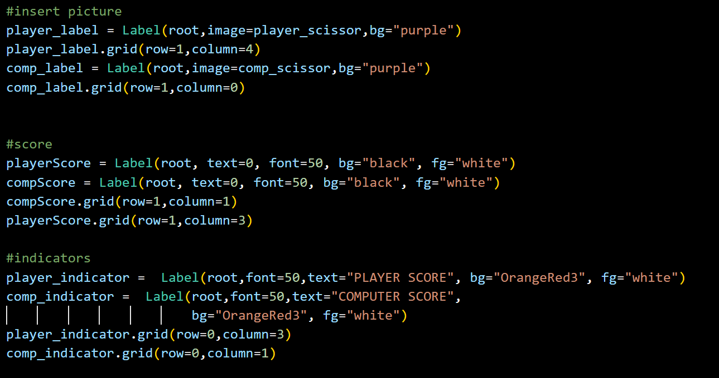
Creating window:
Creating labels:

Slide 5
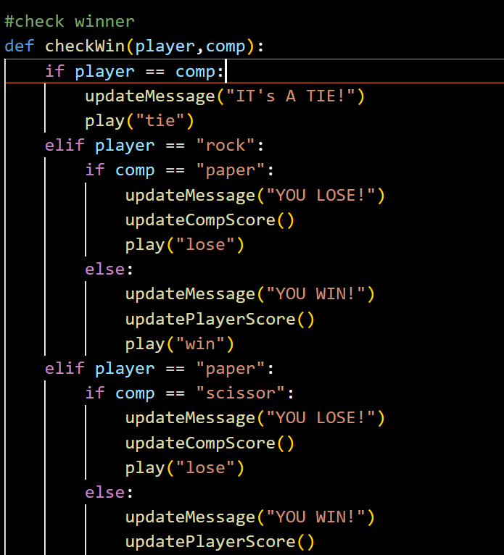
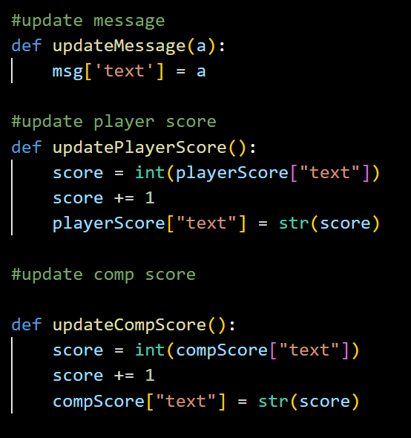
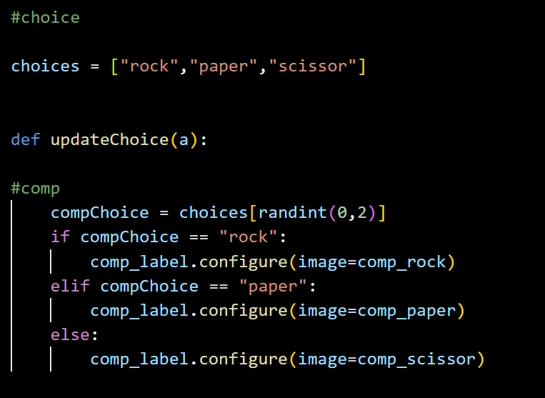
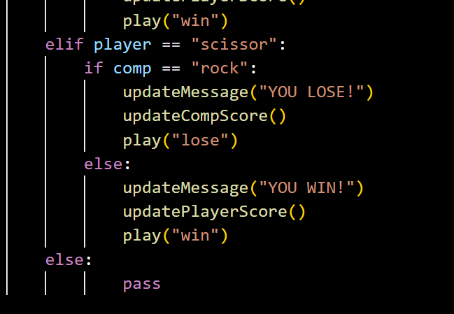
Functions:

Slide 6
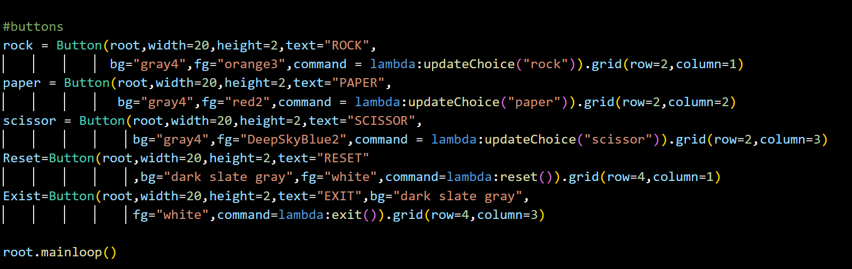
Adding buttons:

Slide 7
List Of The Topics/ Concept Which Are Covered From The Syllabus
Displaying images using PIL library
Randint function from random library
User defined funcions using def method and calling them as required
If-elif-else conditional block
Nested if
List scliling
List Of The Topics/ Concept Which Are Out Of Syllabus
Graphics using tkinter library
i.e. creating labels, buttons, and commanding buttons
Playing audio using pygame

Slide 8
Conclusion
we have successfully developed the rock-paper-scissors game using python.
We used Tkinter library for rendering graphics. We use a random module to generate random choices. PIL module and Pygame library is used to display images and playing audios respectively.
We learned how create labels using tkinter .
We learn how to create button widget. We also learn how to define functions and call the function using button.
In this way, we created a rock-paper-scissors python game.

Slide 9
Thank You

