Slide 1

Zomato Restaurant Analysis
By:-
OMKAR GUPTA
DS-OCT 2025

Slide 2
Introduction to Zomato
History
    Zomato was founded in 2008 as a restaurant discovery platform in India. It started as a website that provided information about restaurants, including menus, reviews, and ratings.
Mission
    Zomato's mission is to ensure that everyone can find and enjoy great food. They aim to connect users with the best dining experiences by providing accurate and comprehensive information about restaurants.
User Base
    Zomato has a large and diverse user base, with millions of active users worldwide. It is available in multiple countries and supports multiple languages, making it accessible to a global audience.

Slide 3

Project Aim
To identify optimal countries and cities for opening new restaurants by analysing existing restaurant performance, market demand, and economic factors, ensuring profitable and strategic expansion.

Slide 4
Data Overview
Restaurant ID: Unique identifier for each restaurant.
Restaurant Name: The name of the restaurant.
CountryCode: Country code of the location where the restaurant is situated.
Country: The country of restaurant located.
City: The city where the restaurant is located.
Address: The specific address of the restaurant.
Locality: The locality or neighborhood where the restaurant is situated.
LocalityVerbose: Detailed information about the locality.
Longitude: The geographical longitude coordinate of the restaurant.
Latitude: The geographical latitude coordinate of the restaurant.
Updated_Cuisines: The type of cuisine offered by the restaurant.
Currency: The currency used for transactions in the restaurant.
Has_Table_booking: Indicates whether the restaurant has a table booking option (Yes/No).
Has_Online_delivery: Indicates whether the restaurant offers online delivery (Yes/No).
Is_delivering_now: Indicates whether the restaurant is currently delivering (Yes/No).
Switch_to_order_menu: Indicates whether users can switch to the order menu (Yes/No).
Price_range: A numeric value indicating the price range category of the restaurant.
Votes: The number of votes or ratings/(feedback) received by the restaurant.
Average_Cost_for_two: The average cost for two people dining at the restaurant.
Price: The cost of two people dining with respective currency symbol.
Price in Rupees: The Price converted to INR.
Rating: The overall rating of the restaurant is based on user reviews.
Updated_Datekey_opening: The date when the restaurant was opened.
Years: The year of restaurant opened.

Slide 5

Key Statistics from Zomato Global Analysis
Total Number of Restaurants: 9,551 restaurants from various countries around the world.
Total Number of Cuisines: 1,825 cuisines from various restaurants across different countries and states.
Total Number of Cities: 141 cities have been analysed from 15 countries.
Total Number of Votes: 1,498,645 votes were cast in the review system to generate feedback.

Slide 6

Data Cleaning and Processing
Treated the missing values in the 'Cuisines' column for the USA.
Standardized the date format.
Processed various currencies and converted them into INR for comparison.
Created new columns for year from the date for better visualization.
Merged the respective currency with its associated cost using string operations.
Used LOOKUP functions to fetch the appropriate country codes.

Slide 7

Methodology
Missing value treatment:- Using pivot table, Taking top 10 Cuisines count , Sorting in Descending order, ISBLANK function, IF function.
Data Enrichment:- Enhanced the data set with additional variables using VLOOKUP, RIGHT, FIND, CONCAT, TEXT, DATEVALUE, SUBSTITUTE, YEAR and connecting tables to cross reference with original data source.
Descriptive Analysis:- Employed Pivot tables for summarizing key metrices, conditional aggregational functions and normal excel functions (count, if, etc.) for analyzing objective questions.
Executive Segmentations:- Applied year and country wise filters to analyse the various outcomes of ratings, prices etc. for different countries at a different timeline.
Data Visualization:- Created dynamic charts and Dashboard for data representation, enabling interactive data exploration.

Slide 8
Year-wise Growth of Restaurant Listings
Restaurants Opening Per Year
Rising trends in 2017–2018 suggest increased business confidence and market demand.
The drop in mid-years like 2012 and 2015 may reflect economic or regulatory factors worth investigating before expansion planning.

Slide 9
Restaurant Presence by Country
  This chart illustrates the distribution of restaurant listings across different countries based on the Zomato dataset.

Slide 10
Customer Engagement by Country (Avg. Votes)
This line chart shows the average number of customer votes per restaurant across different countries, which serves as a proxy for customer engagement and review activity.

Slide 11
Average Dining Cost for Two – Country-wise Comparison
This chart highlights the average cost of a meal for two people across various countries, converted into Indian Rupees (₹) for comparison.
This cost analysis is crucial for financial planning, menu pricing, and identifying ideal customer segments for each market.

Slide 12
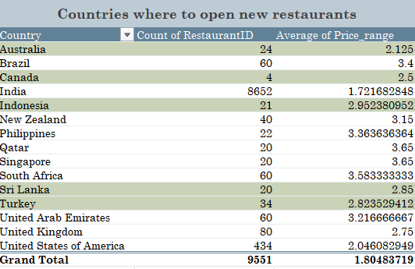
Countries where team can open new restaurants with lesser competition
Most suitable countries for opening new restaurants based on criteria where total number of restaurants are less than 50, average price range is below 3. Countries with fewer listings indicate lesser competition, making them ideal for market entry and growth. Countries with fewer restaurants: Countries with shorter bars, like Australia, Canada, Turkey, Indonesia and Sri Lanka indicate lower restaurant densities

Slide 13
Top 10 Most Popular Cuisines Among Restaurants
Based on the visualization, North Indian, Chinese, Fast Food, Mughlai, and Café are among the top 10 cuisines, favoured for their high ratings and frequent presence.
For our optimized countries, the most recommendable cuisines to include in our menu are Cafe, Indian, American, Italian, Chinese, and Dessert.

Slide 14
Comparison of Average Price Range and Average Ratings by Country

Slide 15
Table Booking Recommendations from Country-wide Data
Among the records, 1,158 entries (12%) offer a table booking option, with limited adoption across countries.
Similar to online delivery, providing table booking services is associated with higher ratings, reflecting positive customer feedback.
Countries like Qatar, the United Arab Emirates, and South Africa have notable support for table booking, contributing to their strong ratings.

Slide 16
Online delivery recommendations from country-wide data
Out of the total records, 2,451 entries (around 26%) offer an online booking option, with limited support across countries.
Implementing or enhancing online delivery services tends to result in higher ratings, indicating positive customer response to this feature.
Notably, in the United Arab Emirates, 47% of the entries (28 records) support online delivery, which correlates with good ratings.

Slide 17
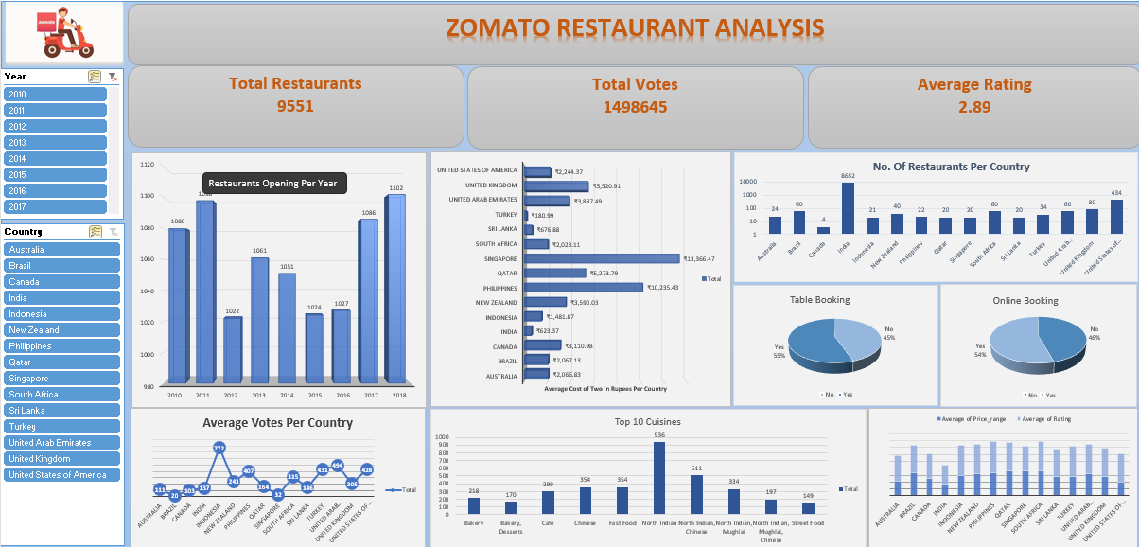
Dashboard

Slide 18
Conclusion
In conclusion, our analysis of Zomato restaurant data reveals promising opportunities for strategic expansion across the globe. By targeting regions with high demand, catering to specific demographic preferences, and capitalizing on competitive advantages, we can confidently recommend the opening of new restaurants. This initiative not only enhances market presence but also delivers exceptional dining experiences, driving sustainable growth for Zomato and enriching the global culinary landscape.

