Slide 1
Predicting Solar Energy Production
Omkar Narayan Naik
15-02-2025

Slide 2
Agenda
Introduction
Data Collection
Exploratory Data Analysis (EDA) And Visualization
Data Preprocessing
Machine Learning Model Development
Model Evaluation

Slide 3

Predicting Solar Energy Production
Project Introduction
Client: A renewable energy provider
Objective: Develop a machine learning model to predict annual solar energy production.
Key Goals:
Improve project planning
Enhance grid integration
Provide data-driven insights for decision-making

Slide 4

Dataset Overview
Data Source: Provided dataset + additional data sources (if applicable)
Target Variable: Estimated Annual PV Energy Production (kWh)
Key Features:
Developer, Region, Utility, PV System Size (kWac & kWdc), Interconnection Date, Energy Storage, etc.
Dataset Size: 218115 Rows, 17 Columns

Slide 5
The Project Workflow

Slide 6
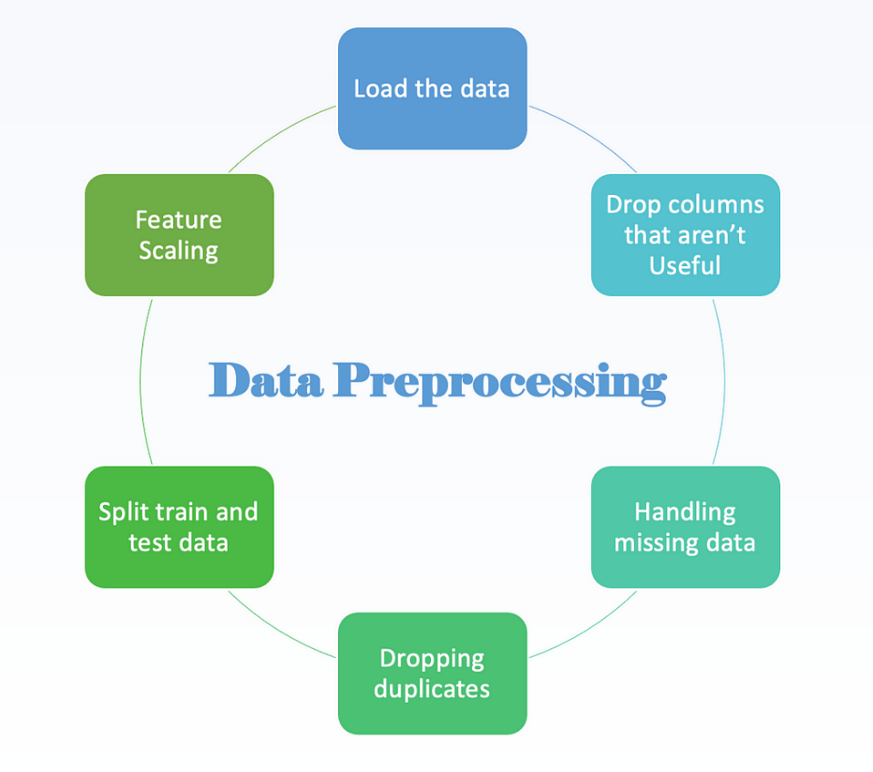
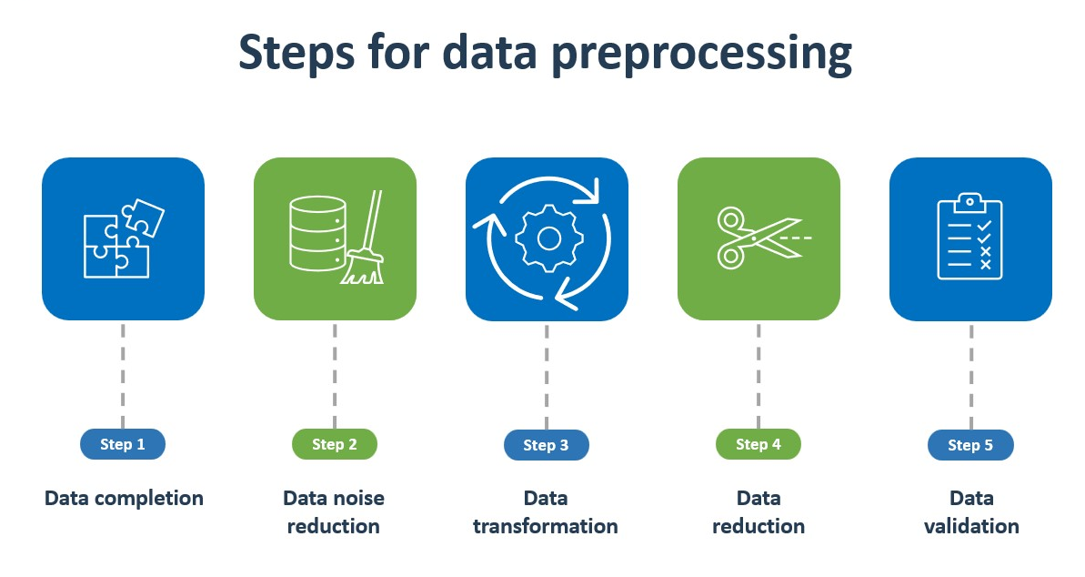
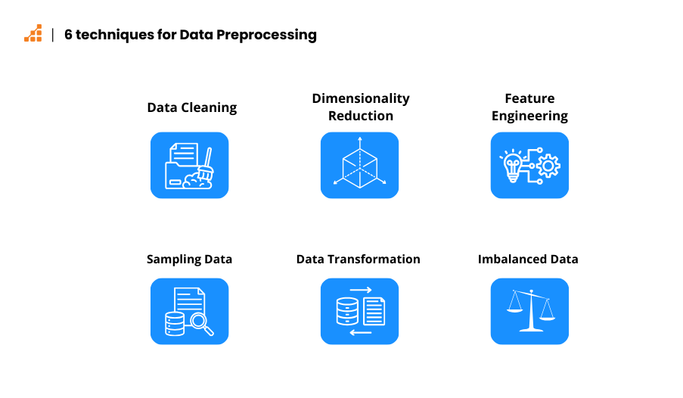
Data Preprocessing

Slide 7
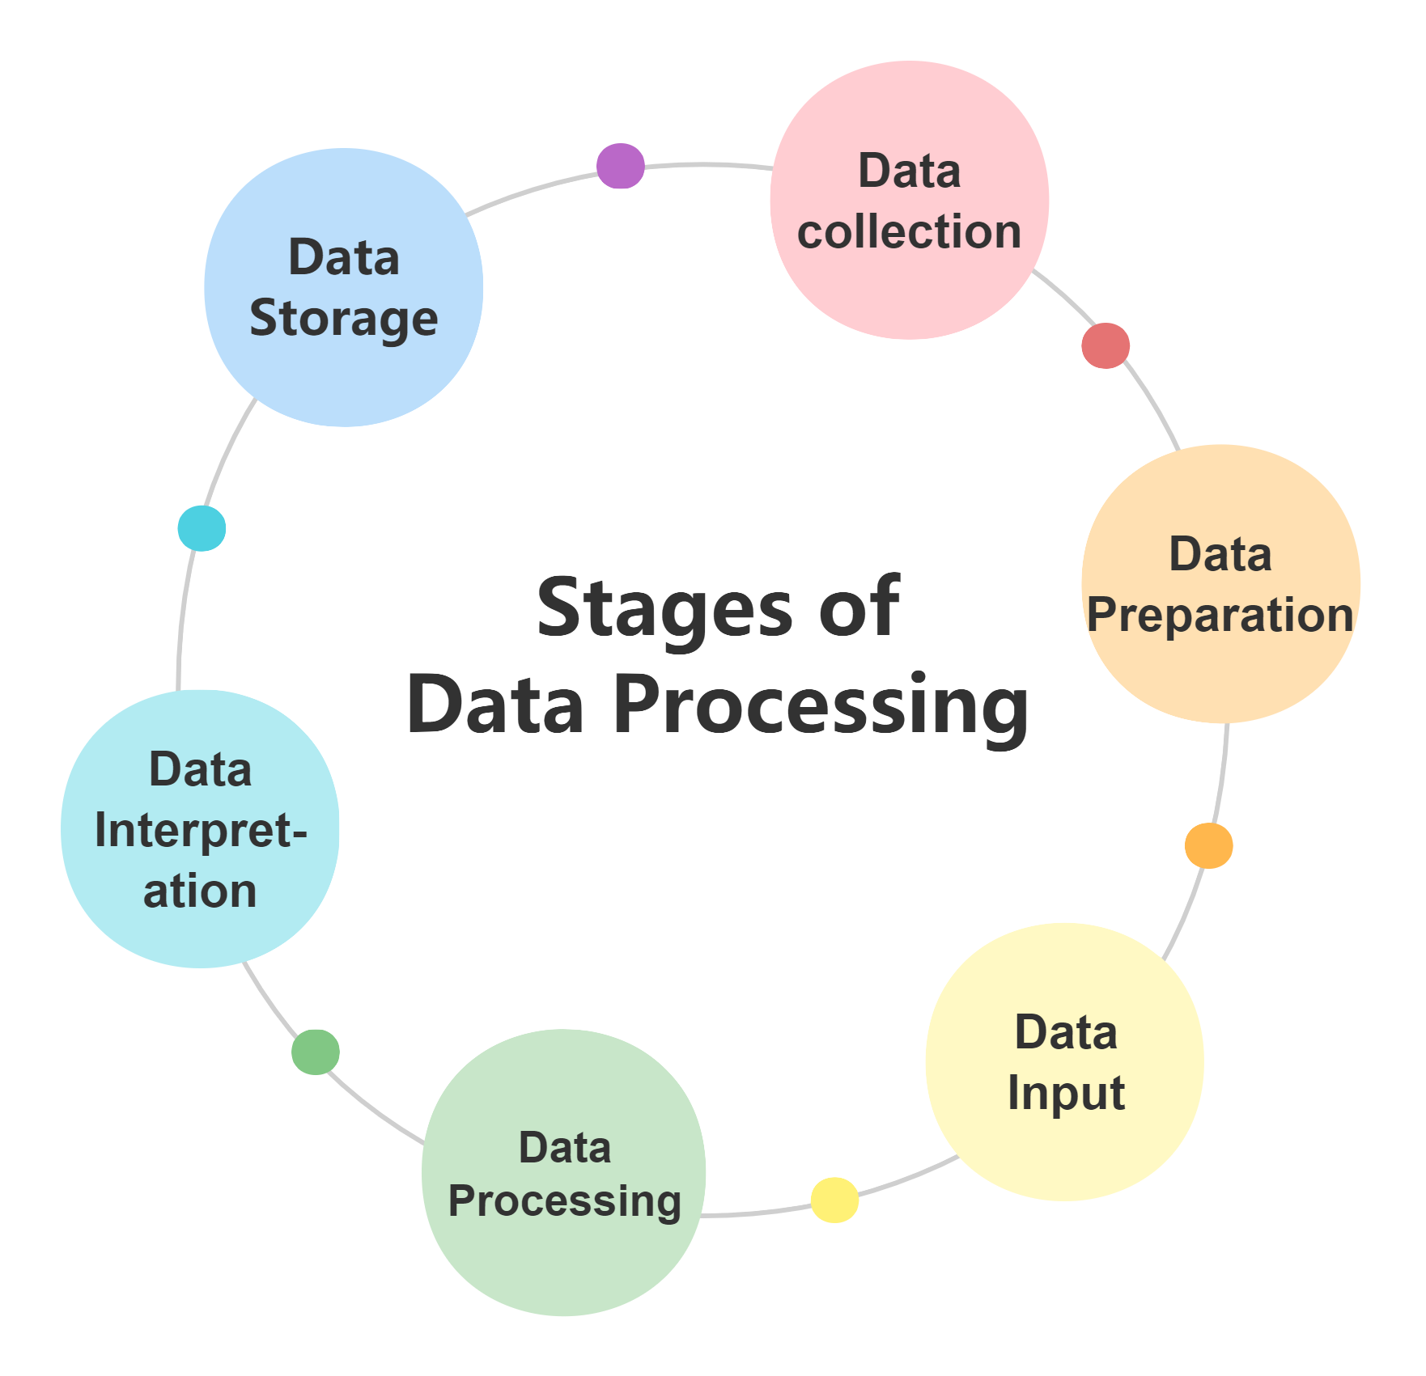
Data Pre-processing
Handling Missing Values:
Numerical: Filled with median
Categorical: Filled with "Unknown"
Encoding Categorical Variables:
Label Encoding for Developer, Utility, etc.
Feature Scaling:
Standardized numerical values

Slide 8
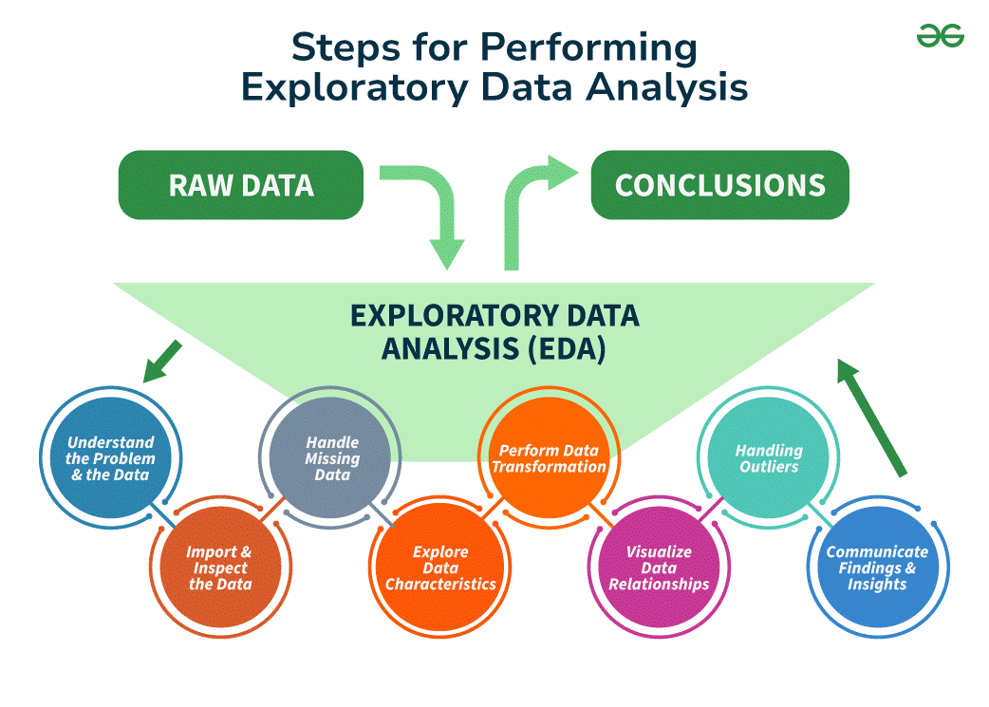
Exploratory Data Analysis
What is EDA?
EDA is the initial phase of data analysis.
It's about examining and understanding your data before diving into modeling.
Basic Statistics
Utilize basic statistics to summarize data.
Key stats include mean, median, and standard deviation.
Data Summary
Summarize the main characteristics of the data.
Identify patterns, anomalies, and insights.
Importance of EDA
EDA helps identify data trends, issues, and outliers.
It guides data preprocessing and feature selection.
A crucial step before building predictive models.

Slide 9
Exploratory Data Analysis (EDA)
Exploratory Data Analysis (EDA)
Key Insights:
Correlation analysis between features
Distribution of solar energy production
Outlier detection using box plots
Relationship between PV System Size & Energy Output

Slide 10
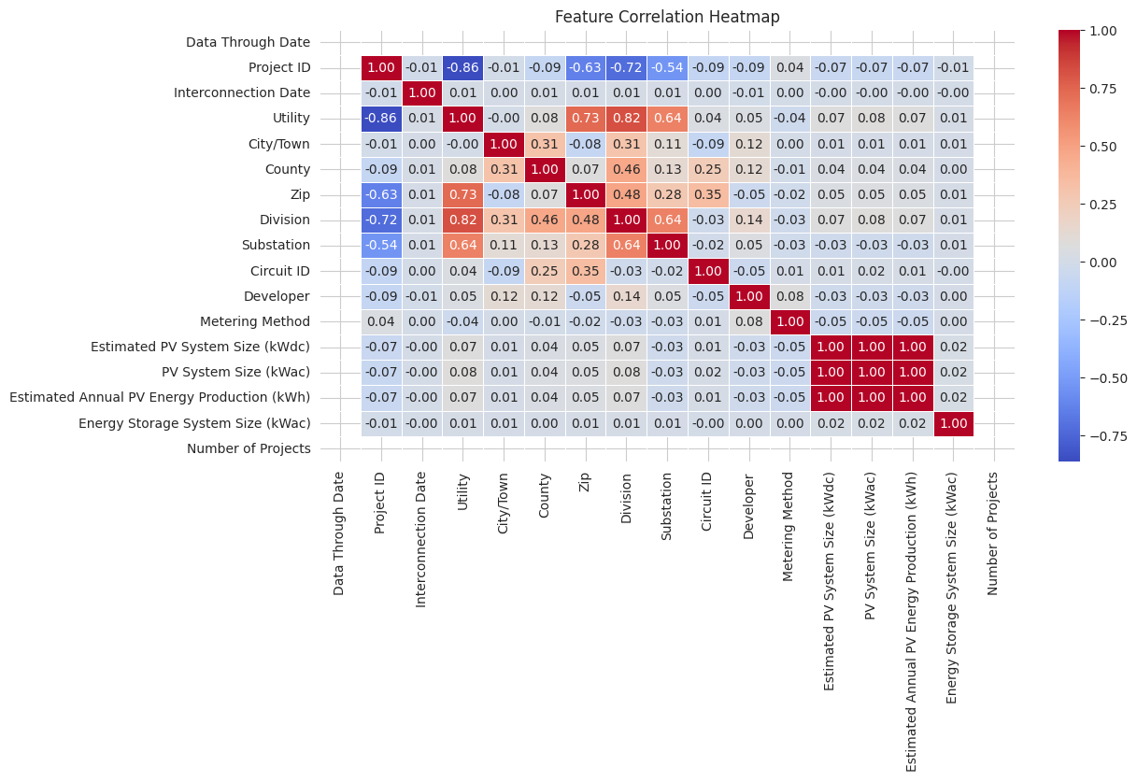
Exploratory Data Analysis (EDA)

Slide 11
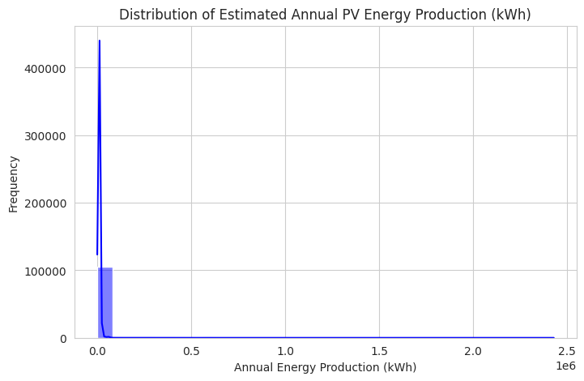
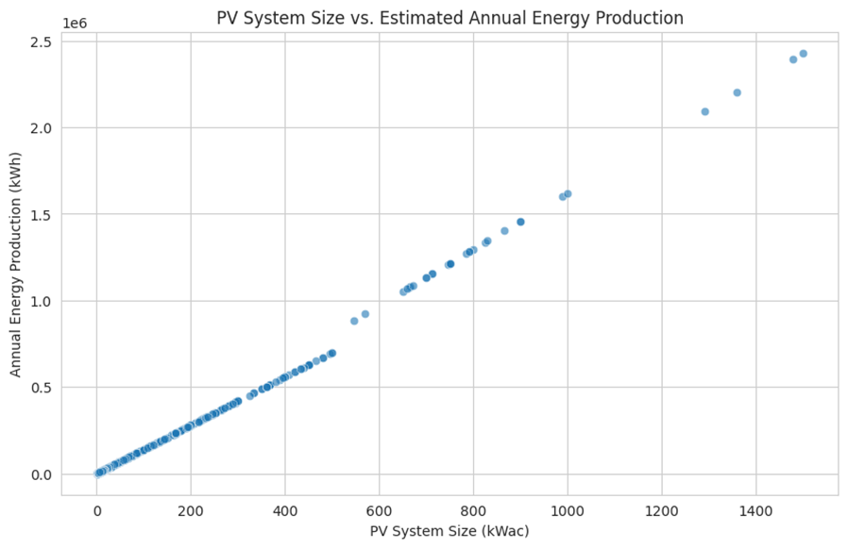
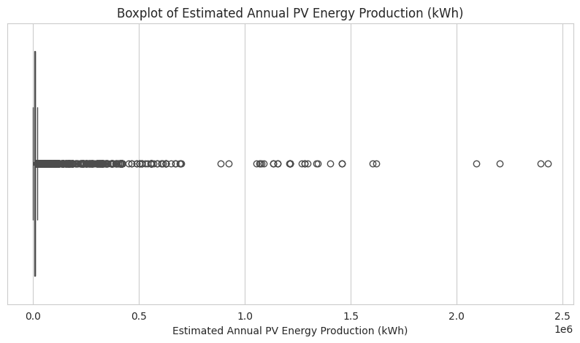
Exploratory Data Analysis (EDA)

Slide 12
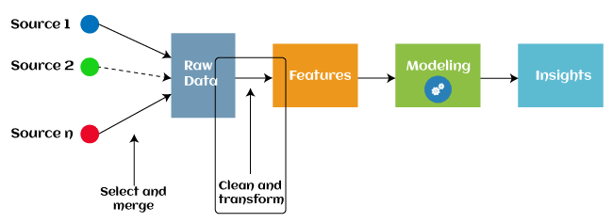
Feature Engineering
New Features Created:
Efficiency Ratio = PV System Size (kWac) / Estimated PV System Size (kWdc)
Years Since Interconnection = 2025 - Interconnection Year
Irrelevant Features Removed:
Project ID, City, County, Zip, etc.

Slide 13

Machine Learning Model Development
Choosing a Machine Learning Algorithm: Selected the right algorithm (e.g., Linear Regression, Random Forest Regressor) for our problem.
Training and Evaluating the Model: Covered the process of training and evaluating the model to ensure its robust and reliable.
Model Evaluation Metrics: Used metrics like accuracy, precision, and recall to assess how well the model is performing.

Slide 14
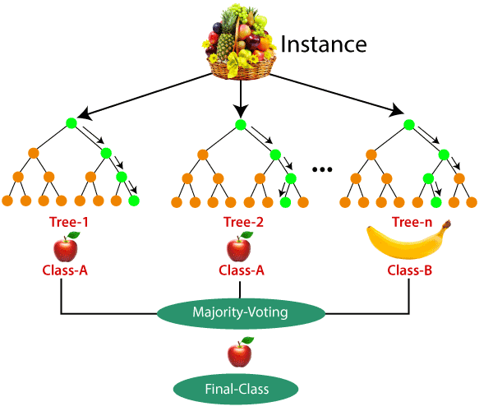
Model Training & Selection
Models Used:
Linear Regression
Random Forest
Evaluation Metrics:
MAE (Mean Absolute Error)
RMSE (Root Mean Squared Error)
R² Score

Slide 15
Feature Importance Analysis
Top Influencing Factors:
PV System Size (kWac)
Developer
Energy Storage System Size
Region
Visual Representation: Bar Chart of Feature Importances

Slide 16
Conclusion & Future Work
Result:
Linear Regression performed with R² = 1.00 (possible overfitting)
Random Forest Regressor performed with R² = 0.99
Key Takeaways:
High accuracy achieved in solar energy prediction
Important features identified for better decision-making
Future Work:
Validate against real-world data
Deploy as a web application using Streamlit/Flask
Build an interactive Power BI dashboard

Slide 17
Thank You!

