Slide 1
Recommendation System
by Omkar Nibandhe.
Prof. Mark Zhang
(CS535 Intro. to Data Mining)

Slide 2
Agenda
Conceptual introduction to recommender system.
Literature review.
Specific details of the system implemented.

Slide 3
Why recommendation system ?
Recommender systems help consumers by making product recommendations that are likely to be of interest to the user such as books, CDs, movies, restaurants, online news articles, and other services.
Predict rating or preference of an item.
Provide richer experience to the users by suggestions.
Suggests items that might keep the user interested.
Notes:
Explore new items related to interests.
USE:
50ms envelope to get the user information and process it for showing recommendations. No hard disk spins but might be look 1 single query on

Slide 4
Types of Recommender System
Content Based
Collaborative Filtering
Hybrid
Notes:
Content based : features, user profile
Collaborative : user groups
Hybrid : can’t use as no features.
Cold Start Penalty (New user/item recommendation)
--Avoid possible in hybrid.

Slide 5
Content Based
Relies on Similarities between the items.
Compares features and finds out similarities.
Builds a user profile.
Recommends an item based on content comparison and user profile.
Example: Pandora
Pros:
Can start recommending immediately as soon as info is available.
Only need to scan the item features and user profile
Cons:
Quality of recommendation is affected (No collaboration)
More computation
Notes:
Cold Start Penalty

Slide 6

Collaborative Filtering
Groups people with similar interests.
Based on assumption that people who agreed in past will agree in future and like similar kind of items.
Example: Spotify, Netflix, Amazon, Facebook, LinkedIn
Pros:
Can produce personalized recommendations.
Do not require content information about users or items
Cons:
Poor accuracy when little data from user ratings.
Algorithms work slowly.
Notes:
Groups.
Eg: news content

Slide 7
Types of Collaborative Filtering
User Based
To predict an item to a user, use opinion of similar users.
Similarity is decided by looking at their overlapping opinions for other items.
User sparsity matrix (large item set, very less common users)
Disadvantage: Recommends only popular item.
Item Based
User is likely to have same opinion for similar items.
Similarity is decided by looking at how other users have rated them.
Prevents User cold start problem as seen in User based CF.
Similarities between items is more stable as compared to users.
Notes:
No info for features needed
User based:
-User by User matrix
-More computation
Item based:
-Item by Item matrix
-Less computation.

Slide 8
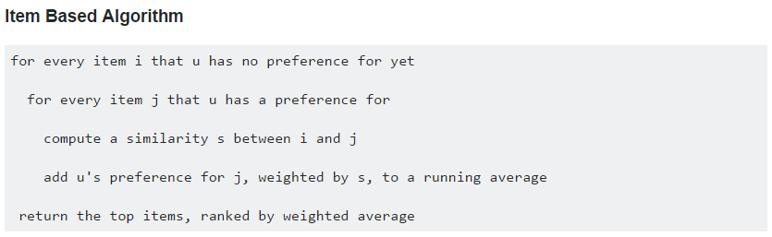
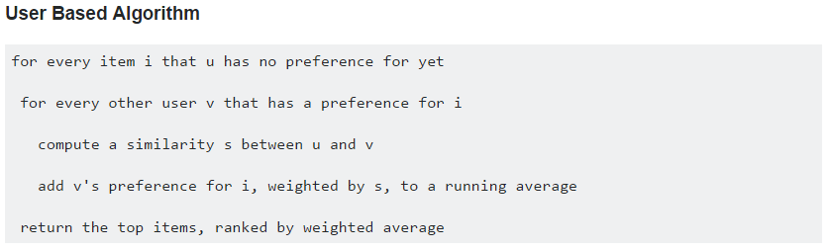
How the algorithms work ?
Ref : https://mahout.apache.org/users/recommender/recommender-documentation.html
Notes:
Self explanatory slide.

Slide 9
Approach for train_all_txt.txt
Use Item based collaborative filtering approach. (no features)
Use Pearson Algorithm. (explained on next slide by comparison)
double score = evaluator.evaluate(recommenderBuilder, null, model, 0.8, 1.0); 80% training on whole data set.
Notes:
My research shows: approaches.
-data model.
-item Similarity = new genericItemSimilarity

Slide 10


Item based collaborative filtering
This similarity measure is based on how much the ratings by common users for a pair of items deviate from average ratings for those items
Sim(I,j) varies from -1 to 1
From Model to Prediction:

Slide 11
Why I chose Pearson model ?
Based on Root Mean Squared error value
Cosine Prediction...20000 Output file writing finished
RMSE=0.773 similarity value between 0 and 1
Euclidian Prediction...20000 Output file writing finished
RMSE=0.769
Pearson Prediction...20000 Output file writing finished
RMSE=0.762 similarity value between -1 and 1
Notes:
RecommenderEvaluator evaluator =
new AverageAbsoluteDifferenceRecommenderEvaluator();

Slide 12
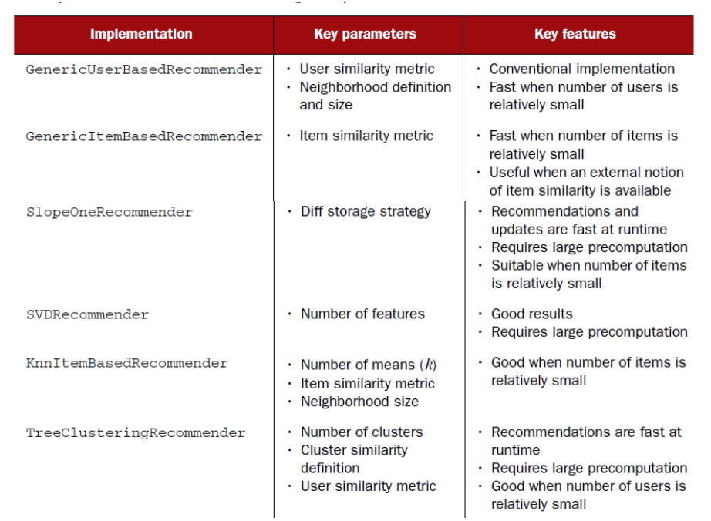
Recommendation Engines

Slide 13
Conclusion
Pearson Prediction has lowest RMSE value.
Item based are usually more practical than user based.
Collaborative because no features.

Slide 14
References
https://mahout.apache.org/users/recommender/recommender-documentation.html
http://www.slideshare.net/Cataldo/tutoria-mahout-recommendation
http://blog.chapagain.com.np/recommender-system-using-java-apache-mahout/
http://archive-primary.cloudera.com/cdh4/cdh/4/mahout-0.7-cdh4.3.2/mahout-core/org/apache/mahout/cf/taste/recommender/Recommender.html
http://www.cs.carleton.edu/cs_comps/0607/recommend/recommender/itembased.html
J. Han, M. Kamber, Data Mining Concepts and Techniques 3rd edition.
http://www10.org/cdrom/papers/519/

