Slide 1
Evidential Deep learning
Omkar NITSURE

Slide 2
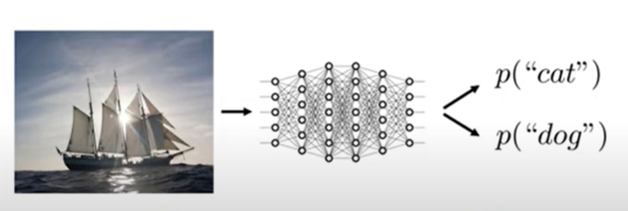
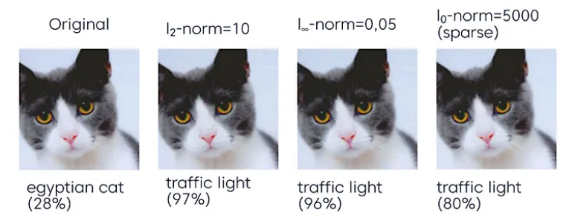
Major Challenges in Deep Learning
To figure out if the neural network is able to identify data points belonging to an unrelated data distribution.
If it is able to know when it simply does not know the answer !!
Can a particular model protect its users from an Adversarial attack.

Slide 3
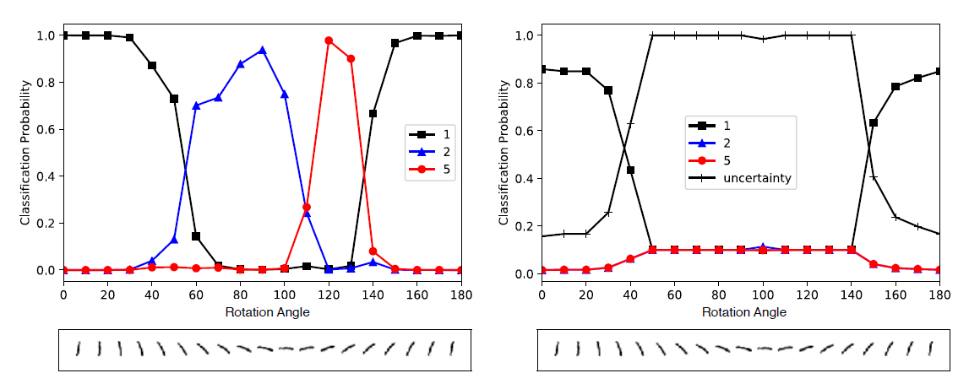

What is the issue with SoftMax?
SoftMax cannot generally know when it does not know the answer. So it continues to predict the wrong class with high confidence.
The outputs of continuous activations in the last layer of the neural network are responsible to adjust the ratio between different class probabilities but SoftMax (being a non-linear activation) simply squashes the prediction to lie within range of [0, 1] and sum up to 1. (Thus predicted relative probabilities are lost)
Probabilistic interpretation of the cross-entropy loss (used to train the model weights with SoftMax output) is Maximum Likelihood Estimation (MLE) which is not capable to infer the predictive distribution variance (uncertainty)
SoftMax

Slide 4



The Theory of Evidence
The Dempster–Shafer Theory of Evidence (DST) assigns belief masses to possible class labels for a sample.
The belief masses can also be assigned to the entire set of class labels. E.g. Any class label is equally likely. ( This signifies “I do not know” in our case)
Thus theory of evidence allows to quantify belief masses and uncertainty through a well-defined theoretical framework.
Thus if we consider K total class labels, then we can provide belief masses b_{k} to each and uncertainty mass u. All of them are non-negative and satisfy the following condition –
All b_{k} and u can be computed using the following formulae – (e_{k} will be clear in next slide)

Slide 5



Evidence for Uncertainty Estimation
Evidence was denoted by e_{k} in the previous slide and uncertainty is inversely proportional to the total evidence (S).
Evidence (e_{i}) is a measure of the amount of support collected from data in favor of a sample to be classified into a certain class from K possible options.
We can model the output of SoftMax as coming from a Dirichlet Distribution which is parametrized by K distinct parameters which satisfy the following condition -
Thus the Dirichlet Distribution serves as a probability density function (pdf) for possible values of the SoftMax output.

Slide 6


Some Inferences
Let us assume some hypothetical values for b and try to understand what exactly do they signify –
=> This implies that there is no evidence to support a particular class and thus it signifies complete uncertainty i.e. u = 1.
=> This implies that we have a belief of 0.8 in the first class, so the total uncertainty becomes 1 – 0.8 = 0.2
We can compute alphas using the equations from the earlier slides and thus compute the expected probability of each of the K classes using the following equation –
Neural networks are capable of forming opinions as Dirichlet Distributions
So if we know the values of parameters of Dirichlet Distribution for classification of a particular sample then we can compute the evidence (e_{i}) estimated by the network to support each class label and thus estimate the epistemic uncertainty

Slide 7
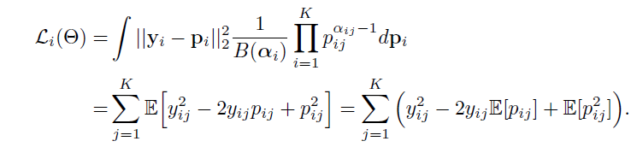
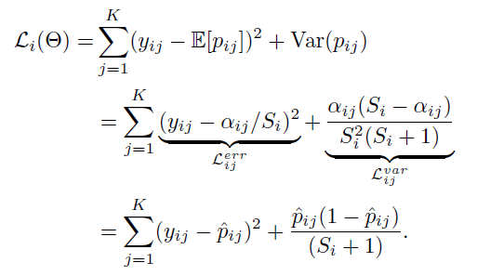



Learning to form Opinions
The new approach for training Neural Networks replaces the SoftMax layer with an activation like ReLU to ensure non-negative output.
The model prediction is then taken as the evidence vector (e_{i}) for the predicted Dirichlet Distribution
Loss function for training is defined as follows –

Slide 8
Understanding the Loss Function
The loss function aims to achieve the joint goals of minimizing the prediction error and the variance of the Dirichlet experiment.
While minimizing the loss, it prioritizes data fit over variance estimation justified by propositions -
The model should generate more evidence when it is more sure of the outcome. In return, it should avoid generating evidences at all for observations it cannot explain.
Thus the loss function optimizes the model to generate more evidence for correct labels while avoiding misclassification by removing misleading evidence.

Slide 9
A bit of light on KL Regularization
During training, the model may discover patterns in the data and generate evidence for specific class labels based on these patterns to minimize the overall loss.
But sometimes, model might encounter a sample which has the pattern that model associates with a particular class but the ground truth for that sample is a different class i.e. that sample is a counter-example.
In such cases, the parameters of the neural network should be tuned by back propagation to generate smaller amounts of evidence for this pattern and minimize the loss of these samples, as long as the overall loss also decreases.
Unfortunately, when the number of counter-examples is limited, decreasing the magnitude of the generated evidence may increase the overall loss, even though it decreases the loss for the counter-examples.
We prefer the total evidence to shrink to zero for a sample if it cannot be correctly classified. (we increase the uncertainty value u)
We achieve this by incorporating a Kullback-Leibler(KL) divergence term into our loss function for regularization. It penalizes the evidence generated for “I do not know” cases which don’t help in data fit.

