Slide 1
Uncertainty Quantification and Benchmarking in Deep Learning
Name - Omkar Nitsure
Guide - Gouranga Bala (under Prof. Amit Sethi)
Roll No - 2100700057
Email - 210070057@iitb.ac.in

Slide 2
Introduction
With the advent of Deep Learning, we see very powerful network architectures, clever optimization techniques and the availability of large amounts of data leading to unprecedented accuracies on various tasks
These accuracies often result in the motivation to deploy these models in the real world, but the biggest challenge is the reliability of their predictions. (Even if the accuracy is 98%, we need to know when is the model going to make that 2% error)
The uncertainty in model predictions can arise due to various reasons like noise in the data (Aleatoric Uncertainty) or the inability of the model (due to fewer learnable weights) to generalize to the data distribution (Epistemic Uncertainty)

Slide 3
The setup used for all the experiments
All experiments done by me in the RnD course are on the following setup -
Training data - 10000 randomly sampled images from train split of MNIST dataset
Base classification model used - LeNet (No of trainable parameters - 60000)
In distribution test examples - 1000 randomly sampled images from test split of MNIST
OOD examples - Set of 500 images of digits (not from MNIST) + 1000 images of Imagenet
I implemented the following 2 methods in code and performed a lot of different experiments on them -
DUQ - Deterministic Uncertainty Quantification
QUAM - Quantification of Uncertainty using Adversarial Models

Slide 4
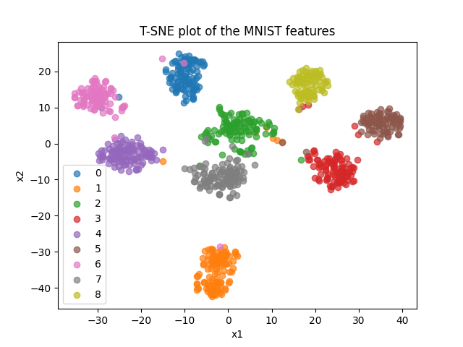
Multiclass Classification Results
I trained a LeNet model on the MNIST dataset for 100 epochs. Following is the T-SNE visualization of the features extracted by the feature extractor before the final classification layer

Slide 5
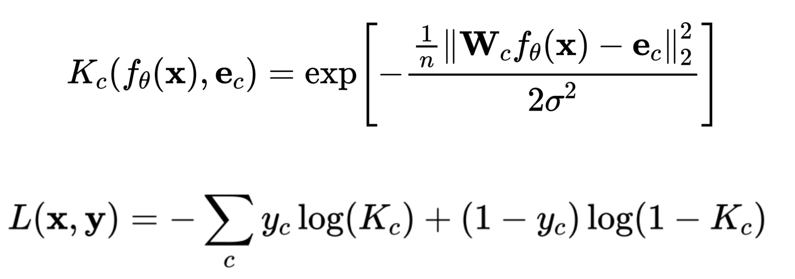
DUQ (Basic Idea)
It consists of a feature extractor network and the features of different classes are then clustered to compute one centroid per class which is then used for classification and uncertainty quantification.
Uncertainty value is defined as the distance between features of an input from the closest centroid
It is trained using a One Vs Rest objective. It is trained such that the features of an input image are close to the centroid of the correct class and far away from the centroids of all other classes.
The centroids are regularized so that the vectors stay close to the origin
Source - https://icml.cc/media/icml-2020/Slides/6512.pdf

Slide 6
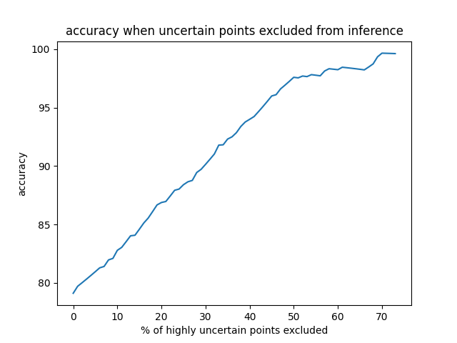
Results
Training was quite stable and loss reduced uniformly.
The model accuracy is a little worse than the SoftMax-based networks.
The following is the plot of accuracy of the model after removing certain percentage of highly uncertain points (tested on the MNIST dataset)
Also some numerical results -
Average uncertainty scores for In Distribution(ID) examples - 14.27
Average uncertainty scores for Out-of-Distribution(OOD) examples - 24313.89

Slide 7
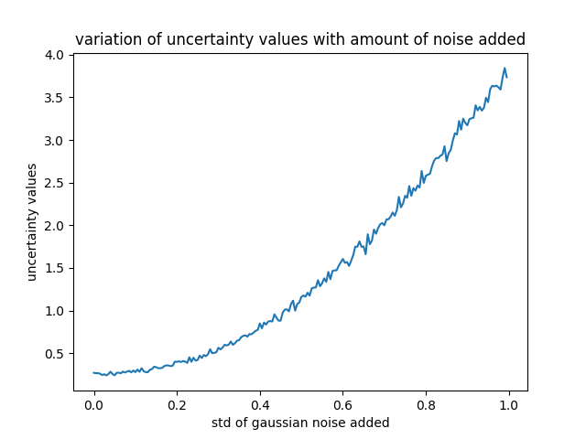
What happens if we add noise to ID examples?
Here, in this plot, we can see that as I increased the standard deviation(std) of the normal distribution from which noise is added to the image, the average uncertainty value increased. This is a nice result shown by the technique justifying its performance for OOD detection.
This analysis can be used in another context. We can use this technique of progressively adding more and more noise to the data and observing the trend of uncertainty scores for benchmarking a technique against all others.

Slide 8
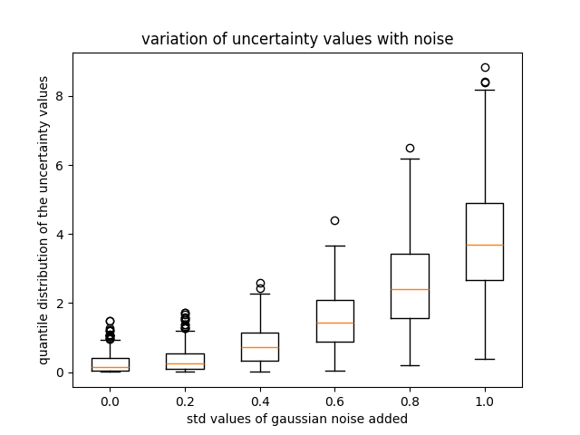
Distribution of uncertainty values for a fixed noise
In the figure, we can see the boxplot of uncertainty values reported by DUQ for some fixed noise values. We can see for larger amount of noise, the uncertainty values are spread out while for smaller amount of noise, they are more concentrated.

Slide 9
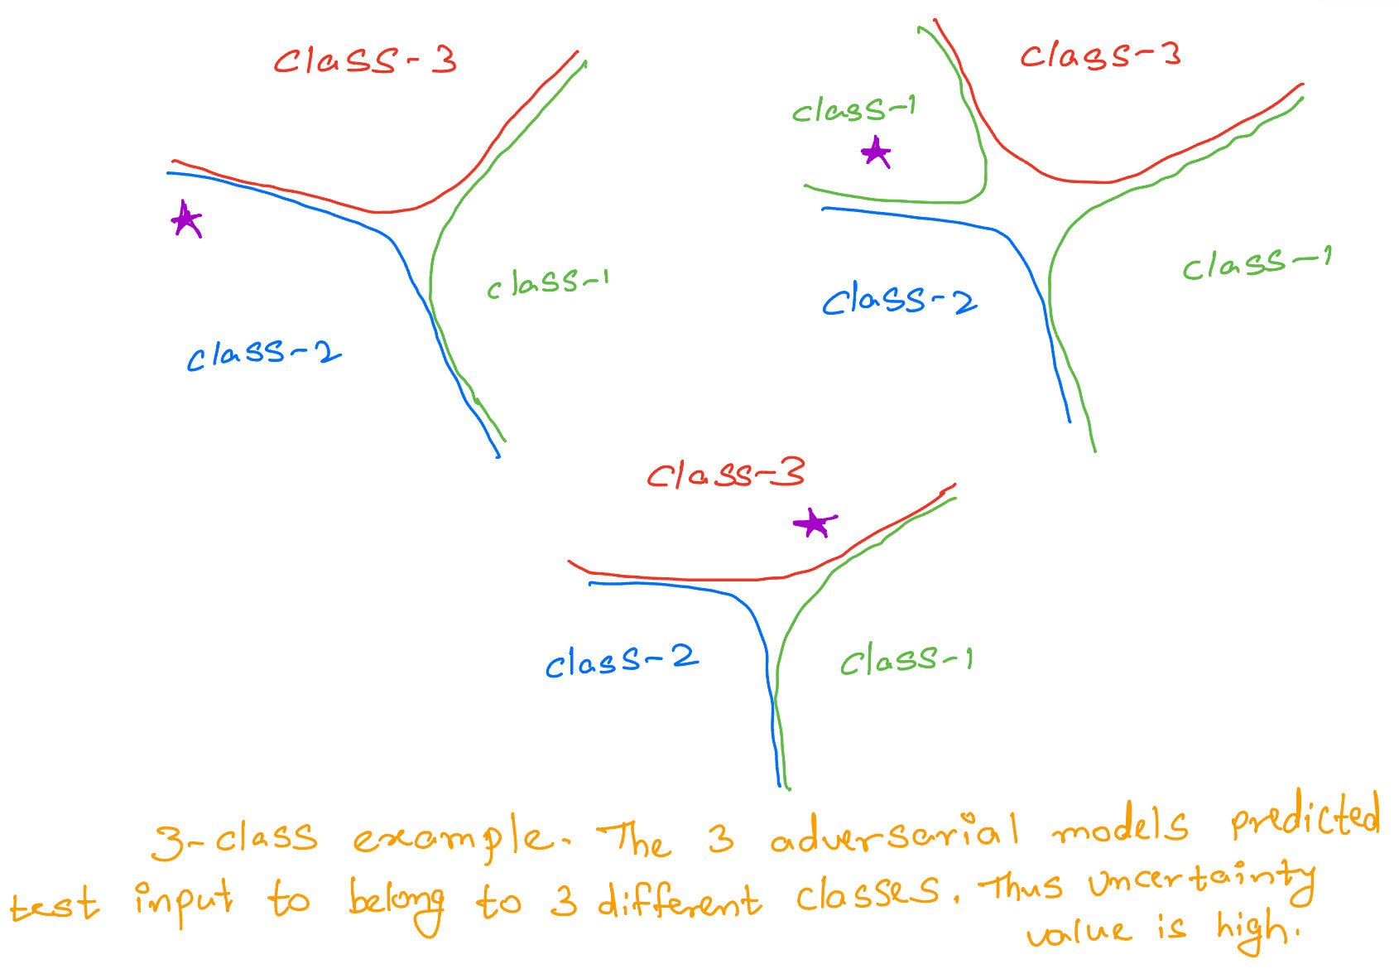
QUAM
The main Idea of the Paper is as follows - Adversarial models are equally likely models that predict differently for a new test point.
It is important to note that, this method doesn’t involve training from scratch like the earlier method and thus can leverage the power of pretraining. This method finetunes the pre-trained model to quantify uncertainty.
The optimization objective is given above
D is usually the KL Divergence

Slide 10
Results
Uncertainty Value - In this technique, uncertainty value is defined as the sum of entropy of the output distribution of K different models fine tuned from the same base model. Larger entropy means more uncertainty.
I ran experiments on ID(MNIST) images, OOD but similar(hand drawn digit images) and completely OOD images(Imagenet). Following are the average uncertainty values given by QUAM.
ID - 0.232
OOD but similar - 0.456
OOD but totally different(Imagenet) - 2.251

Slide 11
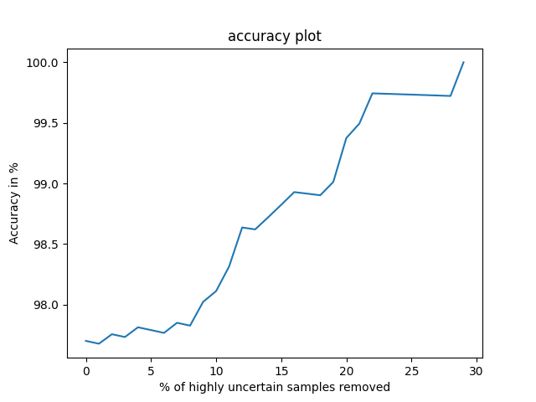
Results
This plot indicates how accuracy varies by throwing off highly uncertain data points before making predictions.
Accuracy is seen to be increasing which is a good sign as the technique is able to identify data points where the model is making wrong predictions
We can also see that the accuracy starts off at a very good value either. This is because QUAM leverages the power of pretraining.

Slide 12
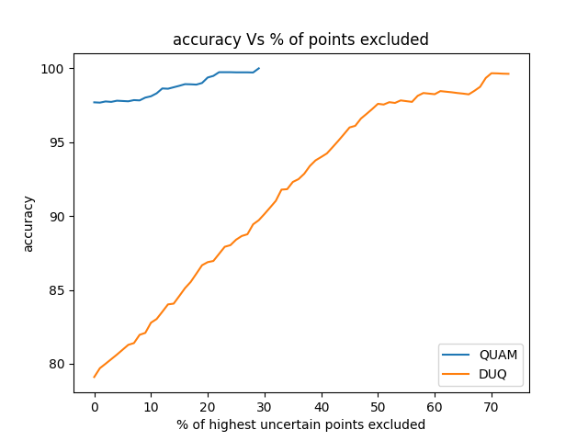
Let’s compare DUQ Vs QUAM
QUAM starts at a very impressive accuracy thanks to pretraining and reaches to 100 % accuracy after throwing just 30 % of the test samples.
DUQ on the other hand starts at a lower accuracy as it is trained from scratch and reaches 100 % accuracy only after throwing 70% of the test data.
Despite its lower performance compared to QUAM, DUQ is still very good given that QUAM needs a lot more compute and memory than DUQ

Slide 13
Major Trade Offs! - Compute and memory
The QUAM method discussed in the last slide is the current state-of-the-art (SOTA) method for uncertainty quantification and has proven to predict epistemic uncertainty accurately. But it has some challenges and trade-offs!
This method is very slow and computationally demanding as it requires training K(usually taken as 5-7) different models per test image
It also has a large memory requirement as it has to store the entire training data at inference.

Slide 14
The memory Requirement Reduction
I used the base model to cluster the training data according to classes and then picked 10 images per class as representatives
The 10 images were chosen such that they were closest to the class centroid (Euclidean distance). So, now the training data used for finetuning the model has just 10K images where K is the number of classes
This reduced the memory requirement with almost the same performance on Uncertainty Quantification. But the latency was still the same.
So, I tried freezing the entire network except the last layer for finetuning
This increased the speed but the performance got a hit!!

Slide 15
Adversarial Attacks for UQ
This technique perturbs the input slightly in the direction (or opposite) of the gradient in order to maximize the change in output distribution.
This allowed throwing out almost 30-40% of the test data without any requirement of uncertainty quantification (model is fairly confident about these data points). This is already a 2X speedup!!
But, then the accuracy drops by around 4-5 % as the model sometimes makes the wrong decision with high confidence.
This method should be seen as a way to speedup the process and not SOTA

Slide 16
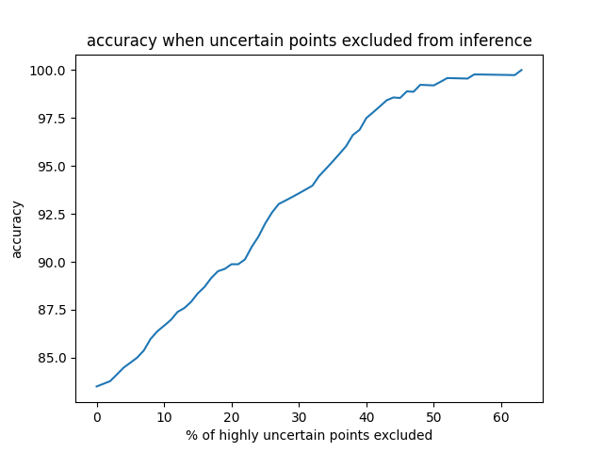
A different training technique I tried
I trained a model with an additional class named OOD using the DUQ technique.
So, this model also has 10 classes namely, digits 0-8 and an OOD class. I removed digit 9 from the training data and checked where it is mapped to OOD at test time.
This approach outperformed the original DUQ method by 3-4% accuracy and required throwing off 60 % of the test data as opposed to 70 % test data for the traditional DUQ.
It also mapped 9 to the OOD class as anticipated.
This is the plot of accuracy Vs percent of test data rejected because of uncertainty

Slide 17
Future Work
A recent paper defines model pruning for LLMs. We can use model pruning to reduce the model size before applying techniques like QUAM for further speedup.
Instead of doing backpropagation through the entire model in QUAM, we can use the gradient information to understand the “important regions” and then train only on those.
Defining a standard Uncertainty Benchmarking pipeline to compare performance of various techniques on aspects like accuracy, latency, AUC, etc. This will help for choosing a tailored technique as per the requirements.

Slide 18
References
Van Amersfoort, Joost, et al. "Uncertainty estimation using a single deep deterministic neural network.” International conference on machine learning. PMLR, 2020.
Schweighofer, Kajetan, et al. "Quantification of Uncertainty with Adversarial Models." Advances in Neural Information Processing Systems 36 (2023): 19446-19484.
Ma, Xinyin, Gongfan Fang, and Xinchao Wang. "Llm-pruner: On the structural pruning of large language models." Advances in neural information processing systems 36 (2023): 21702-21720.
Alarab, Ismail, and Simant Prakoonwit. "Adversarial attack for uncertainty estimation: identifying critical regions in neural networks." Neural Processing Letters 54.3 (2022): 1805-1821.
Liu, Jeremiah, et al. "Simple and principled uncertainty estimation with deterministic deep learning via distance awareness." Advances in neural information processing systems 33 (2020): 7498-7512.
Gruber, Cornelia, et al. "Sources of Uncertainty in Machine Learning--A Statisticians' View." arXiv preprint arXiv:2305.16703 (2023).

