Slide 1
Uncertainty Quantification and Benchmarking in Deep Learning
Name - Omkar Nitsure
Guide - Gouranga Bala (under Prof. Amit Sethi)
Roll No - 2100700057
Email - 210070057@iitb.ac.in

Slide 2
Introduction
With the advent of Deep Learning, we see very powerful network architectures, clever optimization techniques and the availability of large amounts of data leading to unprecedented accuracies on various tasks
These accuracies often result in the motivation to deploy these models in the real world, but the biggest challenge is the reliability of their predictions. (Even if the accuracy is 98%, we need to know when is the model going to make that 2% error)
The uncertainty in model predictions can arise due to various reasons like noise in the data or the inability of the model (due to its smaller size) to generalize to the data distribution

Slide 3
Sources of Uncertainty
Uncertainty in model predictions can arise either because of the distribution shifts in the data (Aleatoric Uncertainty) or less expressive power of the model (Epistemic Uncertainty)
Aleatoric Uncertainty - Models are trained on data sampled from a specific distribution and if the test example is from some other distribution or is noisy, then the prediction of the model will likely be uncertain as it hasn’t seen such data samples during training
Epistemic Uncertainty - Every model architecture has a function space that it can express (search through during gradient descent) and it cannot effectively fit the data distribution if it is outside this function space. Source - Gruber, Cornelia, et al. "Sources of Uncertainty in Machine Learning--A Statisticians' View." arXiv preprint arXiv:2305.16703

Slide 4
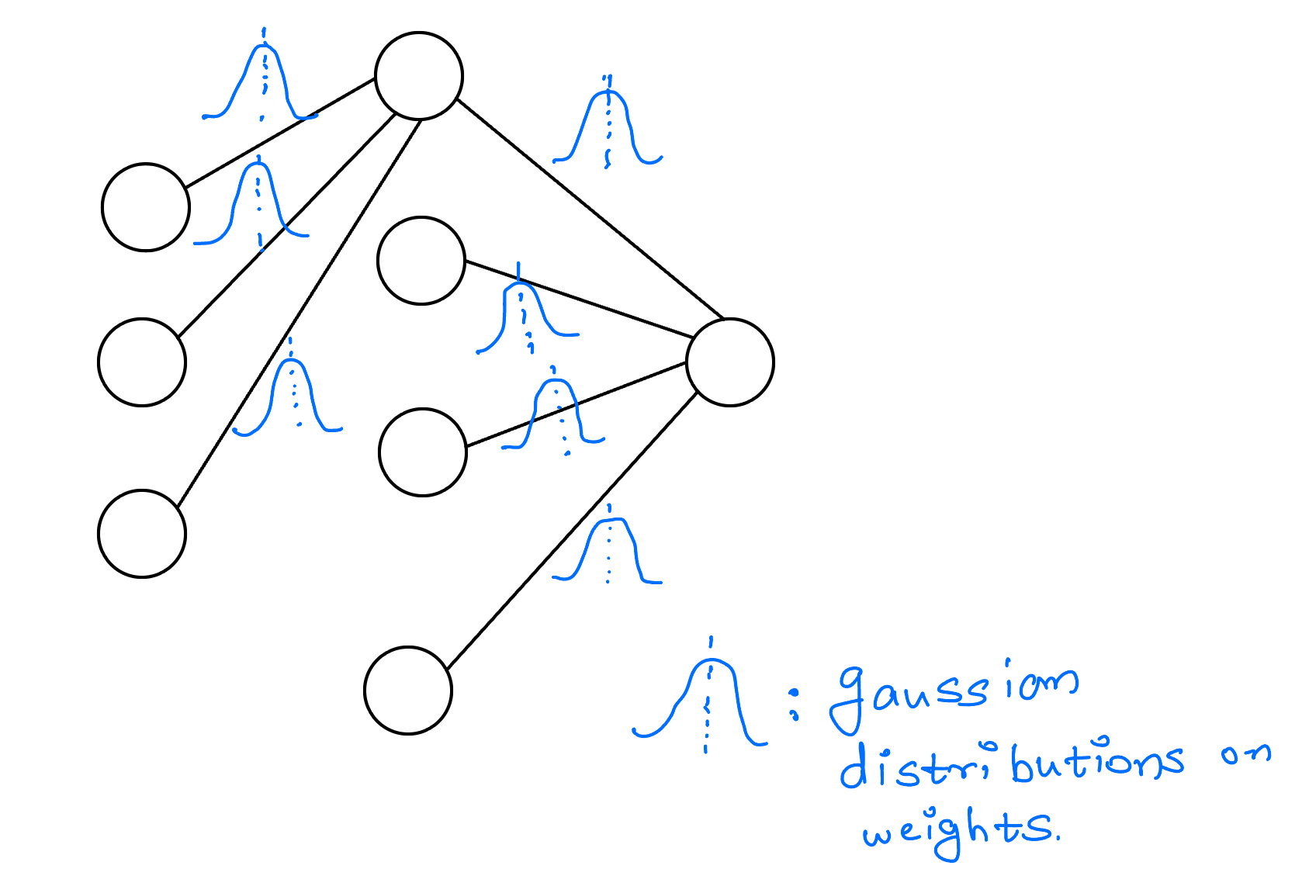
Traditional Methods for Uncertainty Quantification
All methods used can be classified into the following 2 categories -
Bayesian Methods - (Monte Carlo Dropout, Variational Inference in Graphical Neural Networks)
These models learn a distribution over each of these weights and then sample from these distributions at test time
They do multiple forward passes for the same test Example and see if the predictions are similar or not.
Source - Gal, Yarin, and Zoubin Ghahramani. "Dropout as a bayesian approximation: Representing model uncertainty in deep learning." international conference on machine learning. PMLR, 2016.

Slide 5
Frequentist Approach (Non-Bayesian Methods)
Non-Bayesian methods train completely disjoint models in parallel for the same task and on the same dataset rather than trying to estimate the posterior distribution on the weights
These models can have different weight initialization, and hyperparameters (even model architectures in some cases) and then the variance of their predictions for a specific test example serves as the quantifier of uncertainty
Some popular examples are Ensemble Learning, Bootstrap, etc.
Source - Rahaman, Rahul. "Uncertainty quantification and deep ensembles." Advances in neural information processing systems 34 (2021): 20063-20075.

Slide 6
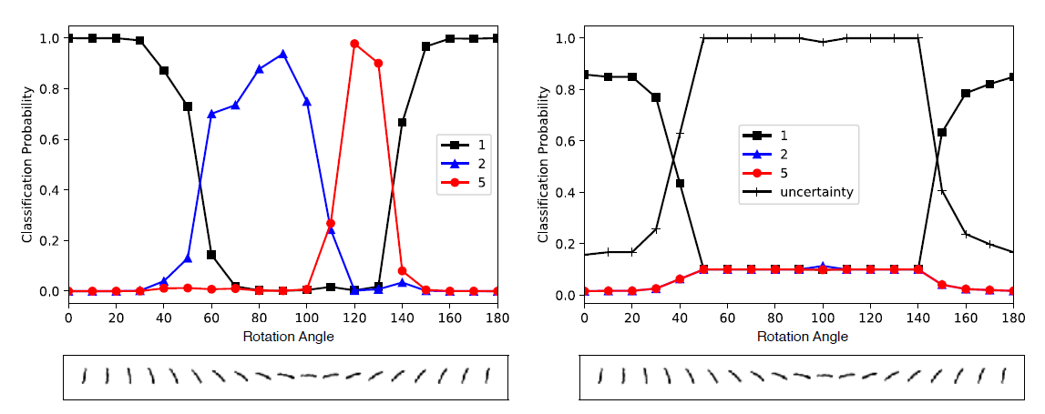
Evidential Deep Learning (problems with SoftMax)
SoftMax generally does not know when the model output is uncertain. So, it continues to predict the wrong class with high confidence.
The outputs of continuous activations in the last layer of the neural network are responsible to adjust the ratio between different class probabilities but softmax (being a non-linear activation) simply squashes the prediction to lie within range of [0, 1] and sum up to 1. (Thus predicted relative probabilities are lost)
Probabilistic interpretation of the cross-entropy loss (used to train the model weights with SoftMax output) is Maximum Likelihood Estimation (MLE) which is not capable to infer the predictive distribution variance (uncertainty)
Softmax

Slide 7



The Theory of Evidence
The Dempster–Shafer Theory of Evidence (DST) assigns belief masses to possible class labels for a sample.
The belief masses can also be assigned to the entire set of class labels. Eg. Any class label is equally likely. ( This signifies “I do not know” in our case)
Thus theory of evidence allows to quantify belief masses and uncertainty through a well-defined theoretical framework.
Thus if we consider K total class labels, then we can provide belief masses b_{k} to each and uncertainty mass u. All of them are non-negative and satisfy the following condition –
All b_{k} and u can be computed using the following formulae – (e_{k} will be clear in next slide)

Slide 8



Evidence for Uncertainty Estimation
Evidence was denoted by e_{k} in the previous slide and uncertainty is inversely proportional to the total evidence (S).
Evidence (e_{i}) is a measure of the amount of support collected from data in favor of a sample to be classified into a certain class from K possible options.
We can model the output of softmax as coming from a Dirichlet Distribution which is parametrized by K distinct parameters which satisfy the following condition -
Thus the Dirichlet Distribution serves as a probability density function (pdf) for possible values of the SoftMax output.

Slide 9


Some Inferences
Let us assume some hypothetical values for b and try to understand what exactly do they signify –
=> This implies that there is no evidence to support a particular class and thus it signifies complete uncertainty i.e u = 1.
=> This implies that we have a belief of 0.8 in the first class, so the total uncertainty becomes 1 – 0.8 = 0.2
We can compute alphas using the equations from the earlier slides and thus compute the expected probability of each of the K classes using the following equation –

Slide 10
Learning to form Opinions
Neural networks are capable of forming opinions as Dirichlet Distributions
So if we know the values of parameters of Dirichlet Distribution for classification of a particular sample then we can compute the evidence (e_{i}) estimated by the network to support each class label and thus estimate the epistemic uncertainty
The new approach for training Neural Networks replaces the SoftMax layer with an activation like ReLU to ensure non-negative output.
The model prediction is then taken as the evidence vector (e_{i}) for the predicted Dirichlet Distribution

Slide 11
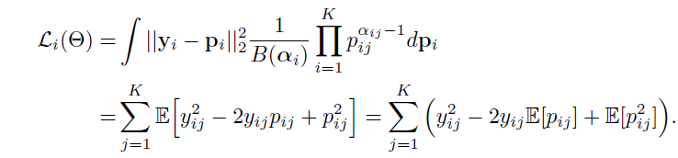
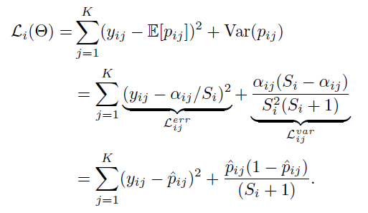

Loss Function for training
Source for all slides on Evidential Deep Learning

Slide 12
The setup used for all the experiments
All experiments done by me in the RnD course are on the following setup -
Training data - 10000 randomly sampled images from train split of MNIST dataset
Base classification model used - LeNet (No of trainable parameters - 60000)
In distribution test examples - 1000 randomly sampled images from test split of MNIST
OOD examples - Set of 500 images of digits other than MNIST + 1000 images of Imagenet
I implemented the following 2 methods in code and performed a lot of different experiments on them -
DUQ - Deterministic Uncertainty Quantification
QUAM - Quantification of Uncertainty using Adversarial Models

Slide 13
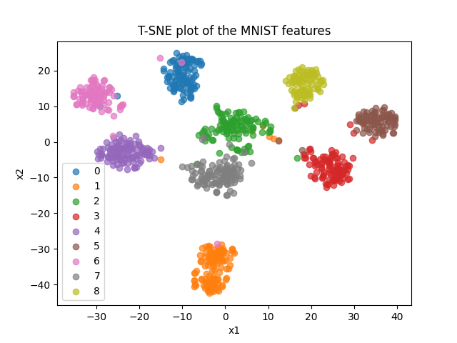
Multiclass Classification Results
I trained a LeNet model on the MNIST dataset for 100 epochs. Following is the T-SNE visualization of the features extracted by the feature extractor before the final classification layer

Slide 14
Deterministic Uncertainty Quantification
It is a robust technique for uncertainty quantification which matches or outperforms Deep ensembles with the computational cost of a single network!!
With suitable value of uncertainty score threshold this technique can be easily applied to the task of OOD(Out-of-Distribution) detection.
This technique is based on the idea of RBF(Radial Basis Functions) networks.
It is very cheap both during training and inference.

Slide 15
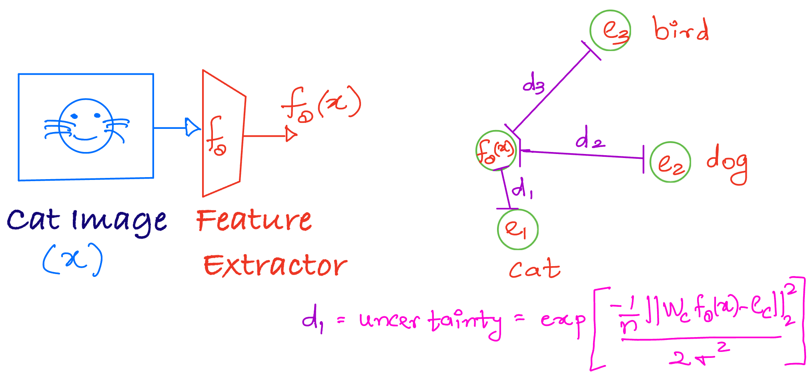
Basic Idea
It consists of a feature extractor network and the features of different classes are then clustered to compute one centroid per class which is then used for classification and uncertainty quantification.
Uncertainty value is defined as the distance between features of an input from the closest centroid

Slide 16
How is it trained ?
It is trained using a One Vs Rest objective. It is trained such that the features of an input image are close to the centroid of the correct class and far away from the centroids of all other classes.
Centroids are updated after each iteration with exponential moving average
The centroids are regularized so that the vectors stay close to the origin and large space is then available for the features of OOD examples outside this small sphere.
It is important that the distance function is “well-behaved” and thus loss consists of another term which imposes penalty over the Jacobian.

Slide 17
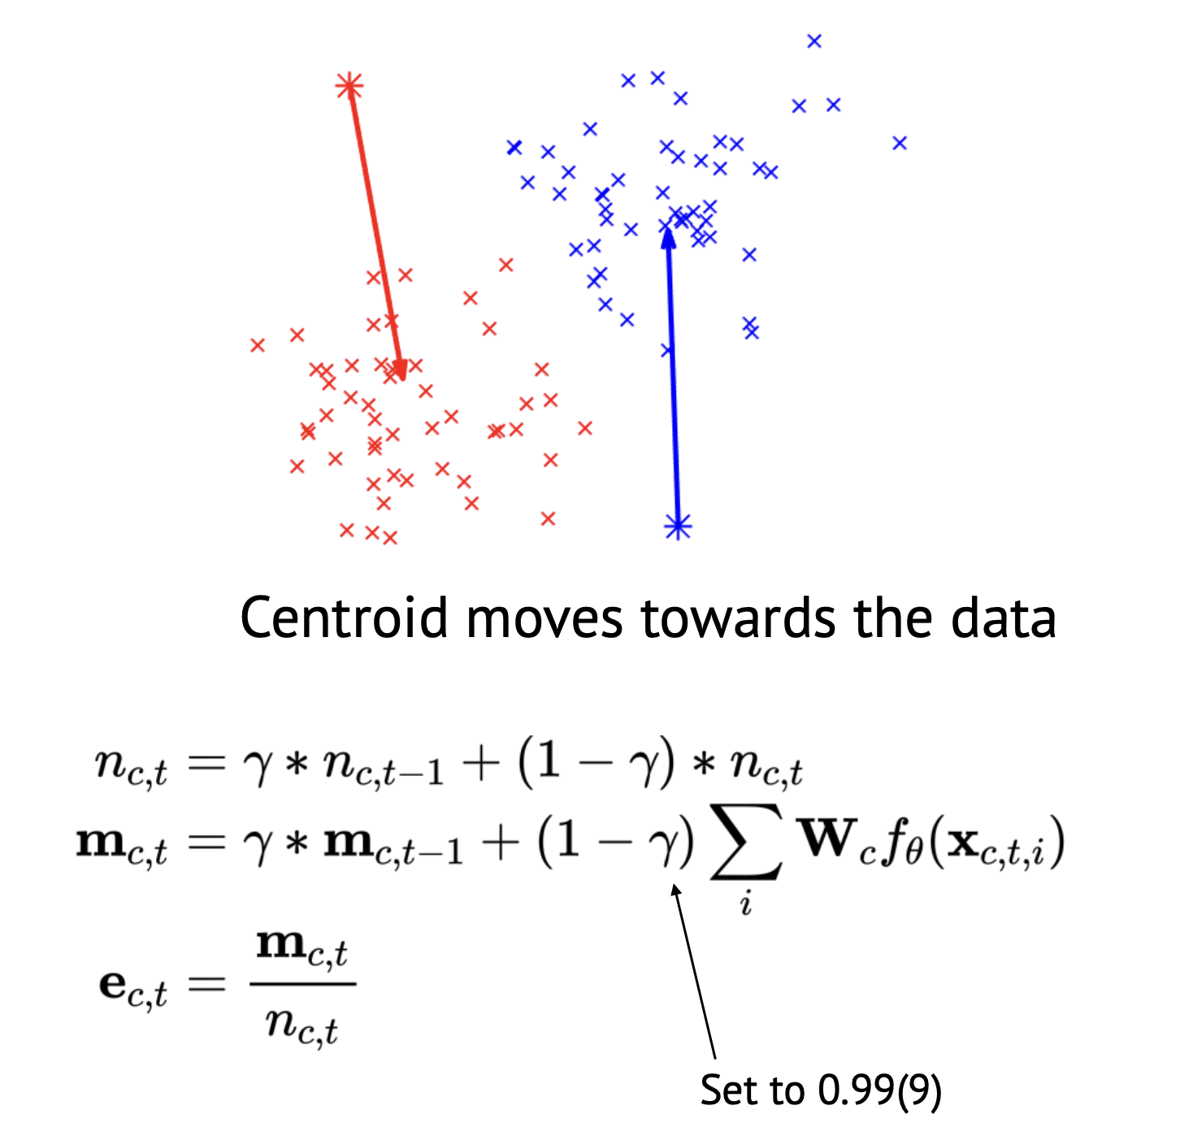
How are the centroid moved ?
Centroids are updated using an exponential moving average with heavy momentum.
This heavy momentum is used to make it work for mini-batch training

Slide 18
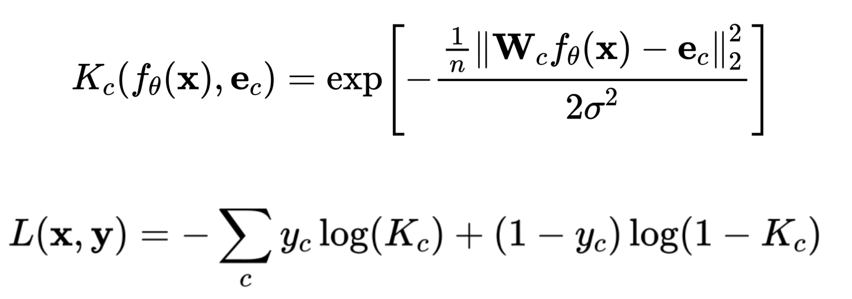
The Loss Function
Here, Kc is the kernel function and it is evaluated for each class.
L(x, y) is the standard loss function used for training DUQ models
Source - https://icml.cc/media/icml-2020/Slides/6512.pdf

Slide 19
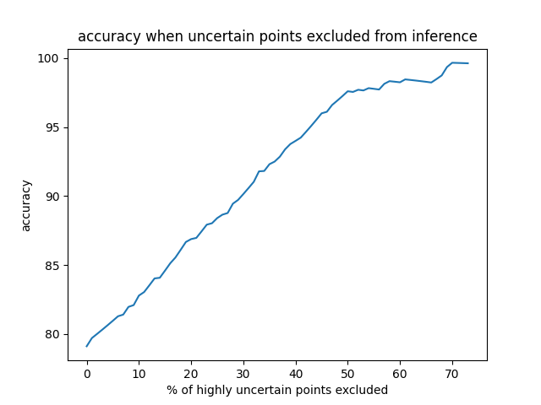
Results
Training was quite stable and loss reduced uniformly.
The model accuracy is similar to the common softmax based networks.
The following is the plot of accuracy of the model after removing certain percentage of highly uncertain points (tested on the MNIST dataset)
Also some numerical results -
Average uncertainty scores for In Distribution(ID) examples - 14.27
Average uncertainty scores for Out-of-Distribution(OOD) examples - 24313.89

Slide 20
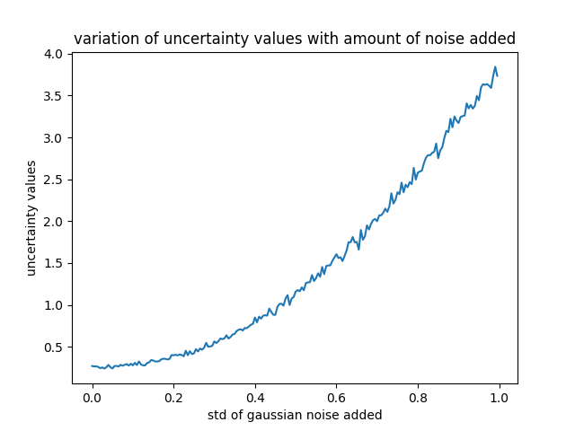
What happens if we add noise to ID examples?
Here, in this plot, we can see that as I increased the standard deviation(std) of the normal distribution from which noise is added to the image, the average uncertainty value increased. This is a nice result shown by the technique justifying its performance for uncertainty quantification.
This analysis can be used in another context. We can use this technique of progressively adding more and more noise to the data to see the UQ value given by a technique for benchmarking it against all others.

Slide 21
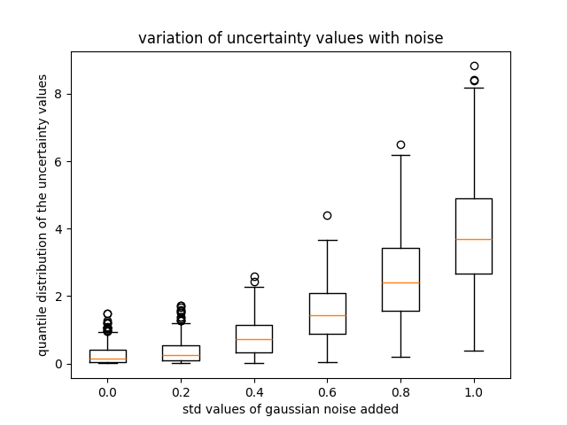
Distribution of uncertainty values for a fixed noise
In the figure, we can see the boxplot of uncertainty values reported by DUQ for some fixed noise values. We can see for larger amount of noise, the uncertainty values are spread out while for smaller amount of noise, they are more concentrated.

Slide 22
QUAM
This paper introduces QUAM as a framework for uncertainty quantification. QUAM approximates the integral that defines epistemic uncertainty better than all the previous methods.
They introduce the concept of Adversarial Models for estimating the integrals.
The main Idea of the Paper is as follows - Adversarial models are equally likely models that predict differently for a new test point.
It is important to note that, this method doesn’t involve training from scratch like the earlier method and thus can leverage the power of pretraining. This method finetunes the pre-trained model to quantify uncertainty.

Slide 23
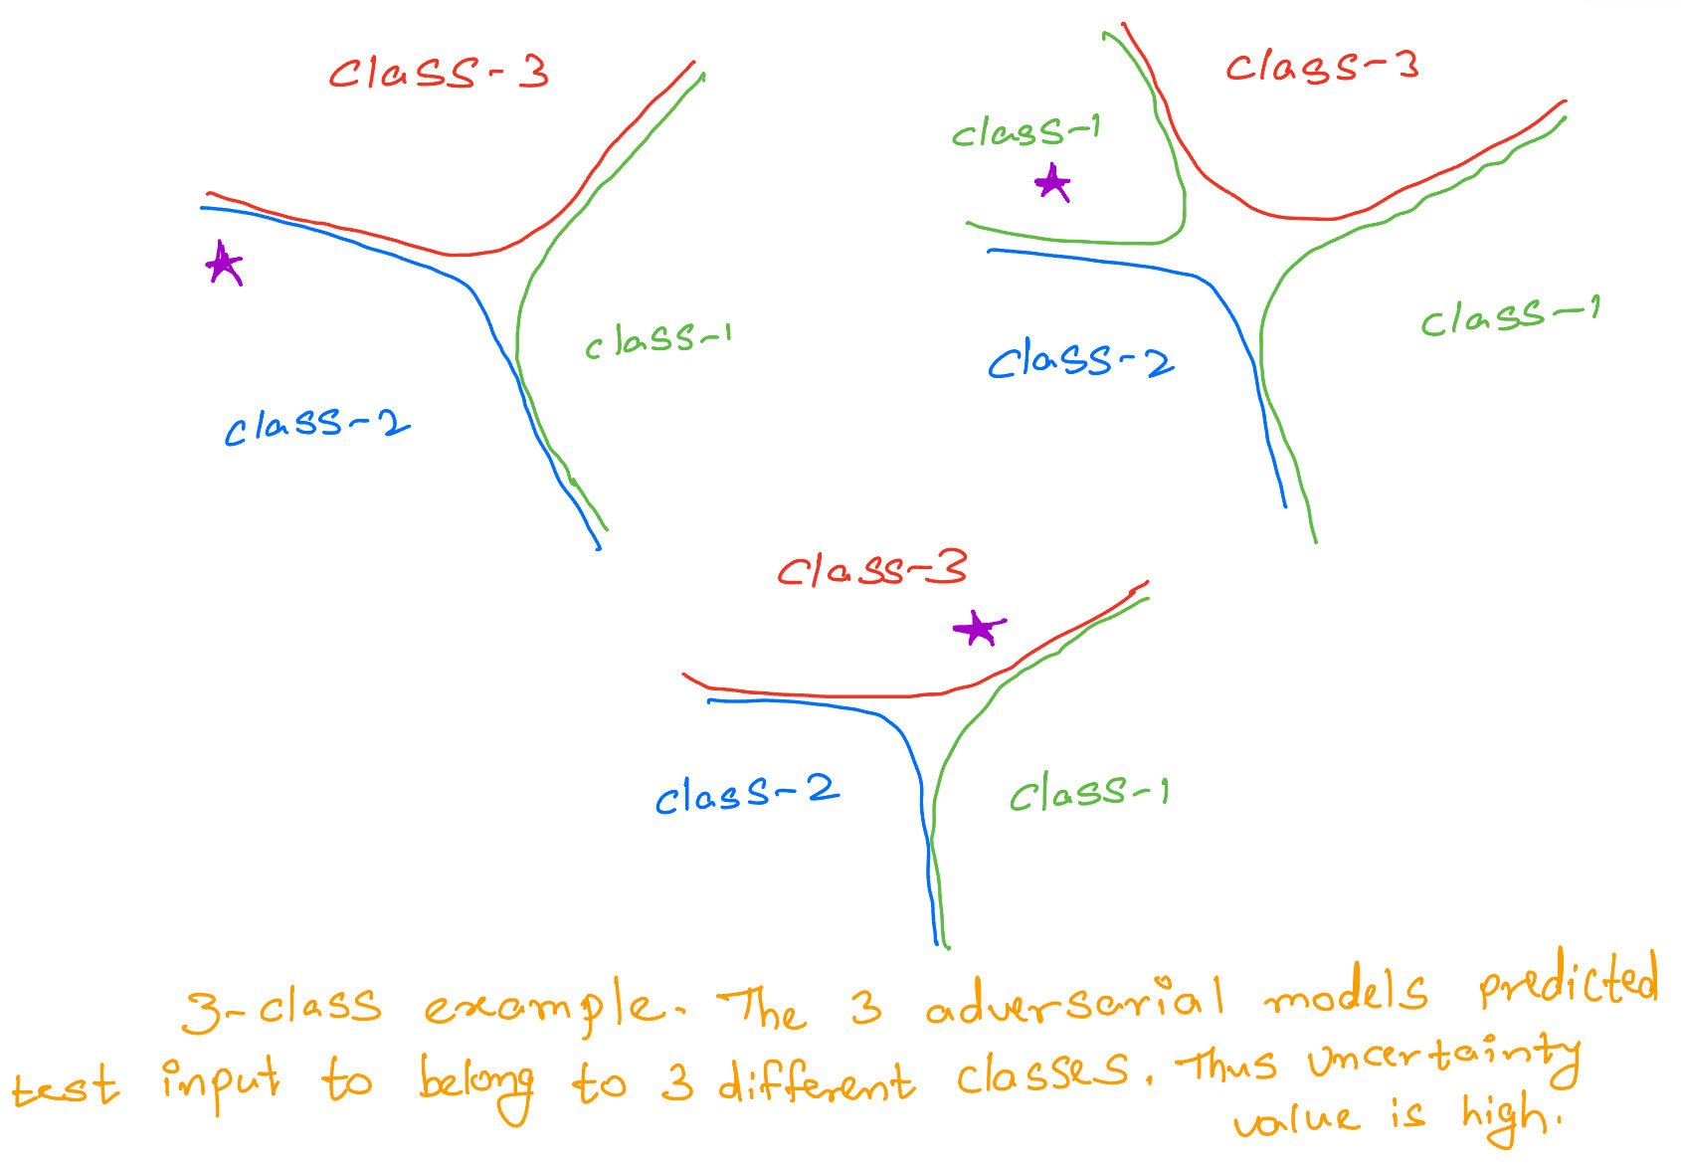
How does this technique work ?
If the 3 fine-tuned models predict the input to belong to different classes then the uncertainty value(usually measured as the entropy of the predictive distribution) is high.
And if the predictions are similar(or same) then the model is confident about its prediction and the uncertainty values are low.

Slide 24
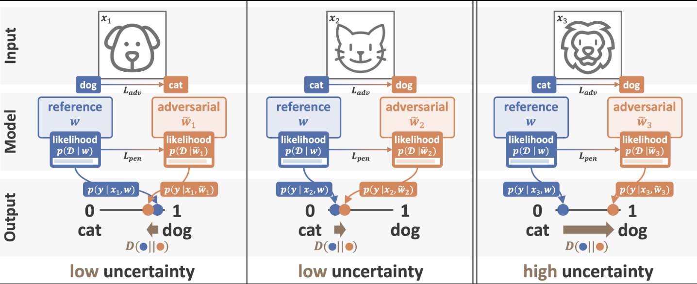
Intuition of the technique
Image Source

Slide 25
Adversarial Model definition and Optimization
We can see the definition of Adversarial models above
The problem can be rephrased in the above convex optimization problem
Here, D is the distance metric (usually KL divergence)
P(.) is the output probability distribution

Slide 26
Major Trade Offs! - Compute and memory
The QUAM method discussed in the last slide is the current state-of-the-art (SOTA) method for uncertainty quantification and has proven to predict epistemic uncertainty accurately. But it has some challenges and trade-offs!
This method is very slow and computationally demanding as it requires training K(usually taken as 5-7) different models per test image
It also has a large memory requirement as it has to store the entire training data at inference.

Slide 27
Results
Uncertainty Value - In this technique, uncertainty value is defined as the sum of entropy of the output distribution of K different models fine tuned from the same base model. Larger entropy means that the model is totally confused about its prediction.
I ran experiments on ID(MNIST) images, OOD but similar(hand drawn digit images) and completely OOD images(Imagenet). Following are the average uncertainty values given by QUAM.
ID - 0.232
OOD but similar - 0.456
OOD but totally different(Imagenet) - 2.251

Slide 28
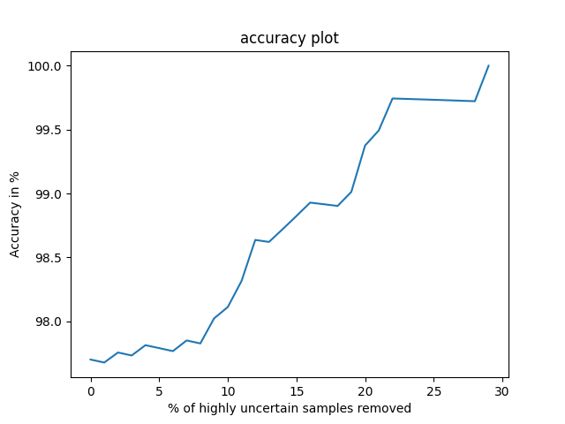
Results
This plot indicates how accuracy varies by throwing off highly uncertain data points before making predictions.
Accuracy is seen to be increasing which is a good sign as the technique is able to identify highly uncertain data points
We can also see that the accuracy starts off at a very good value either. This is because QUAM leverages the power of pretraining.

Slide 29
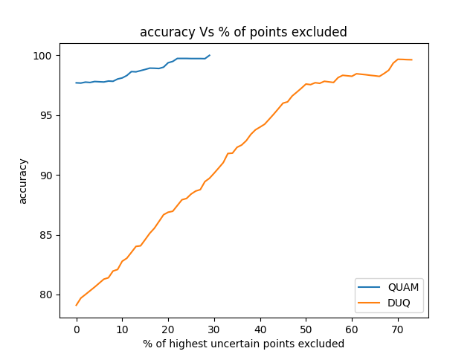
Let’s compare DUQ Vs QUAM
QUAM starts at a very impressive accuracy thanks to pretraining and reaches to 100 % accuracy after throwing just 30 % of the test samples.
DUQ on the other hand starts at a lower accuracy as it is trained from scratch and reaches 100 % accuracy only after throwing 70% of the test data.
Despite its lower performance compared to QUAM, DUQ is still very good given that QUAM needs a lot more compute and memory than DUQ

Slide 30
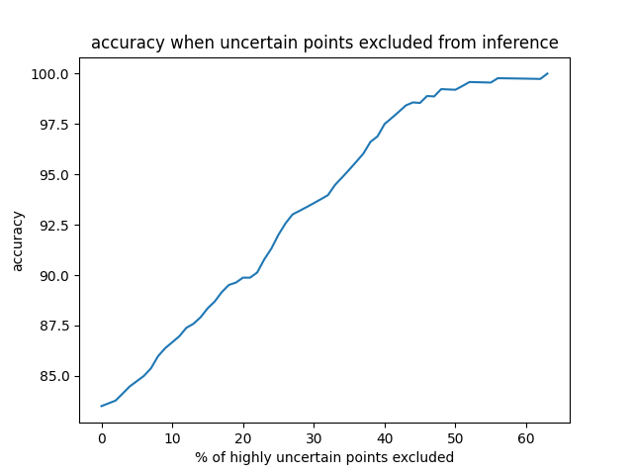
A different training technique I tried
I trained a model with an additional class named OOD using the DUQ technique.
So, this model also has 10 classes namely, digits 0-8 and an OOD class. I removed digit 9 from the training data and checked where it is mapped at test time.
This approach outperformed the original DUQ method by 3-4% accuracy and required throwing off 60 % of the test data as opposed to 70 % test data for the traditional DUQ.
It also mapped 9 to the OOD class as anticipated.
This is the plot of accuracy Vs percent of test data rejected because of uncertainty

