Slide 1
Swin Transformers for computer vision
Omkar NITSURE

Slide 2
Problems with using transformers for vision tasks
In transformer based language models, tokens are of fixed size but in vision the elements can vary substantially in Scale.
Images have much higher resolution as compared to words in passages of text.
Vision tasks like semantic segmentation require prediction at pixel-level which becomes intractable as computational complexity of Transformer self-attention is Quadratic to image size

Slide 3
Then what is the solution?
SWIN Transformers !!
Construct a hierarchical representation by starting from small-sized patches and gradually merging neighboring patches in deeper Transformer layers. (This allows for linear computation complexity to input image size as the self attention is computed only within each local window)
This is in direct contrast with Vision Transformers which have quadratic computation complexity due to computation of self-attention globally
Lets now take a detailed look at the architecture!😉

Slide 4
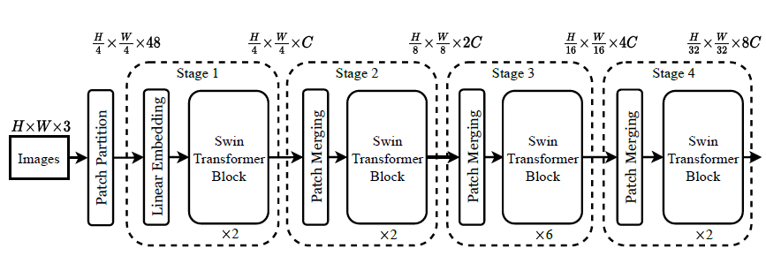


Patchifying the image
Let the initial patch size be 4 by 4 and the image size be H by W by 3 (RGB). Then we break the image into disjoint patches of size 4 by 4 by 3 each. So we have H/4 by W/4 patches of size 4 by 4 by 3 each

Slide 5


Linear Embedding layer
Transformers are used to work with sequence of tokens but what we have is a set of patches.
The embedding layer simply converts each individual patch into a vector (token) that can then be fed into a Transformer. So in our case, the embedding layer embeds patches of shape 4 by 4 by 3 in a linear vector of dimension C.

Slide 6


Patch Merging Layer
Patch merging layer performs 2 tasks. They are as follows –
They concatenate the tokens of 4 patches in the 2 by 2 neighbourhood. Thus we get H/8 by W/8 number of vectors each of length 4C (As 4 patches are concatenated to make the vector).
The vectors are then down-sampled to a length of 2C by using a linear layer. (The vectors are projected onto a lower dimensional vector space). This is done to ensure that network learns global features

Slide 7
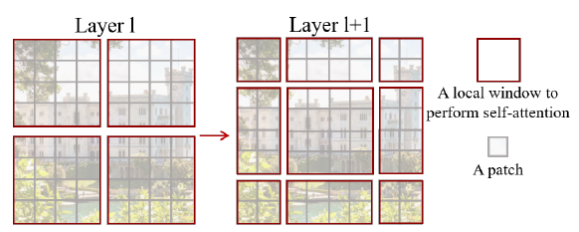
Shifted window approach
In initial layer, a regular window partitioning is used and self attention is computed within every window.
In the subsequent layers, the window partitioning is shifted (in contrast to CNNs which use sliding windows) which provides connections among them thus significantly enhancing modelling power. It also ensures much less latency as compared to CNNs.
This approach is made even more efficient by using the same key set to all query patches within a window

Slide 8
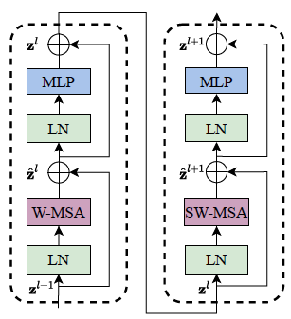
Swin transformer block
SWIN Transformer uses window-based MSA (W-MSA)
The windows are shifted in later layers and thus it is called SW-MSA
It has a 2-layer MLP with GELU activation (MLP)
There is Layer-Normalization layer before each of the above 2 units. (LN)
Residual connections are used after every module.

Slide 9

Window based Self-Attention
Global self-attention has a Quadratic computational complexity with image size.
Window based self-attention breaks the image into non-overlapping windows and performs self attention within only those windows. Thus computational complexity is Quadratic with window size (which is usually fixed at 7 by 7) and linear in image size which is exactly what we want.

Slide 10
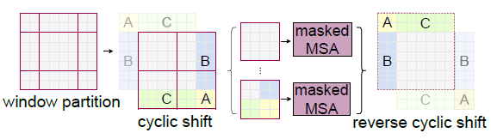
Efficient batch computation for shifted configuration
One issue with shifted-window partitioning is that it creates more windows and some of them are in-fact smaller than the usual window size.
One solution can be padding these smaller windows and masking the padded patches while performing self-attention. But it is not computationally efficient.
We can use a more efficient batch computation approach by cyclic-shifting toward the top-left direction.
We can also use Relative Position Bias in self-attention which improves performance
Note: - The above technique ensures that we have the same number of batched windows as before shifting but some windows will have sub-windows which are not adjacent to each other. Thus while computing self-attention for such a window, it is computed independently for all such sub-windows.

