Slide 1
EXPIRY.ALERT — v1.0
My Inventory
● 3 alerts
Smart Household
Expiry Management System
FOOD + MEDICINE
Milk • Dairy
Expires in 2 days
02 days
Amoxicillin • Medicine
A simple system that helps households prevent unsafe use and reduce avoidable product waste — before expiry dates arrive.
Expires in 5 days
05 days
Bread • Bakery
▣
ADD PRODUCTS
◉
TRACK EXPIRY
✉
GET REMINDERS
Expired yesterday
EXPIRED
Food or medicine with expiry dates
Automatic daily status checks
Timely alerts before items expire
▸ Daily job checks dates • Alerts via in-app + email
SYSTEM DESIGN PRESENTATION — Sep 2026 • Author: shaileshyande0074@gmail.com
Smart • Safe • Waste-aware

Slide 2
EXPIRY.ALERT
SYSTEM DESIGN
02
FOOD • MEDICINE
What we'll cover
A concise walk-through — from problem to implementation-ready diagrams.
01
Problem & Vision
02
Scope & Requirements
03
Data & Domain Model
—
—
—
Why memory-based checking fails; what EXPIRY.ALERT solves
In-scope capabilities and quality attributes
ER + Class / Object design
04
Behavior & Flow
05
Architecture & Stack
06
Roadmap & Next Steps
—
—
—
Use-case, Activity, State & Sequence
How the reminder loop runs reliably
Barcode / OCR / reports & rollout
⏱ 10-min read • Diagrams are implementation-ready (entities → tables, classes → code) • Reminder loop is cron-based and idempotent
Smart Household Expiry Management System
Confidential • System Design Presentation • Sep 2026

Slide 3
EXPIRY.ALERT
SYSTEM DESIGN
03
FOOD • MEDICINE
Manual checking is inconsistent, fragmented, and easy to forget.
🧠
⏰
🗂️
⚠️
Memory-dependent
No early warning
Scattered information
Health & waste risk
People must remember dates for every item.
There are no reminders before an item expires.
Food & medicine details are not stored in one place.
Expired items may be used or usable items discarded late.
No single source of truth
Discover expiry too late
Food ≠ Medicine no central view
Safety + cost impact
HIGH IMPACT
HIGH IMPACT
HIGH IMPACT
HIGH IMPACT
→
The opportunity
Reduce waste
Save time
Centralize product records and act before dates arrive — with automated daily checks and timely reminders.
↑ Safety
↗ Convenience
Smart Household Expiry Management System
Confidential • System Design Presentation • Sep 2026

Slide 4
EXPIRY.ALERT
SYSTEM DESIGN
04
FOOD • MEDICINE
EXPIRY.ALERT centralizes product records and acts before expiry dates arrive.
In-scope now • Future-ready by design
01
02
03
04
Add products
Store details
Check expiry
Send alerts
Food or medicine • Name, category • Qty, expiry date
Dates, quantity, category — one place
Compare against current date daily
Upcoming or expired in-app + email
EXPIRY.ALERT helps households, stores and small businesses keep track of food and medicine expiry. Users add product details, view expiry status at a glance, and get warnings before items expire — reducing waste, improving safety, and making day-to-day tracking effortless on mobile or desktop.
🔮 Future enhancements
• Barcode / QR scanning
• OCR: image-based expiry detection
• Monthly reports (expired vs upcoming)
• Cross-device sync (mobile + web)
🏠
Households
🏪
Stores
🏢
Small business
📱 💻
Mobile + Web
Family safety
Less write-offs
Compliance
Anytime access
Smart Household Expiry Management System
Confidential • System Design Presentation • Sep 2026

Slide 5
EXPIRY.ALERT
SYSTEM DESIGN
05
FOOD • MEDICINE
◈
Functional requirements
MUST-HAVE
⬢
Non-functional requirements
QUALITY ATTRIBUTES
✓
Register & log in
IN SCOPE
Easy to use
USABILITY
★★★★★
Secure auth (hash, session/JWT)
Clean UI, 2-click add product
✓
Add / edit / delete products
IN SCOPE
Fast performance
PERFORMANCE
‹150ms
CRUD with validation & expiry check
Indexed expiry queries <150ms
✓
Store expiry dates
IN SCOPE
Secure user data
SECURITY
OWASP
Date field + index for fast queries
Hash + auth + isolation
✓
Send reminders
IN SCOPE
Cross-device / browser
COMPATIBILITY
99%
Daily job: upcoming & expired
Responsive web + mobile
✓
Show upcoming & expired
IN SCOPE
Reliable & maintainable
RELIABILITY
99.5%
Filters, sorting, badges
Cron, logs, modular code
Smart Household Expiry Management System
Confidential • System Design Presentation • Sep 2026

Slide 6
EXPIRY.ALERT
ARCHITECTURE
06
FOOD • MEDICINE
Three layers + a daily job. Simple, reliable, and easy to scale.
PRESENTATION
APPLICATION
DATA
▭
⚙
⬢
→
→
Web / Mobile UI • Add / edit products • Upcoming / Expired views
API + Validation • Auth & CRUD • Expiry comparison
DB: Users, Products, Reminders • Indexed expiry_date • User isolation
React / Responsive
Node / Python API
PostgreSQL / MySQL
⏰ DAILY REMINDER JOB (cron / scheduler)
1
Fetch products where expiry near
›
2
Compare current date
›
3
Create reminder (if not exists)
›
4
Send notification in-app + email
Idempotent • Indexed query • User-isolated • Logs & retry on failure • Configurable window (e.g., 7 days before expiry)
Smart Household Expiry Management System
Confidential • System Design Presentation • Sep 2026

Slide 7
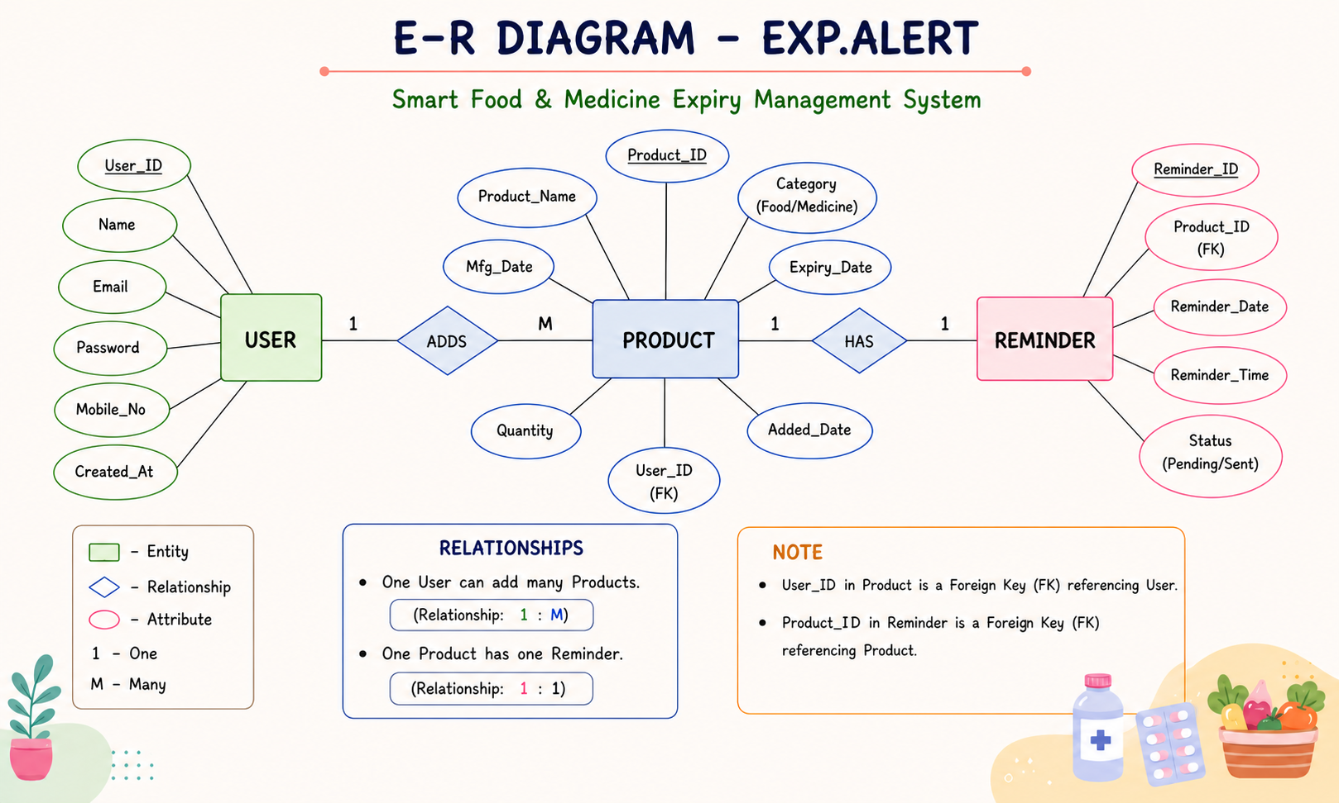
EXPIRY.ALERT
SYSTEM DESIGN
07
FOOD • MEDICINE
Core database relationships for expiry tracking — corrected for consistency and keys.
How to read this ER
Users 1—* Products (owns)
Products 1—* Reminders (generates)
FK: products.user_id → users.id
FK: reminders.product_id → products.id
Expiry indexed for daily scan
Reminder unique per product+date
Design notes
• Add indexes: expiry_date, user_id
• Use ON DELETE CASCADE
• Reminder status: pending/sent
↗ Zoom: see HD image in full-size view
Smart Household Expiry Management System
Confidential • System Design Presentation • Sep 2026

Slide 8
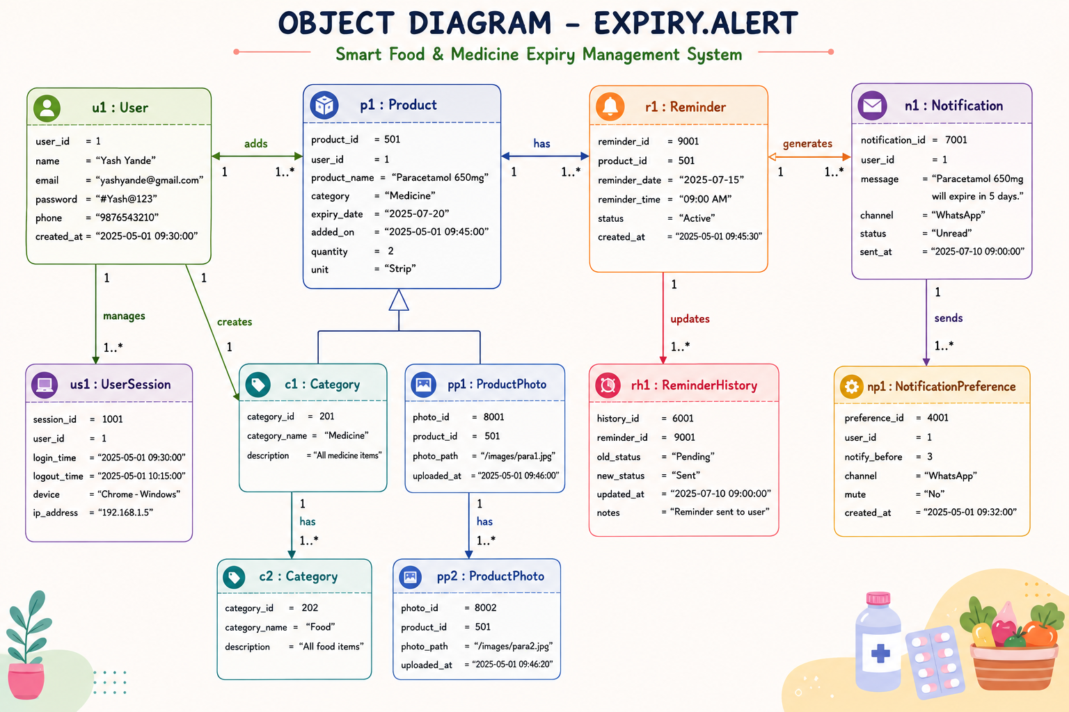
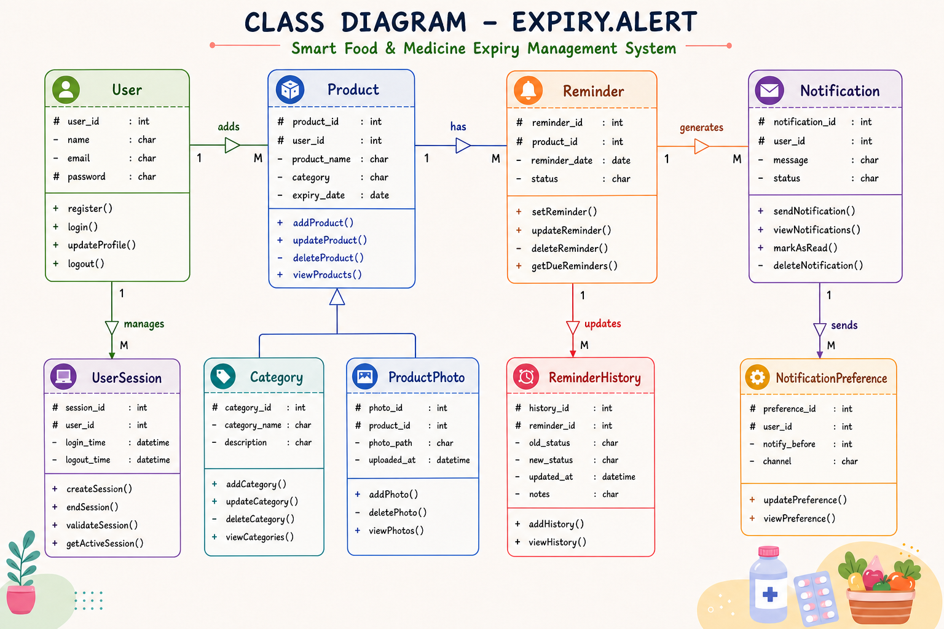
EXPIRY.ALERT
SYSTEM DESIGN
08
FOOD • MEDICINE
Each class maps directly to a database entity and its behavior.
User —1..*→ Product —1..*→ Reminder • Methods: addProduct(), checkExpiry(), sendAlert()
Class diagram — structure & operations
Object diagram — runtime example (1 user → 2 products → reminders)
Smart Household Expiry Management System
Confidential • System Design Presentation • Sep 2026

Slide 9
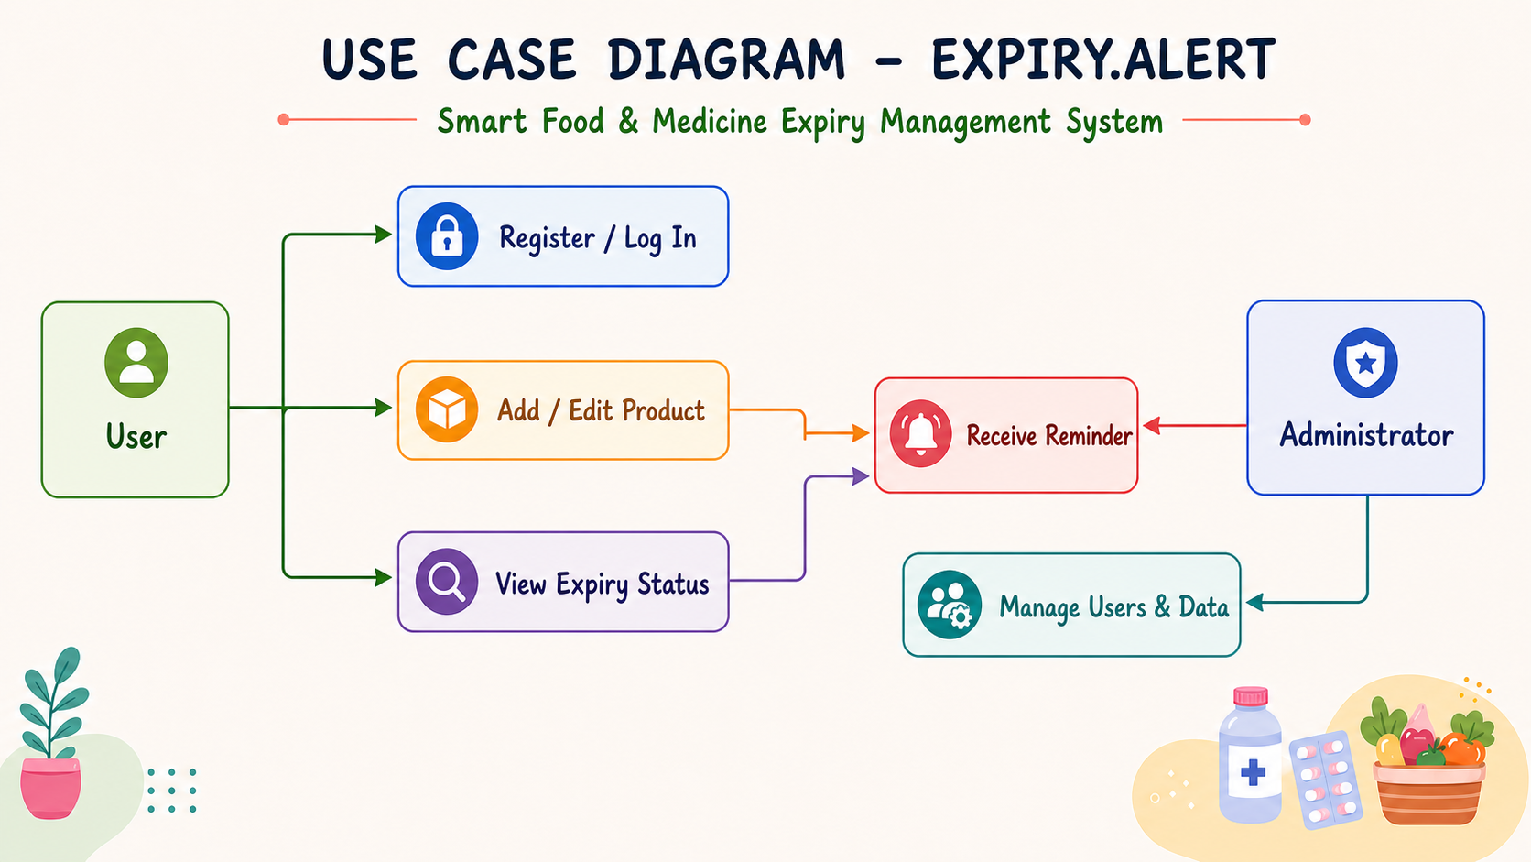
EXPIRY.ALERT
SYSTEM DESIGN
09
FOOD • MEDICINE
The administrator maintains the user and system data — refined for clarity.
Actors & use cases
User: Register, Login
User: Add / Edit / Delete
User: View upcoming/expired
System: Send reminders (auto)
Admin: Manage users & data
Includes: authentication
Design notes
• System is actor for cron job
• Extend: filter by category
• Precondition: user authenticated
↗ Zoom: see HD image in full-size view
Smart Household Expiry Management System
Confidential • System Design Presentation • Sep 2026

Slide 10
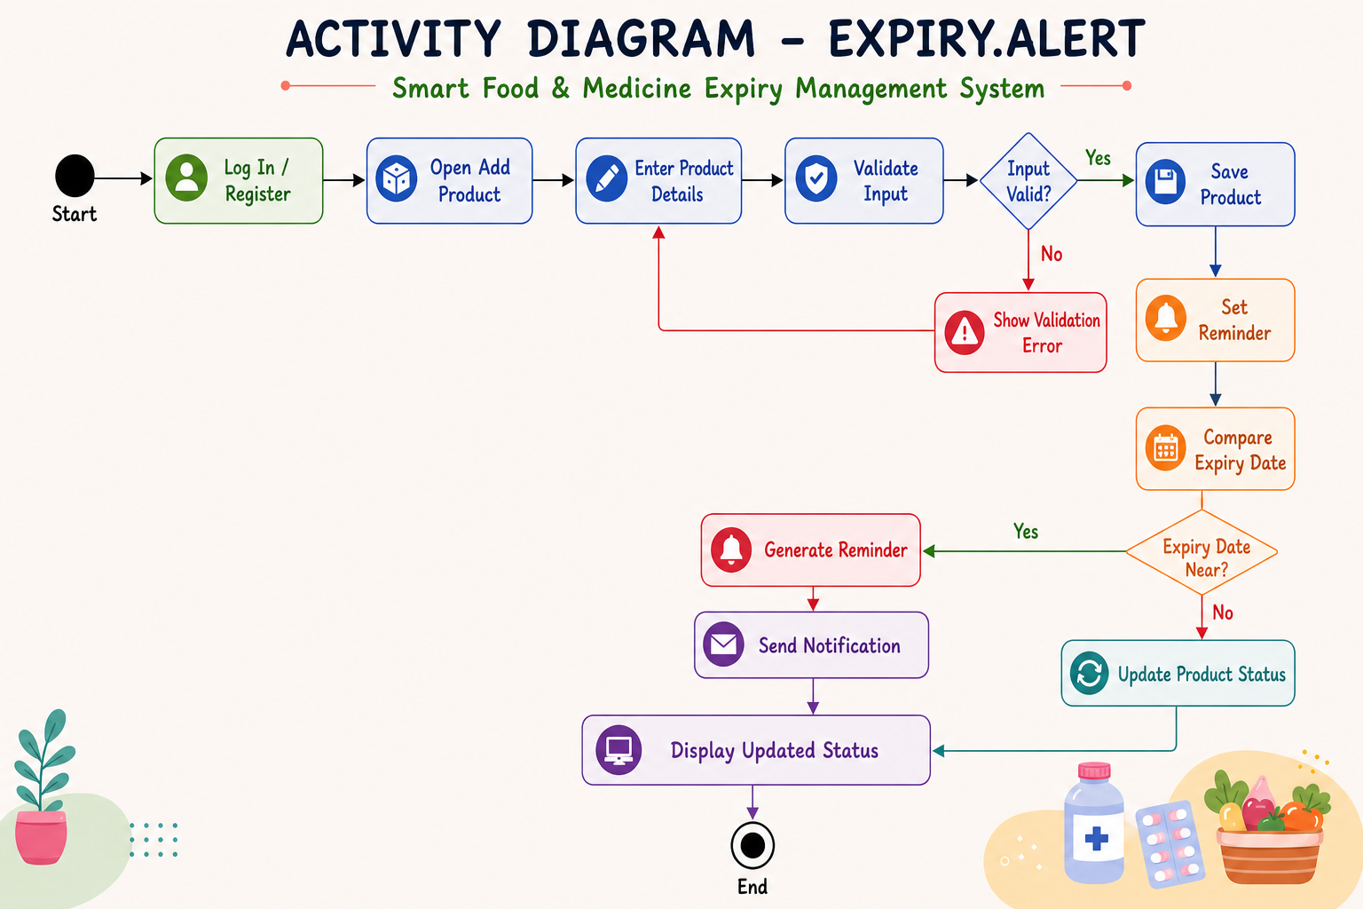
EXPIRY.ALERT
SYSTEM DESIGN
10
FOOD • MEDICINE
A repeatable workflow turns product data into timely action.
Flow steps
Login → Add product
Validate → Store securely
Daily check: expiry vs today
Branch: upcoming / expired / ok
Generate reminder → notify
User views dashboard
Design notes
• Decision: daysUntilExpiry?
• Loop: daily scheduler
• Error path: validation failure
↗ Zoom: see HD image in full-size view
Smart Household Expiry Management System
Confidential • System Design Presentation • Sep 2026

Slide 11
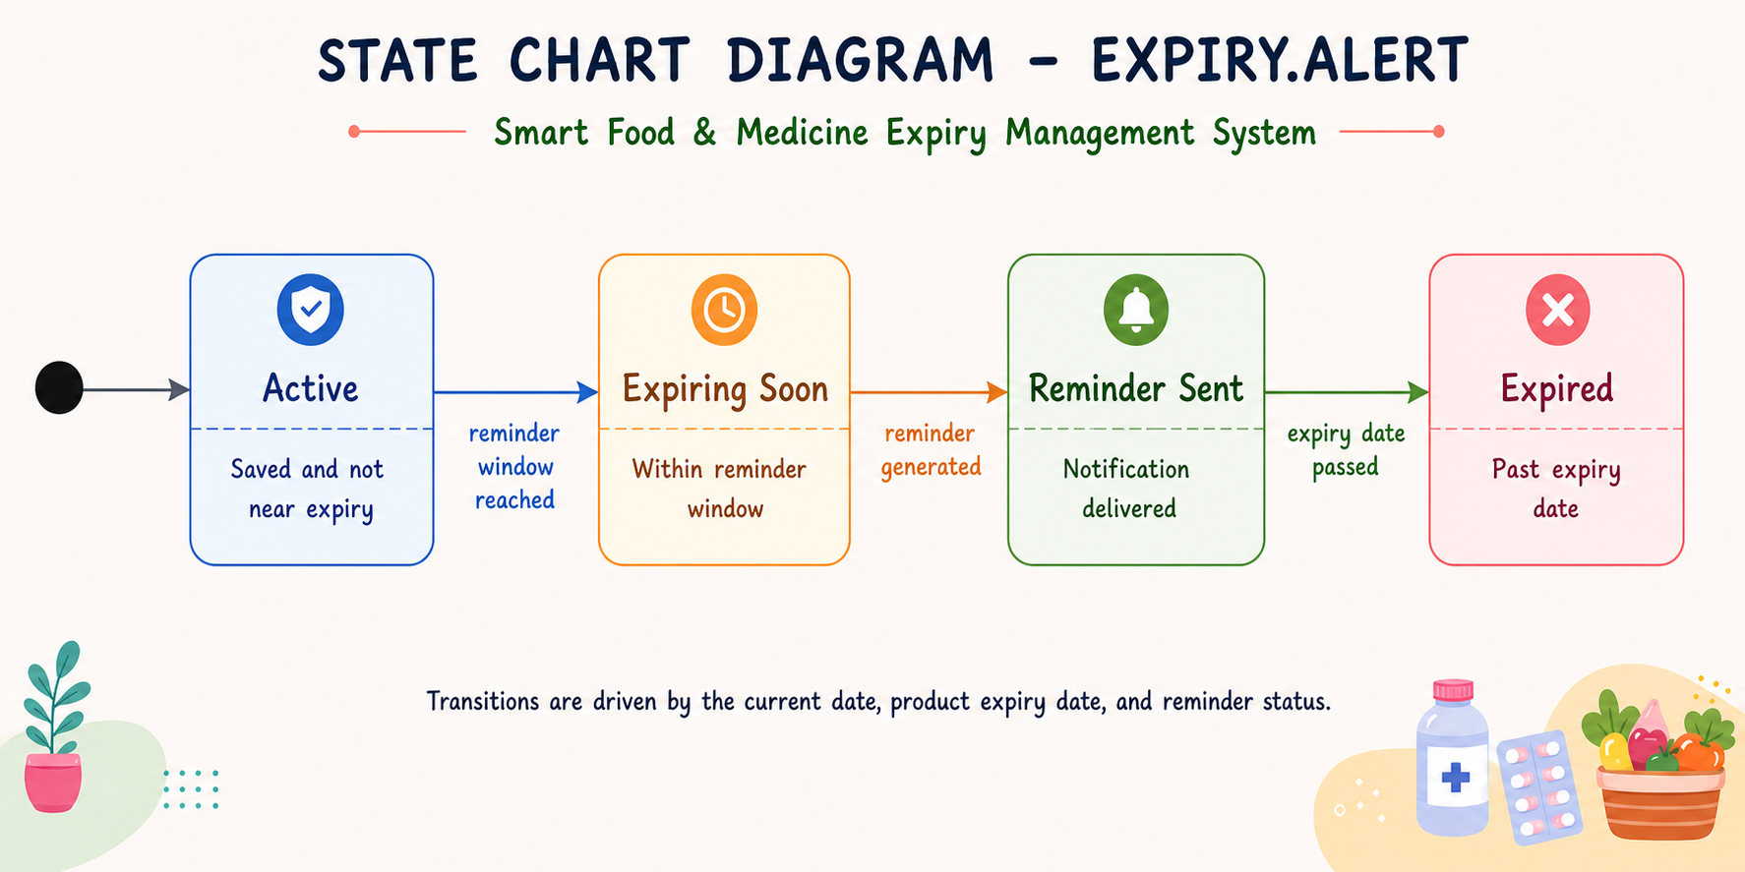
EXPIRY.ALERT
SYSTEM DESIGN
11
FOOD • MEDICINE
Date comparison moves a product through clear, user-visible states.
States & transitions
Fresh → Expiring Soon
Expiring Soon → Expired
Any → Updated (edit date)
Trigger: expiry_date - today
Guard: threshold (e.g., 7d)
Action: badge + alert
Design notes
• Initial: fresh on create
• Final: archived / deleted
• History: allow restore
↗ Zoom: see HD image in full-size view
Smart Household Expiry Management System
Confidential • System Design Presentation • Sep 2026

Slide 12
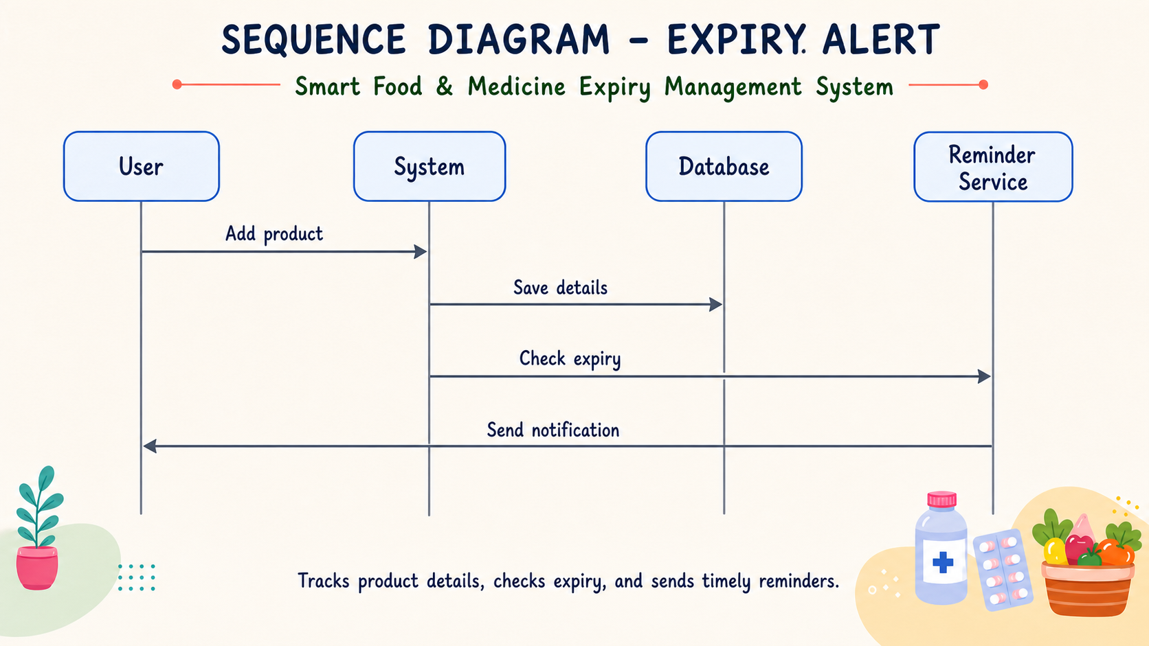
EXPIRY.ALERT
SYSTEM DESIGN
12
FOOD • MEDICINE
The reminder service connects saved product data to the user notification.
Call sequence
Scheduler → ReminderService
Service → DB: query expiring
Service → Product: check dates
Service → Reminder: create
Service → Notification: send
User ← Notification: alert
Design notes
• Alt: no products → no alert
• Loop over each product
• Idempotent create
↗ Zoom: see HD image in full-size view
Smart Household Expiry Management System
Confidential • System Design Presentation • Sep 2026

Slide 13
EXPIRY.ALERT
IMPLEMENTATION
13
FOOD • MEDICINE
Straightforward stack — optimized for speed, security, and maintainability.
Frontend
Backend
Data & Jobs
Web: React / Tailwind Mobile: PWA / Flutter Charts: expiry timeline
API: Node.js / Express Auth: JWT + bcrypt Validation: Zod / Joi
DB: PostgreSQL ORM: Prisma / Sequelize Cron: node-cron / BullMQ
Quality
Approach
Metric / Target
Performance
Indexed queries + pagination
<150 ms query, 2s page
Security
Hash, JWT, RBAC, SQL-inject safe
OWASP top-10 covered
Reliability
Idempotent job + logs + retry
99.5% job success
Usability
2-click add, color badges
SUS > 80, <3s task
Maintainability
Modular services, tests
>80% coverage
Smart Household Expiry Management System
Confidential • System Design Presentation • Sep 2026

Slide 14
EXPIRY.ALERT
ROADMAP
14
FOOD • MEDICINE
Phase 1 — MVP (Now)
Weeks 1–4
Phase 2 — Smart (Next)
Weeks 5–8
Phase 3 — Insights
Weeks 9–12
• Core CRUD
• Barcode / QR scan
• Monthly reports
• Auth + expiry check
• OCR expiry detection
• Waste analytics
• Daily reminders
• Category filters
• Family sharing
• Upcoming / Expired views
• Email + push
• Admin dashboard
Why this design wins
Success metric
✓ Prevents unsafe use of expired food/medicine
↓ expired-use incidents • ↓ waste (kg/month) ↑ reminder open-rate • ↑ DAU / retention
✓ Reduces waste and saves money
✓ Single source of truth — anytime, anywhere
Thank you — Questions?
Contact: shaileshyande0074@gmail.com System Design Presentation — Sep 2026
EXPIRY.ALERT • Smart Household Expiry Management System • FOOD + MEDICINE
EXPIRY.ALERT — Smart Household Expiry Management
Q&A • Feedback welcome

