Slide 1
🔎
FACTIFY
Indian News Authenticity Detector
A Support Vector Machine approach to flagging fake news headlines
B.Tech Project Presentation | Team Lead: Omkar Kumar (25BAI10893)

Slide 2
01 · FOUNDATION
Problem Statement, Objective & Scope
⚠️
🎯
🧭
Problem
Objective
Scope
Misinformation spreads rapidly through WhatsApp forwards and social media in India, often mimicking real news formatting and tone — making manual verification slow and unreliable at scale.
Build a machine learning model that analyzes the linguistic patterns of a news statement and predicts whether it is likely Real or Fake, giving users an instant, first-pass credibility check.
Focused on short Indian news headlines/claims in English (IFND dataset). Delivered as a lightweight, interactive Streamlit web app — not a replacement for professional fact-checking.
Factify — Indian News Authenticity Detector
2

Slide 3
02 · SETUP
Hardware / Software Requirements
🖥️ Hardware
🧰 Software
Standard PC / laptop (dual-core CPU or better)
Minimum 4 GB RAM (8 GB recommended for smooth training)
~500 MB free disk space for dataset & model artifacts
Internet connection (dataset download, package installs)
Python 3.9+
scikit-learn — LinearSVC model & TF-IDF vectorizer
pandas — dataset loading & cleaning
Streamlit — interactive web app frontend
NumPy — confidence score computation
pickle — model & vectorizer serialization
Factify — Indian News Authenticity Detector
3

Slide 4
03 · PIPELINE
Architecture / Process Flow
1
2
3
4
5
6
Dataset
Label Mapping
Train/Test Split
TF-IDF Vectorize
Train LinearSVC
Streamlit App
IFND CSV loaded;
nulls & label
noise removed
Text/numeric
variants mapped
to 0 (Fake) / 1 (Real)
80/20 stratified
split on the
Statement column
Unigrams + bigrams,
top 10,000 features,
English stop-words
Support Vector
Machine learns the
decision boundary
User input → vector →
decision score →
verdict + confidence
Offline (train.py): steps 1–5 run once to produce svm_model.pkl & tfidf_vectorizer.pkl | Online (app.py): step 6 loads those artifacts for live predictions
Factify — Indian News Authenticity Detector
4

Slide 5
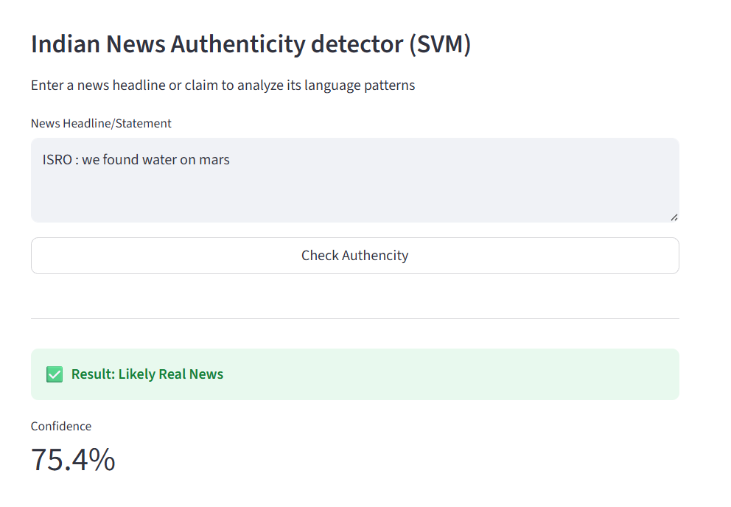
LIVE DEMO · EXAMPLE 1
Detecting a Plausible Real Claim
Input Statement
"ISRO : we found water on mars"
✅ Likely Real News
Confidence: 75.4%
Why: The phrasing resembles a formal institutional statement ("ISRO :"), a pattern the TF-IDF model associates more strongly with verified news sources.
Factify — Indian News Authenticity Detector
5

Slide 6
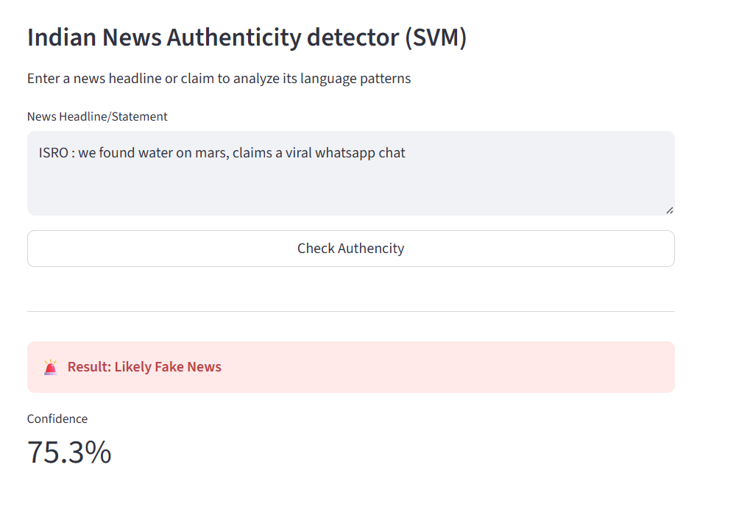
LIVE DEMO · EXAMPLE 2
Flagging a Viral Misinformation Pattern
Input Statement
"ISRO : we found water on mars, claims a viral whatsapp chat"
🚨 Likely Fake News
Confidence: 75.3%
Why: Appending "claims a viral whatsapp chat" introduces hedging language typical of unverified forwards — the model correctly flips its verdict despite an identical core claim.
Factify — Indian News Authenticity Detector
6

Slide 7
04 · IMPACT
Usability & Application
📱
Everyday Fact-Checking
📰
Newsroom Triage
Anyone can paste a forwarded headline and get an instant, first-pass credibility signal before sharing it further.
Journalists and editors can quickly flag suspicious claims for deeper manual verification, saving review time.
🎓
Media Literacy Tool
🛡️
Platform Moderation Aid
Demonstrates to students how language patterns — not just facts — can betray misinformation, building critical reading habits.
Can be extended as a pre-screening layer for social platforms or WhatsApp-forward checkers to reduce viral spread.
Factify — Indian News Authenticity Detector
7

Slide 8
05 · TEAMWORK
Contribution of Each Member
Member
Registration No.
Contribution
Omkar Kumar (Leader)
25BAI10893
Model pipeline design, TF-IDF & LinearSVC training, Streamlit app integration
Ayush Yadav
25BAI10946
Dataset cleaning, label mapping & preprocessing logic
Vaidant Udawat
25BAI10266
Streamlit UI/UX design and result presentation
Samiksha Sinha
25BAI10556
Model evaluation, classification report analysis
Nyasha Kumari
25BAI10550
Documentation, testing & sample case validation
Anirudh Arya
25BAI11192
Presentation design and project coordination
Factify — Indian News Authenticity Detector
8

Slide 9
06 · SOURCES
References
1
IFND Dataset (Kaggle)
kaggle.com/datasets/sonalgarg174/ifnd-dataset
Indian Fake News Dataset — used to train and evaluate the classifier.
2
scikit-learn Documentation
scikit-learn.org/stable/documentation.html
TfidfVectorizer and LinearSVC reference for feature extraction and model training.
3
Streamlit Documentation
docs.streamlit.io
Used to build the interactive web interface for real-time predictions.
4
pandas Documentation
pandas.pydata.org/docs
Used for dataset loading, cleaning, and label preprocessing.
Factify — Indian News Authenticity Detector
9

Slide 10
THANK YOU
Group Members
OK
Omkar Kumar • Leader
AY
Ayush Yadav
25BAI10893
25BAI10946
VU
Vaidant Udawat
SS
Samiksha Sinha
25BAI10266
25BAI10556
NK
Nyasha Kumari
AA
Anirudh Arya
25BAI10550
25BAI11192

