Slide 1
CampusNet Connect in real time with your course friends
Team Members:
Rohan Girase
Ramanand Shankarling
Rakesh Musalay
Naveen Ravi
Omkar Salunke
Tarun Moorjani

Slide 2
Motivation
Connect students taking same/similar courses and also help students pick the right courses
Provide a portal for students to buy and sell textbooks, class notes and other educational material.

Slide 3
Core Modules
CourseConnect
Dashboard
Marketplace

Slide 4
CourseConnect
Connect with the Current or previously enrolled students
View all the current class enrolled students and also previously enrolled students.
Built in chat application to connect 1:1
Push notifications and email alerts in the app for incoming messages

Slide 5
Dashboard
Graphs to show trending courses
Analytics for popular courses
Recommended courses list based on the courses set by the user in the profile page.

Slide 6
Marketplace
Basic classifieds module for students to sell and buy textbooks and other educational materials
Send messages to seller though a chat module
Incoming message notifications in the profile page

Slide 7
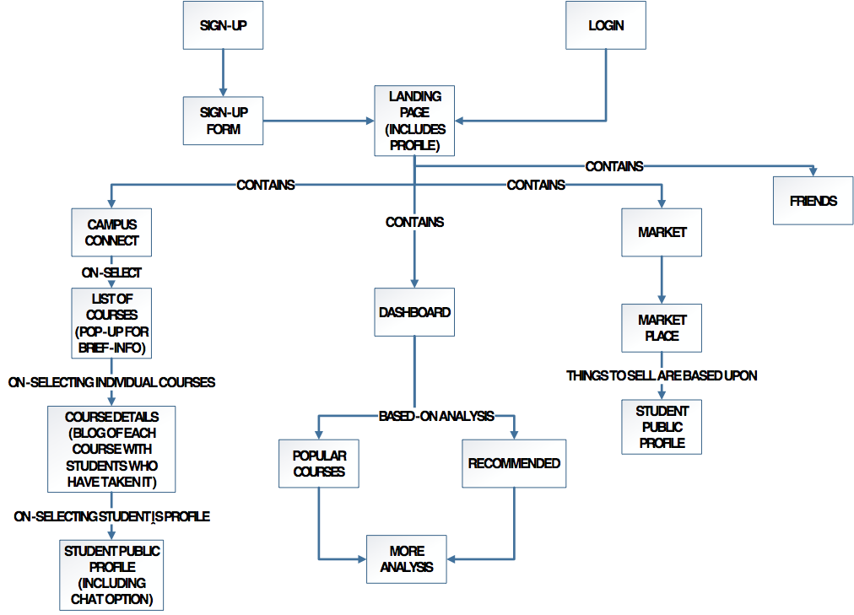
Workflow

Slide 8
Technology stack
MEAN stack
Bootstrap UI
AWS E2 instance running ubuntu image
Mlab cloud for mongodb

Slide 9
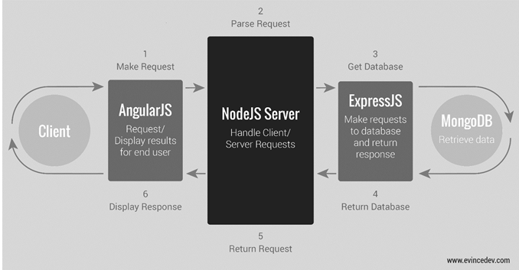
MEAN Architecture Flow

Slide 10
Current progress
Developed the login and registration modules using the MEAN stack
Implemented JWT authentication for secure login
Created Login and registration API’s and successfully able to read and write data to the mongoDB
Hosted the application with AWS EC2 instance

Slide 11
Challenges
Issues with mongoDB connection
JWT token authentication implementation problems
Generic angular, node.js and hosting issues in AWS EC2

Slide 12
The road ahead
Start with the CampusConnect module
Populate demographic personal info in profile page
Implement chat messaging module inside the CampusConnect module.

Slide 13
Demo
http://ec2-34-232-64-186.compute-1.amazonaws.com:3000/

