Slide 1

Pimpri Chinchwad Education Trust (PCET) Pimpri Chinchwad College of Engineering An ISO 9001:2015 Certified Institute, NBA Accredited, Accredited by NAAC with ‘A’ grade
Department of Computer Engineering
M.Tech First Year Sem-2 (2024-25)
Predicting State of Charge (SoC) for EV(electric vehicle) based on trip data
Guided By
Dr. K Rajeshwari
(Dean Academics & Professor)
Presented By
Omkar Rane 124M1B001

Slide 2
Contents
Introduction
Motivation
Problem statement
Objectives
Literature survey
About dataset
Architecture
Results
Conclusion

Slide 3
Introduction
Precise SoC estimation is crucial for EV battery lifespan and range prediction.
Traditional methods rely on battery parameters, but this study uses trip data logs
This research uses trip data (speed, acceleration, surroundings) for SoC prediction.
Machine learning models dynamically respond to real-time driving conditions.
Challenges: Variability in driving conditions (road gradient, traffic, temperature).

Slide 4
Motivation
State of Charge (SoC) estimation is critical for EV efficiency and battery longevity.
Traditional methods (Coulomb Counting, Kalman Filtering) have limitations such as sensor noise, battery aging, and dependency on fixed models.
Driving conditions (road gradient, speed, acceleration, traffic) significantly impact SoC but are often ignored in conventional approaches.

Slide 5
Problem Statement
Accurate State of Charge (SoC) prediction is essential for EV battery management and range estimation.
Traditional methods rely on battery-specific parameters, making them susceptible to sensor noise, battery aging, and model inaccuracies.
External driving factors such as speed, acceleration, road gradient, and traffic conditions are often ignored, leading to less reliable SoC estimations.
Lack of real-time adaptability in conventional SoC estimation techniques.

Slide 6
The Need for a Solution:
Machine Learning-based approaches can integrate trip data for more accurate and adaptive SoC prediction.
Developing a data-driven framework to estimate SoC based on real-world driving conditions.
Evaluating and deploying optimized ML models for better prediction accuracy and generalization.

Slide 7
Objective
"Leveraging Machine Learning (ML) on trip data to develop a data-driven framework for enhanced and adaptive State of Charge (SoC) prediction."

Slide 8
Literature survey of existing work
Paper | Authors | Methodology | Key Findings
[1] | Zhao et al. | RNN-based SoC prediction | Improved battery data processing and SoC estimation accuracy
[2] | Xuan et al. | PCA-SVR model | Achieved high accuracy in SoC prediction
[3] | Bhushan et al. | CNN with k-decay learning rate optimization | Enhanced SoC prediction accuracy with optimized model training
[4] | Li et al. | Ensemble learning (AdaBoost.Rt-RNN) | Improved generalization and robustness in SoC estimation
[5] | Unterrieder et al. | EMF-based SoC estimation | Prototype models improved SoC estimation reliability

Slide 9
[6] | Homan et al. | A Comprehensive Model for Battery State of Charge Prediction | Fractional-order impedance model (FOIM)
[7] | Zhang et al. | Lithium-Ion Battery Modeling and State of Charge Estimation | GAN-based fusion model
[8] | Wong et al. | A Novel Fusion Approach Consisting of GAN and CNN for Battery SoC Prediction | CNN-LSTM hybrid model
[9] | Song et al. | Combined CNN-LSTM Network for State-of-Charge Prediction | Transformer Neural Network
[10] | Agustono et al. | State of Charge Prediction of Lead Acid Batteries using AdaBoost-PSO-SVM | AdaBoost-PSO-SVM
[11] | Li et al. | PSO-SVM with AdaBoost | AdaBoost-PSO-SVM improves SoH estimation accuracy alongside SoC prediction

Slide 10
About Dataset
In this study, we utilize the dual-Electric Vehicle Dataset (d-EVD) [12], an open-access dataset designed to support research in electric vehicle (EV) energy consumption modelling and battery management. The dataset, collected by Vicomtech, comprises real-world driving data from two electric vehicles—a Nissan e-NV200 and a Renault Zoe—operated under diverse road, weather, and traffic conditions.
The d-EVD dataset provides comprehensive trip logs, including vehicle speed, acceleration, energy consumption, battery state of charge (SoC), power demand, GPS coordinates, road gradient, ambient temperature, and regenerative braking data. These parameters enable a detailed analysis of energy consumption patterns influenced by driving behaviour and external environmental factors. The dataset consists of over 300 hours of driving data, covering a range of driving scenarios such as urban, highway, and mixed traffic conditions.

Slide 11
Architecture
SoC prediction pipeline:
Data Flow:
Raw Data → Preprocessing → Pre-processed Data
Training Flow:
Pre-processed Data → Train Linear Regression → Save Model + Scaler Pre-processed Data → Train Random Forest & Neural Network → Save Model + Shared Scaler
Evaluation Flow:
Load Pre-processed Data → Load Trained Models → Compute Metrics
Deployment Flow:
User Selects Model → Uploads Model & Scaler → Enters Input Features → Predicts SoC

Slide 12
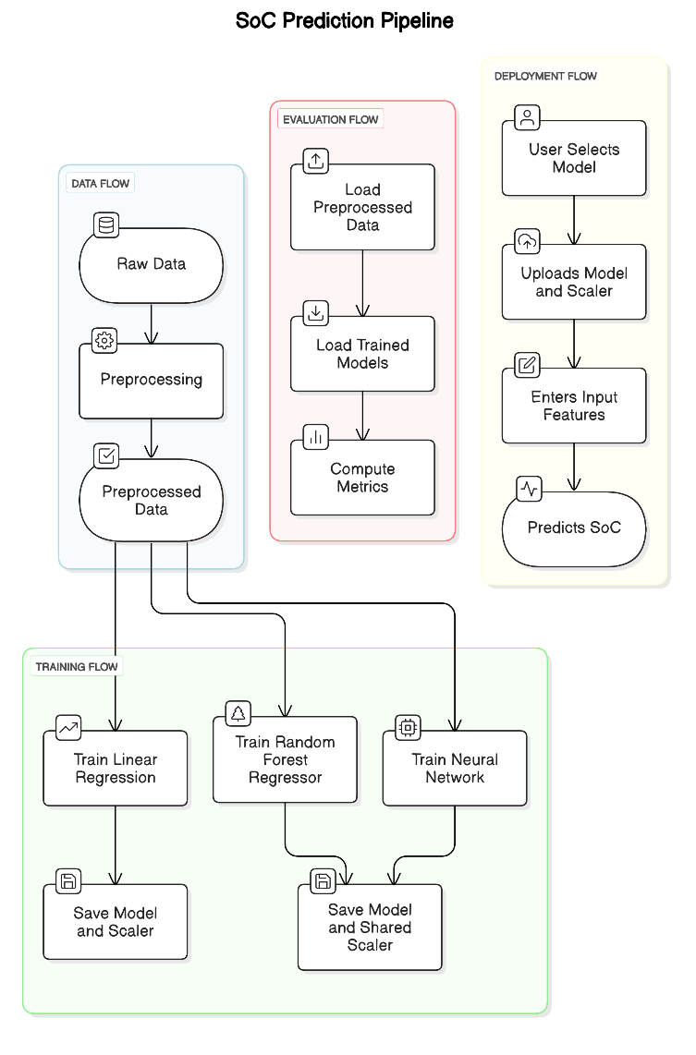

Slide 13
Results
Model | RMSE | MAE | R² Score
Random Forest Regressor | 0.0005 | 0.0003 | 1
Neural Network | 0.0093 | 0.0066 | 0.9984
Linear Regression | 0.0356 | 0.0266 | 0.976

Slide 14
Random forest regressor model:
Achieved the lowest RMSE (0.0005) and MAE (0.0003), indicating near-perfect predictions. The R² Score of 1.0000 suggests a perfect fit, which may indicate overfitting, meaning the model might not generalize well to unseen data.
Neural network model:
The RMSE of 0.0093 and MAE of 0.0066 show high accuracy while allowing for better generalization than Random Forest. The R² Score of 0.9984 indicates that the model explains 99.84% of the variance, making it a strong candidate for real-world deployment.
Linear regression Model:
It has the highest RMSE (0.0356) and MAE (0.0266), indicating larger errors in SoC prediction. The R² Score of 0.9760 suggests that while the model explains 97.6% of the variance, it lacks the ability to capture complex non-linear relationships, making it the least accurate of the three models.

Slide 15
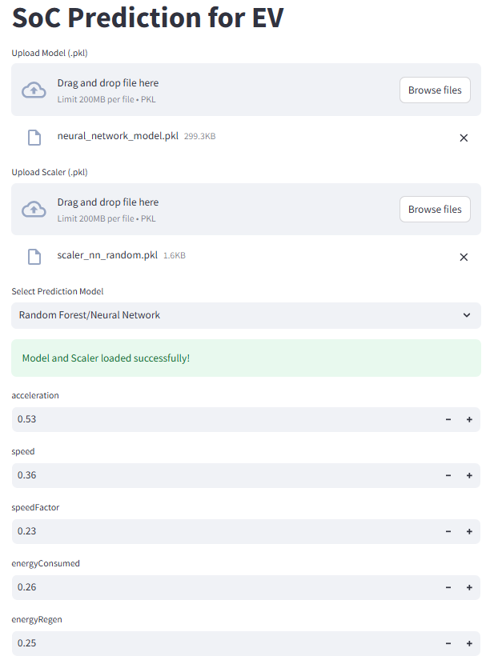
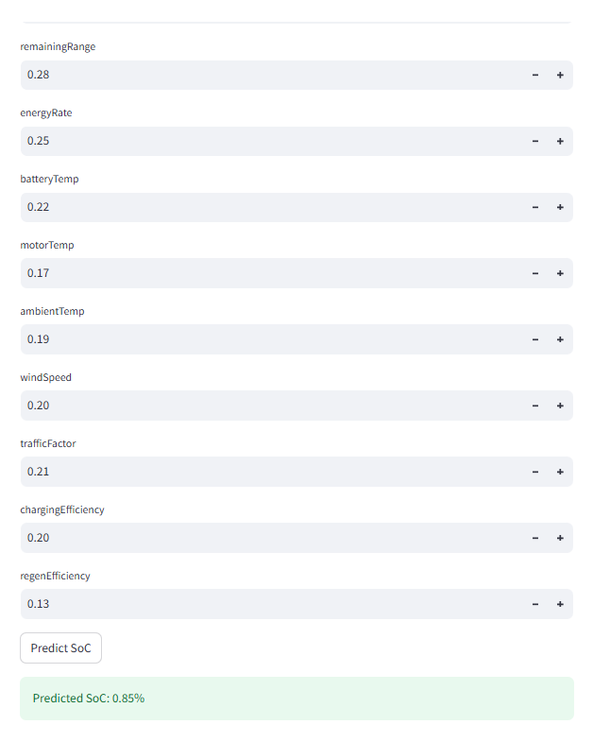

Slide 16
Conclusion
The conclusions indicate that Neural Networks deliver the best performance in terms of predictive accuracy and generalizability, thus rendering them most suitable for real-world deployment.
Future work can focus on: Validation of Random Forest generalization on unseen data. Enabling predictions in real-time with the use of live telemetry data from EVs Elongating Neural Network protocols to enhance speed and precision in SoC prediction. This research sheds light on the potential for undertaking an effective trip-data-based State of Charge prediction technique as a reasonable alternative for conventional voltage-based battery-centric estimation methods aimed at improved energy management strategies for electric vehicles.

Slide 17
References
[1] F. Zhao, Y. Li, X. Wang, et al., "Lithium-Ion Batteries State of Charge Prediction of Electric Vehicles Using RNNs-CNNs Neural Networks," IEEE Access, 2020.
[2] L. Xuan, L. Qian, J. Chen, et al., "State-of-Charge Prediction of Battery Management System Based on Principal Component Analysis and Improved Support Vector Machine for Regression," IEEE Access, 2020.
[3] N. Bhushan, S. Mekhilef, K. S. Tey, et al., "Dynamic K-Decay Learning Rate Optimization for Deep Convolutional Neural Network to Estimate the State of Charge for Electric Vehicle Batteries," Energies, 2024.
[4] R. Li, H. Sun, X. Wei, et al., "Lithium Battery State-of-Charge Estimation Based on AdaBoost.Rt-RNN," Energies, 2022.
[5] C. Unterrieder, M. Lunglmayr, S. Marsili, et al., "Battery State-of-Charge Estimation Prototype Using EMF Voltage Prediction," IEEE Conference, 2014.
[6] B. Homan, G. J. M. Smit, R. P. van Leeuwen, et al., "A Comprehensive Model for Battery State of Charge Prediction," University of Twente & Saxion University, 2023.
[7] X. Zhang, X. Li, K. Yang, et al., "Lithium-Ion Battery Modeling and State of Charge Prediction Based on Fractional-Order Calculus," Mathematics, 2023.

Slide 18
[8] K. L. Wong, K. S. Chou, R. Tse, et al., "A Novel Fusion Approach Consisting of GAN and State-of-Charge Estimator for Synthetic Battery Operation Data Generation," Electronics, 2023.
[9] X. Song, F. Yang, D. Wang, et al., "Combined CNN-LSTM Network for State-of-Charge Estimation of Lithium-Ion Batteries," IEEE Access, 2019.
[10] I. Agustono, M. Asrol, A. S. Budiman, et al., "State of Charge Prediction of Lead Acid Battery using Transformer Neural Network for Solar Smart Dome 4.0," International Journal of Emerging Technology and Advanced Engineering, 2022.
[11] R. Li, W. Li, H. Zhang, "State of Health and Charge Estimation Based on Adaptive Boosting Integrated with Particle Swarm Optimization/Support Vector Machine (AdaBoost-PSO-SVM) Model for Lithium-Ion Batteries," International Journal of Electrochemical Science, 2022.
[12] Vicomtech, dual-Electric Vehicle Dataset (d-EVD), Available: https://github.com/Vicomtech/d-EVD_dual-Electric-Vehicle-Dataset.

Slide 19
Thank You

