Slide 1
Business Analyzer
Guide :
Ms. Monika Kute
Team :
35. Shivam Kuchekar
50. Omkar Waghmare
90. Shruti Patil
Team :

Slide 2
Introduction
Nowadays most of the products of tally apps in the market are.
There are many complains of data synchrozing regarding those app. Also Ledger never matches the tally.
The main point is that this app don’t have backup storage.
All of those are paid apps which every person cannot afford.
Those apps don’t have an enough security, which is very necessary for such apps because we have many private things in it.
Therefore, to overcome all this issues we made a new app called Business Analyzer.
Also in our app we are providing a much better security with all the modifications in it.

Slide 3
Literature Survey
There are various techniques that can be used to tally or for GST generation.
These 2 mobile apps are one of it.
1. Biz Analyst : Biz Analyst is a mobile app.This app is also regarding to tally and GST generation. But it also have some disadvantages too which we are going to solve in our app. Firstly there are many complains of data synchrozing regarding this app. Also Ledger never matches the tally. Also the services are very slow. They don’t take actions sooner. The main point is that this app don’t have backup storage.

Slide 4
Literature Survey Cont...
2. BizMis : BizMiss tally on mobile is a mobile app basically having each and every feature. But this app also have some rare disadvantages which we are overcoming in our app. First of all it’s a paid app which every person cannot afford. Second thing and main thing is that this app don’t have an enough security, which is very necessary for such apps because we have many private things in it. Many of them complained but no one takes action.

Slide 5
Scope Of The Project
The algorithm aims to accurately tally and generate GST. The Business Analyzer algorithm is built on Java and MySql library.
It automatically calculates sales credit notes and also the purchase debit notes, which is not properly available in above apps but is actually needed.
It will also help the user to check the stock using stock analyzer after purchasing or selling the stocks, which is very important for the user because one user cannot check all the stocks.
Many companies’ data will be there in this app but to handle it simultaneously is a very difficult part for one

Slide 6
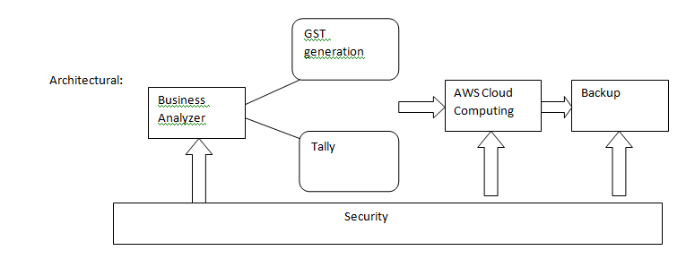
Architecture Diagrams

Slide 7
Hardware Requirement
2 GB RAM(minimum)
32 GB ROM (minimum)
Smartphone (Android)

Slide 8
Software Requirement
Software : -
Android Studio 2
Java
My SQL
AWS
Platform -- Windows , Linux or any

Slide 9
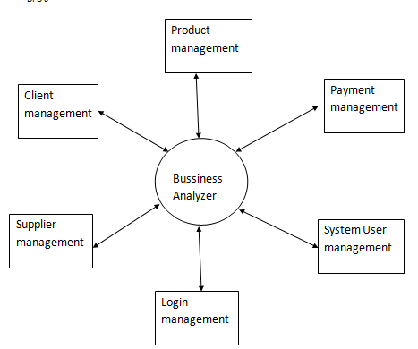
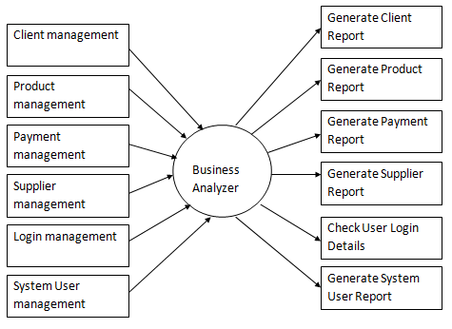
UML Diagrams Class Diagram

Slide 10
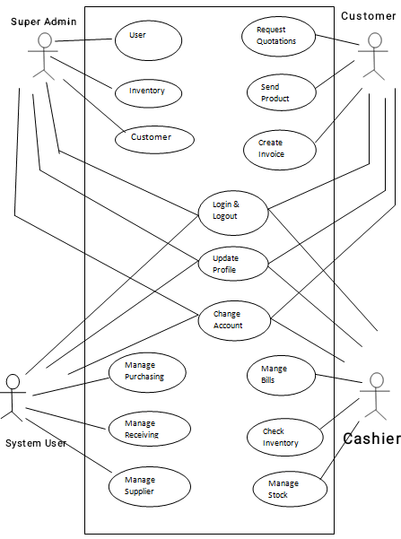
Usecase Diagram

Slide 11
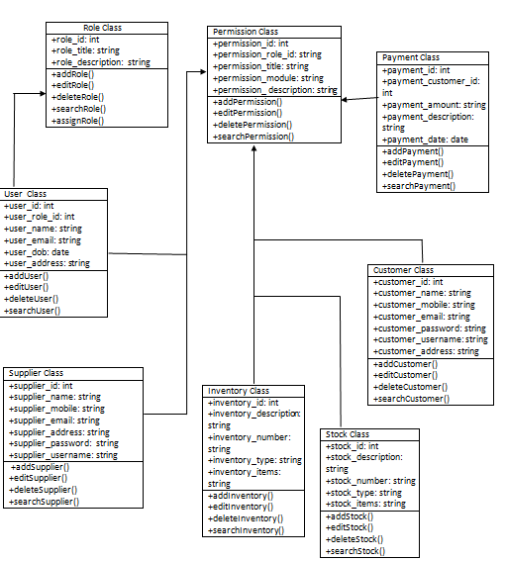
Class Diagram

Slide 12
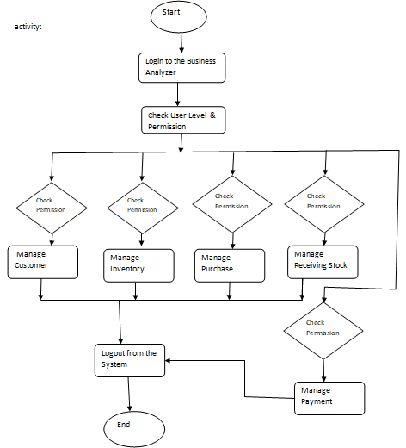
Activity Diagram

Slide 13
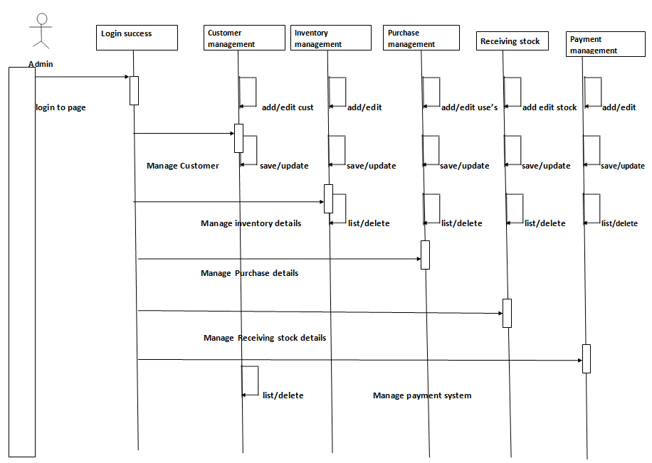
Sequence Diagram

Slide 14
Application
Sales, inventory and purchase management
Integrated payroll management
Access and security control
GST invoicing
Budgets and scenario management
Auto bank reconciliation
Data backups and data synchronization

Slide 15
Future Scope
Now our app is android supported only. In future it will also available for iOS devices and windows system.

Slide 16
Conclusion
Our application create sells and also purchase invoices.
For the best security it only shares access with the sells team member.
App provides backup service to restore data in some case.

Slide 17
Reference
Book Reference:
1] Android Programming: The Big Nard Ranch Head
2]Android Development Java Programming
Website Reference https:
1]https//bizanalyst.in
2] ]http://ieeexplore.ieeee.org
IEEE Reference :
1] athyanath Lappasi Ramamoorthy .Faculty of Technology, Telecommunication and Networks Birmingham City University, UK .
2]Jagdev Bhogal.Facultyo f Technology, Telecommunication and Networks Birmingham City University, UK,

Slide 18
Thank you …!

