Slide 1
Elevator pitch
For (target Customer): This is for all Navigational Database customers.
Who (statement of need or opportunity): To convince potential customers to start using cost saving Airport Procedures.
The (Product Name): Honeywell RNP/RNAV Savings Calculator
Is a (Product Category): Analytics Solutions
That (key benefit, compelling reason to use): Advanced and latest flight path
Unlike (primary competitive alternative): Instrument Procedures
Our product ( statement of primary differentiation): Honeywell RNP/RNAV Savings calculator will enable Navigational database customers management teams to make rational and informed decisions and save lot of money in their regular operations.

Slide 2
PRISM-Predictive Real Time Insight & Safety Monitor Tool
For (target Customer): This is for All the OEM (Original Equipment Manufacturers)- Boeing, Airbus.
Who (statement of need or opportunity): To predict when a component may fail, enabling proactive interventions before failure occurs ensuring efficient flight safety operations, minimizing operational maintenance costs.
The (Product Name): PRISM-Predictive Real Time Insight & Safety Monitor Tool
Is a (Product Category): AI Integration in Avionics.
That (key benefit, compelling reason to use): Advanced detection of the component failure like fuel contamination, engine degradation trends without compromising the Flight operational safety.
Unlike (primary competitive alternative): NA.
Our product ( statement of primary differentiation): Honeywell Predictive AI Safeguard Tool will be a step-ahead in advancing the flight safety concerns by providing prior caution to the FMS in case of any unforeseen emergency situations.

Slide 3
PR & FAQ
PR (Press Release) Outline:
RNP/RNAV Savings Calculator — Today Honeywell has released first of its kind in the industry analytics solutions related to RNP/RNAV Procedures to make customers take informed and rational decisions.
Most of the times companies or customers delay the adoption of latest technologies, systems and methods due to lack of awareness or compelling pitch or various other reasons. But when nudged with proper value propositions, no customer or company will run away from adopting such newer products or systems. RNP/RNAV procedure has potential to generate exponential revenue with customization specific to customer. So, this analytic solution related RNP/RNAV will enable sales team to project the custom RNP/RNAV in a unique manner to the potential customers.
Problem — Value proposition and benefits were not clear. Customers focus on transitionary costs first.
Solution — RNP/RNAV Savings calculator is deep data analytic solution developed based on years of real flight data from various customers, data suppliers and systems providers. This will enable right decision makers with more details to pitch for early adoption of RNP/RNAV Procedures in their commercial operations.
Potential savings over next 5 and 10 years.
Enabling ATC to handle higher number of flights
Cost details like Pilot training etc.
Success stories of RNP/RNAV adoption
Quote from You — Ramesh mentioned that deep analytic solution related RNP/RNAV savings calculator will propel the early adoption of such procedures to wider customer base at the accelerated pace than the current adoption trends.
How to Get Started — Get in touch with Honeywell Sales team.
Customer Quote — Southwest Airlines appreciated the deep data analytics solution related to RNP/RNAV which convinced their CEO to shift their fleet to RNP/RNAV Procedures where ever such procedures are allowed after seeing the potential benefits in the years to come.
Closing and Call to Action — For more details visit Honeywell.com/RNP-RNAV-SAVINGS

Slide 4

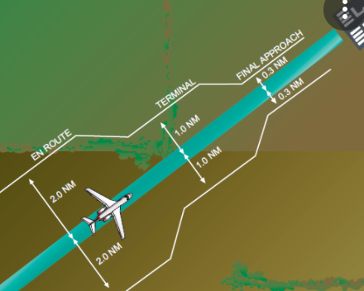
Product-in-a-box
RNP/RNAV Savings
Product Roadmap (MVOs)
MVO 1
MVO 2
MVO 3
Southwest
Airlines
Large US
commercial
Operators
Visit Honeywell.com/RNP-RNAV-SAVINGS
Connect with NavDB Operations team for custom solutions.
Business Case summary
- Revenue over next 3 years : $10 M
- Costs : $2 M
Aircraft Flying Made Efficient

