Slide 1

Walchand College of Engineering
(Government Aided Autonomous Institution)
Vishrambag, Sangli, 416415
Department of Computer Science & Engineering
Presentation on
1947
Real Time Traffic Sign Detection with Voice Alert
AY:2023-24
Team Members:
21510016 : Anurag Takalkar
21510017 : Onkar Yemul
21510042 : Omkar Auti
Under the guidance of
Prof. N.L.Mudegol
Date:08 December 2023

Slide 2
Agenda
Abstract
Problem statement
Objectives
Methodology
UML diagrams
Technology stack
Implementation/Results
Outcomes/Applications
Conclusion
References

Slide 3
Abstract
1. Global Crisis: Annual traffic accidents claim 1.3 million lives, affecting 20-50 million with long-term disabilities, causing immense human suffering and economic strain.
2. Economic Impact: Road accidents incur significant costs, including medical expenses and lost productivity, with countries facing a 3% GDP loss.
3. Call for Innovation: Urgent need for innovative solutions to mitigate accidents and improve safety globally.
4. Our Solution: We propose a real-time traffic sign detection system using image and video processing, offering textual and audio feedback. This technology aims to reduce accidents, save lives, and address economic repercussions.

Slide 4
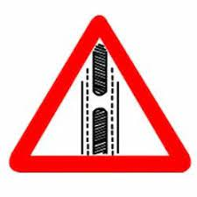
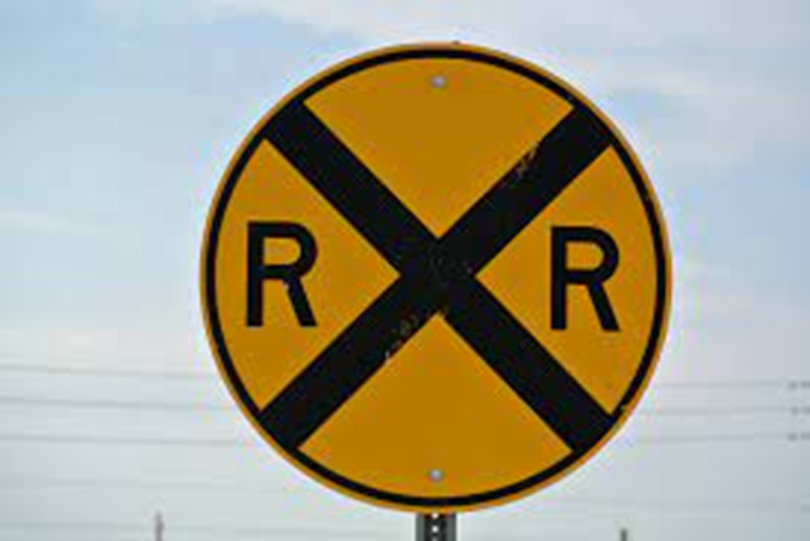
Why We NEED Traffic Sign detection Model ?

Slide 5
Problem statement
Developing a real-time traffic sign detection system with voice alerts in English, Hindi, and Marathi. The system processes image/video feeds, identifies signs, and provides textual and voice notifications, enhancing safety by alerting drivers about nearby traffic signs for rule adherence.

Slide 6
Objectives
1. Data Collection and Preprocessing: Curate a diverse Indian traffic sign dataset, normalize colors, resize images, and apply augmentation for model robustness.
2. Model Training: Split the dataset, train and optimize the model, ensuring accuracy and precision.
3. Traffic Sign Detection System: Develop a highly accurate and robust real-time detection system.
4. User-Friendly Interface: Create an intuitive interface displaying clear, concise real-time information for an enhanced user experience.

Slide 7
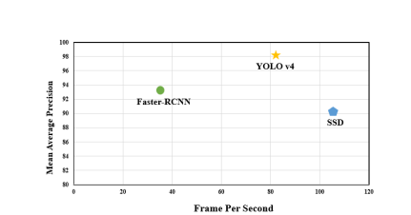
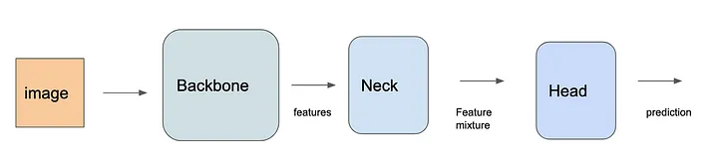
Methodolgy
Why YOLO ?

Slide 8
Methodolgy
YOLOv5 Implementation: Utilizes YOLOv5, a cutting-edge object detection algorithm.
Real-time Detection: YOLO is a fast CNN for instantaneous object detection.
Bounding Boxes and Probabilities: The algorithm divides the image into regions, predicting bounding boxes and associated probabilities for each segment, providing precise localization of objects.
Efficient Processing: Single-pass forward propagation ensures real-time accuracy with non-max suppression for efficiency.

Slide 9
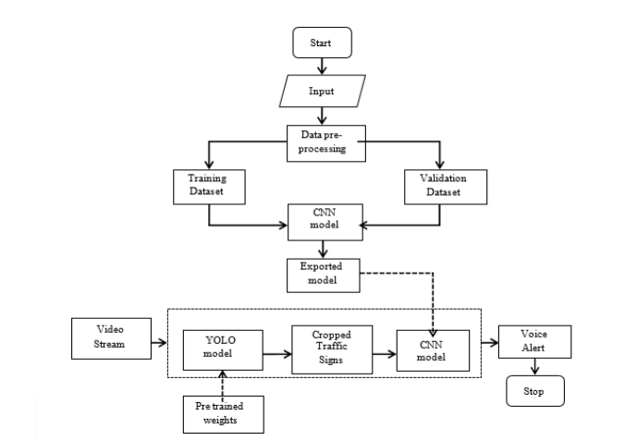
UML Diagrams
.

Slide 10
Technology Stack
YOLO V5
Google Text to Speech
PlaySound
Python Tkinter

Slide 11
Implementation/results
1.Real-Time detection and classification upto 30 fps
2. Accuracy as high as 98%
3. mAP@0.5=91.75%
4. mAP@0.5:0.95=74.65%

Slide 12
Outcomes/Applications
1. Accurate Detection: Our system, utilizing YOLOv5, demonstrates a remarkable upto 98% accuracy in identifying various traffic signs.
2. Multilingual Alerts: Offering voice notifications in English, Hindi, and Marathi ensures comprehensive communication with diverse users.
3. Enhanced Road Safety: Real-time sign recognition facilitates informed driving decisions, contributing to overall road safety.
4. User-Friendly Interface: The intuitive Tkinter-based GUI provides clear and concise visual and audio feedback, ensuring a seamless user experience.

Slide 13
Conclusion
1.Enhanced Safety: Our real-time traffic sign detection system employs YOLOv5 for accurate sign recognition, promoting safer driving conditions.
2. Multilingual Alerts: With voice alerts in English, Hindi, and Marathi, our GUI provides real-time guidance for diverse road users.
3. User-Friendly Interface: Tkinter-based GUI ensures an intuitive experience, delivering clear visual and audio notifications for identified traffic signs.
4.Robust Performance: Leveraging advanced image processing and deep learning, our system achieves a high accuracy of 98% for effective and reliable traffic sign detection.

Slide 14
references
World Health Organization (WHO)", March 2022, [online] Available: https://www.who.int/news-room/fact-sheets/detail/road-traffic-injuries
2. Kaggle link of the dataset-
https://www.kaggle.com/datasets/ahemateja19bec1025/trafficsignlocalizationdetectionssdannotated
3. Morten B. Jensen, Kamal Nasrollahi and Thomas B. Moeslund, "Evaluating state-of-the-art object detector on challenging traffic light data", Proceedings of the IEEE Conference on Computer Vision and Pattern Recognition Workshops, pp. 9-15, 2017.
https://openaccess.thecvf.com/content_cvpr_2017_workshops/w9/html/Jensen_Evaluating_State-Of-The-Art_Object_CVPR_2017_paper.html

Slide 15
Thank You

