Slide 1
CHEM 545/546 Group Project
Members: Omkar Bhambure, Yueyang Chen, Rachel Gebhart, Isaac Kretzmer

Slide 2
Project Objectives
Goal: Analyze characteristics of SEM images
Deliverables:
Average particle size (float radius)
Particle size distribution (float average, histogram)
Measure of how spherical/elliptical the particles are (density plot)
Stretch: some measure of irregularity/roughness (we’ll figure this out later)
Inputs:
*.TIFF from FEI XL830 SEM

Slide 3
How We Start
Use Edge detection to separate particles and create binary
Fit curve splines
Count particles
…all of the analysis!
OpenCV Package
Open Source Python Package for Image Processing (MIT License)
Multiple methods of edge detection available for use
Sobel
Canny
Laplace

Slide 4
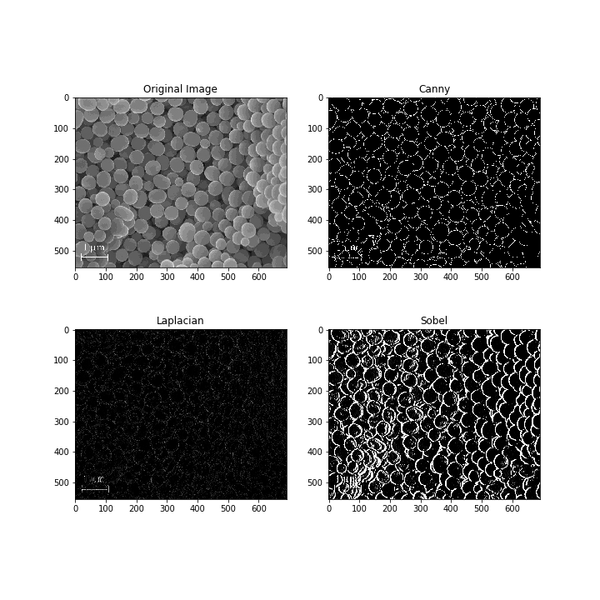
Example

Slide 5
Canny Edge Detection
Smooth image using Gaussian filter
Noise filtering
Find intensity gradients
First derivatives
Remove non-maximum peaks
Compare to nearby gradients
Mark weak edges
Caused by true edges, noise, and color
Hysteresis edge tracking
Remove edges caused by noise and color
Pros
Non-maximum suppression and weak edge marking extract edges well
Cons
Fails with very noisy images, requires parameter tuning

Slide 6
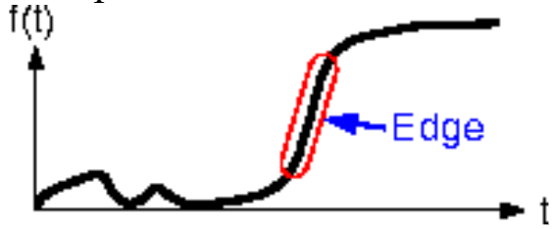
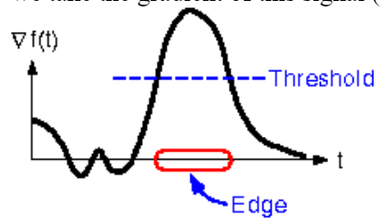
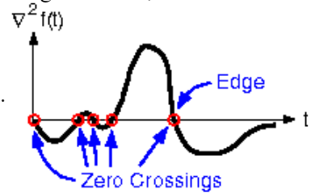
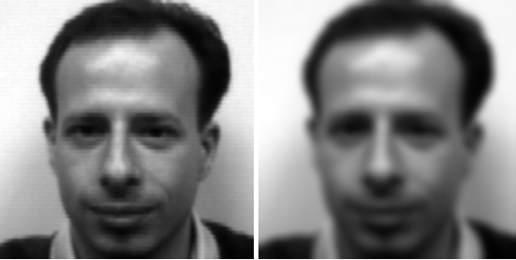
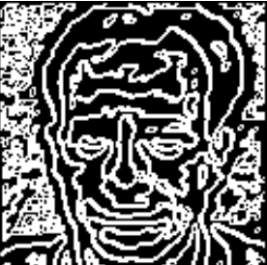
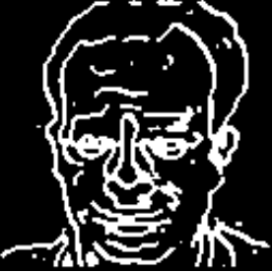
Laplacian Edge Detection
1D image
Pros:
Easy to calculate (One pass calculation)
Cons:
First order
Derivative
Sensitive to noise
Need to apply filter before/after the edge detection
Examples:
Second order
Derivative

Slide 7
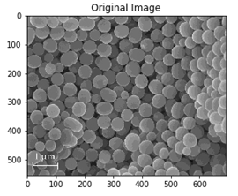
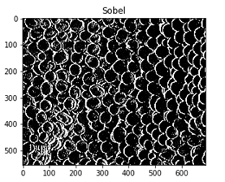



Sobel Edge Detection
Sobel operator is a joint Gaussian smoothing and differentiation operation
You can specify the direction of the derivative
Size of the Kernel can be changed
Pros:
Edges seem thick and bright
Cons:
High Computational time
It is very noisy.

