Slide 1
CAPSTONE PROJECT
AI AGENT FOR SMART FARMING ADVICE
Presented By:
Student Name : Omkar Challagolla
College Name : Vignan’s Lara Institute Of Technology and
Science
Department : Computer Science and Engineering

Slide 2
OUTLINE
Problem Statement
Proposed System/Solution
System Development Approach
Algorithm & Deployment
Result (Output Image)
Conclusion
Future Scope
References

Slide 3
PROBLEM STATEMENT
Small-scale farmers often lack access to real-time, localized agricultural advice, leading to suboptimal crop choices and lower yields. Challenges include understanding soil health, unpredictable weather, pest outbreaks, and fluctuating market prices.
With increasing climate unpredictability, soil degradation, pest outbreaks, and volatile market prices, making the right farming decisions has become more critical than ever. Farmers need timely, localized recommendations that consider multiple factors such as soil health (NPK levels, pH), weather conditions, rainfall, humidity, and temperature, along with market trends.
This project aims to bridge this knowledge gap using AI to offer personalized crop
recommendations and smart farming advice.

Slide 4
PROPOSED SOLUTION
The proposed system aims to address the challenge of helping small-scale farmers make data-driven crop selection decisions. This involves leveraging machine learning,
weather data, and cloud deployment to provide accurate and personalized crop recommendations. The solution consists of the following components:
Data Collection:
Gather historical agricultural data, including soil nutrient values (N, P, K), pH levels, temperature, humidity, and rainfall.
Incorporate real-time data sources such as weather APIs to enhance the relevance and accuracy of predictions.
Data Preprocessing:
Clean and preprocess the dataset to handle missing values, remove inconsistencies, and normalize numerical features.
Perform feature engineering to extract meaningful insights that influence crop suitability and yield.
Machine Learning Algorithm:
  Use IBM Watson AutoAI to automate model selection, testing multiple classification algorithms (e.g., Random Forest, Decision Tree).Select the best model based on
accuracy and confidence metrics for predicting the most suitable crop.
Deployment:
Deploy the trained model using IBM Watson Machine Learning as a REST API.Allow real-time predictions through a web interface or chatbot by sending input values and retrieving crop recommendations.
Evaluation:
Measure model performance using accuracy and confidence percentage for multiclass classification.Continuously improve the system based on validation results and real-time testing with user inputs.

Slide 5
SYSTEM APPROACH
The system approach outlines the strategy and methodology used to design, develop, train, and deploy the AI-powered crop
recommendation system on IBM Cloud. It ensures seamless integration of data processing, machine learning, and cloud deployment.
System requirements
Hardware: Internet-connected device (Laptop/Desktop), minimum 4GB RAM
Platform: IBM Cloud Lite (free tier)
Services Used : IBM Watson Studio, IBM Watson Machine Learning , Cloud Object Storage
Library required to build the model
IBM AutoAI (No manual coding required – automated pipeline generation)
Watson Machine Learning SDK (for deployment and API usage)
Python (optional for testing):requests (to call REST API)
pandas and numpy (for dataset handling in local tests)
matplotlib or seaborn (for any visualization)
Postman (for API testing)
Jupyter Notebook (for model evaluation and local tests, if applicable)

Slide 6
ALGORITHM & DEPLOYMENT
Algorithm Selection:
  The AutoAI feature in IBM Watson Studio was used to automatically train and evaluate multiple classification algorithms including Decision Trees, Random Forest, Gradient Boosting, and Logistic Regression. Based on performance metrics such as accuracy and confidence, the best model was selected. Since the task involves recommending one crop from multiple options, a multiclass classification approach was appropriate..
Data Input:
  The following features were used as input to train the model:N (Nitrogen content in soil),P (Phosphorus content in soil),K (Potassium content in soil),Temperature (in °C),Humidity (in %),pH level of the soilRainfall (in mm).
  These input features were selected as they are critical environmental factors that influence the suitability of a crop for a given region..
Training Process:
The AutoAI pipeline automatically split the dataset into training and validation sets. It performed data preprocessing (handling missing values, encoding), model selection, and hyperparameter optimization. The model was trained using historical agricultural data from a crop recommendation dataset, ensuring it could generalize well to new inputs.
Prediction Process:
  Once the best-performing model was selected, it was deployed as a REST API using IBM Watson Machine Learning. Real-time crop predictions are generated when the model receives input data (e.g., NPK, temperature, rainfall, etc.). The model returns the most suitable crop label (e.g., rice, mothbeans) along with confidence scores..

Slide 7
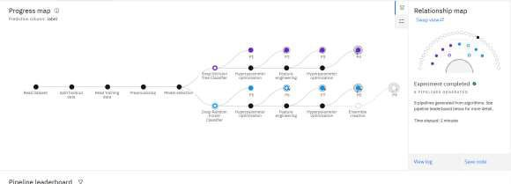
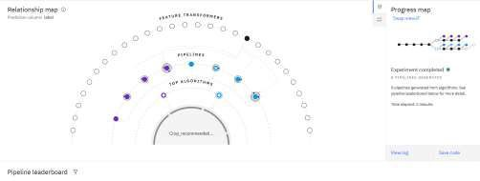
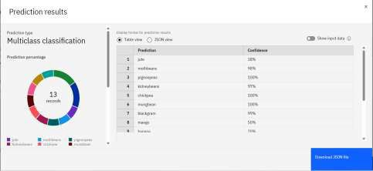
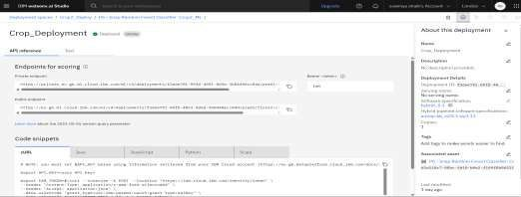
RESULT

Slide 8
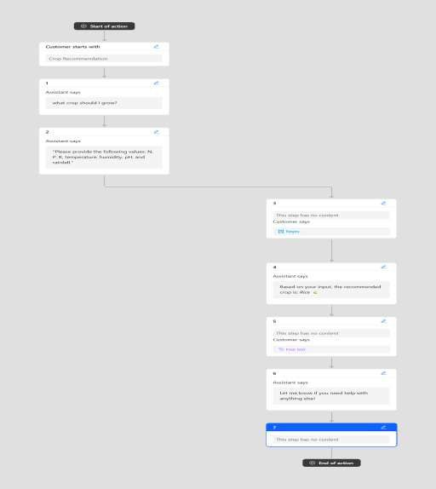
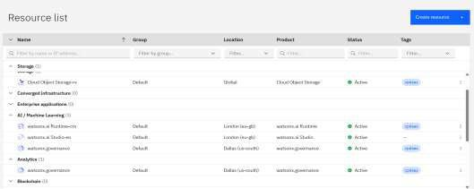
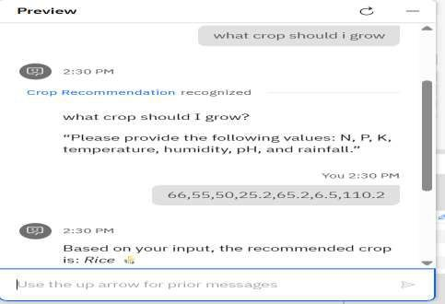
RESULT

Slide 9
CONCLUSION
This AI-driven crop recommendation system provides real-time, personalized agricultural guidance to small-scale farmers using IBM Cloud services. By integrating machine learning, natural language processing, and cloud deployment, it empowers farmers to make informed decisions based on soil conditions, weather, and other environmental factors.
The solution is scalable, modular, and designed for multilingual interaction through Watson Assistant. Deployed as a cloud-based API, it ensures accessibility and ease of use, even in remote areas. This system not only enhances productivity and profitability but also lays the foundation for future expansion into pest control, price forecasting, and sensor-based smart farming.

Slide 10
FUTURE SCOPE
Integrate real-time soil sensors to capture live data such as moisture, pH, and temperature for dynamic, hyperlocal
crop recommendations.
Add pest and disease detection using CNNs, allowing farmers to upload crop images and receive instant diagnostic
advice.
Enhance RAG (Retrieval-Augmented Generation) to include real-time market prices, government advisories, local
weather alerts, and pest warnings for smarter, context-aware responses.
Develop a mobile-friendly chatbot or progressive web app with voice input and multilingual support for ease of use
in rural areas.
Implement offline-first access to ensure the assistant works even in areas with poor or intermittent internet
connectivity, syncing data when a connection becomes available.

Slide 11
REFERENCES
1. Crop Recommendation Dataset – Kaggle: https://www.kaggle.com/datasets/atharvaingle/crop-recommendation-dataset
2. IBM Watson Studio Documentation – AutoAI: https://dataplatform.cloud.ibm.com/docs/content/wsj/autoai/overview -autoai.html
3. IBM Watson Assistant Documentation:
https://cloud.ibm.com/docs/assistant
4. IBM Weather Company Data API:
https://www.ibm.com/weather/weather-data/
5. IBM Cloud – Watson Machine Learning:
https://cloud.ibm.com/catalog/services/machine-learning
6. Credly Certifications – IBM: Getting Started with AI, Journey to Cloud, RAG Lab:
https://www.credly.com/organizations/ibm/badges
7. Research Paper – “Machine Learning Approaches for Smart Agriculture: A Survey

Slide 12
GITHUB LINK
Github Link:https://github.com/omkarch21/ibm_skills_build

Slide 13
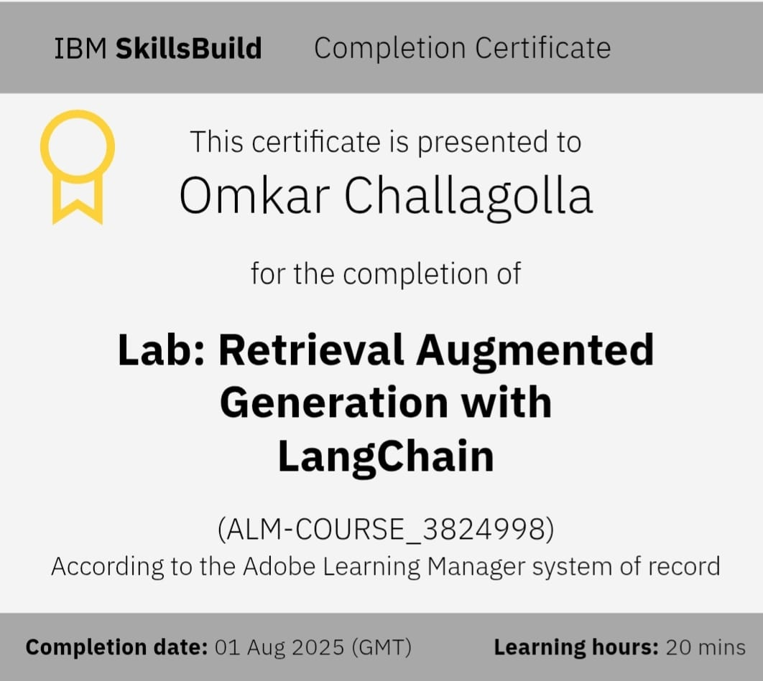
IBM CERTIFICATIONS

Slide 14
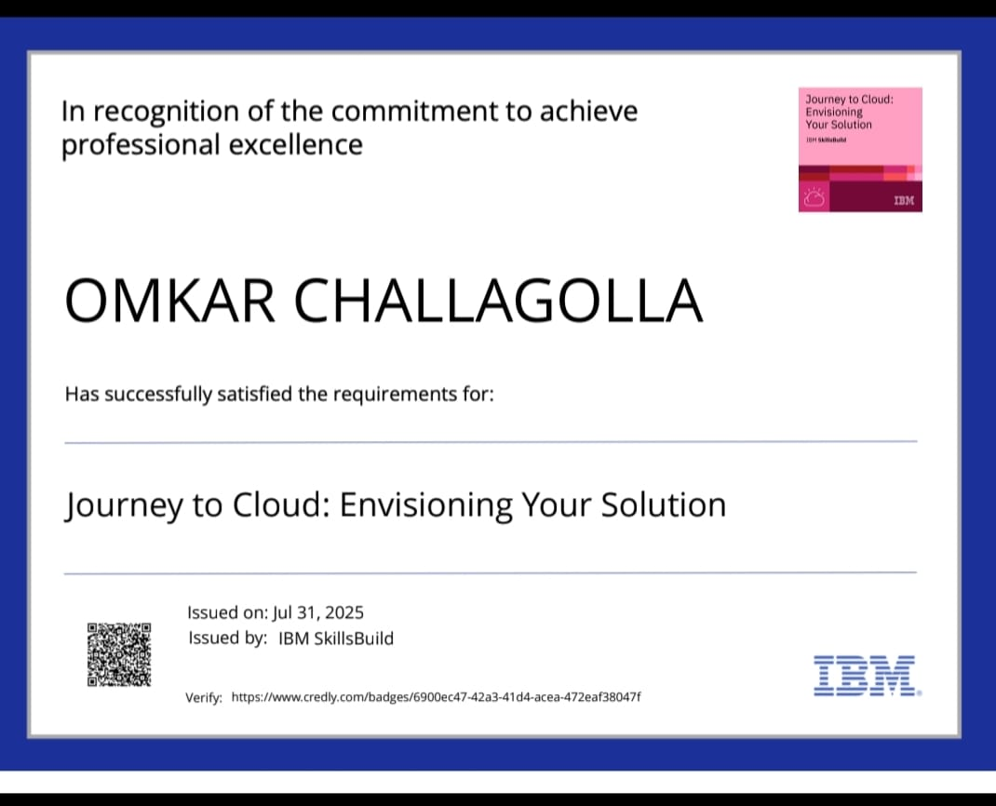
IBM CERTIFICATIONS

Slide 15
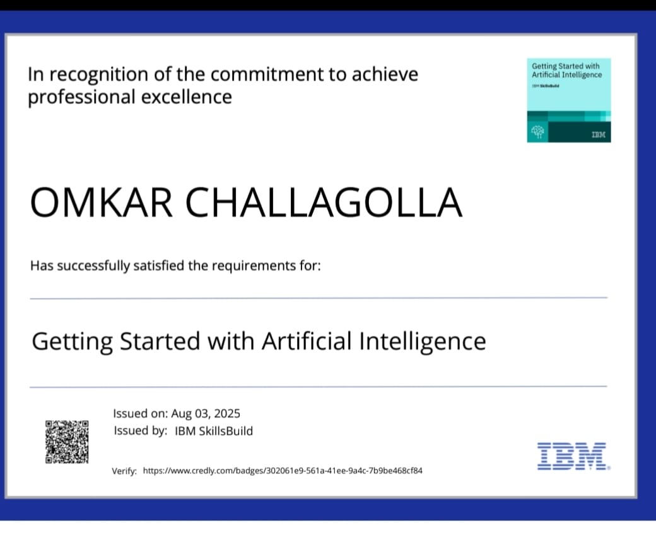
IBM CERTIFICATIONS

Slide 16
THANK YOU

