Slide 1
Smart Refrigerator Health Tracker

Slide 2
Problem Statement
Monitor the health of the people by monitoring their daily food consumption.
In spite of the great progress in field of health science, people still have unhealthy lifestyle because of lack of reach of this knowledge.
Few people have this knowledge too, but they fail to have good balance because they can’t keep the track record of their food consumptions.
To solve that we have many heath tracker apps available online as well as mobile integrated, but people are lazy to remember and record their data.

Slide 3
Problem Statement
People often fail to remember which things they need to buy when they are in market.
Cases such as running out of groceries are common too.

Slide 4
Our Approach
We solved this problem with latest world revolution technology: “Internet Of Things”
We need to track the food consumption of every family.
If we put the sensor in refrigerator that tells us the food item and its quantity present in, we can keep track of food programatically without human efforts.

Slide 5
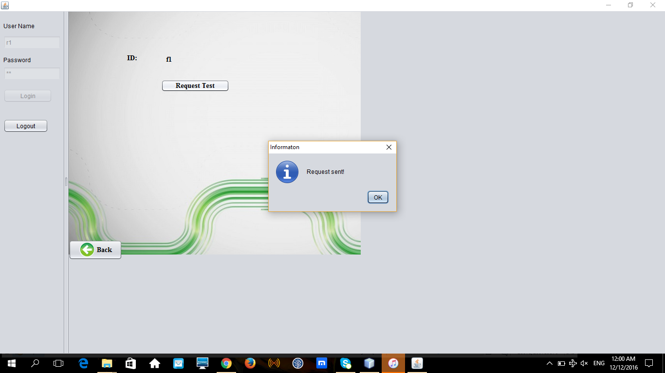
1) Use case: Send information to Health Care

Slide 6
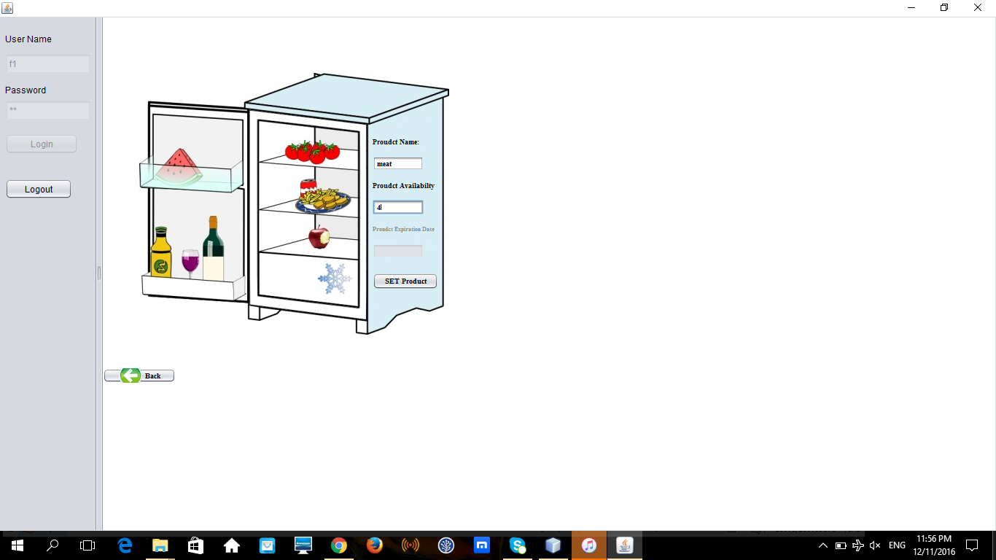
2) Use case: Analyze the food consumption of each family independently

Slide 7
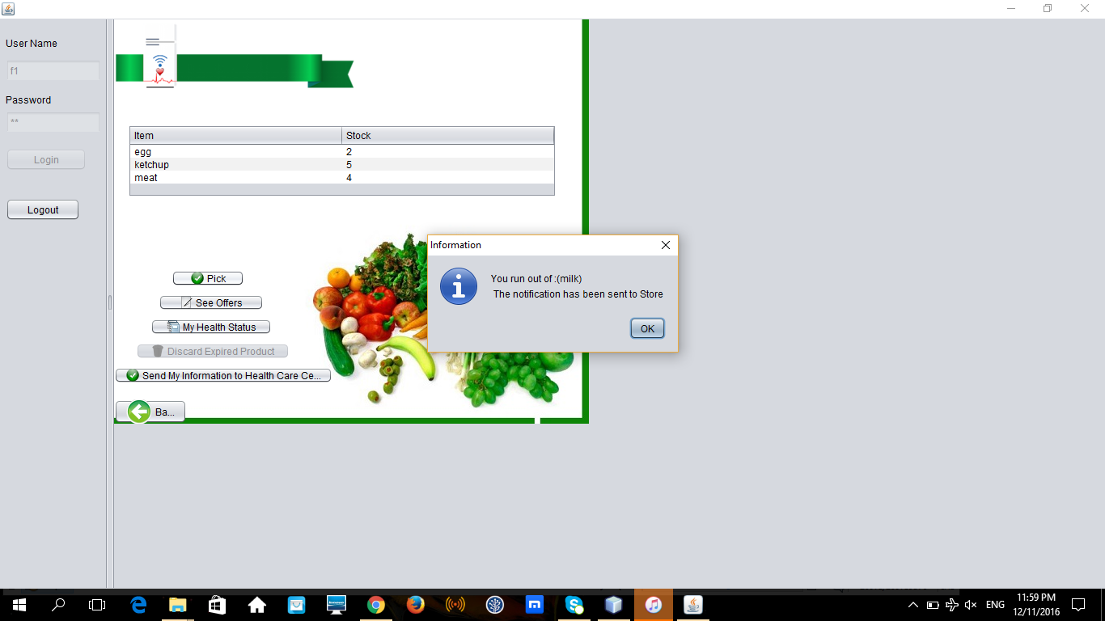
3) Use case: Notify the stock and Send/Receive Order placed by home refrigerator

Slide 8
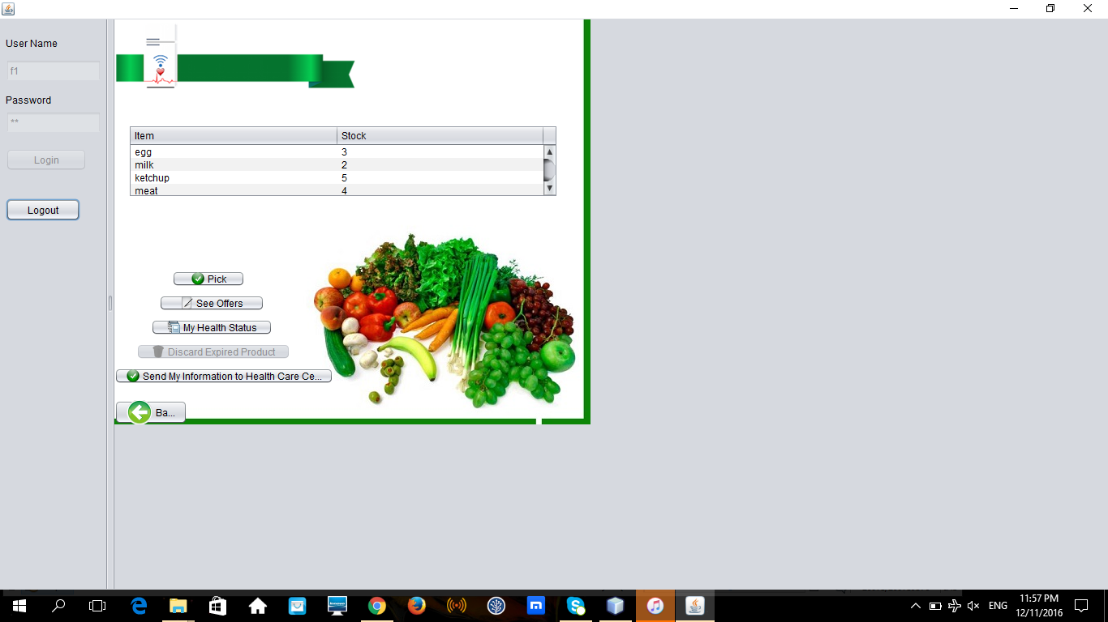
4) Use case: Send information to Healthcare Center

Slide 9
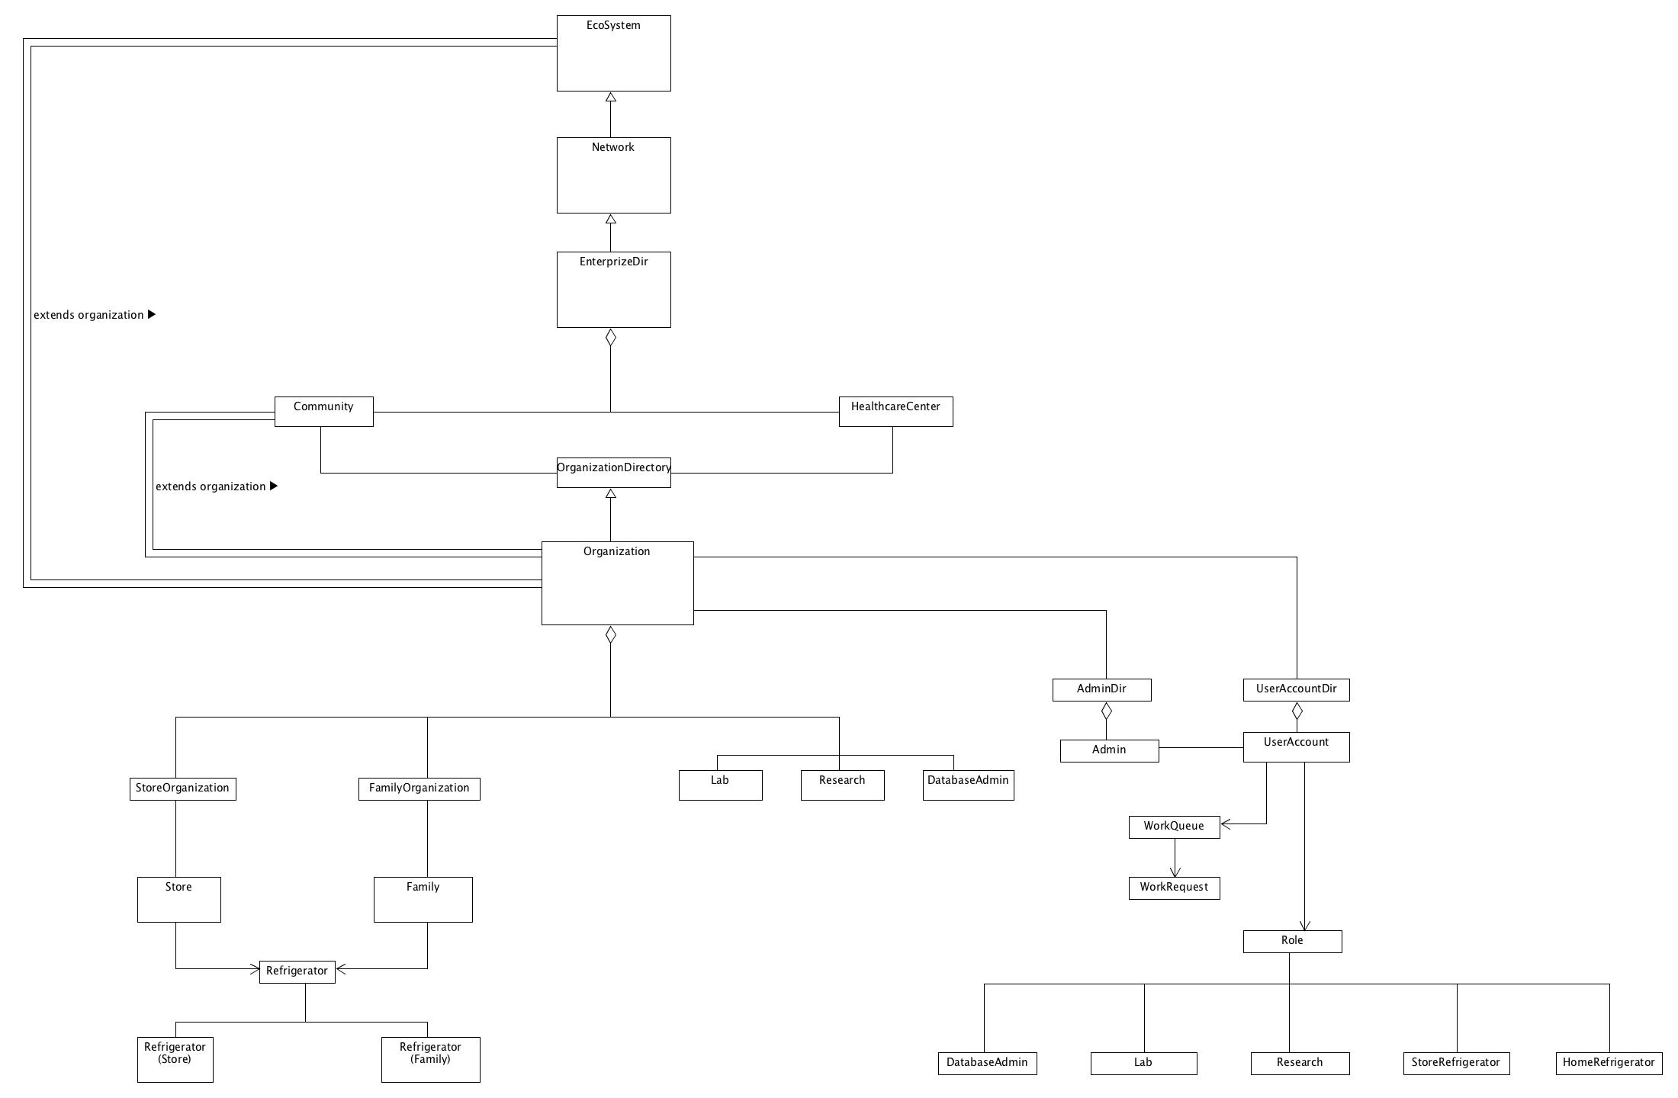
Object Model

Slide 10
Scope
1) Health organization get this valuable data which will help them to track the health status of the citizens.
2) Family gets the latest report without having to go to health center.
3) Easy diet advice.

Slide 11
Future Scope
1)Family can get this on mobile and see what the refrigerator holds.
2) Store can optimize their business.

Slide 12
DEMO

Slide 13
QUESTIONS ?

Slide 14
Thank You

