Slide 1
Coffee Café Sales & Transaction Analysis
Power BI Portfolio Project
Sales Performance | Product Analysis | Store Performance

Slide 2
1. Project Overview
Turning transaction data into actionable business insights
• Analyze café sales performance across January–June 2023.
• Identify revenue trends, high-performing products and categories, and store performance.
• Build an interactive executive dashboard in Power BI.
• Use DAX and dimensional modeling to create reusable business metrics.
• Present findings in a concise format suitable for business and interview discussions.
Coffee Café Sales & Transaction Analysis | Power BI

Slide 3
2. Dataset Overview
Transaction-level coffee café sales data
Transactions
Quantity Sold
Revenue
Avg. Transaction
149,116
214,470
$698,812.33
$4.69
• 3 store locations
• 9 product categories
• 80 products
• 11 source columns
• Analysis period: January 1, 2023 – June 30, 2023
• Data-quality checks found 0 duplicate rows and 0 null values.
Coffee Café Sales & Transaction Analysis | Power BI

Slide 4
3. Data Model & DAX
A simple dimensional model supports flexible analysis
DateTable
Transactions
ProductTable
Date, Year, Month
Fact table
Product attributes
• DateTable → Transactions: one-to-many relationship
• ProductTable → Transactions: one-to-many relationship
• Core DAX measures: Total Revenue, Total Transactions, Quantity Sold, Average Transaction Value
• Additional analysis measures: Revenue Contribution % and Month-over-Month Revenue Growth %
Coffee Café Sales & Transaction Analysis | Power BI

Slide 5
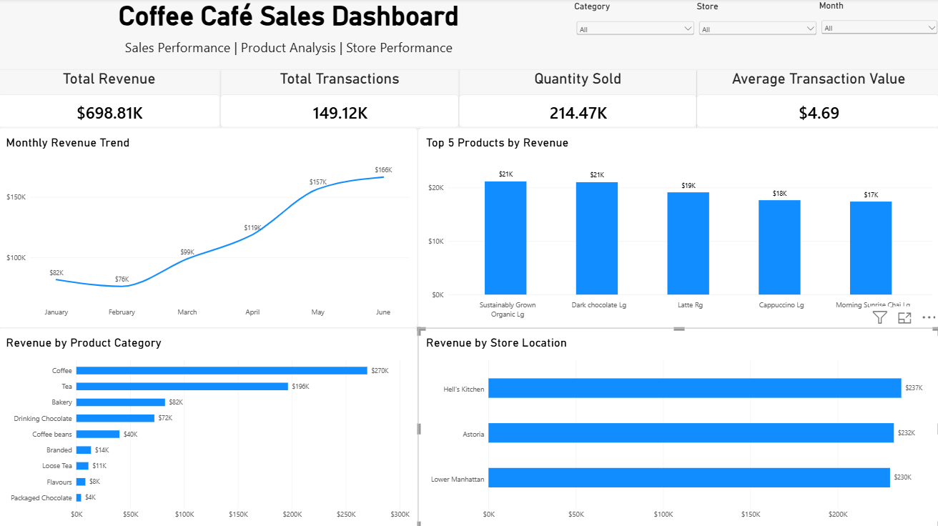
4. Executive Dashboard
A focused dashboard built around the main business questions
Coffee Café Sales & Transaction Analysis | Power BI

Slide 6
5. Key Business Findings
What the Power BI analysis reveals
• Coffee is the highest revenue-generating product category, at approximately $270K.
• June is the highest-revenue month at approximately $166K.
• February is the lowest-revenue month at approximately $76K.
• Hell's Kitchen generates the highest store revenue at approximately $236.5K.
• Sustainably Grown Organic Lg is the highest-revenue individual product.
• Revenue and quantity rankings are not always identical, so both measures are useful for performance analysis.
Coffee Café Sales & Transaction Analysis | Power BI

Slide 7
6. Recommendations & Limitations
Turning observations into next steps while keeping conclusions grounded
Recommendations
• Monitor the Coffee category and its product mix.
• Investigate February performance using traffic, promotions, availability, and seasonality data.
• Compare product mix and pricing across stores.
• Monitor high-revenue products and their contribution over time.
Limitations
• Only six months of data are available.
• No customer-level information is provided.
• No detailed promotion or discount data.
• No product cost or profit information.
• Transaction data identifies patterns but does not by itself establish the causes of revenue changes.
Coffee Café Sales & Transaction Analysis | Power BI

Slide 8
7. Conclusion
• The Power BI dashboard converts raw café transactions into a concise business performance view.
• The analysis combines data modeling, DAX, time-series analysis, product analysis, and store analysis.
• The final dashboard focuses on the information most useful for business decision-making and interview discussion.
• The project demonstrates an end-to-end Power BI workflow from data validation to dashboard storytelling.
Power BI project completed

