Slide 1

Presented by- Omkar Dhumal Batch-3
Case study
On
E-commerce website

Slide 2
Ecommerce Web API using ASP.Net & Angular
Creation of ASP.Net core web API
Implementation of Controllers & Models for Backend
SQL query commands for storing the data into database
Implementation of Angular for the e-commerce application
Implementation of Login & Register part
Implementation of Authentication part for user & admin
Implementation of add products & edit products for the admin
Implementation of add to cart for the user

Slide 3
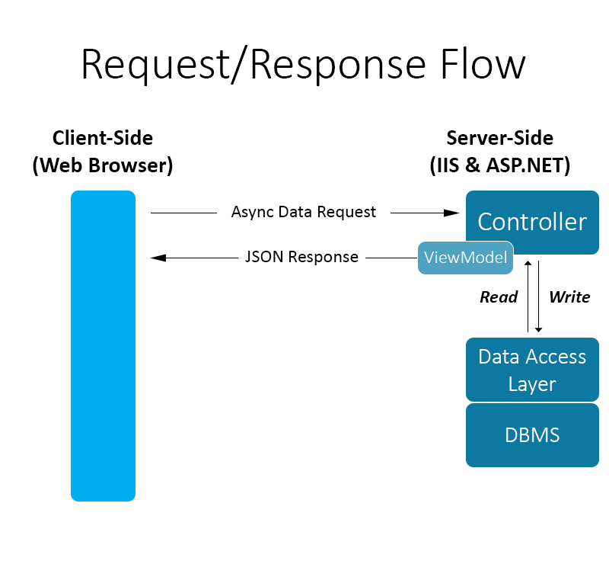
Request Response Model...

Slide 4
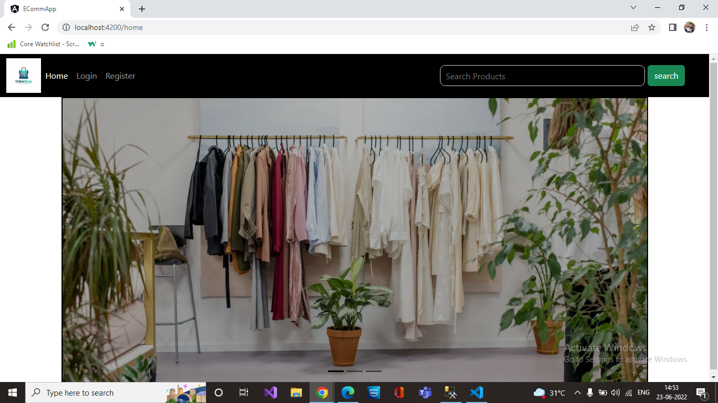
Home Page

Slide 5
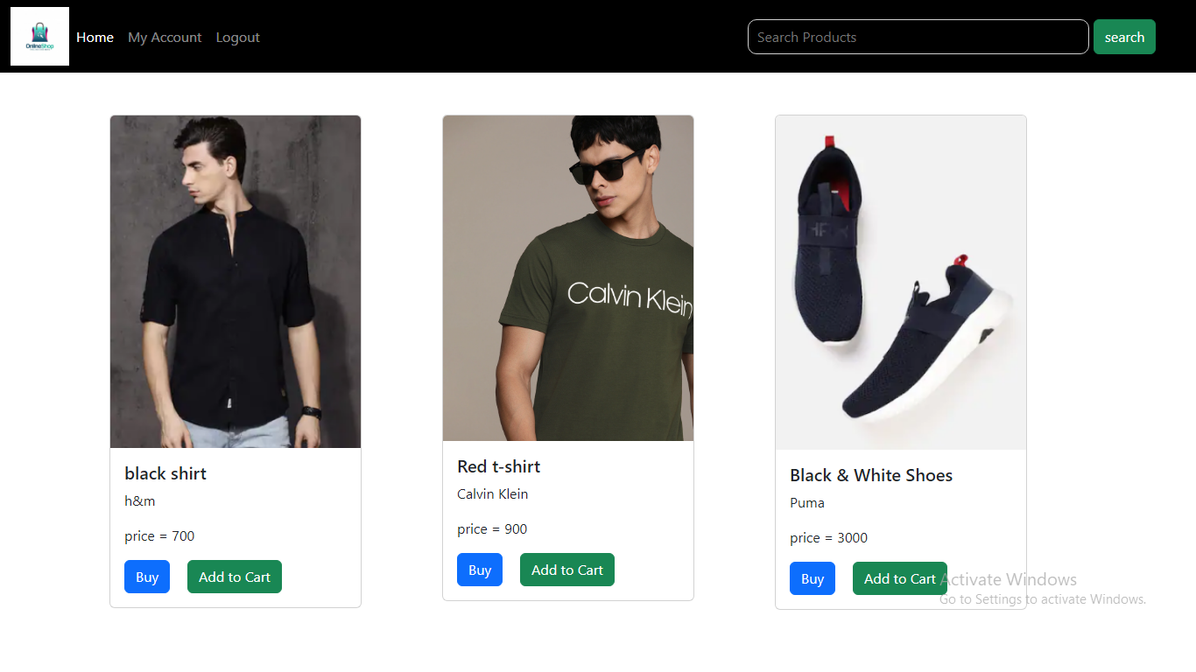
Products Page

Slide 6

GitHub Link
Link-https://github.com/omkardhumal7/program-files

Slide 7
Thank You...

