Slide 1


BYOP Project - Part 4
Bridging the Gap: Empowering Fresh Graduates for Successful Placements
Team: Jigyasa, Rajarshi, Shambhavi, Omkar, Ananya, Prashil

Slide 2
Task 1: North Star Metric

Slide 3

What’s the North Star Metric of Your Product?
Successful placements: Percentage of graduates who secure a job offer within a specific timeframe after graduation.
Time-to-Placement: The average duration it takes for a graduate to secure a job after completing their education.
User Engagement: The level of active participation and interaction of fresh graduates on platforms designed for showcasing their skills to potential employers.

Slide 4
Task 2: Metrics across AARRR

Slide 5
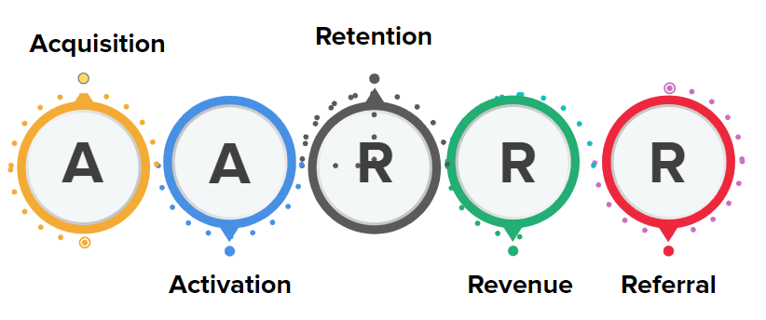
Recap- AARRR Framework

Slide 6
Identify the acquisition metrics for your product
S.No. | Metric | Description of the Metric | Why Include this Metric?
1 | User Sign-ups/Registrations | Tracking the number of users who registered on the portal. | Indicates the platform's attractiveness and the effectiveness of marketing efforts in attracting potential users.
2 | Conversion Rates: | Track the percentage of users who, after engaging with the platform, secure job placements or internships through the portal. | Measures the efficiency of the user journey and helps identify areas for improvement in the acquisition process.
3 | Source of Acquisition: | Identifying the sources that drive users to the platform. It could be social media, online advertisements, or any other marketing channel. | Guides future marketing strategies by highlighting the most effective channels and optimizing resource allocation.
4 | Cost of Acquisition: | Calculating the cost associated with acquiring a new user. | Evaluates the efficiency and sustainability of the acquisition strategy, ensuring that the cost of bringing in users aligns with the platform's goals and resources.

Slide 7
Identify the activation metrics for your product
S.No. | Metric | Description of the Metric | Why Include this Metric?
1 | Profile Completion Rate: | The percentage of users who have filled out their profiles with necessary information and details. | Gauges user engagement and provides comprehensive information to attract potential employers.
2 | Job Search/Listing Interaction: | Measures the frequency and depth of user interactions with job listings or search functionality on the platform. | Reflects user interest, showcasing the platform's relevance in connecting candidates with suitable positions.
3 | Application Submission Rate: | The percentage of users who submit job applications through the platform. | Demonstrates the platform's efficacy in converting user interest into active pursuit of employment opportunities.
4 | Skill Demonstration Activity: | Tracks the frequency and quality of user activities showcasing their skills, such as uploading projects, completing assessments, or adding portfolio items. | Measures user commitment to presenting capabilities, offering insights into the platform's effectiveness in facilitating skill demonstration.

Slide 8
Identify the retention metrics for your product
S.No. | Metric | Description of the Metric | Why Include this Metric?
1 | User Engagement Frequency: | Tracks how often users interact with the platform over time. | Indicates the platform's ongoing relevance and value to users, fostering long-term engagement and loyalty.
2 | Repeat Application Rate: | Measures the percentage of users who submit multiple job applications. | Reflects user satisfaction and ongoing interest in finding opportunities through the platform.
3 | Skill Development Participation: | Tracks user involvement in ongoing skill development activities or courses. | Demonstrates the platform's effectiveness in supporting users' continuous professional growth and development.
4 | Feedback and Survey Responses: | Gathers user feedback and survey responses regarding their experience with the platform. | Provides insights into user satisfaction, concerns, and suggestions, guiding improvements to enhance user retention.

Slide 9
Identify the revenue metrics for your product
S.No. | Metric | Description of the Metric | Why Include this Metric?
1 | Average Revenue per User (ARPU): | Calculates the average revenue generated by each user. | Assesses the platform's financial performance and helps optimize strategies to increase per-user revenue.
2 | Conversion of Free to Paid Users: | Measures the percentage of users who transition from free to paid subscription or premium services. | Indicates the effectiveness of converting users into paying customers, crucial for sustained revenue growth.
3 | Upsell/Cross-sell Success Rate: | Tracks the success rate of promoting and selling additional features or services to existing users. | Maximizes revenue by encouraging users to upgrade or purchase complementary offerings, enhancing their overall experience.
4 | Customer Lifetime Value (CLV): | Estimates the total revenue a platform expects to earn from a user throughout their entire relationship. | Guides decisions on customer acquisition costs and helps prioritize efforts to retain high-value, long-term users.

Slide 10
Identify the referral metrics for your product
S.No. | Metric | Description of the Metric | Why Include this Metric?
1 | Referral Conversion Rate: | Measures the percentage of referred users who successfully sign up or engage with the platform. | Evaluates the effectiveness of referral programs in acquiring new users, leveraging existing user networks.
2 | Referral Source Tracking: | Identifies the sources or channels from which successful referrals originate. | Informs the optimization of referral strategies by highlighting the most fruitful channels for acquiring new users.
3 | Referral Program Participation Rate: | Tracks the percentage of existing users actively participating in the referral program. | Assesses the engagement level of current users in advocating for the platform, influencing the success of referral initiatives.
4 | Referral Reward Effectiveness: | Measures the impact of referral incentives on user behavior and acquisition. | Helps fine-tune the design of referral rewards to maximize their attractiveness and encourage ongoing user advocacy.

Slide 11
Task 3: Improvement Strategies

Slide 12
Improvement Strategies
User Behaviour | Ways to Improve and Grow the Product
Acquisition | Referral Programs: Encourage existing users to refer their peers from similar colleges. Offer incentives, like extended access to premium features, for successful referrals. Free Workshops and Training Sessions: Offer free workshops or training sessions on various job-related skills through the platform. These can serve as an introduction to the portal's functionalities while providing valuable learning opportunities Continuous Feedback Loop: Actively seek feedback from users and implement changes or additions based on their needs.
Activation | A/B Testing: Constantly test different user flows and activation strategies to identify what works best. Incentivized Actions: Offer incentives or rewards for completing specific actions on the platform, such as applying to a certain number of jobs, connecting with a particular number of professionals, or sharing the platform with friends. Networking Opportunities: Facilitate connections between users, allowing them to network with professionals or other students in a similar position

Slide 13
Improvement Strategies
User Behaviour | Ways to Improve and Grow the Product
Retention | Enhance Personalized User Experiences: Implement personalized features and recommendations based on user behavior and preferences. Introduce Loyalty Programs: Launch loyalty programs or tiers that reward users for continuous engagement and achievement milestones. Implement Proactive Communication and Support: Establish regular communication channels to provide updates, tips, and support.
Revenue | Diversify Monetization Channels: Explore additional revenue streams beyond subscription fees, such as premium features, advanced analytics, or premium support. Optimize Pricing Structure: Review and adjust pricing plans to align with user value perception and market competitiveness. Strengthen Customer Education Programs: Educate users on the value of premium features and how they can benefit from an upgraded subscription.

Slide 14
Improvement Strategies
User Behaviour | Ways to Improve and Grow the Product
Referral | Incentivize Referral Program Participation: Increase the attractiveness of referral programs by offering enhanced rewards and recognition. Utilize Social Proof and Success Stories: Leverage success stories and positive user experiences to encourage referrals. Expand Referral Channels: Identify and leverage new channels for referrals beyond traditional methods.

Slide 15
Task 4: Elevator Pitch

Slide 16
Elevator Pitch
https://drive.google.com/file/d/1uJWsXY5mBZH7PYMILauo-sx5sV_X-dfa/view?usp=sharing

