Slide 1
PROJECT TITLE - SEASONAL AGRICULTURE PERFORMANCE ANALYSIS
STUDENT NAME : OMKAR VINOD GAIKWAD
COLLEGE NAME : ALL INDIA SHRI SHIVAJI MEMORIAL SOCIETY’S INSTITUTE
OF INFORMATION TECHNOLOGY , PUNE
AICTE STU ID : STU695f8daf9dc851767869871

Slide 2


PROBLEM STATEMENT
Agricultural activities are influenced by seasonal variations in environmental conditions, farming practices, resource availability and market conditions. As a result, agricultural performance may differ from one season to another.
However, raw agricultural data does not clearly explain how agricultural performance changes across seasons or what patterns can be observed in different seasonal conditions.
The problem is to analyze the given agricultural dataset and investigate seasonal differences in agricultural performance by identifying meaningful patterns, trends, relationships and variations within the available data.

Slide 3
PROJECT DESCRIPTION
The project analyzes agricultural performance across different seasons, including Kharif, Rabi, and Zaid, using farm-level data from multiple Indian states.
It examines how environmental factors such as rainfall, temperature, humidity, soil condition, and irrigation affect crop yield, production, and profitability.
The study compares crop-wise and region-wise performance to identify which seasonal patterns are most suitable for specific crops and locations.
It also evaluates economic indicators such as cost, revenue, and profit to understand farm sustainability and resource efficiency.
The main objective is to provide data-driven insights that support better decision-making in crop selection, irrigation planning, and agricultural management.

Slide 4

WHO ARE THE END USERS?
The end users of this project can be:-
Farmers: to understand which crops perform best in each season and which irrigation method is more efficient.
Agricultural officers / extension workers: to guide farmers with seasonal crop planning and resource management.
Agribusiness companies: to estimate crop productivity, market demand, and profitability trends.
Policymakers and government agencies: to support agricultural planning, irrigation policies, and rural development programs.
Researchers and students: to study climate-crop relationships and seasonal agricultural performance.
In short, the project is useful for anyone involved in farming, agriculture planning, or agricultural data analysis.

Slide 5

Technology Used
Python for data analysis and visualization.
Pandas for handling and cleaning the dataset.
NumPy for numerical operations.
Matplotlib and Seaborn for charts and graphs.
SciPy for statistical testing.
Jupyter Notebook for project execution and documentation.

Slide 6
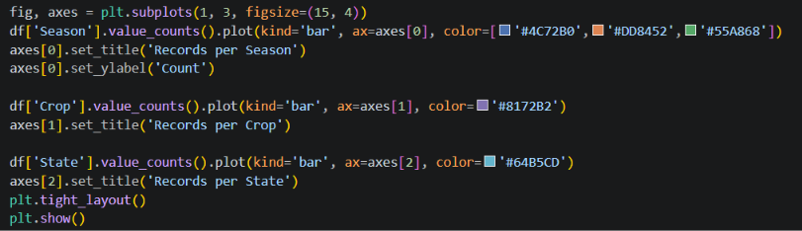
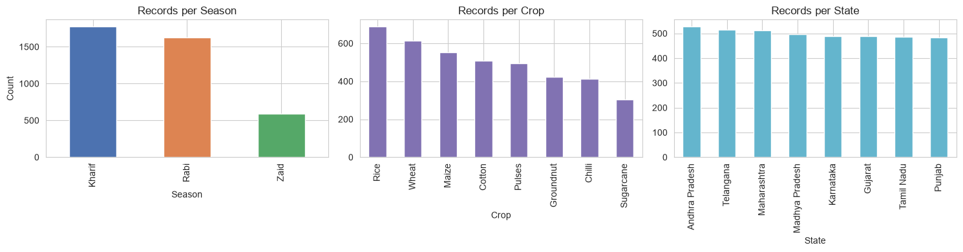
RESULTS

Slide 7
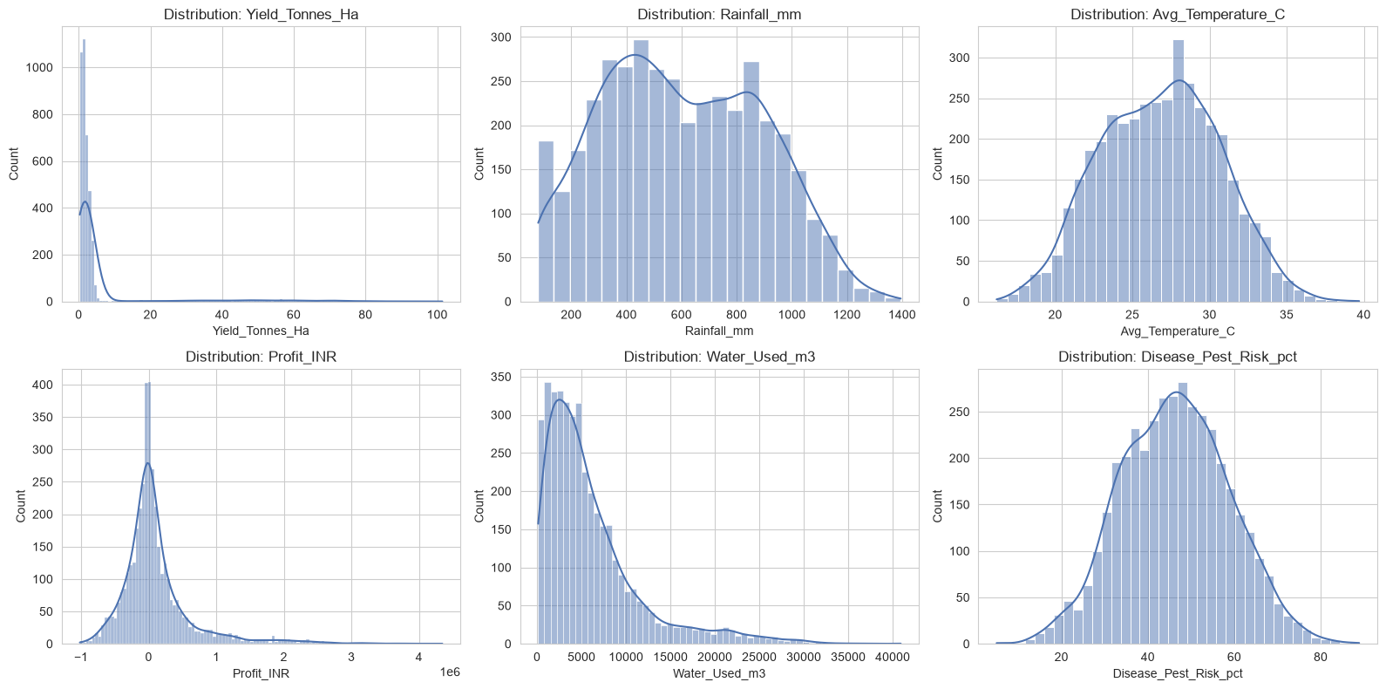
RESULTS

Slide 8
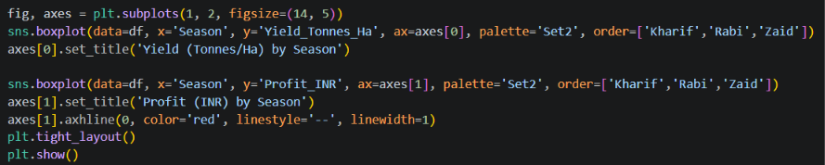
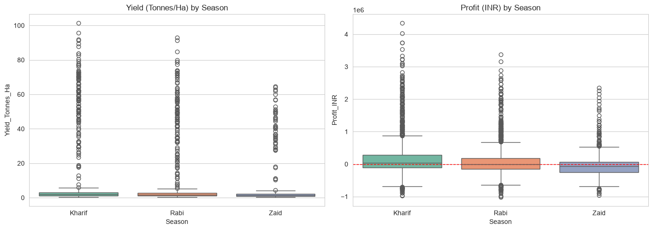
RESULTS

Slide 9
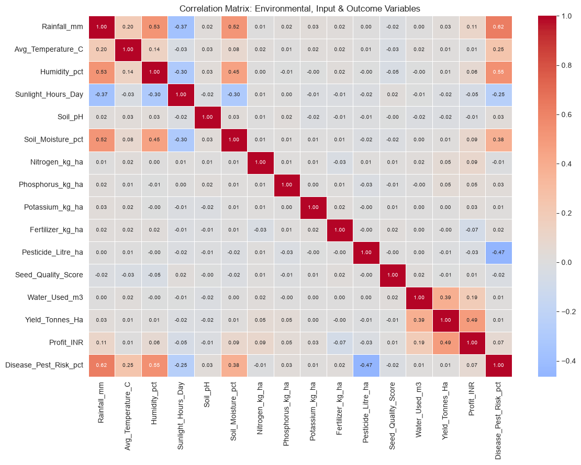
RESULTS

Slide 10
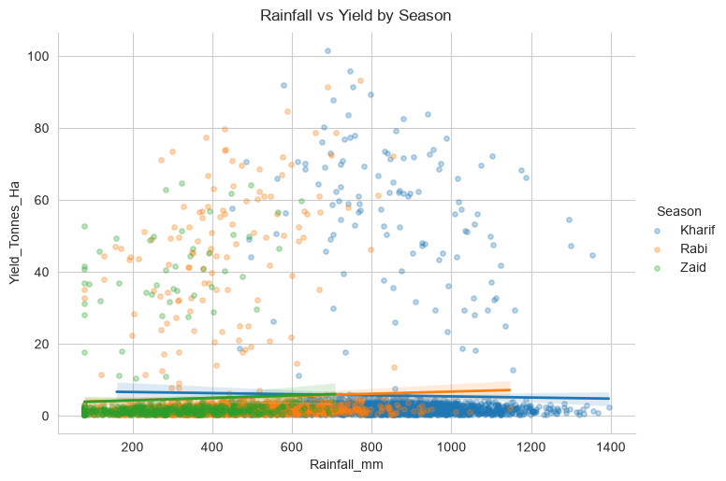
RESULTS

Slide 11
FUTURE SCOPE
Future scope includes collecting multi-year data to study long-term seasonal trends and climate-change impacts on crop performance.
Real-time weather, soil moisture, satellite imagery, market prices, and pest alerts can be integrated to improve prediction accuracy.
Machine-learning models could forecast yield, profit, disease risk, and water requirements for individual farms.
The project can also be extended into a web or mobile dashboard that provides farmers with crop-selection, irrigation, fertilizer, and pest-management recommendations.
Regional data, IoT sensors, and government schemes could further support precision farming and better agricultural planning.

Slide 12
GitHub Link
https://github.com/omkarg984/VOIS_Internship

Slide 13
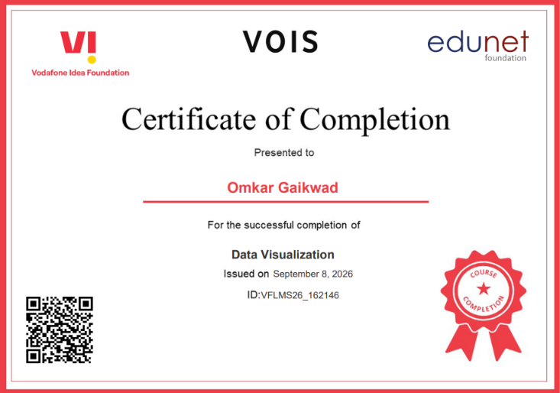
VOIS Course completion certificate - Course name- Data Visualization

Slide 14
THANK YOU
.
.

