Slide 1
Automatic Question Paper Generation System

Slide 2
DOMAIN INTRODUCTION
Asp.net
Asp.NET is an open source web framework for building modern web apps and services with .NET Asp.Net.
It creates websites based on html5, css, and javascript that are simple, fast, and can scale to millions of users.

Slide 3
OBJECTIVE
The Automatic Question Generator system helps the staffs to prepare the questions for the questions.
The Question Prepared can be generated as the pdf.

Slide 4
ABSTRACT
Preparing a question paper for examinations like internal and external is a very tedious job for staffs in college and universities.
Automatic question generator system propose a new idea to reduce the paper work, analyze the type of question and marks for that question.
In this system, Two or more staffs can prepare a question for same subject all the questions as store in the database.
After the submission of the question the COE can generate the final question paper that which contains the correct pattern with shuffled question given by staffs.
Questions are generated as PDF.

Slide 5
Existing System
In the existing system the question preparation is a tedious job for the staffs.
They need to do lot of paper work to prepare the question paper.
It take more time until the final question is generated.
Need to contact related staffs to prepare the questions.
After all need to select the final question and take the printout.

Slide 6
Proposed System
In our proposed system questions paper format can be created as pdf.
Lots of paper works can be reduced.
Stress for taking the question can be minimized.
To use this system the Staff and the COE first want to login into the system.
After staff login the are accepted by COE and then the staffs prepare the question for which pattern they want and questions are submitted.
COE generate the last stage of questions.

Slide 7
SYSTEM REQUIREMENTS
HARDWARE REQUIREMENTS:
System : Pentium IV 2.4 GHz
Hard Disk : 250 GB
Monitor : 15 VGA color
Mouse : Logitech.
Keyboard : 110 keys enhanced
Ram : 2GB

Slide 8
SOFTWARE REQUIREMENTS:
O/S : WINDOWS 7
LANGUAGE : ASP.NET
CODE BEHIND : C#
IDE : VISUAL STUDIO 10
DATA BASE : SQL SERVER 2008

Slide 9
Flow Diagram
Staff
Register
Admin
No
No
Login
Login
Yes
Yes
Confirm Staff
Prepare question for subject
Allocate Staff for subject
DB
Create questions
Shuffle Questions
Generate questions as pdf
Submit

Slide 10
USE CASE DIAGRAM
Login
Allocate staff
DB
View And Shuffle Question
Admin
Generate PDF

Slide 11
USE CASE DIAGRAM
Enroll
Login
View Allocation
DB
Prepare question
Staff

Slide 12
Modules
COE
Login
Verify Staff
Allocate Staff
Shuffle Questions
View Questions
Generate PDF
STAFF
Login OTP
Select Pattern
Prepare Questions

Slide 13
Admin Module
Here the admin first want to login into the system. Once he/she successfully logged in into the system then they can do the following process.
The admin can able to verify the staffs that who are all registered to the system.
After the registration and verification process done, admin can now able to allocate the staffs according to the subject wise questions.
After the questions are prepare by the staffs admin can now able to view the question in patter wise.
Then they can able to view the each pattern of questions.
Once the view page is loaded all the questions are shuffled.
At last it can be generated as the pdf file format.

Slide 14
Admin Flow
Admin
No
Login
Yes
Allocate Staff for subject
DB
Shuffle Questions
Generate questions as pdf

Slide 15
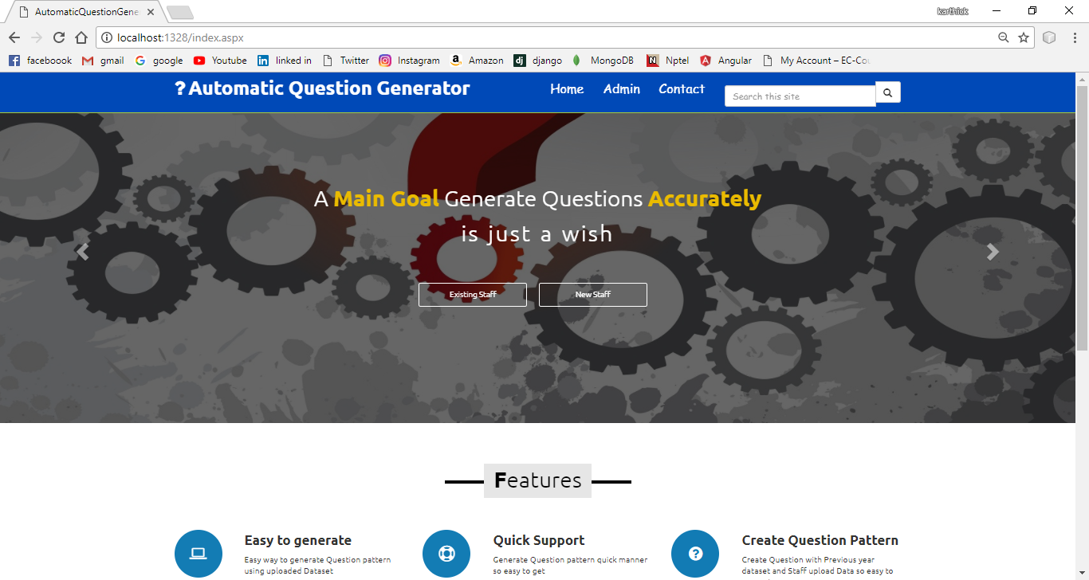

Slide 16
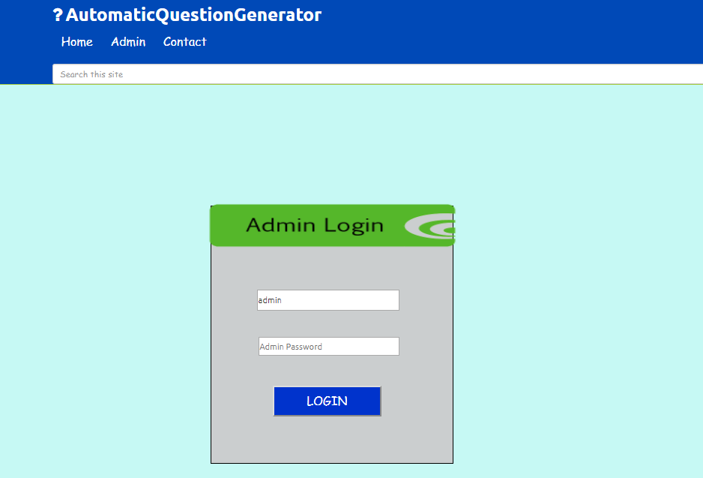

Slide 17
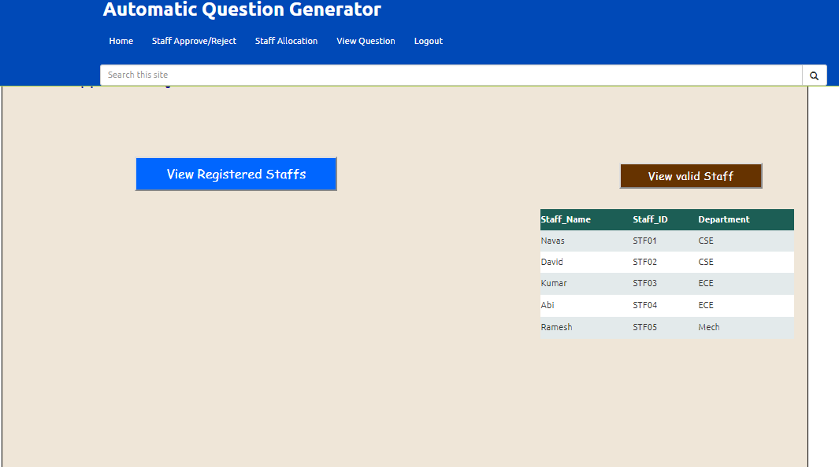

Slide 18
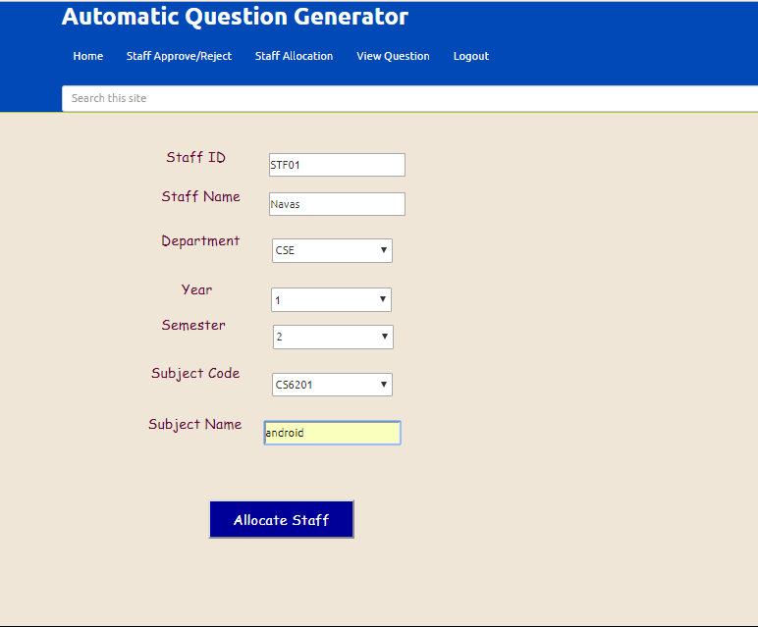

Slide 19
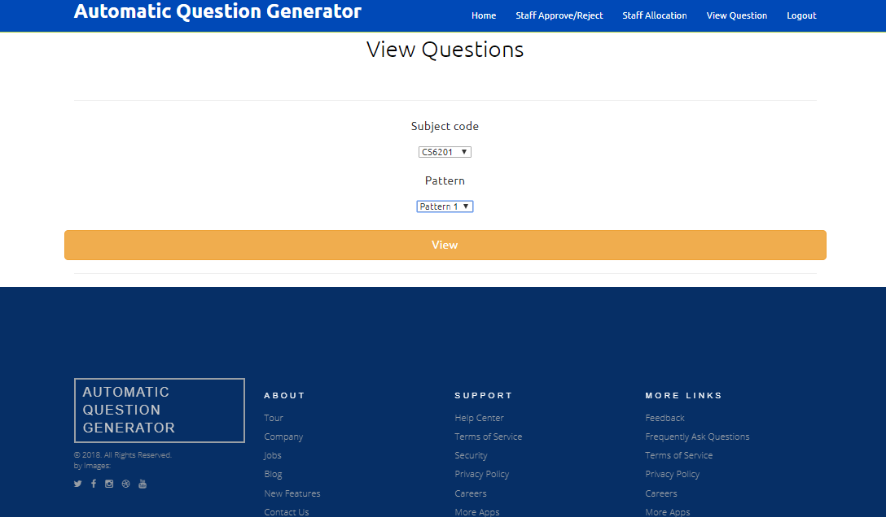

Slide 20
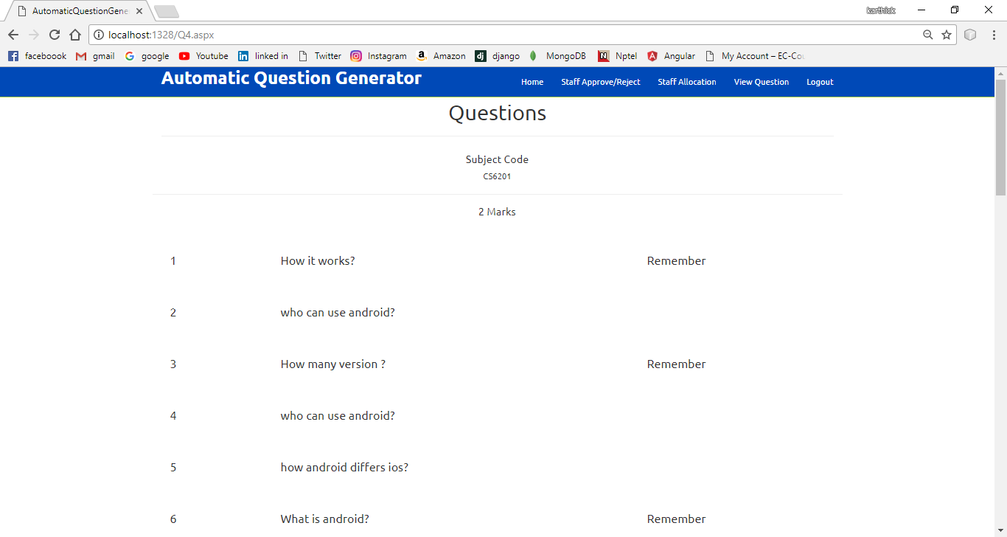

Slide 21
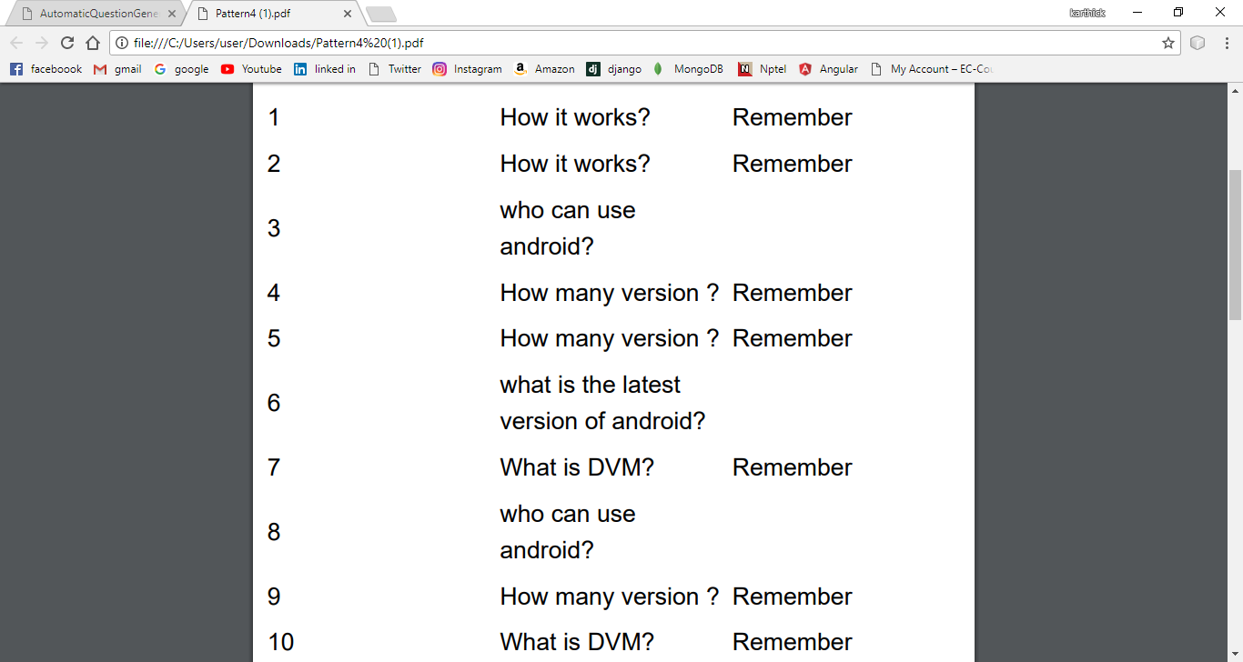

Slide 22
Staff Module
Here the staff first want to register to the system and then wait for the approval of the admin.
Once the staff is approved by the admin then they can able to successfully login into the system.
They can able now see their profile and can also prepare the questions.
Here the staffs can able to prepare the questions for which they are allocated.
The staffs are allocated to prepare more than one subject questions.
All the questions prepared by the staffs are based on the pattern.
The prepared questions are saved in the database successfully.

Slide 23
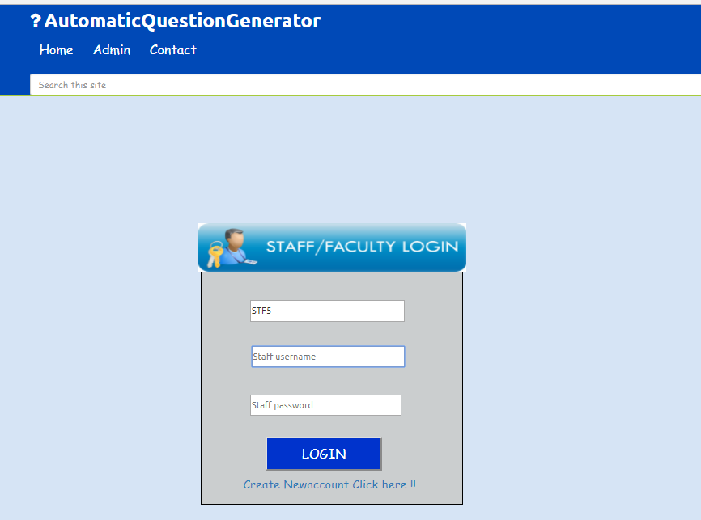

Slide 24
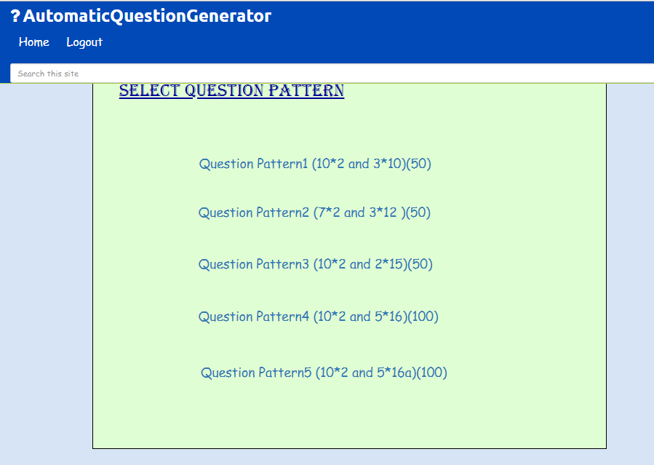

Slide 25
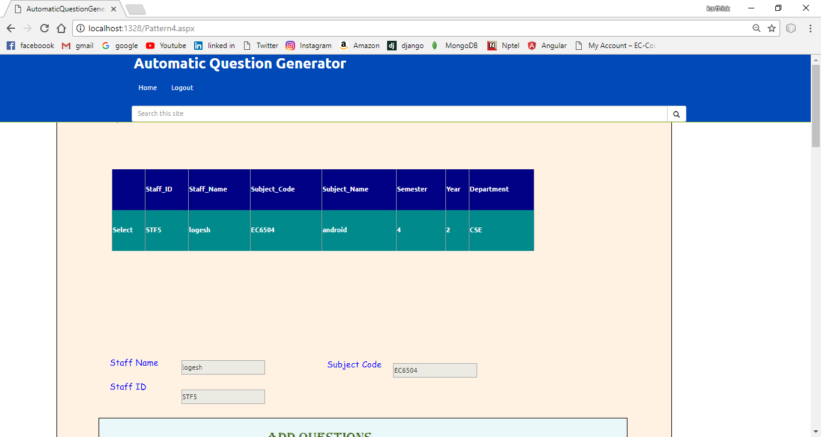
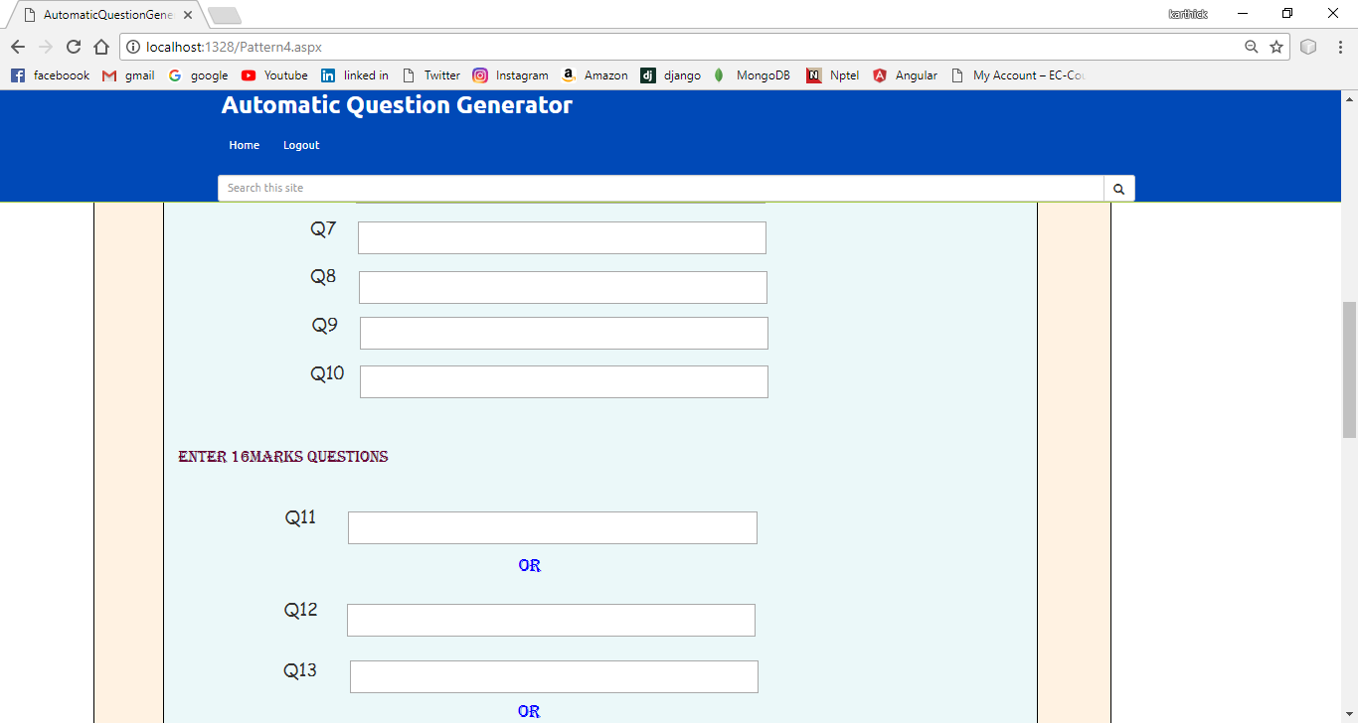

Slide 26
Staff Flow
Staff
Register
No
Login
Yes
Prepare question for subject
DB
Create questions
Submit

Slide 27
CONCLUSION
The system is more helpful for the staffs to prepare the question paper.
It helps to reduce more time for preparing the questions.
The staff can able to submit questions easily.
PDF generation of the question paper make staff more easier to take print out.
The application is more responsive and effective.

Slide 28
FUTURE ENHANCEMENT
In Future we can able to add the mail module to send the questions to the staffs itself, so that they can able to take the printout where the work of admin will be reduced.
We can also have the sub admin module to allocate the staffs for preparing the question paper.
We can also add the OTP login method where our system will be more secured.

Slide 29
THANK YOU…

