Slide 1
Fraud Transaction Detection
Model Evaluation.

Slide 2
Problem Statement
Data source: Kaggle.
Data Background: It simulates mobile money transactions based on a sample of real transactions extracted from one month of financial logs from a mobile money service implemented in an African country. The original logs were provided by a multinational company, who is the provider of the mobile financial service which is currently running in more than 14 countries all around the world.
Objective: Detecting Fraud Transactions.
Data shape : 6362620 Rows , 11 columns.

Slide 3
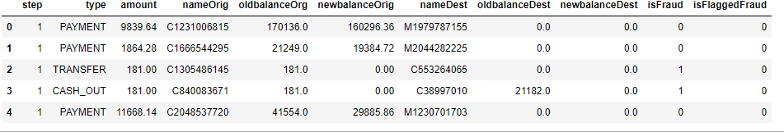
Data

Slide 4
Data Description.
step - maps a unit of time in the real world. In this case 1 step is 1 hour of time. Total steps 744 (30 days simulation).
type - CASH-IN, CASH-OUT, DEBIT, PAYMENT and TRANSFER.
amount - amount of the transaction in local currency.
nameOrig - customer who started the transaction
oldbalanceOrg - initial balance before the transaction
newbalanceOrig - new balance after the transaction
nameDest - customer who is the recipient of the transaction
oldbalanceDest - initial balance recipient before the transaction. Note that there is not information for customers that start with M (Merchants).
newbalanceDest - new balance recipient after the transaction. Note that there is not information for customers that start with M (Merchants).
isFraud - This is the transactions made by the fraudulent agents inside the simulation. In this specific dataset the fraudulent behavior of the agents aims to profit by taking control or customers accounts and try to empty the funds by transferring to another account and then cashing out of the system.
isFlaggedFraud - The business model aims to control massive transfers from one account to another and flags illegal attempts. An illegal attempt in this dataset is an attempt to transfer more than 200.000 in a single transaction.

Slide 5
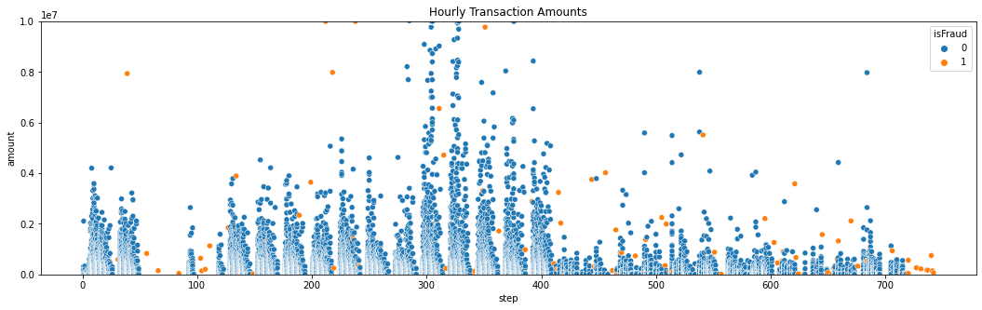
The plot clearly shows that there is some sort of seasonality in the number of transaction during the day. We observe a pattern every 24 hours. we do not know what time of the day '0' represent here but we observe highest transactions clusters around the middle of 24hour period. It might be noon or mid day. Let’s see if fraud transactions has that kind of pattern.

Slide 6
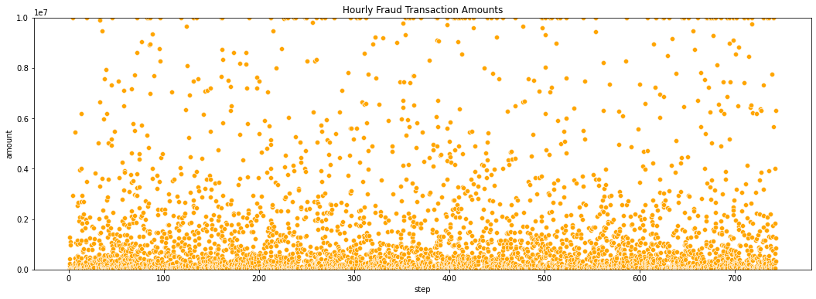
Fraud transactions does not show that significant pattern like safe ones in terms of number of occurrence. They happen every hour almost in the same frequency. There are more fraud transactions in low amounts and less in high amount. But the pattern does not change time to time.

Slide 7
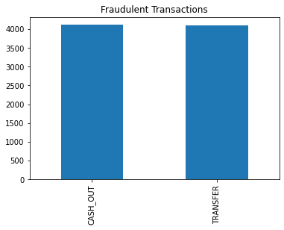
Types of Transactions have Fraud Cases.

Slide 8
Data Findings
Even though safe transactions slows down in 3rd and 4th day and after 16th day of the month, fraud transactions happens at a steady pace. Especially in the second half of the month there are much fewer safe transactions, but number of fraud transactions does not decrease at all.
Fraud proportion over all transactions is 0.01% while the fraud amount proportion is 0.1%
There is some sort of seasonality in the number of transaction every 24 hours. Fraud transactions does not show that significant pattern. They happen every hour almost in the same frequency.
There are more fraud transactions in low amounts and less in high amount. This distribution does not change much.
Fraud transaction happens in a large range such as 119 dollars to 10M dollars. Most of the fraud transactions are of Lesser amount. But in 1M there is an interesting increase similar to safe transactions.
There are 16 fake fraud cases with '0' amount.
Fraud activities only happens with TRANSFER and CASH_OUT transactions. DEBIT usage is very safe.

Slide 9
Baseline Modelling.
Models Considered : Logistic-Regression, KNeighbor-Classifier, RandomForest-Classifier, XGB-Classifier, svm.SVC.
Model Name | Train Accuracy | Test Accuracy
Logistic Regression | 77.66% | 72.33%
KNeighbor Classifier | 83.17% | 83.61%
Random Forest Classifier | 100.0% | 87.93%
XG-Boost Classifier | 100.0% | 89.66%
SVM-SVC | 63.18% | 59.48%

Slide 10
Hyper Parameter tuning.
Best Parameters for Random Forest Classifier
Best Parameters for XG Boost Classifier
Parameters | Best Values
Criterion | Entropy
Max depth | 10
Min Sample Split | 4
N Estimators | 10
Parameters | Best Values
Col Sample | 0.7
Gamma | 0.0
Learning Rate | 0.1
Max Depth | 5
N Estimators | 100

Slide 11
Model Performance After Parameter Tuning
Models considered : Random Forest Classifier and XG-Boost Classifier
Model | Train Accuracy | Test Accuracy
Random Forest Classifier | 98.91% | 98.86%
XG-Boost Classifier | 99.55% | 99.55%
Model | Values | Precision | Recall | F1-Score
Random Forest Classifier | 0 | 0.99 | 0.99 | 0.99
 | 1 | 0.99 | 0.99 | 0.99
XG-Boost Classifier | 0 | 0.99 | 0.99 | 0.99
 | 1 | 0.99 | 0.99 | 0.99

Slide 12
Model Performance After Balancing Data with best parameters
Models considered : Random Forest Classifier and XG-Boost Classifier
Model | Train Accuracy | Test Accuracy
Random Forest Classifier | 99.2% | 99.13%
XG-Boost Classifier | 90.0% | 89.66%
Model | Values | Precision | Recall | F1-Score
Random Forest Classifier | 0 | 1.00 | 1.00 | 1.00
 | 1 | 1.00 | 0.74 | 0.85
XG-Boost Classifier | 0 | 1.00 | 1.00 | 1.00
 | 1 | 1.00 | 0.79 | 0.88

Slide 13
Model Performance After Sub-Sampling original Data applying SMOTE
Models considered : Random Forest Classifier and XG-Boost Classifier
Model | Train Accuracy | Test Accuracy
Random Forest Classifier | 93.44% | 93.33%
XG-Boost Classifier | 99.51% | 98.94%
Model | Values | Precision | Recall | F1-Score
Random Forest Classifier | 0 | 1.00 | 1.00 | 1.00
 | 1 | 1.00 | 0.74 | 0.85
XG-Boost Classifier | 0 | 1.00 | 1.00 | 1.00
 | 1 | 0.97 | 0.98 | 0.98

Slide 14
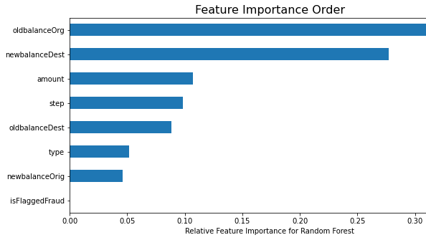

Slide 15
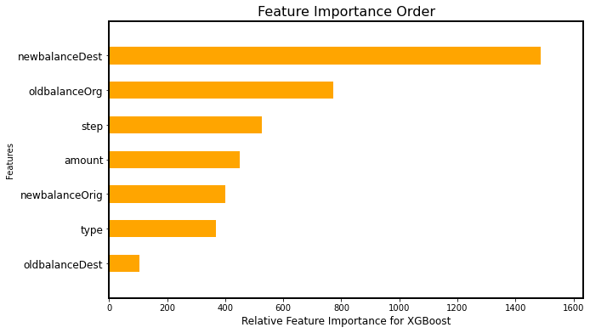

Slide 16
Future Enhancements.
Reindex this dataset with time-stamps and analyze it as time series to find some seasonality on both fraud transaction frequency and amount as well.
Enhancing Model performance with threshold values for ROC-AUC Score.

