Slide 1
Title: Adaptive Routing Protocol Analysis And Performance Evaluation In IPV6 Network
Presented By:
1.Aditya Vaibhav Naik (Roll No: B-23)
2.Onkar Vilas Kolate (Roll No: A-68)
3.Omkar Somnath Kokane (Roll No: A-67)
Guided By: Dr. S. B. Dhonde

Slide 2

Introduction
IPv6 is the next generation IP protocol which will eventually replace the current protocol IPv4. IPv6 has number of improvements and simplifications when compared to IPv4.In today’s world each and every networking company are willing to adopt IPv6 as it has many advantages over IPv4.
The basic requirement for developing an IPv6 network is routing and for this routing protocols are needed to be used.
Routing refers to the process of determining the best route for the transmission of data packets from source to destination and it is based upon routing protocols.
There are two types of routing protocols: interior gateway protocol (IGP) and exterior gateway protocol (EGP). RIP, OSPF, EIGRP, IS-IS are most commonly used IGPs and a typical EGP is BGP (Border Gateway Protocol).
RIP and EIGRP is a distance vector dynamic routing protocol that uses hop count as its routing metrics. OSPF and IS-IS is a link state routing protocol that uses cost and bandwidth as its routing metrics.
Therefore, This project will conclude that which protocol amongst IS-IS, RIP, EIGRP, OSPF is best suited for an IPv6 networks

Slide 3
Literature Survey
The study of this paper represents a simple comparative study of RIP and OSPF protocols. It gives the information about RIP protocol and its versions such as RIP v1, RIP v2, RIPng. The difference between these versions is stated in the paper whereas it also gives information of OSPF and its versions The comparison between RIP and OSPF was carried out by considering parameters such as latency, Packet loss, Throughput, Convergence time.[1]
At the end the result was concluded in the form of comparison graph. Here RIP sends the contents of the routing table every 30s whereas OSPF sends hello packets in every 10s and when any data is updated, it sends the updated data alone and not the whole routing database. RIP sends the whole routing information through periodic updates which overloads the network and results in unnecessary waste of bandwidth. RIP has higher convergence time than OSPF .OSPF on the other hand has fast convergence and efficiently uses the bandwidth. Since OSPF has fast convergence, packet loss is less. The throughput rate is higher for OSPF than RIP. Therefore all over analysis concludes that OSPF is better than RIP.[1]
Drawback of this paper is author have not considered IS-IS and EIGRP for comparison.[1]

Slide 4
Study of this paper represents a detailed description of EIGRP, RIP, OSPF routing protocol and analyzed their performance. This paper also gives information about header format of the routing protocols. The performance analysis is based upon parameters such as router updates, Number of next hop updates, Utilization, Throughput, Queuing delay.[2]
This article concludes by presenting a comprehensive survey of current research on routing protocols from various experimental results evaluating the performance of RIP, OSPF, and EIGRP. OSPF has the least cost of transmission and maximum throughput followed by EIGRP and RIP for the case of queuing delay EIGRP has the least delay followed by OSPF, RIP EIGRP has the maximum link utilization followed by OSPF, and RIP.[2]
Drawback of this paper is that the author has not considered IS-IS routing protocol and one of the important parameter which is Gitter.[2]

Slide 5
In Study of this paper represents the performance evaluation which was carried out of different routing protocol like RIP and OSPF for IPv6. OPNET simulation tool 14.5 was used to evaluate the performance of RIP and OSPF in three network models in which two network models will perform on one routing protocol only while the third are used to evaluate the performance of combination of RIP and OSPF protocols. The performance of these routing protocol are based on packet delay variation, end to end delay, traffic received, traffic sent, response time, jitter, page response time, object response time, traffic dropped for IPv6 Etc.[3]
By comparing these protocols performance, They have come across that the combined implementation of RIPNG and OSPFv3 routing protocol in the network in IPv6 performs better than RIPNG and OSPFv3. In the case of individual routing protocol performance, overall performance of OSPFv3 is better than RIPNG. [3]
Drawback of this paper is that the author has not considered other protocols such as EIGRP and IS-IS[3]

Slide 6
Problem Statement
Performance Evaluation and Analysis of RIP, OSPF,IS-IS and EIGRP Adaptive routing protocols

Slide 7
objectives
1. To Study the adaptive routing protocols
2. To simulate EIGRP, RIP, OSPF, IS-IS networks using network simulator software
3. To analyze and evaluate the performance of these protocols

Slide 8
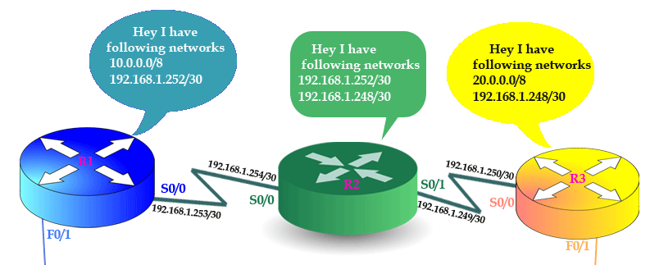
Adaptive routing
Adaptive routing, also called dynamic routing, is a process for determining the optimal path a data packet should follow through a network to arrive at a specific destination. Its purpose is to prevent packet delivery failure.
In adaptive routing routers get configured automatically by using the routing protocols. It changes the path by considering metrics.
Router metrics are metrics used by a router to make routing decisions. Metric is decided by hop count, Bandwidth, Load, Traffic, Reliability.
There are two types of adaptive routing:-
Intradomain which includes Distance vector and link state routing.
Interdomain which includes path vector routing.

Slide 9
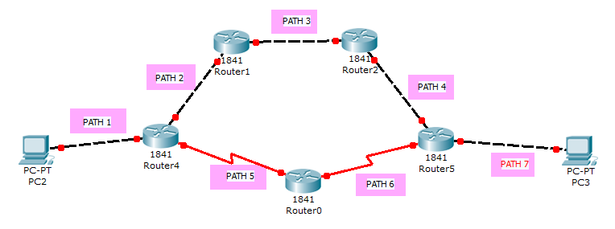
Distance vector routing
Distance vector routing is the type of intradomain routing which means that routing is done within an autonomous system.
Autonomous system is the system which is handled by single administrator.
In the distance vector the links required to reach destination are taken into considerations It can be also called as hop count.
Types of distance vector routing are:-
RIP(Routing Information Protocol)
EIGRP(Enhanced Interior Gateway Routing Protocol)

Slide 10
Link state routing protocol
Link State routing is the type of intradomain routing which means that routing is done within an autonomous system.
Autonomous system is the system which is handled by single administrator.
In the link state routing Metrics are taken into consideration.
Router metrics are metrics used by a router to make routing decisions. Metric is decided by hop count, Bandwidth, Load, Traffic, Reliability.
Types of Link State Routing are:-
OSPF(Open Shortest Path First)
IS-IS(Intermediate system-Intermediate system)

Slide 11
PROCEDURAL FLOW CHART OF SIMULATION
SYSTEM UNDERSTANDING
SELECTION OF PARAMETERS USED FOR PERFORMANCE EVALUATION
SELECTION AND CREATING NETWORK MODEL
COMPARATIVE ANALYSIS OF RESULT FROM DIFFERENT NETWORK MODEL
RESULTS
RUNNING SIMULATION

Slide 12
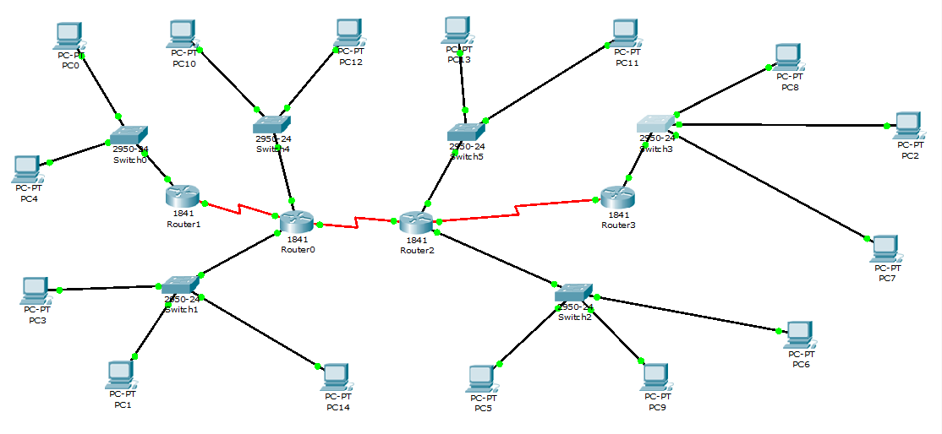
Design
Network design consisting 4 Routers, 6 switches, 15 pc’s

Slide 13
references
[1] Megha Jaykumar, Dr.P.Bharathi “A comparative study on RIP and OSPF protocols” in IEEE, 2nd International Conference on Innovations in Information Embedded and Communication Systems, 2015.
[2] Mr. R. Jayaprakash, Ms. K. Saroja “ RIP, OSPF, EIGRP Routing Protocols” in IJRCAR, Volume-3, Issue-7
[3]Rajneesh Narula1, Pallavi Aggarwal “Performance evaluation of RIP and OSPF in IPv6 using opnet simulator 14.5” in International Journal of Technical Research and Volume 2, Issue 6 (Nov-Dec 2014)
[4]Chandra Wijaya “Performance Analysis of Dynamic Routing Protocol EIGRP and OSPF in IPv4 and IPv6 Network” in 2011 First International Conference on Informatics and Computational Intelligence
[5]Mr. R. Jayaprakash, Ms. K. Saroja “RIP, OSPF, EIGRP ROUTING Protocols” in INTERNATIONAL JOURNAL OF RESEARCH IN COMPUTER APPLICATIONS AND ROBOTICS ISSN 2320-7345

