Slide 1
Ai-DRIVEN SUPPLY CHAIN DISRUPTION PREDICTOR AND INVENTORY OPTIMIZATION SYSTEM
Addressing risks in the coffee supply chain
Omkar More

Slide 2
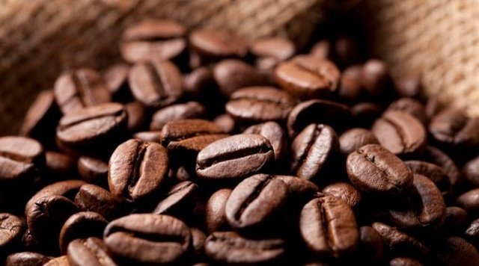
Why This Topic?
- Coffee is one of the most traded commodities globally, but its supply chain is fragile.
- The coffee industry is heavily affected by weather patterns, political instability, and global trade disruptions.
- Supply chain disruptions lead to price volatility, impacting millions of farmers, exporters, and consumers.
- I wanted to develop a solution that leverages AI to predict risks and optimize inventory management.

Slide 3
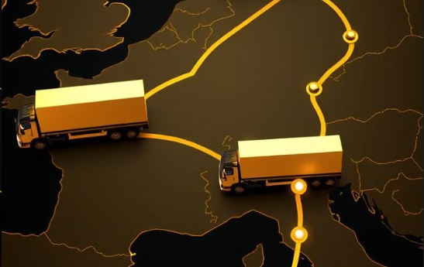
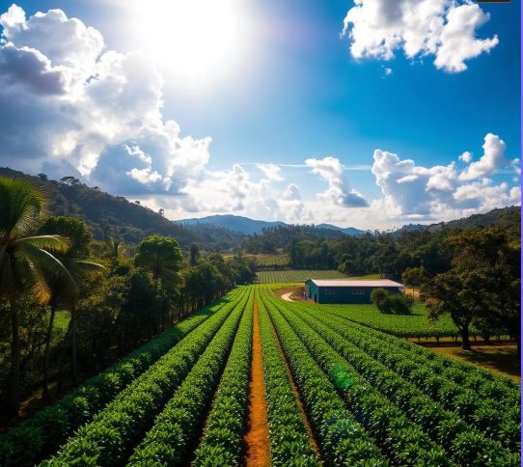
Issues in Coffee Supply Chain
Weather-Related Disruptions: Extreme weather events like floods, droughts, and storms significantly affect crop yield.
1
Inconsistent Supply : Harvesting seasons and environmental changes lead to irregular coffee production.
2
Volatile Prices: Supply chain disruptions increase costs for producers and buyers.
3
Data Fragmentation: Lack of a centralized system to monitor risks like political instability or crop failures .
4
Manual Inventory Adjustments: Delays in response due to outdated, manual processes.
5

Slide 4
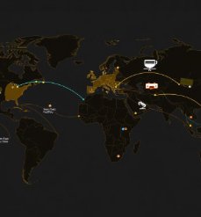

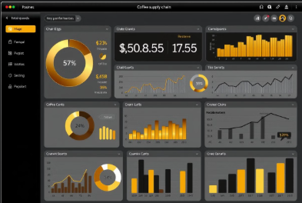
Approach and Solution
Collected coffee-related news from NewsAPI and weather data from OpenWeatherMap.
Data Collection
Data Monitoring and Analysis
Performed sentiment analysis on news articles using Meta's LLaMA model. Detected risks with OpenAI GPT and assigned risk scores.
Predictive Disruption Modeling
Integrated a MySQL database for inventory management. - Automated stock adjustments using risk scores and predefined thresholds.
Real-Time Dashboard
Developed an interactive Flask-based dashboard for visualization. Integrated email notifications for high-risk situations.

Slide 5
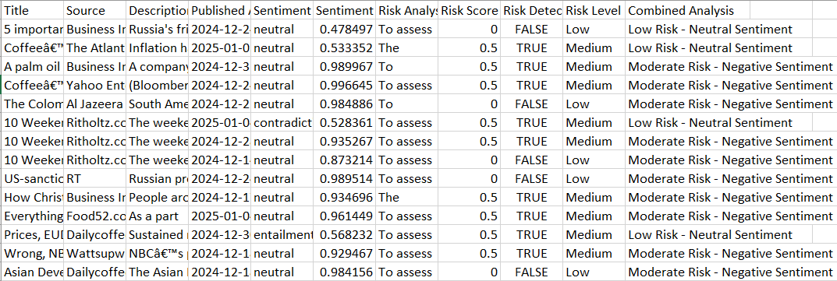
Solving It with Code
Milestone 1:
Milestone 2:
Global Data Monitoring and Analysis Engine
Global Data Collection
News Data Collection: Fetches articles about coffee production, trade, prices, and climate-related issues from the News API.
Weather Data Collection: Collects weather information for major coffee-producing regions using the OpenWeatherMap API.
Coffee News Monitoring: Fetches coffee-related news from global sources using the News API.
Sentiment Analysis: Analyzes the sentiment of news articles using the Meta LLaMA pipeline.
Risk Analysis: Assesses potential supply chain risks using OpenAI's GPT API.
Data Aggregation: Saves sentiment and risk analysis results in CSV files for further processing.
Output:

Slide 6
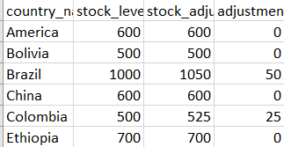
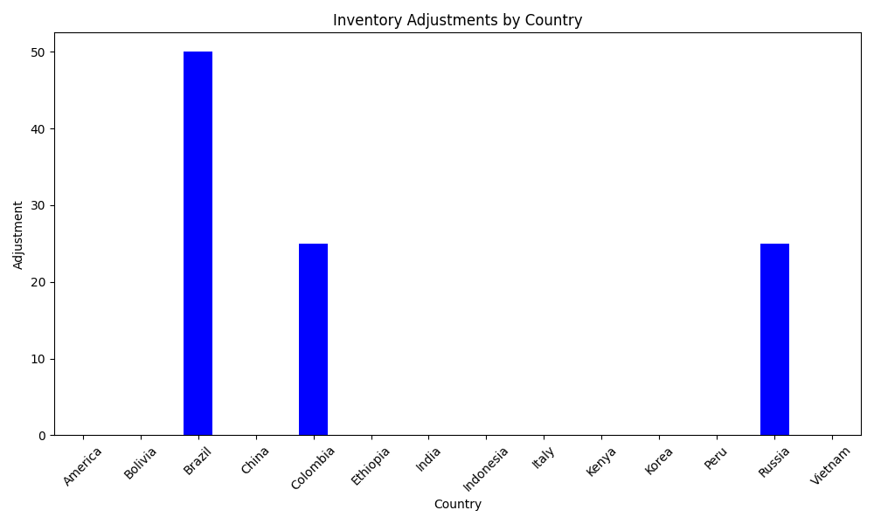
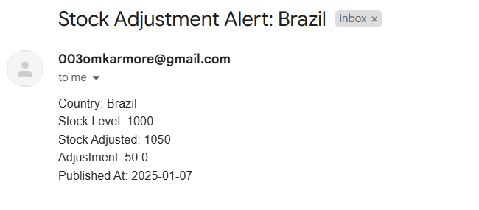

Milestone 3:
Predictive Disruption Modeling and ERP Integration
Milestone 4:
Real-Time Alert and Reporting Dashboard Deployment
MySQL Database Integration: Stores inventory and risk data for analysis and adjustments.
Stock Adjustment Rules: Adjusts inventory levels based on risk severity (High, Medium, Low).
Automated Inventory Management: Tracks and updates stock levels in the database.
Interactive Dashboard: Visualizes risk levels and inventory adjustments using Flask and Matplotlib.
HTML Dashboard Template: Provides a web-based interface for viewing visualizations and insights.
Email Notifications: Sends alerts for critical risks and stock adjustments.
Real-Time Insights: Provides actionable insights through a web-based interface.
Output :

Slide 7
Future Enhancements
Train machine learning models (Random Forest, LSTM, XGBoost). Use historical data to predict future disruptions in coffee supply. Impact: Businesses can prepare for risks before they occur.
Connect with SAP, Oracle NetSuite for automated stock adjustments. Use ERP APIs to sync inventory, suppliers, and warehouse data. Impact: Fully automated inventory management.
Implement real-time data streaming (Kafka, WebSockets, FastAPI). Fetch live news and weather updates for instant risk assessment. Impact: Faster response to supply chain disruptions.
Real-Time Data Processing 🚀
AI-Based Risk Forecasting 🤖
Advanced ERP System Integration 🔗
Climate Impact & Long-Term Risk Analysis 🌍
Mobile & Cloud Deployment 📱☁️
Integrate NASA Earth Data, Copernicus Climate Data for climate risk forecasting. Predict how climate change affects coffee supply over 5-10 years. Impact: Helps businesses plan for long-term agricultural risks.
Deploy dashboard on AWS/GCP/Azure for global access. Develop a mobile-friendly web app (PWA) for real-time alerts. Impact: Enables remote monitoring & faster decision-making.

Slide 8

Conclusion
The project successfully addresses critical supply chain risks in the coffee industry using AI-driven tools.
The system integrates data collection, sentiment analysis, risk assessment, and inventory optimization.
This scalable approach can benefit other industries with fragile supply chains.

Slide 9

Thank You
Omkar More
Email Address: moreomkar609@gmail.com
GitHub link:
https://github.com/omkarmore003/Info_Intern

