Slide 1
FraudGuard
Data Warehouse and Mining (DWM) · Department of INFT · Vidyalankar Institute of Technology · Academic Year 2026–2027
Financial Fraud Detection & Customer Risk Analysis
A web-based system that analyses loan applications with a data warehouse star schema and OLAP, compares five ML models for fraud detection, and supports the loan workflow for three roles.
5,000
103 (2.06%)
5
3
loan applications
fraud cases
ML models compared
role-based modules
Omkar Padhi · Roll No 24101C0003 Shremaan Kumar · Roll No 24101C0002

Slide 2
Problem Statement and Objectives
Problem
Objectives
Fraud is rare: only 103 of 5,000 applications (2.06%).
Manual review is slow, subjective and records no reason.
Flat records give no view of fraud by time, loan type or segment.
Model loan data as a star schema and analyse it with OLAP
1
Assess data quality and perform exploratory analysis
2
Build an ML pipeline that handles class imbalance
3
Compare five classifiers on the same test set
4
Provide Customer, Bank Officer and Admin modules with role-based access
5
Class balance: 4,897 genuine, 103 fraud

Slide 3
Dataset, Preprocessing and EDA
Dataset
Fraud % by loan type
5,000 loan applications, 25 attributes, 5 June 2022 to 4 June 2025
Target FraudFlag: 103 fraud, 4,897 genuine
0 missing values, 0 duplicate rows
Preprocessing
13 features (8 numeric, 5 categorical); outcome fields excluded
Impute, scale and one-hot encode (32 encoded features)
Stratified 80 / 20 split: 4,000 train, 1,000 test
SMOTE applied to the training set only
Fraud % by quarter of application date

Slide 4
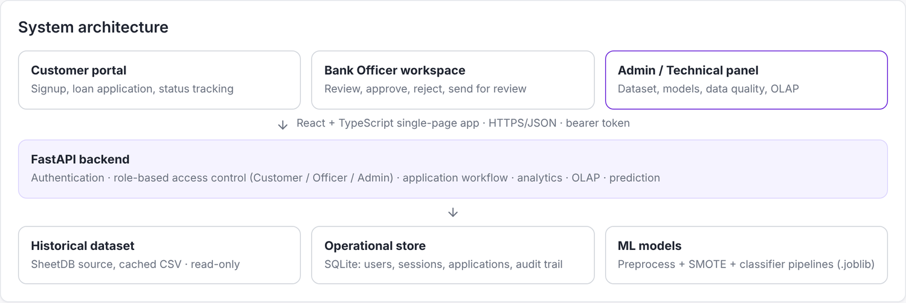
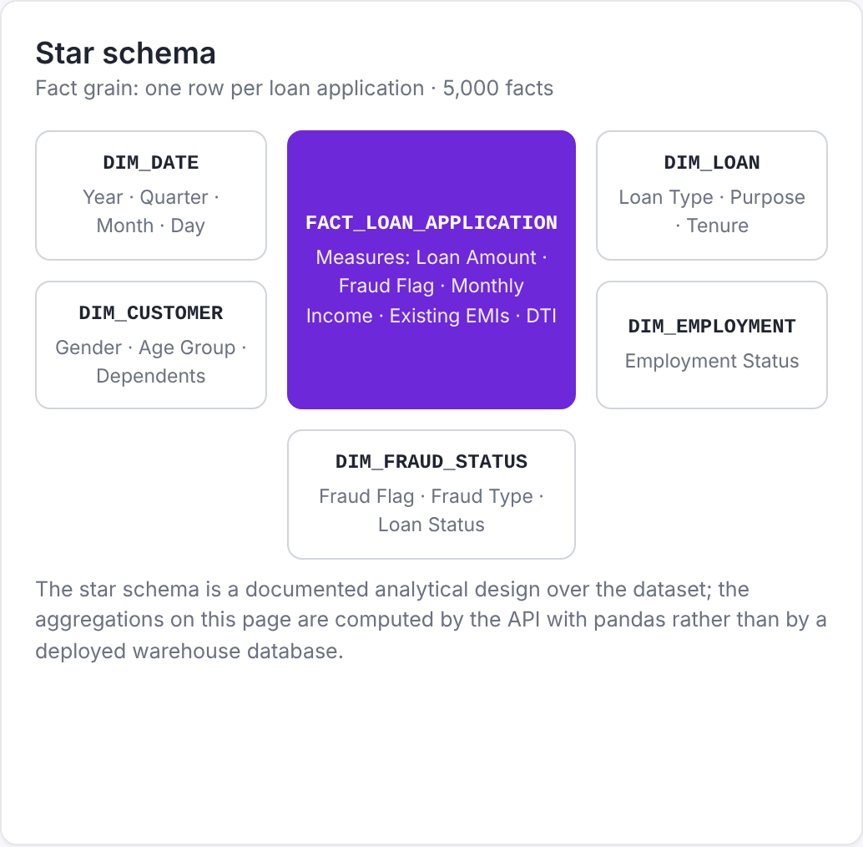
System Architecture and DWM / OLAP
System architecture: React frontend, FastAPI backend, dataset, SQLite and saved models
OLAP hierarchy
Year
Quarter
Month
Loan Type
Operations: roll-up, drill-down, slice, dice and pivot
Measures: loan count, fraud count, fraud %, loan amount
Star schema: one fact table and five dimensions

Slide 5
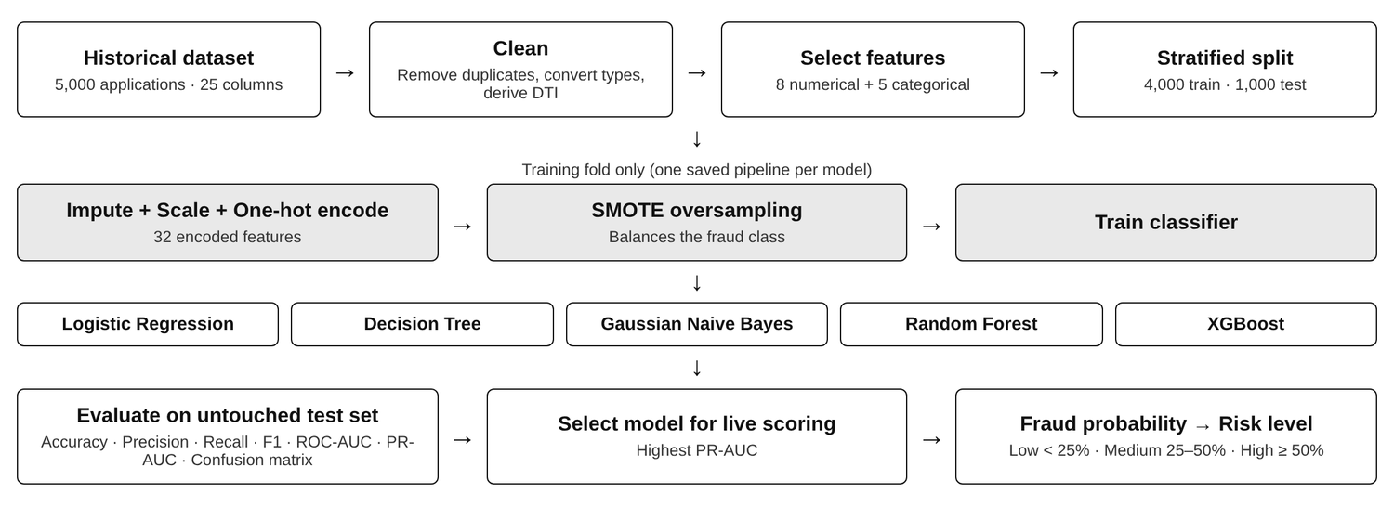
Fraud Detection and ML Methodology
Binary classification of FraudFlag
Five models: Logistic Regression, Decision Tree, Gaussian Naive Bayes, Random Forest, XGBoost
Each model returns a fraud probability for an application
Probability is shown to the Bank Officer as a risk level
The officer makes the final decision; reason is stored in the audit trail
ML workflow: identical pipeline for all five models
Low risk
Medium risk
High risk
Fraud probability below 25%
Fraud probability 25% to 50%
Fraud probability 50% and above

Slide 6
ML Model Comparison and Key Results
Model | Accuracy | Precision | Recall | F1 | ROC-AUC
Logistic Regression | 60.6% | 2.1% | 38.1% | 3.9% | 0.5072
Decision Tree | 85.1% | 0.8% | 4.8% | 1.3% | 0.4412
Gaussian Naive Bayes | 66.4% | 2.1% | 33.3% | 4.0% | 0.5189
Random Forest | 97.9% | 0.0% | 0.0% | 0.0% | 0.5353
XGBoost | 94.7% | 0.0% | 0.0% | 0.0% | 0.5553
Fraud cases detected (out of 21)
Test set: 1,000 applications, 21 fraud. Models trained once; not retrained.
97.9%
38.1%
0.5553
Highest accuracy (Random Forest) but 0% recall: every application predicted genuine
Highest recall (Logistic Regression): 8 of 21 fraud found, with 381 false alarms
Highest ROC-AUC (XGBoost); all models are close to 0.5, so accuracy alone is misleading

Slide 7
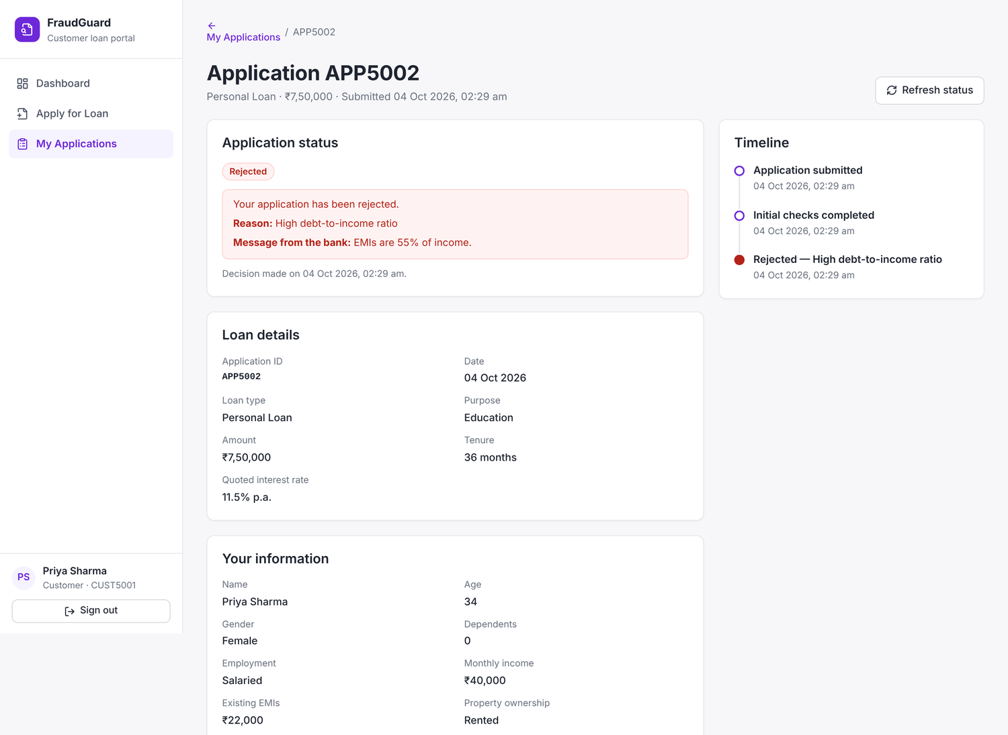
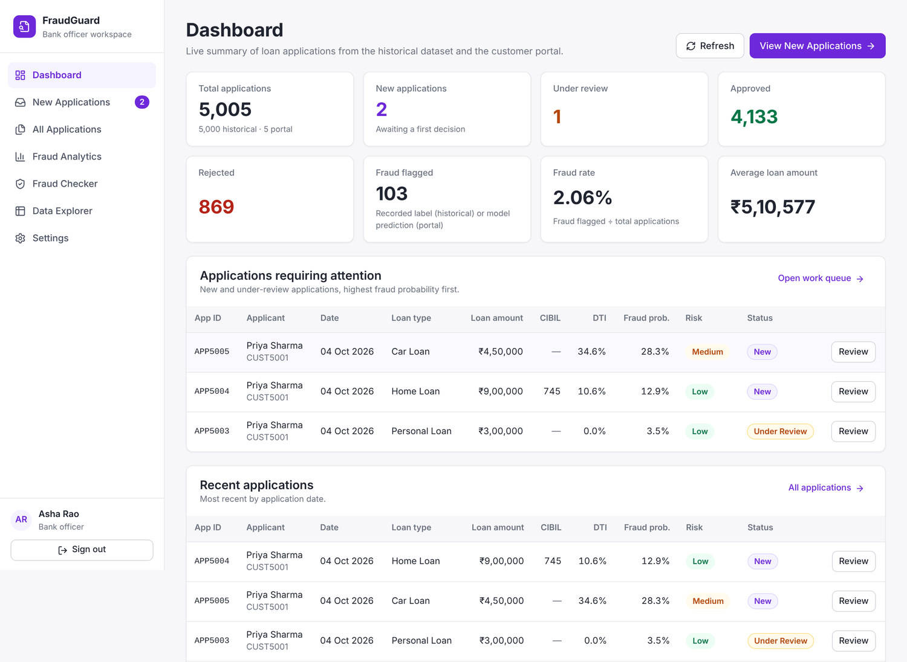
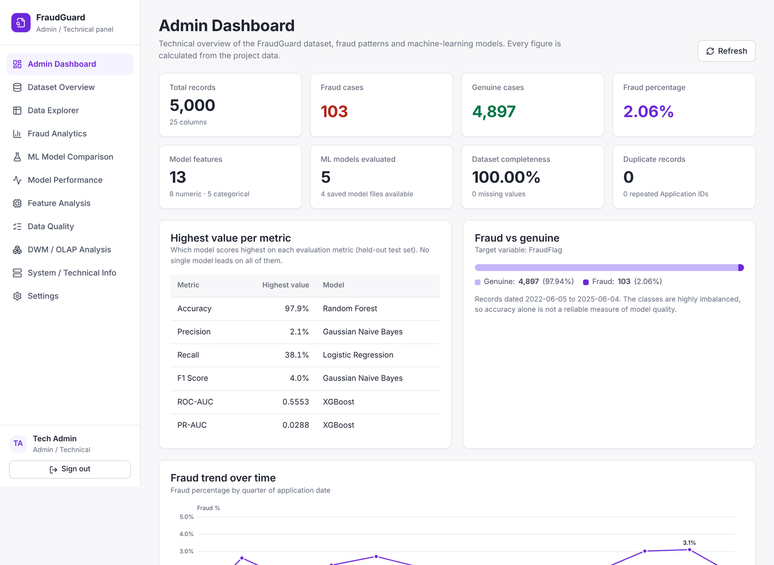
Application Modules
Customer
Bank Officer
Admin / Technical
Sign up, apply for a loan, track status and timeline, see the rejection reason
Review applications with fraud probability; approve, reject or send for review
Dataset overview, data quality, ML model comparison, OLAP and system information
Workflow: Customer applies → Bank Officer reviews and decides → Admin monitors data, models and system. Access to each module is controlled by role.

Slide 8
Conclusion and Future Scope
5
38.1%
0.5553
ML models trained and compared
highest recall (Logistic Regression)
highest ROC-AUC (XGBoost)
Conclusion
Future Scope
Loan data modelled as a star schema and analysed with OLAP
Five models trained and compared in an identical pipeline
No model detects fraud reliably with the available attributes
Working Customer, Bank Officer and Admin modules with audit trail
Richer features such as credit history and repayment behaviour
Threshold tuning and cross-validation
Per-application explanations (e.g. SHAP)
Star schema in a relational warehouse with scheduled ETL
Thank You
Omkar Padhi (24101C0003) · Shremaan Kumar (24101C0002)

