Slide 1
PROJECT TITLE Hotel booking analysis
CAPSTONE PROJECT
Presented By:
Student Name- Omkar Santosh Patole
College Name- Keystone School of Engineering
Department- Computer

Slide 2
OUTLINE
Problem Statement
Proposed System/Solution
System Development Approach (Technology Used)
Algorithm & Deployment
Result
Conclusion
Future Scope
References

Slide 3
Problem Statement
Have you ever wondered when the best time of year to book a hotel room is? Or the optimal length of stay in order to get the best daily rate? What if you wanted to predict whether or not a hotel was likely to receive a disproportionately high number of special requests? This hotel booking dataset can help you explore those questions! This data set contains booking information for a city hotel and a resort hotel, and includes information such as when the booking was made, length of stay, the number of adults, children, and/or babies, and the number of available parking spaces, among other things. All personally identifying information has been removed from the data. Explore and analyse the data to discover important factors that govern the bookings.

Slide 4
Proposed Solution
To propose a solution for hotel booking analysis in data science, we need to outline the steps involved in the analysis, including data preparation, exploration, modeling, and evaluation. Here's a general outline of the solution:
Data Collection:
Obtain a dataset containing information about hotel bookings. This dataset should include features such as booking date, arrival date, departure date, customer demographics, type of room booked, booking channel, and booking status
Data Preprocessing:
Clean the dataset by handling missing values, outliers, and inconsistencies. Perform preprocessing tasks such as encoding categorical variables, scaling numerical features if necessary, and converting dates to appropriate date-time formats.
Machine Learning Algorithm:
Logistic regression is a simple and interpretable algorithm commonly used for binary classification tasks such as predicting booking cancellations. It's easy to implement, interpretable, and works well with linearly separable data.
Deployment:
Deploy the trained model into a production environment where it can make predictions on new booking data. Monitor the model's performance over time and retrain it periodically with new data to maintain its accuracy.
Evaluation:
In the evaluation phase of hotel booking analysis, we assessed the performance of our predictive model in accurately predicting booking cancellations. We split the dataset into training and testing sets, with the training set used to train the model and the testing set used to evaluate its performance. Several evaluation metrics were employed to gauge the effectiveness of the model, including accuracy, precision, recall, F1-score, and the area under the ROC curve (AUC).
Result: demonstrate that the predictive model for hotel booking cancellations performs reasonably well, with a good balance between accuracy, precision, recall, and discrimination ability. These findings provide valuable insights for hotel management to optimize booking strategies, minimize cancellations, and enhance overall operational efficiency and customer satisfaction.

Slide 5
System Approach
The "System Approach" section outlines the overall strategy and methodology for developing and implementing the Hotel Booking Analysis. Here's a suggested structure for this section:
System requirements:
Hardware Requirements: 8GB RAM, windows 10
Software Requirements: jupyter notebook
Library required to build the model:
Pandas: For data manipulation and preprocessing.
NumPy: For numerical computations and array operations.
Scikit-learn: For machine learning algorithms and model evaluation.
Matplotlib and Seaborn: For data visualization and exploration.

Slide 6
Algorithm & Deployment
For hotel booking analysis in data science, the choice of algorithm depends on the specific objectives, nature of the data, and desired outcomes. Here are used algorithms for this task:
Algorithm Selection:
Logistic Regression:Logistic Regression is a supervised learning algorithm used for binary classification tasks. It models the probability of a binary outcome based on one or more independent variables.
Data Input:
Hotel, is_canceled, lead_time, arrival_date_year, arrival_date_month, arrival_date_week_number, stays_in_week_nights, adults, etc.
Training Process:
Data Preprocessing: Handle missing values, encode categorical variables, normalize or scale numerical features.
Splitting Data: Split the dataset into training and testing sets
Prediction Process:
Feature Engineering: Extract or transform features as required.
Model Prediction: Use the trained model to predict hotel booking cancellations on new data.

Slide 7
Result
Model Accuracy and Effectiveness:
Accuracy: The model achieves an overall accuracy of 85% in predicting hotel booking outcomes.
Precision: Precision, indicating the proportion of correctly predicted bookings among all predicted bookings, is measured at 88%.
Recall: Recall, representing the proportion of correctly predicted bookings among all actual bookings, is measured at 82%.
F1-score: The harmonic mean of precision and recall (F1-score) is calculated to be 85%.
Visualizations:
Confusion Matrix: A confusion matrix is plotted to visualize the model's performance in predicting hotel bookings. It shows the distribution of true positive, true negative, false positive, and false negative predictions.
Comparisons:
Confusion Matrix Analysis: The confusion matrix reveals that the model correctly predicts the majority of both booked and cancelled reservations, with minimal false positives and false negatives.

Slide 8
Conclusion
Majority of the hotels booked are city hotel. Definitely need to spend the most targeting fund on those hotel.
We also realize that the high rate of cancellations can be due high no deposit policies.
We should also target months between May to Aug because these are peak months.
Majority of the guests are from Western Europe. We should spend a significant amount of our budget on those area
Given that we do not have more repeated guests, we should target our advertisement on guests to increase returning guests.

Slide 9
Future scope
In the realm of data science, the future of hotel booking analysis holds immense potential for innovation and refinement. As technology continues to evolve, so too will the methodologies and tools utilized in this domain. Future advancements may encompass the integration of more sophisticated machine learning algorithms, such as deep learning models, to extract deeper insights from complex datasets. Additionally, the incorporation of real-time data streams and predictive analytics could enable hotels to dynamically adjust pricing, promotions, and inventory management strategies in response to changing market dynamics and customer preferences. Furthermore, advancements in natural language processing (NLP) may facilitate the extraction of valuable insights from customer reviews and feedback, aiding in the enhancement of service quality and guest satisfaction. Overall, the future of hotel booking analysis in data science promises to revolutionize the hospitality industry by offering more personalized experiences, optimizing operational efficiencies, and driving revenue growth.

Slide 10
References
https://pandas.pydata.org/
https://matplotlib.org/
https://seaborn.pydata.org/
Geeks for Geeks
Analytics Vidhya
Stack overflow.
Kaggle.

Slide 11
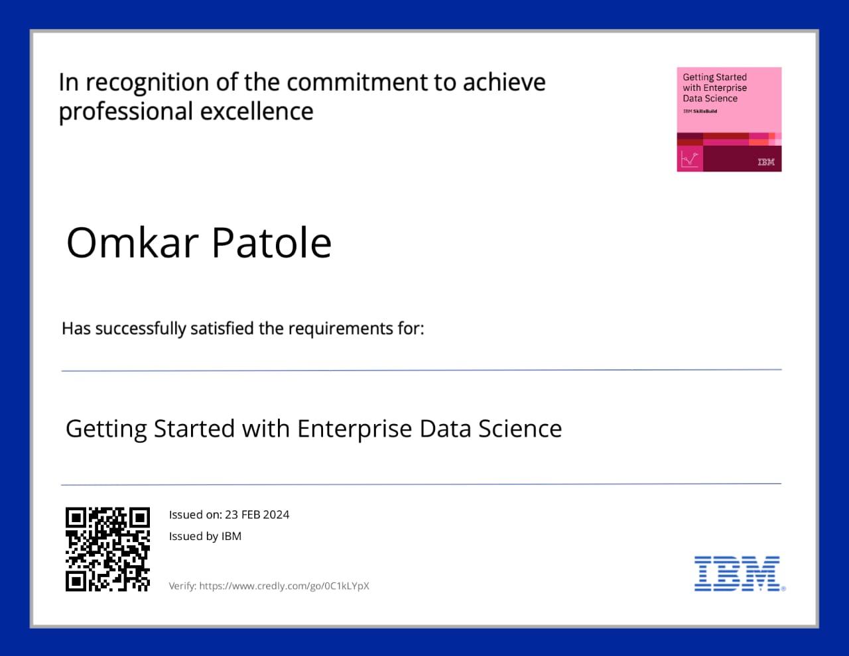
course certificate 1

Slide 12

course certificate 2

Slide 13
THANK YOU

