Slide 1

BANK ANALYTICS
PROJECT
Debit , Credit & Loan Performance Analysis
EXCEL
TABLEAU
POWER BI
MYSQL
Notes:
Add your name, date, and institution.

Slide 2

01 Introduction
The what and why behind this project
💳
What is this project?
A full-cycle bank analytics project built on real transactional and lending data — cleaned, modeled, and visualized into two live dashboards.
📊
Why does it matter?
Banks process millions of transactions daily. Without analytics, risk hides in the noise. This project makes that risk visible and actionable.
🏦
What did we build?
A Debit & Credit dashboard tracking cash flow across branches and banks, and a Loan dashboard monitoring 65.5K loans for defaults and growth trends.

Slide 3
02 Data Overview
Two datasets, thousands of records, one story
🏦
🏢
📅
💼
6 Banks
6 Branches
2024 Data
65.5K Loans
Axis · HDFC · ICICI · Kotak · PNB · SBI
City Center · Main · East · Downtown · Suburban · North
12 months of monthly transaction records
2016 – 2020 · 17 Indian states covered
Debit & Credit Dataset
Bank Loan Dataset
Transaction method: bank transfer, credit card, debit card
Fields: date, amount, branch, bank, account ID
Cleaned in Excel · queried in MySQL
Visualized in Power BI with DAX measures
Borrower: state, age group, religion, grade
Loan: product code, funded amount, status, interest
Queried and aggregated in MySQL
Dashboarded in Power BI and Tableau

Slide 4
03 KPIs — Debit & Credit Dashboard
Formulas and business insights behind each metric
₹127.6M
₹127.29M
1.0025
318.12K
Total Credit Amount
Total Debit Amount
Credit to Debit Ratio
Net Transaction Amount
📐 SUM(Amount) WHERE Type = "Credit"
📐 SUM(Amount) WHERE Type = "Debit"
📐 Total Credit ÷ Total Debit
📐 Total Credit − Total Debit
Measures total deposits — compared against debits for cash flow health.
Measures total withdrawals — tracks outflow across all branches.
Ratio > 1 = bank receives more than it pays. Positive signal.
Net cash flow for the period. Positive = healthy reserve building.
0.000190
~9K/mo
₹42M avg
~16.7%
Account Activity Ratio
Transactions per Month
Txn Amount by Branch
Txn Volume by Bank
📐 No. of Transactions ÷ Account Balance
📐 COUNT(Transactions) grouped by Month
📐 SUM(Amount) grouped by Branch
📐 SUM(Amount) per Bank ÷ Total × 100
Shows how active customers are relative to their balances.
Detects high/low activity periods. Dec dropped sharply to 0.3K.
Compares branch contribution. All 6 branches nearly equal share.
Each bank holds ~16.4–16.8% — well diversified across partners.

Slide 5
03 KPIs — Loan Dashboard
KPIs 1–9: Volume, Geography & Demographics
Total Loan Amount Funded
Total Loans
Total Collection
💰
🔢
🔄
Measures total value of loans disbursed. Tracks overall lending scale.
Counts number of loans issued. 65.5K total across 2016–2020.
Reflects repayment performance including principal and interest.
Total Interest
Branch-Wise Performance
State-Wise Loan
📈
🏢
🗺️
Captures revenue earned from loan interest. ₹155.3M total.
Analyzes revenue (interest, fees, total) by branch. Top: Mathura 2.1K.
Geographic distribution. UP leads (12K), Punjab 2nd (10.2K).
Religion-Wise Loan
Product Group-Wise Loan
Disbursement Trend
🕌
📦
📅
Monitors loan distribution across demographics. Hindu 75.01%.
Categorizes by product types. XLG dominates at 86.83%.
Tracks changes in loan disbursements over time (2016–2020).

Slide 6
03 KPIs — Loan Dashboard
KPIs 10–18: Risk, Status & Verification
Grade-Wise Loan
Default Loan Count
Delinquent Client Count
🏅
⚠️
🔔
Portfolio risk by borrower credit grades A–G. Grade B leads (26K).
Loans in default. 1K defaults — default rate of 1.6%.
Borrowers with missed payments. 7K delinquent clients tracked.
Delinquent Loan Rate
Default Loan Rate
Loan Status-Wise Loan
📉
❌
🔵
Percentage of overdue loans in portfolio. Currently 10.8%.
Proportion of defaulted loans to total. 1.6% — needs monitoring.
Active 55.47% · Fully Paid 24.19% · Net-Off 9.54% · NPA 0.81%.
Age Group-Wise Loan
Loan Maturity
No Verified Loans
👥
⏱️
🚫
Categorizes by borrower age. 26–35 leads (23.6K), 36–45 next (20.6K).
Tracks timeline until full repayment. Used for duration risk analysis.
Identifies loans without proper verification. 25.8% — major risk flag.

Slide 7
04 Process
From raw data to insight — step by step
01
02
03
04
05
Data Collection
Cleaning &
Transformation
Data Modeling
Visualization
Insights &
Recommendations
Excel
Excel + MySQL
Power BI
Power BI + Tableau
All tools
Gathered raw transaction and loan records. Organized fields and removed duplicates in Excel.
Handled nulls, standardized formats, and created calculated columns. SQL queries for aggregation.
Built star-schema relationships. Wrote DAX measures for ratios, running totals and KPIs.
Designed interactive dashboards with bar, donut and area charts. Added slicers for dynamic filtering.
Interpreted patterns, flagged risks and generated business recommendations from the final dashboards.

Slide 8
05 Analysis
Key findings from both dashboards
💳 DEBIT & CREDIT
🏦 LOAN PORTFOLIO
✅ Positive cash flow of ₹318.12K across 2024
📍 Uttar Pradesh leads with 12K funded loans
📊 All 6 branches nearly balanced (₹41.7M–₹42.9M)
👥 Age 26–35 is largest borrower group (23.6K)
🏦 6 banks each hold ~16.4–16.8% of total volume
🟡 XLG product dominates at 86.83% of loans
📈 Monthly transactions steady ~9K; Dec drops to 0.3K
⚠️ 25.8% loans unverified — key risk flag
💰 Kotak leads (16.8%), HDFC lowest (16.43%)
📉 1.6% default, 10.8% delinquent — gap needs action
🔄 Credit-to-debit ratio 1.0025 — healthy but thin
✅ 55.47% active, 24.19% fully paid — growing base

Slide 9
06 Recommendations & Insights
Turning data into decisions
🔒
Verify Unverified Loans
📞
Early Collection Strategy
💹
Strengthen Cash Buffer
25.8% of loans are unverified. Better verification before loan approval can help reduce risk
Delinquency (10.8%) far exceeds default (1.6%). Launch early-warning calls 30 days before due dates.
Credit-to-debit ratio is only 1.0025. Build a 3–5% buffer reserve to absorb seasonal demand shocks.
🗺️
Expand in Low-Loan States
🎯
Diversify Product Mix
🏆
Replicate Branch Success
States like Himachal Pradesh, Jharkhand and Tripura are under-served. Target them for next growth cycle.
XLG holds 86.83% of loans. Promoting XL and XTL reduces concentration risk and grows revenue streams.
City Center and Main Branch lead in volume. Share their best practices with lower-performing branches.

Slide 10
07 Conclusion
What we proved with data
✅ Bank maintains positive cash flow with a balanced credit-debit ratio across all 6 branches and banks.
📈 Collections (₹808.3M) comfortably exceed funded loans (₹751M), confirming portfolio health.
⚠️ Verification gaps (25.8%) and high delinquency (10.8%) are the top risks requiring immediate action.
🛠️ Excel, MySQL, Power BI and Tableau together delivered end-to-end analytics in a single workflow.

Slide 11
08 Challenges & Learnings
Obstacles overcome — skills gained
CHALLENGES
LEARNINGS
🧹
Dirty Data
⚡
SQL Efficiency
Inconsistent date formats, nulls and duplicate records needed 3+ hours of Excel cleaning before analysis.
Writing optimized GROUP BY and JOIN queries in MySQL to pre-aggregate millions of rows before loading into Power BI.
🔗
Tool Integration
🎨
Dashboard Design
Syncing data across MySQL, Excel, Power BI and Tableau without format loss required careful planning.
Choosing the right chart for each KPI — donut for composition, area for trend, bar for comparison.
📉
Incomplete Dec Data
📐
DAX Mastery
December showed near-zero transactions — flagged early and documented as a data gap, not a real trend.
CALCULATE, DIVIDE and time-intelligence functions are now instinctive after building this project end to end.
🧮
Complex DAX
🔍
Data Storytelling
Writing accurate running totals, ratio measures and time-intelligence functions in Power BI was the steepest curve.
Every visual must answer one clear question. Tableau helped simplify charts that Power BI made complex.

Slide 12
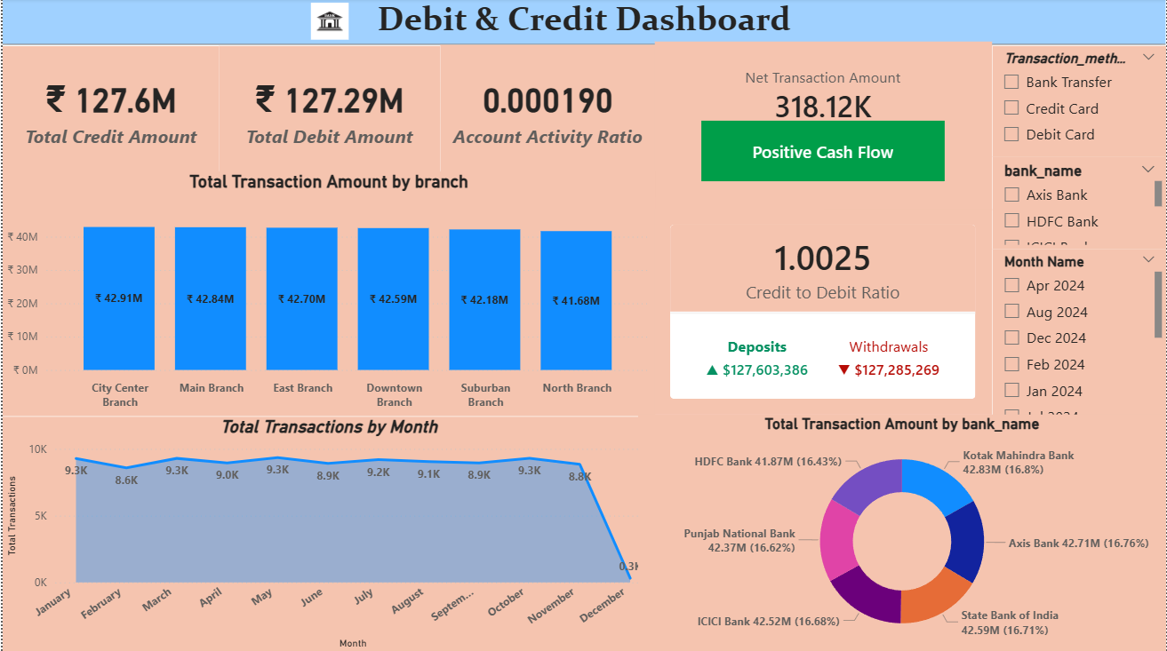
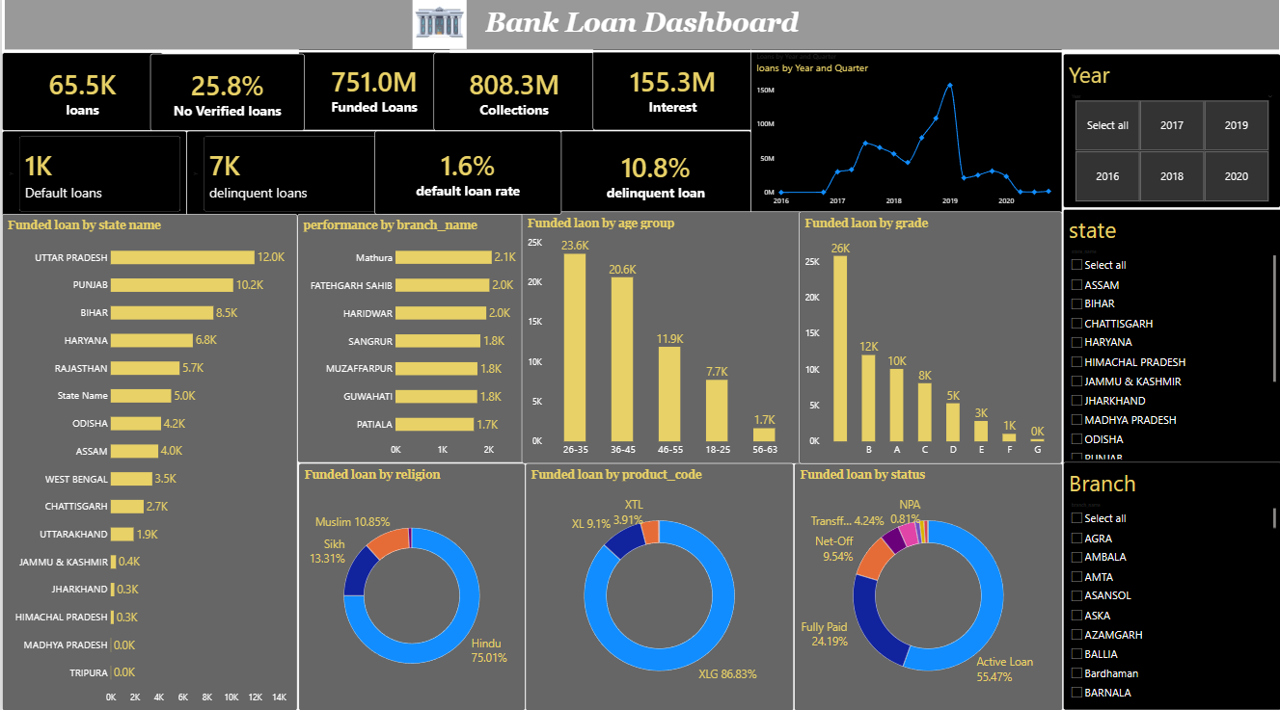
09 Dashboard / Report
Built in Power BI
Debit & Credit Dashboard
Bank Loan Dashboard

Slide 13
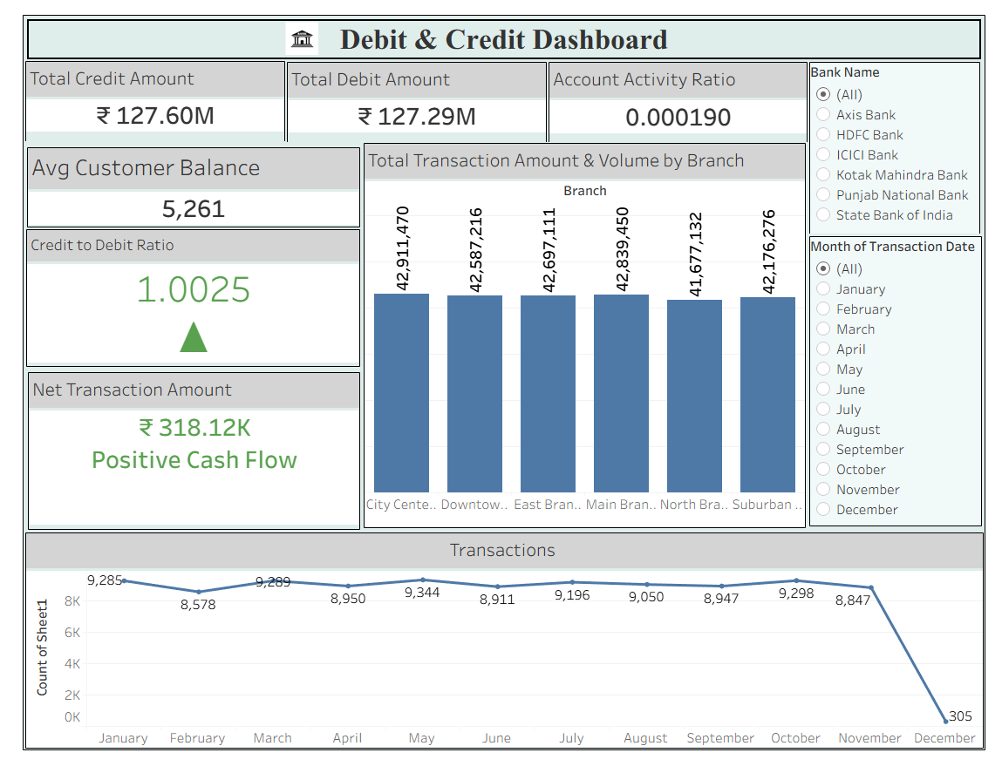
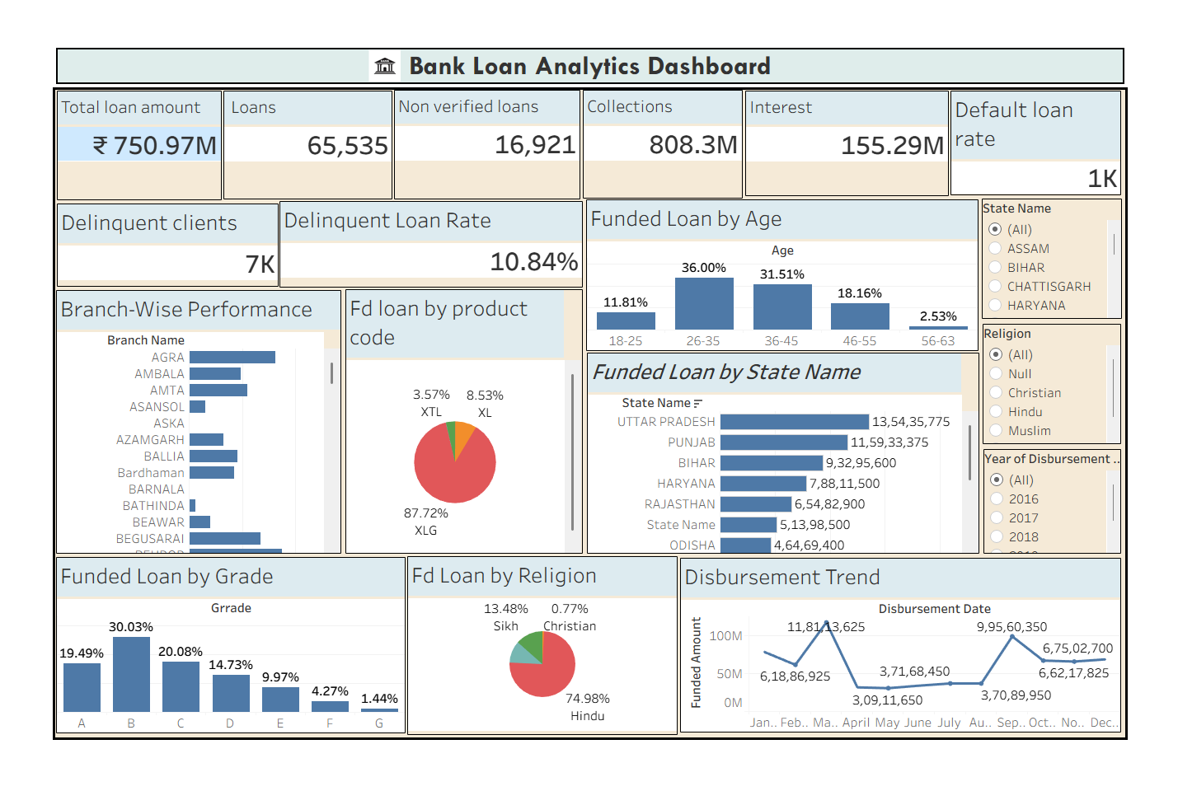
Built in Tableau
Debit & Credit Dashboard
Bank Loan Dashboard

Slide 14
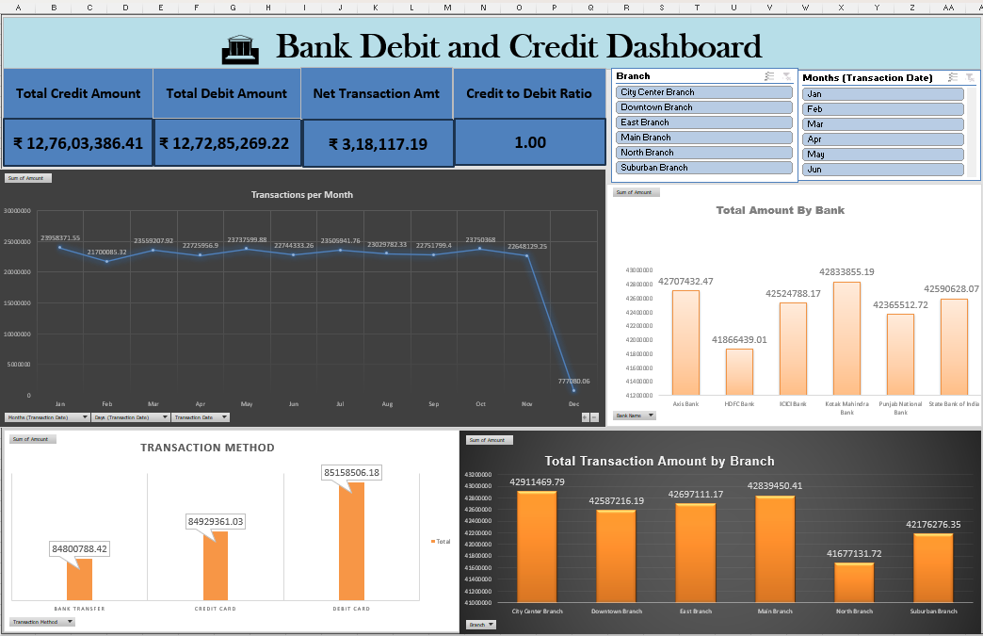
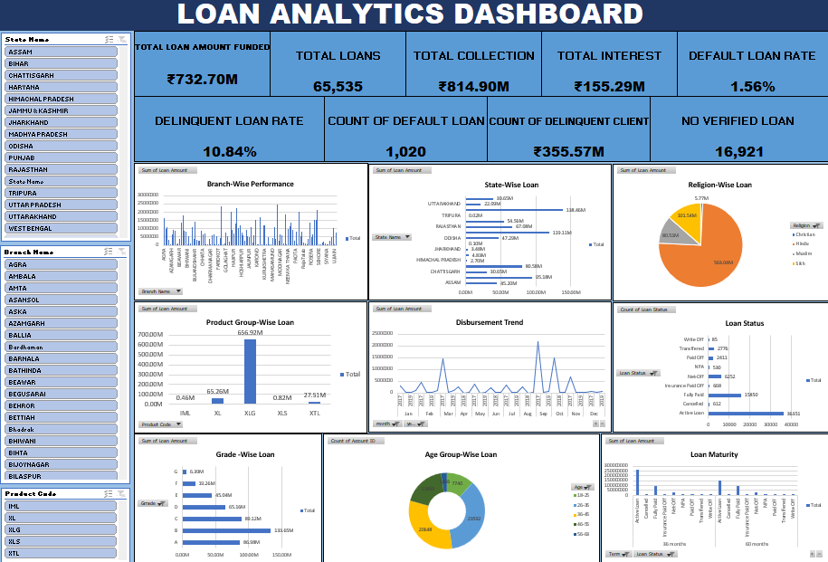
Built in Excel
Debit & Credit Dashboard
Bank Loan Dashboard

Slide 15


