Slide 1

A REPORT ON
CREDIT-BOOST
For ‘Kaldin Solutions’
BY
Gayatri Rajiv Shirsath Course: MCA II Roll No: 22030
PRATIBHA INSTITUTE OF BUSINESS MANAGEMENTCHINCHWAD, PUNE-19
2023-2024

Slide 2
INDEX
Chapter No | Details
1 | Introduction
1.1 | Company Profile / Institute Profile / Client Profile
1.2 | Abstract
1.3 | Existing System and Need for System
1.4 | Scope of System
1.5 | Operating Environment - Hardware and Software
1.6 | Brief Description of Technology Used
1.6.1 | Operating systems used (Windows or Unix)
1.6.2 | RDBMS/No Sql used to build database (mysql/ oracle, Teradata, etc.)
2 | Proposed System
2.2 | Feasibility Study
2.3 | Objectives of Proposed System
2.4 | Users of System
3 | Analysis and Design
3.1 | System Requirements (Functional and Non-Functional requirements)
3.2 | Entity Relationship Diagram (ERD)
3.3 | Table Structure
3.4 | Use Case Diagrams
3.5 | Class Diagram
3.6 | Activity Diagram
3.7 | Deployment Diagram
3.8 | Module Hierarchy Diagram
3.9 | Sample Input and Output Screens

Slide 3
INTRODUCTION
Introduction
Company Profile:
Kaldin Solutions is a tech savvy company with the power
of a software giant and the direction and flow of a dot-com. In addition, Kaldin Solutions Technology is people friendly; not just technology oriented. Think of us as a powerful UNIX server with a user-friendly windows front end. We understand that most of our customers are neither familiar with technology, nor have the time and resources to devote to their technical needs. This is where we step in to lend a helping hand. Kaldin Solutions Technology shields you from the technology aspect of your business so that you can concentrate on what matters; your business. We use state of the art infrastructure, time tested software methodologies, and the best practices to deliver your outsourcing solutions.
Existing System and Need for System
Current project is titled as Credit-Boost which is specifically designed for the CIBIL score repair companies
which allows them to interact with their clients on real time. The primary concern of this system is to provide an automated system which allow user to manage all work action conducted
in repairing CIBI score of clients using individuals credit history. System also contains own letter library that may client/

Slide 4
company ever needed. It provides advance search options in order to save user time and provides compact update in an easy- to-read format. It provides easy communication with company clients and manages all events and appointments with client in easy manner. Along with this, it provides company a good dashboard that helps company manage them in good manner.
The system provide user friendly interface which helps to manage their day to day activity with different work functions
like import, export and sync things with security. Along with this system provide a site template options to manage their work area which editable site content in order to manage their work specific site contents
1.3 Scope of work
Personalization for Metro 2 Letters:
Develop sophisticated features to facilitate the automatic creation of Metro 2 letters, ensuring they are tailored to each individual's credit profile.
Implement dynamic templates that allow for the insertion of relevant credit information, such as account details,
payment history, and dispute items.
Utilize advanced algorithms to ensure the inclusion of legally required disclosures mandated by the FCRA Act,
enhancing compliance and transparency.
Regulatory Compliance and Rule Adherence:
Ensure strict adherence to rules and regulations governing the writing of Metro 2 letters for dispute items, as stipulated by the FCRA Act and other relevant regulatory
bodies.

Slide 5

Implement comprehensive checks and balances to verify that all Metro 2 letters generated by the system meet the prescribed legal requirements and standards.
Operating Environment:
Hardware & Software Requirements
At Server Side:
Hardware Requirements:
Name | Details
Processor | Intel Pentium 4th onwards*
RAM | 4GB
Hard Drive | 40GB
Software Requirements:
Name | Details
Operating System | Windows7 onwards , Linux
Database Sever | MySQL SERVER
Application Server | Apache tomcat 8.5.61

Slide 6
Browser | Chrome, Firefox
Framework
At Client Side:
Hardware Configuration:
Name | Details
Processor | Intel Pentium 4th onwards*
RAM | 4GB
Hard Drive | 40GB
Software Environment
Name | Details
Operating System | Windows7 onwards , Linux
Browser | Chrome, Firefox
1.5 Detailed Description of Technology used:
CORE JAVA

Slide 7
JSP (Java Server Pages)
CSS
JAVASCRIPT
JSON
JQUERY & AJAX
Proposed System
Purpose of System:
Tailored Letter Generation:
Develop advanced functionalities enabling automated creation of personalized Metro 2 letters, customized according to each individual's unique credit profile.
Utilize dynamic templates to seamlessly incorporate pertinent credit details, including account specifics, payment history, and dispute resolutions.
Compliance Assurance:
Ensure adherence to regulatory guidelines, particularly those outlined in the FCRA Act, governing the composition of Metro 2 letters for dispute resolution.
Implement robust validation mechanisms to guarantee that all generated Metro 2 letters meet stringent legal requirements and standards.
Objectives:
Customized Letter Generation:
Create a system that automatically generates personalized letters tailored to each individual's credit information.
Ensure Legal Compliance:

Slide 8
Develop mechanisms to guarantee that all generated letters adhere to legal regulations, particularly those outlined in the FCRA Act.
Feasibility Study:
Introduction:
Credit-Boost is a revolutionary software platform designed to empower Credit Repair Companies (CRCs) to streamline their operations, enhance client communication, and ultimately deliver superior CIBIL score improvement services. This feasibility study explores the project's viability across key areas specific to the needs of CRCs.
Benefits for CRCs:
Automated Workflows: Reduce manual tasks associated with managing client credit data. Credit-Boost automates repetitive processes, allowing CRCs to focus on high-value activities and client relationships.
Enhanced Client Communication: Foster seamless communication with clients through an integrated platform. Track progress, schedule appointments, and send updates – all within a centralized system.
Advanced Search and Reporting: Save valuable time with Credit-Boost's advanced search functionalities. Generate comprehensive reports and leverage data insights to optimize client strategies.
Improved Efficiency: Credit-Boost streamlines workflows, eliminates redundant tasks, and facilitates efficient data

Slide 9
management. This translates to increased productivity and faster turnaround times for CRCs.
Customizable Site Templates: Manage your brand presence and customize client-facing web pages with Credit-Boost's pre-built templates. Maintain consistent messaging and tailor content specific to your services.
Data Security and Compliance: Credit-Boost prioritizes data security with robust encryption protocols and access control mechanisms. Ensure client privacy and regulatory compliance with data protection standards.
User-Friendly Interface: Credit-Boost boasts an intuitive and user-friendly interface, making it easy for your team to adopt the platform quickly. Empower your staff with the tools they need to excel.
Secure Import/Export/Sync: Seamlessly import, export, and synchronize data with enhanced security features. Maintain data integrity and ensure a smooth workflow.
Credit-Boost understands the unique challenges faced by CRCs. This platform is designed to:
Reduce Operational Costs: Automate tasks, improve efficiency, and minimize time spent on administrative activities. Ultimately, Credit-Boost can help CRCs reduce operational costs.
Increase Client Satisfaction: Streamlined communication, improved turnaround times, and a dedicated platform for client interaction contribute to enhanced client satisfaction and loyalty.
Gain a Competitive Edge: Credit-Boost equips CRCs with advanced tools and features, empowering them to provide a superior service and differentiate themselves in the market.

Slide 10
Conclusion:
Credit-Boost offers a comprehensive solution for CRCs seeking to optimize their operations, strengthen client relationships, and achieve greater success in the CIBIL score repair industry.
Analysis and Design
System Requirements (Functional and Non-Functional requirements)
Functionally:
Manage clients, credit data, communication, and reports.
Secure import/export/sync of client data.
Offer customizable site templates for CRCs.
Prioritize security and data privacy compliance. Non-Functionally:
Ensure performance, scalability, high availability, and user- friendliness.
Maintain robust security through encryption and access controls.

Slide 11
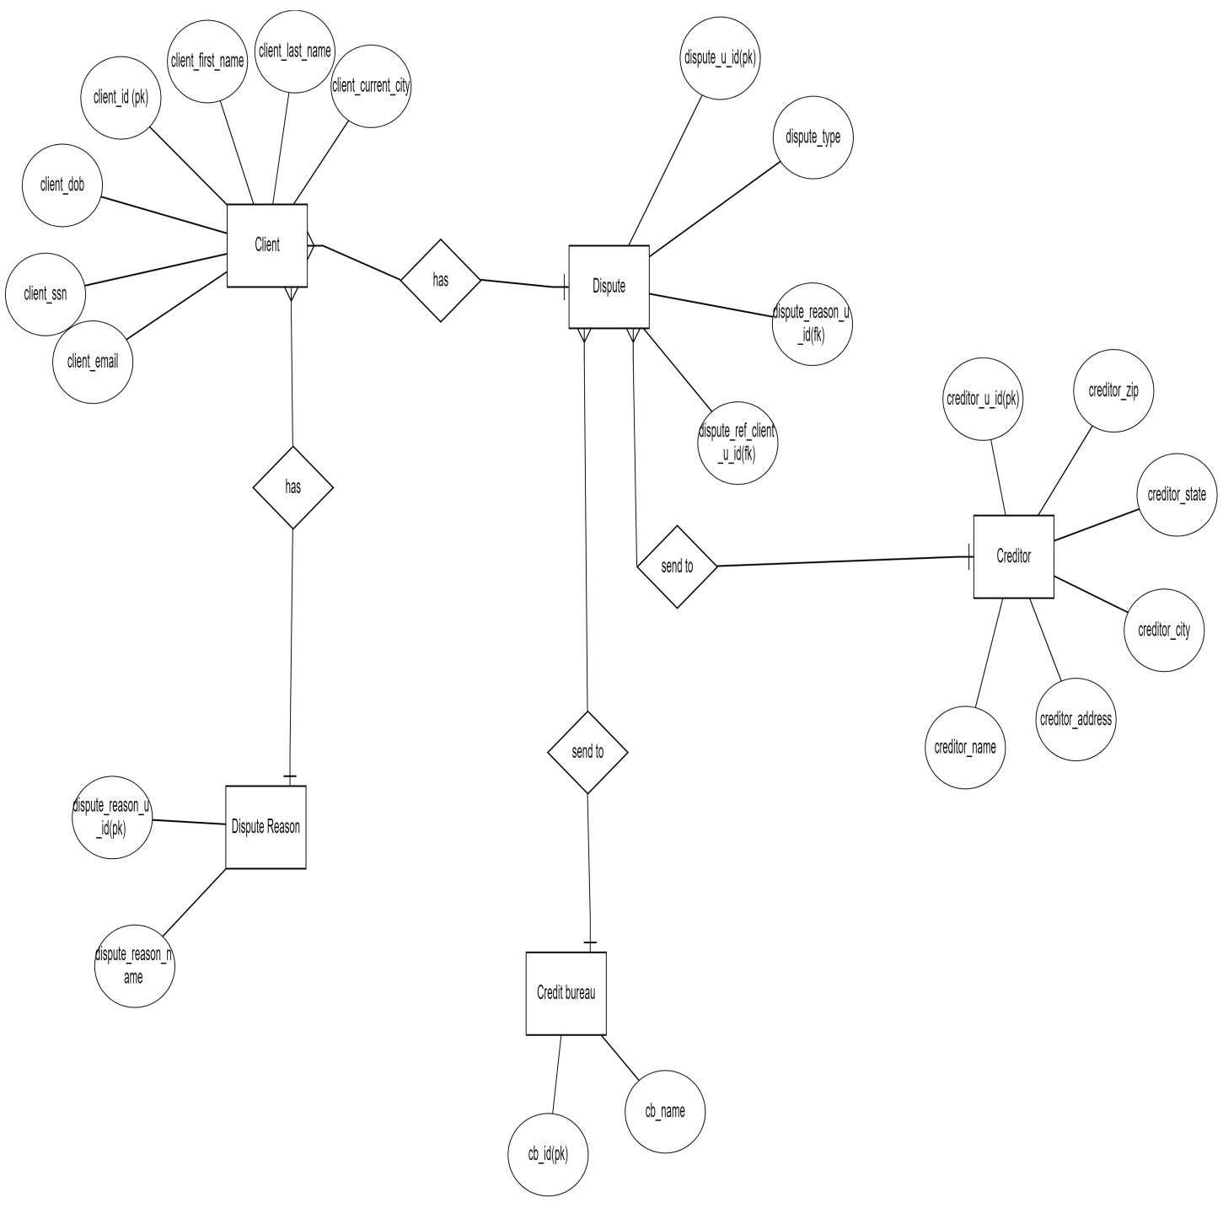
Entity Relationship Diagram (ERD)
ERD Diagram for building letters

Slide 12
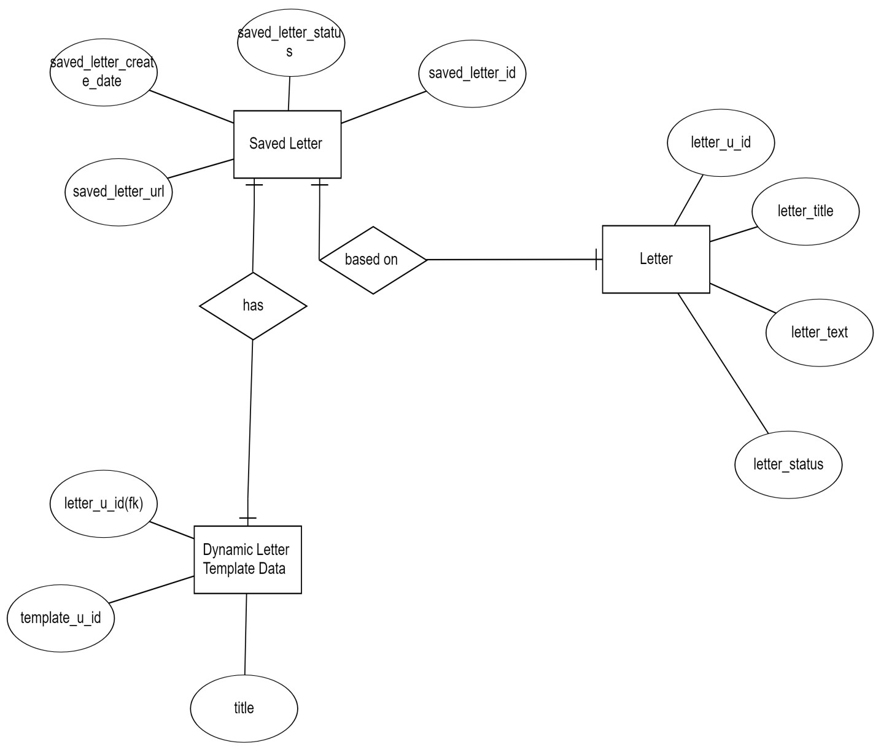
ERD for saving Letters:

Slide 13
Table Structure
Client:
Column Name | Data Type | Description
client_id | int | Unique identifier for each client.
client_u_id | varchar(255) | Unique identifier for the client.
fk_company_id | int | Foreign key referencing the company to which the client belongs.
client_siffix | varchar(255) | Suffix for the client's name.
client_first_name | varchar(255) | First name of the client.
client_middle_name | varchar(255) | Middle name of the client.
client_last_name | varchar(255) | Last name of the client.
client_dob | date | Date of birth of the client.
client_ssn | varchar(255) | Social Security Number of the client.
client_ssn_enc | varchar(255) | Encrypted Social Security Number of the client.
client_email | varchar(255) | Email address of the client.
client_phone_1 | varchar(255) | Primary phone number of the client.
client_phone_2 | varchar(255) | Secondary phone number of the client.
client_phone_3 | varchar(255) | Additional phone number of the client.
client_phone_3_ext | varchar(255) | Extension for additional phone number of the client.
client_fax | varchar(255) | Fax number of the client.
client_current_street | varchar(255) | Street address of the client's current location.
client_current_city | varchar(255) | City of the client's current location.
client_current_state | varchar(255) | State of the client's current location.
client_current_zip | varchar(255) | ZIP code of the client's current location.
client_previous_street | varchar(255) | Street address of the client's previous location.
client_previous_city | varchar(255) | City of the client's previous location.
client_previous_state | varchar(255) | State of the client's previous location.
client_previous_zip | varchar(255) | ZIP code of the client's previous location.
client_note | varchar(1000) | Note or additional information about the client.
client_ref_client_status_type_u_id | varchar(255) | Reference to client status type.

Slide 14
Column Name | Data Type | Description
client_status | tinyint | Status of the client (1=Active, 0=Delete).
client_start_date | datetime | Date when the client's service started.
client_privacy_guard_report | longtext | Privacy guard report of the client.
client_affiliate_u_id | varchar(255) | Unique identifier for the client's affiliate.
client_password | varchar(255) | Password for client authentication.
client_affiliate_paid_status | tinyint | Paid status of the client's affiliate (0=Unpaid, 1=Paid).
client_card_number | varchar(45) | Credit card number of the client.
client_card_expiration | varchar(45) | Expiration date of the client's credit card.
client_card_cvv | varchar(45) | CVV (Card Verification Value) of the client's credit card.
client_agreement_signed_image | varchar(255) | Image of the client's signed agreement.
client_agreement_signed_date | datetime | Date when the client's agreement was signed.
client_service_type | varchar(45) | Type of service for the client.
client_is_active | tinyint | Indicator of whether the client is active.
client_column_visible | varchar(500) | Columns visible for the client.
fk_client_processing_issue_id | int | Foreign key referencing processing issues related to the client.
fk_client_team_id | int | Foreign key referencing the team assigned to the client.
fk_client_team_id1 | int | Additional foreign key referencing the team assigned to the client.
fk_client_affiliate_id | int | Foreign key referencing the affiliate associated with the client.
fk_Customer_FolderId | int | Foreign key referencing the folder ID of the customer.
fk_Customer_WorkflowId | int | Foreign key referencing the workflow ID of the customer.
fk_Customer_statusid | int | Foreign key referencing the status ID of the customer.
fk_client_enum_id | int | Foreign key referencing enumeration values related to the client.
fk_Customer_Secondary_FolderId | int | Foreign key referencing the secondary folder ID of the customer.
client_create_date | datetime | Date when the client was created.
client_create_by | varchar(45) | User who created the client record.
client_modified_date | datetime | Date when the client record was last modified.
client_modified_by | varchar(45) | User who last modified the client record.
isPortalAccess | tinyint(1) | Indicator of whether the client has portal access.
monitoring_agency | varchar(45) | Monitoring agency associated with the client.

Slide 15
Column Name | Data Type | Description
credit_monitoring_username | varchar(150) | Username for credit monitoring services.
credit_monitoring_password | varchar(255) | Password for credit monitoring services.
secret_key | varchar(150) | Secret key associated with the client.
multipleAgreementIds | varchar(45) | Multiple agreement IDs related to the client.
interestRetting | int | Interest rating for the client.
isClientAgreementSigned | tinyint(1) | Indicator of whether the client agreement is signed.
client_agreement_signed_pdf | varchar(255) | PDF file of the client's signed agreement.
client_isAdded_toSolr | tinyint(1) | Indicator of whether the client is added to Solr.
customerUserName | varchar(140) | Username associated with the customer.
ref_saleforce_id | varchar(255) | Reference to the Salesforce ID.
is_saleforce_updated_flag | tinyint | Indicator of whether the Salesforce record is updated.
idiq_process_status | tinyint(1) | Status of IDIQ process related to the client.
lead_source | int | Source of lead for the client.
email_opt_out_in | tinyint(1) | Option to opt-out or opt-in for email communication.
sms_opt_out_in | tinyint(1) | Option to opt-out or opt-in for SMS communication.
client_reference_id | int | Reference ID for the client.
is_viewed | tinyint(1) | Indicator of whether the client record is viewed.
fk_master_company_id | int | Foreign key referencing the master company ID.
customer_type_when_added | tinyint(1) | Type of customer when added.
payment_terms_setup_amount | varchar(45) | Setup amount for payment terms.
payment_terms_monthly_amount | varchar(45) | Monthly amount for payment terms.
is_audit_deleted | tinyint(1) | Indicator of whether the record is deleted from audit.
is_audit_report_hidden | tinyint(1) | Indicator of whether the audit report is hidden.
client_billing_street | varchar(255) | Street address for client billing.
client_billing_city | varchar(255) | City for client billing.
client_billing_state | varchar(255) | State for client billing.
client_billing_zip | varchar(255) | ZIP code for client billing.
client_subscription_plan_u_id | int | Subscription plan ID for the client.

Slide 16
Creditor Table
Column Name | Data Type | Description
creditor_id | int | Unique identifier for each creditor.
creditor_u_id | varchar(255) | Unique identifier for the creditor.
creditor_name | varchar(255) | Name of the creditor.
creditor_name_with_special_char | varchar(255) | Name of the creditor with special characters.
creditor_address | varchar(255) | Address of the creditor.
creditor_city | varchar(255) | City of the creditor.
creditor_state | varchar(255) | State of the creditor.
creditor_zip | varchar(255) | ZIP code of the creditor.
creditor_phone | varchar(255) | Phone number of the creditor.
creditor_phone_ext | varchar(255) | Extension for the creditor's phone number.
creditor_creditor_account_type | varchar(255) | Type of account for the creditor.
creditor_creditor_note |  | Note or additional information about the creditor.
 | varchar(255)
creditor_status | tinyint | Status of the creditor (0=Deleted, 1=Active).
createdDate | datetime | Date when the creditor record was created.
company_id | int | Company ID associated with the creditor, used for maintaining special character data.
creditor_fax | varchar(45) | Fax number of the creditor.
subscriber_code | varchar(255) | Subscriber code for the creditor.

Slide 17
Dispute
Column Name | Data Type | Description
dispute_id | int | Unique identifier for each dispute.
dispute_u_id | varchar(255) | Unique identifier for the dispute.
dispute_ref_client_u_id | varchar(255) | Reference to the client associated with the dispute.
dispute_ref_creditor_u_id | varchar(255) | Reference to the creditor associated with the dispute.
dispute_ref_dispute_reason_u_id | varchar(255) | Reference to the reason for the dispute.
dispute_instruction | longtext | Instructions or details regarding the dispute.
dispute_status | tinyint | Status of the dispute (0=Delete, 1=Active).
dispute_type | varchar(45) | Type of dispute (default is 'NEGATIVE').
new_dispute_ref_dispute_reason_u_id | varchar(255) | Reference to a new dispute reason.
dispute_instruction_u_id | varchar(255) | Unique identifier for dispute instruction.
companyId | int | Company ID associated with the dispute.
created_date | datetime | Date when the dispute was created.
updatedBy | varchar(100) | User who last updated the dispute.
teamId | int | Team ID associated with the dispute.
is_client_dispute_item | tinyint(1) | Indicator of whether the dispute item belongs to a client.
dispute_category | int | Category of the dispute.
linked_account_dispute_u_id | varchar(255) | Unique identifier for a linked account related to the dispute.

Slide 18
Dispute_reason
Column Name | Data Type | Description
dispute_reason_id | int | Unique identifier for each dispute reason.
dispute_reason_u_id | varchar(255) | Unique identifier for the dispute reason.
dispute_reason_name | varchar(1000) | Name or description of the dispute reason.
dispute_reason_status | tinyint | Status of the dispute reason (0=Deleted, 1=Active).
company_id | int | Company ID associated with the dispute reason.
reason_group_id | int | Group ID associated with the reason, default is -1.
Dynamic_letter_template_data:
Column Name | Data Type | Description
id | int | Unique identifier for each template data entry.
template_u_id | varchar(255) | Unique identifier for the template.
title | varchar(255) | Title of the template.
sub_title | varchar(255) | Subtitle of the template.
dispute_type | varchar(100) | Type of dispute associated with the template.
emotion | tinyint(1) | Emotion indicator for the template (1=Positive, 0=Negative).
text | longtext | Text content of the template.
differentiate_dispute_type | tinyint(1) | Indicator for whether the template differentiates by dispute type.
creditor_type | tinyint(1) | Indicator for whether the template differentiates by creditor type.
created_at | timestamp | Date and time when the template data entry was created.
is_deleted | tinyint(1) | Indicator for whether the template data entry is deleted.
IncludeType | varchar(100) | Type of inclusion (e.g., 1,1,1,1).
quickSelectAll | varchar(100) | Quick select options (e.g., 1,1,1,0).
numberOfItems | varchar(100) | Number of items (e.g., -1,-1).
creditorLetterSelection | tinyint(1) | Indicator for creditor letter selection.
templateFormat | tinyint(1) | Format of the template (e.g., 1).

Slide 19
Column Name | Data Type | Description
bureauSelection | tinyint(1) | Indicator for bureau selection.
Letter:
Column Name | Data Type | Description
letter_id | int | Unique identifier for each letter.
letter_u_id | varchar(255) | Unique identifier for the letter.
letter_ref_letter_category_u_id | varchar(255) | Reference to the letter category associated with the letter.
letter_title | varchar(512) | Title of the letter.
letter_description | varchar(1024) | Description or summary of the letter.
letter_text | longtext | Text content of the letter.
letter_status | tinyint | Status of the letter.
company_id | int | Company ID associated with the letter.
createdAt | datetime | Date and time when the letter was created.
updatedAt | datetime | Date and time when the letter was last updated.
letter_category | int | Category of the letter.
Saved_letter
Column Name | Data Type | Description
saved_letter_id | int | Unique identifier for each saved letter.
client_id_int | int | Reference to the client associated with the saved letter.
saved_letter_u_id | varchar(255) | Unique identifier for the saved letter.
saved_letter_ref_client_u_id | varchar(255) | Reference to the client associated with the saved letter.
saved_letter_title | varchar(255) | Title of the saved letter.
saved_letter_note | varchar(1000) | Note or additional information about the saved letter.
saved_letter_text | longtext | Text content of the saved letter.
saved_letter_print_status | tinyint | Print status of the saved letter (0=not printed, 1=printed).
saved_letter_status | tinyint | Status of the saved letter (0=deleted, 1=active).

Slide 20
Column Name | Data Type | Description
saved_letter_modified_date | datetime | Date and time when the saved letter was last modified.
saved_letter_create_date | datetime | Date and time when the saved letter was created.
saved_letter_generated_date | datetime | Date and time when the saved letter was generated.
saved_letter_url | varchar(1000) | URL associated with the saved letter.
saved_letter_counter | int | Counter for the saved letter.
isDeleted | tinyint | Indicator for whether the saved letter is deleted.
letter_printed_date | datetime | Date and time when the saved letter was printed.
fax_message_id | bigint | ID of the fax message associated with the saved letter.
fax_message_status | varchar(45) | Status of the fax message associated with the saved letter.
isDownloaded | varchar(45) | Indicator for whether the saved letter is downloaded.
templateId | varchar(100) | ID of the template associated with the saved letter.
creditor_u_id | varchar(255) | Unique identifier for the creditor associated with the saved letter.
letter_tab_name | varchar(725) | Tab name associated with the saved letter.
is_interim_letter | tinyint | Indicator for whether the saved letter is an interim letter.
is_secondary_bureau_letter | tinyint | Indicator for whether the saved letter is a secondary bureau letter.
letter_type | varchar(255) | Type of the saved letter.
Credit_bureau:
Column Name | Data Type | Description
credit_bureau_id | int | Unique identifier for each credit bureau.
credit_bureau_u_id | varchar(255) | Unique identifier for the credit bureau.
company_id | int | ID of the company associated with the credit bureau.
credit_bureau_name | varchar(255) | Name of the credit bureau.
credit_bureau_logo | varchar(255) | URL or path to the logo of the credit bureau.
credit_bureau_address | varchar(1000) | Address of the credit bureau.
credit_bureau_phone | varchar(255) | Phone number of the credit bureau.
credit_bureau_city | varchar(255) | City where the credit bureau is located.
credit_bureau_state | varchar(255) | State where the credit bureau is located.
credit_bureau_zip | varchar(255) | ZIP code of the credit bureau's location.
credit_bureau_country | varchar(255) | Country where the credit bureau is located.
credit_bureau_create_date | datetime | Date and time when the credit bureau was created.

Slide 21
Column Name | Data Type | Description
credit_bureau_create_by | varchar(45) | User who created the credit bureau.
credit_bureau_modified_date | datetime | Date and time when the credit bureau was last modified.
credit_bureau_modified_by | varchar(45) | User who last modified the credit bureau.
credit_bureau_fax | varchar(45) | Fax number of the credit bureau.
3.4 Use case diagram for generating letter

Slide 22
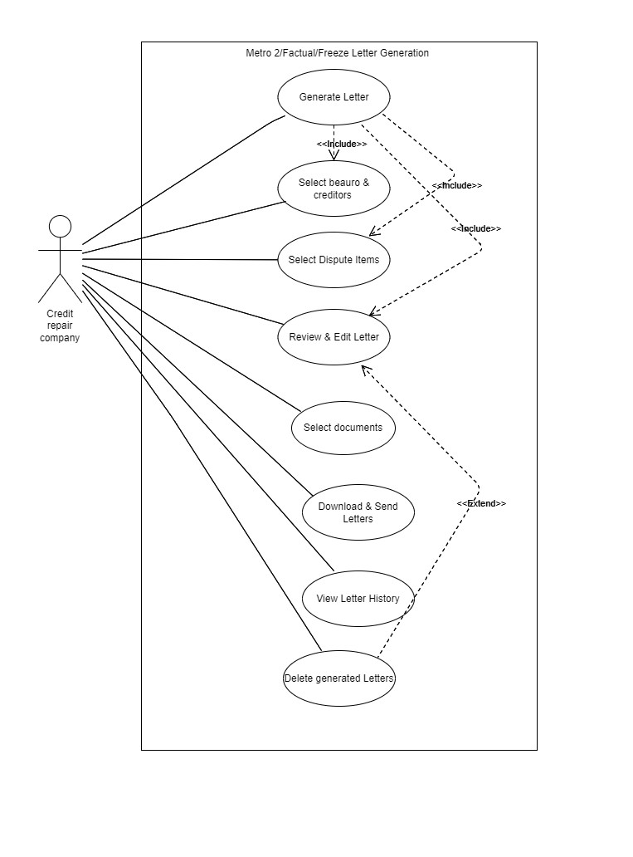
3.5 Class Diagram

Slide 23
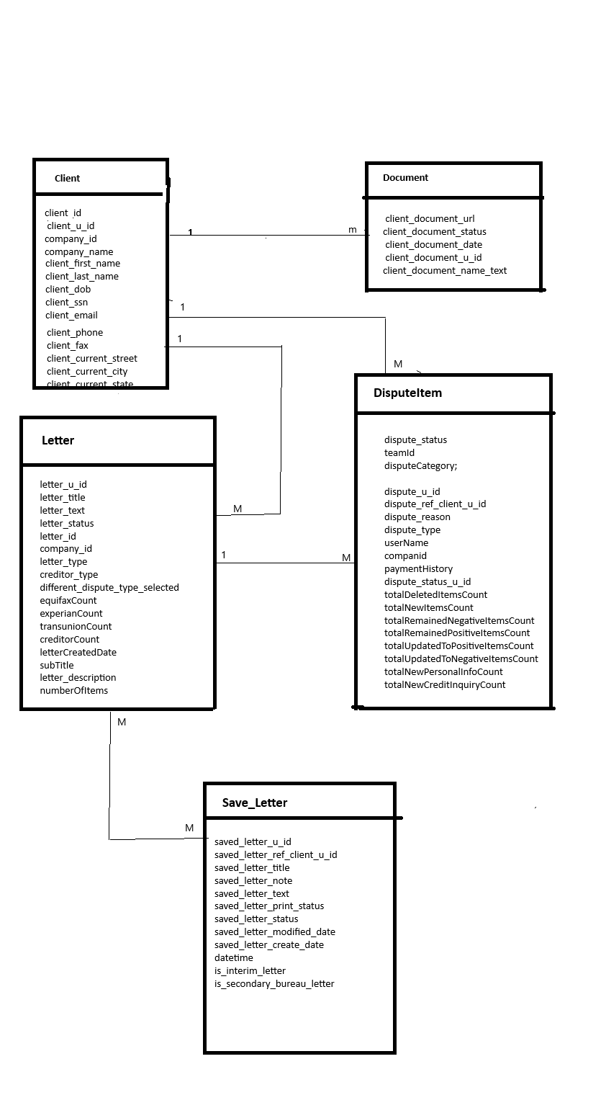
3.6. Activity Diagram

Slide 24
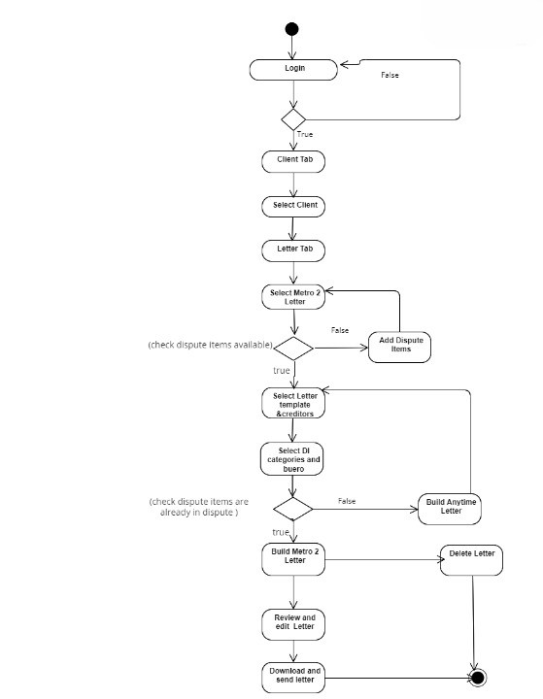
Activity Diagram for generating metro letter
3.7 Deployment Diagram:

Slide 25
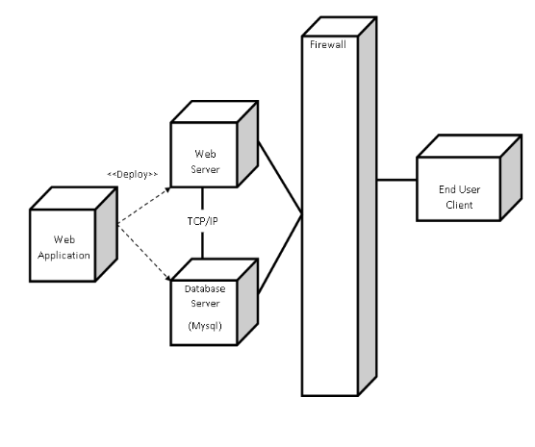
3.9 Sample Input and Output Screens

Slide 26
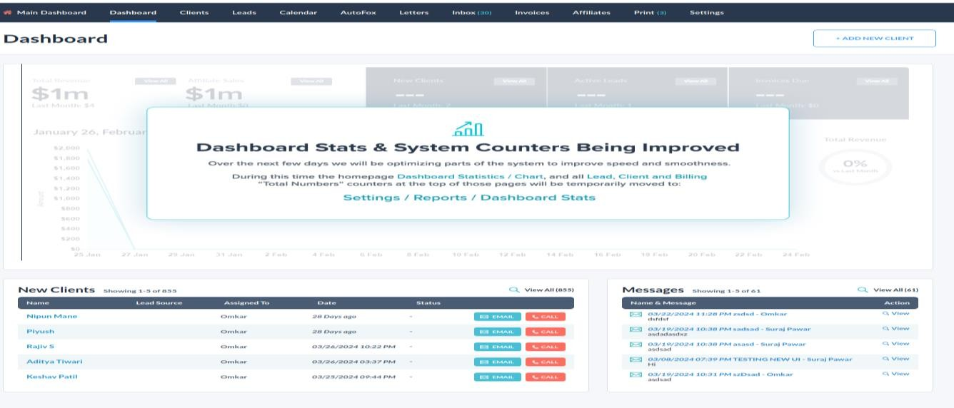
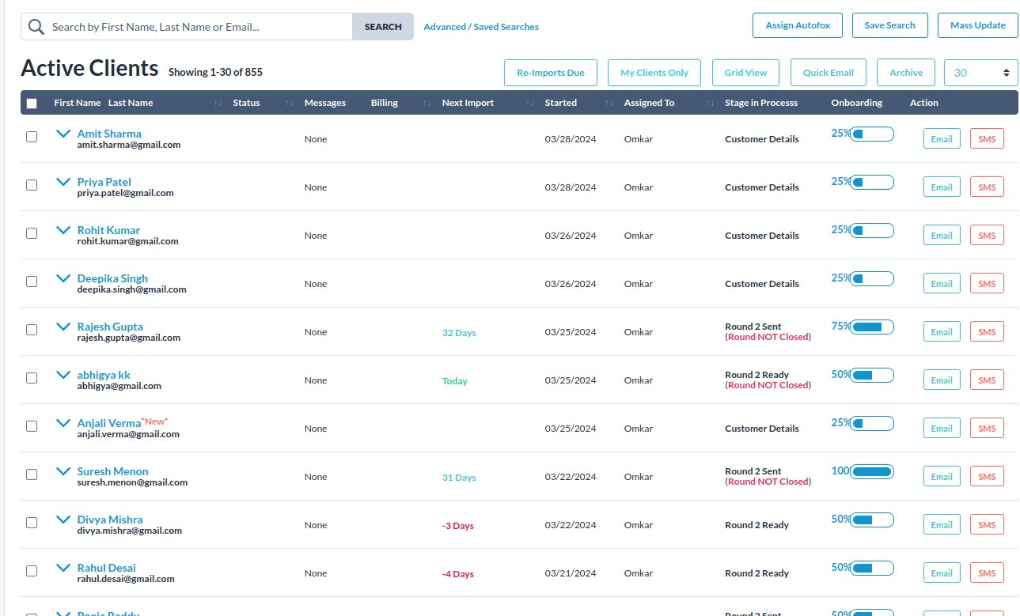

Slide 27
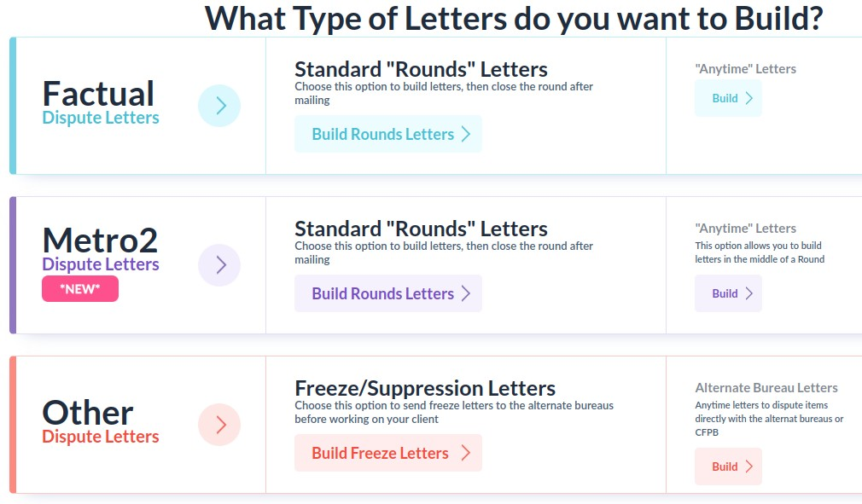
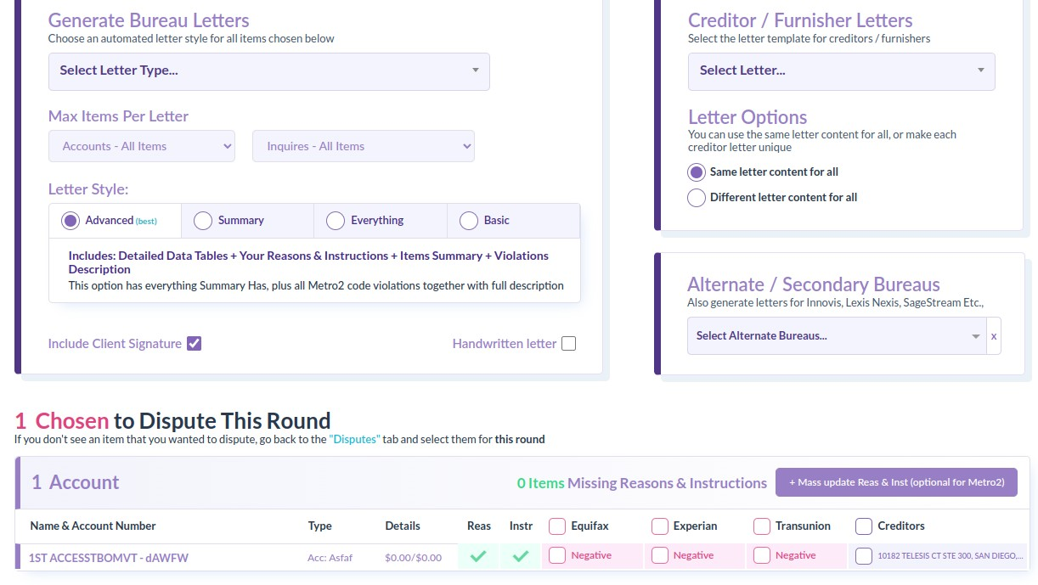

Slide 28
