Slide 1
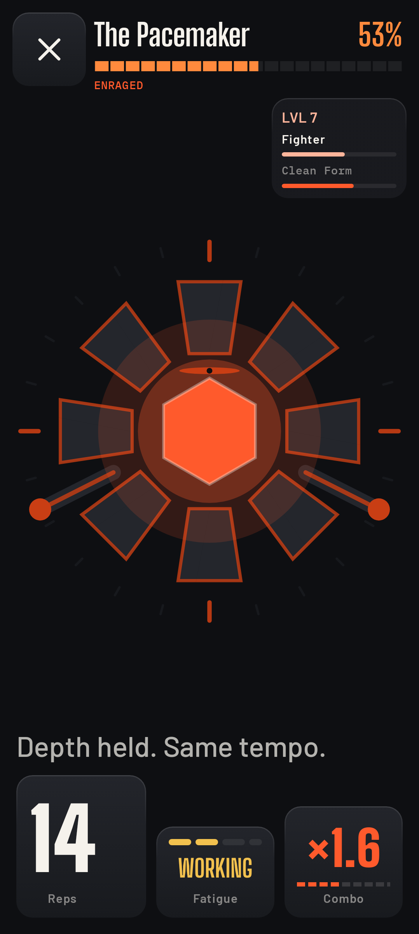
CLASHFIT
Your body is the controller.
Your camera is the referee.
A fitness game where a clean rep does more damage than a sloppy one —
because the phone measured the difference.
Team Da Goats · Omkar Kadam · Ujjwal Pardeshi · iQOO Hackathon 2026

Slide 2
THE PROBLEM
Fitness apps count what you tell them.
You type in three sets of ten. The app believes you.
It never saw the reps, so it cannot know whether they were deep, controlled, or worth anything at all — and neither can you.
So the number that motivates you
is the one number nobody checked.
Make the camera the referee and
every number becomes evidence.
ClashFit scores depth, range, tempo and alignment on every single rep, on the phone, and pays you in damage for the good ones.

Slide 3
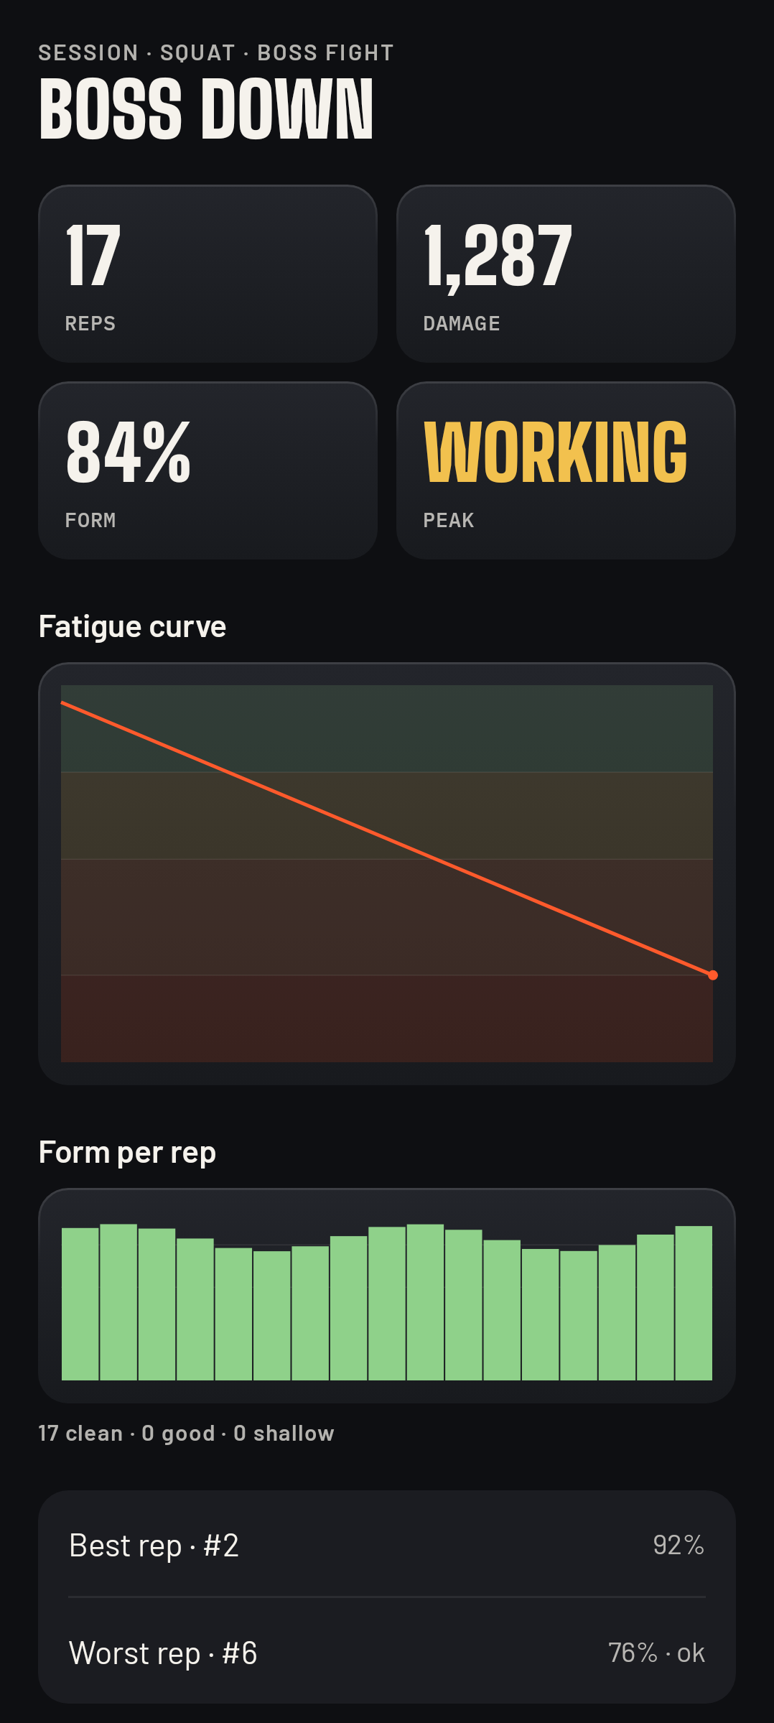
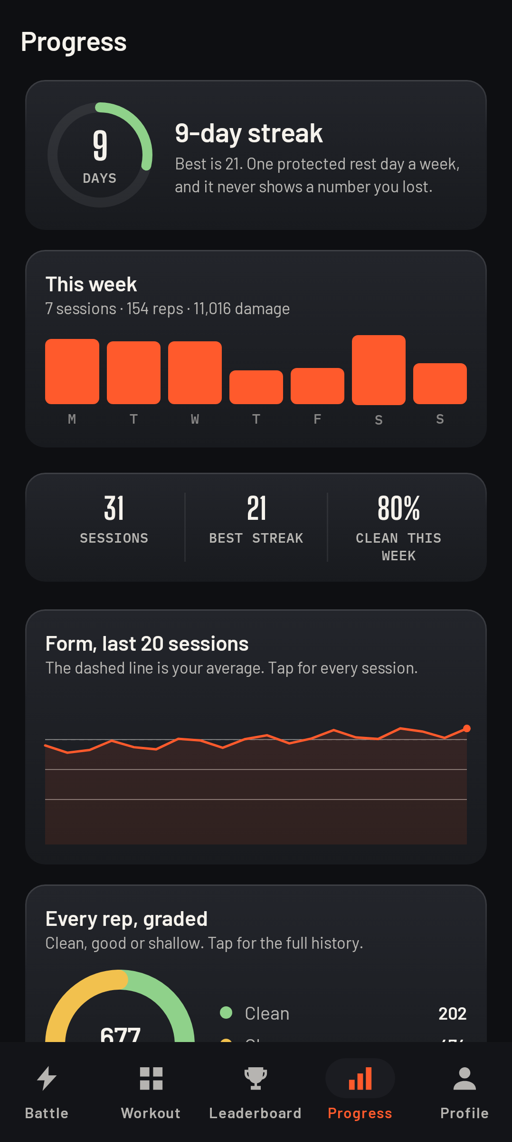
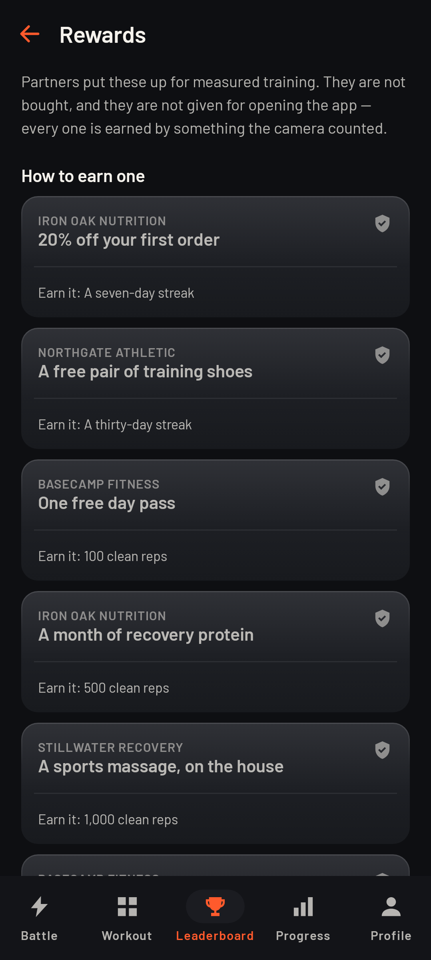
THE PRODUCT
A rep is a hit. A sloppy rep is a weak one.
The fight — boss HP, combo, fatigue
Every rep graded, after the set
Form over time, measured
Rewards earned by clean reps

Slide 4
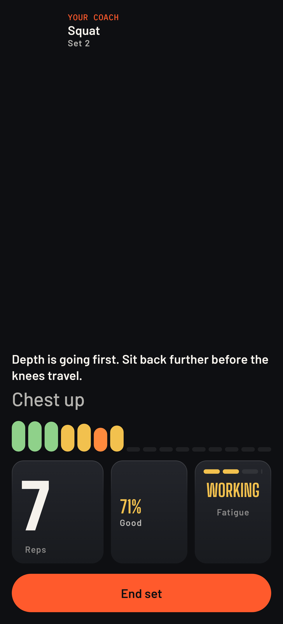
HOW IT JUDGES
The referee: 33 landmarks, every frame.
MediaPipe PoseLandmarker
33 body points, on-device, at camera rate
Four measurements per rep
depth · range of motion · tempo · alignment
A fatigue estimate
velocity and range loss against your own baseline
Nothing is stored
frames are read, scored and discarded in the same instant
Workout mode — the same referee, coaching

Slide 5
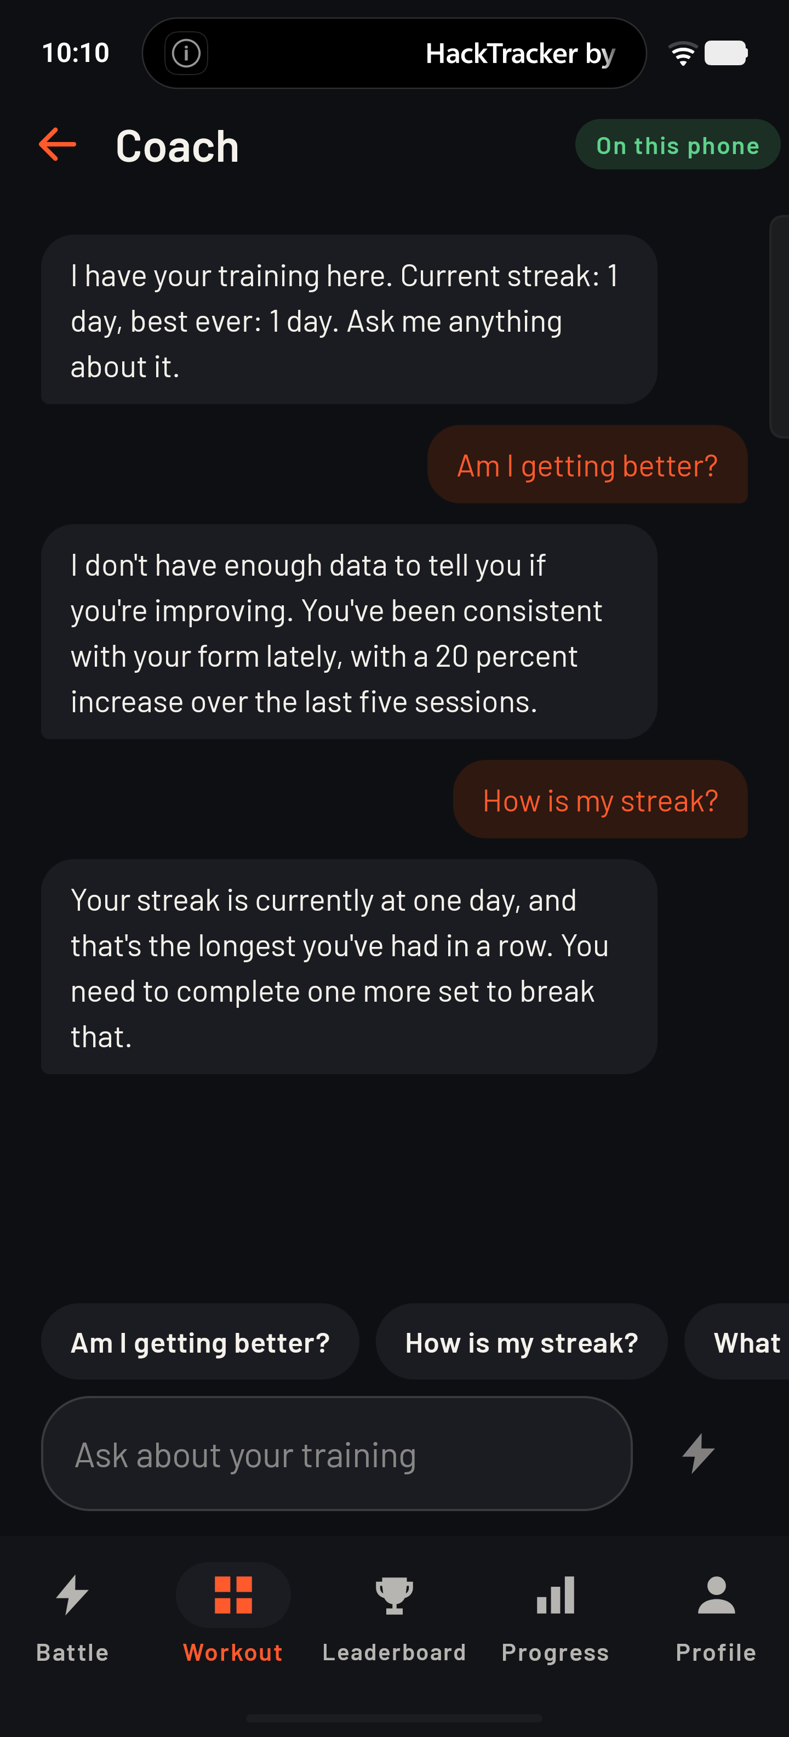
ON-DEVICE AI
A coach that only says what it measured.
Gemma 3n E2B · int4 · 3.1 GB runs inside the app — no network, no account, no request leaves the phone.
It is handed a fact sheet built from your own measurements and told it may use nothing else. Ask it something the numbers do not cover and it says so.
On this phone
Cloud
Built-in
Gemma 3n, offline
only if you opt in
template bank, always
The badge on screen always names the voice that answered, because "an AI said it" and "a lookup table said it" are different claims.

Slide 6
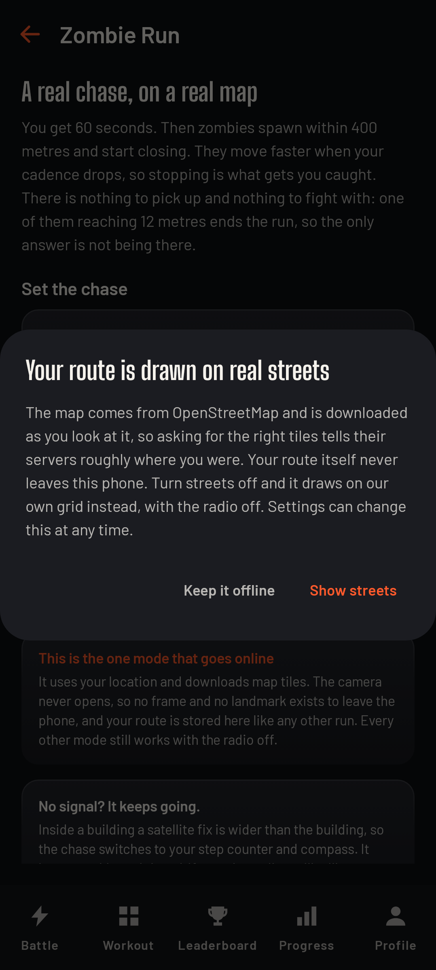
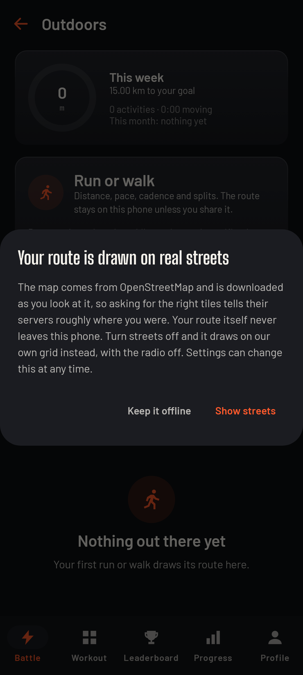
BEYOND THE ROOM
Outdoors, the chase is the workout.
Zombie Run puts a pack on a real map behind you, and they close when your cadence drops — so stopping is what gets you caught.
Runs and walks are tracked through six quality gates, and fall back to your own footsteps indoors, with a stride learned from your outdoor GPS.

Slide 7
LIVE
Zombie Run, on a real street.
▶
video drops in here
▶
video drops in here
The chase
Caught, and the map

Slide 8
LIVE
A walk, tracked and graded.
Six quality gates before a fix may move your distance:
accuracy under 25 m · a 10-second settle window
sane coordinates · monotonic timestamps
nothing faster than 8 m/s · a 2 m jitter floor
A rejected fix never becomes the anchor for the next one — which is what makes the jitter filter safe for a slow walk.
▶
video drops in here
Distance, pace, route

Slide 9
TECHNICAL DEPTH
Built to be checked, not just demoed.
942
41,268
29
18
494 ms
TESTS, ALL GREEN
LINES OF KOTLIN
SCREENS
GAME MODES
COLD START
Kotlin 2.3 · Jetpack Compose · Room · CameraX · MediaPipe Tasks (Vision + GenAI) · Filament 3D · osmdroid · Firebase Auth & Firestore
One engine, many modes
The same rep counter, depth gate and form score drive a boss fight, a gym log and a clinical sit-to-stand test. Two things that must agree are one thing.
Pure core, testable on the JVM
Scoring, fatigue, route maths and reward rules are Android-free, so 942 tests run in seconds without a device.
Rendered screenshot baselines
Every screen is drawn at 320 dp, 384 dp, tablet and 1.5x text, so a broken layout is caught before a phone sees it.

Slide 10
WHAT THE IQOO 15 DOES
Everything that matters happens on the device.
Camera
MediaPipe pose and hand tracking at camera rate — the referee, and gesture control without touching the screen
Neural engine
Gemma 3n E2B int4 generating coaching text offline, in about a second
GPU
Filament renders the 3D boss while the pose pipeline runs
Sensors
step counter, compass and GPS fused into one position, indoors and out
Voice
offline speech recognition for commands, text-to-speech for the coach
No frame, no landmark and no route ever leaves the phone. Only a score, a name and a level go to the leaderboard — and the app says so on its own privacy screen.

