Slide 1
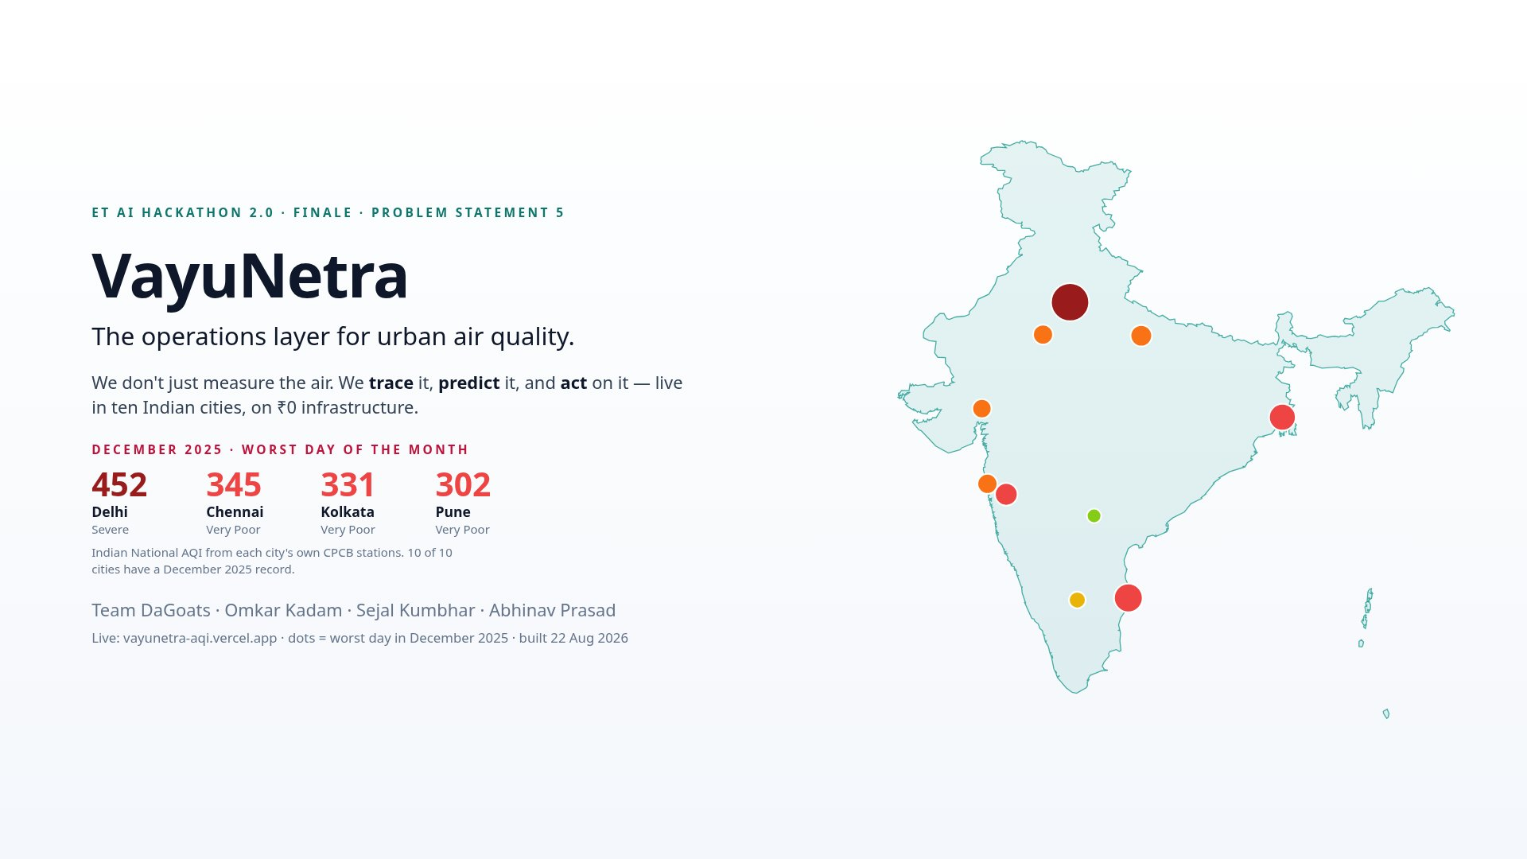
Notes:
[A · 0:00] Good morning. Every Indian metro measures its air; several forecast it. Nothing acts on it. VayuNetra is the operations layer: it traces who is polluting each square kilometre, predicts the next 72 hours with honest probabilities, ranks where to send an inspector with cited evidence, and tells citizens in their own script — live in ten cities, at zero infrastructure cost. The map behind me is live.

Slide 2
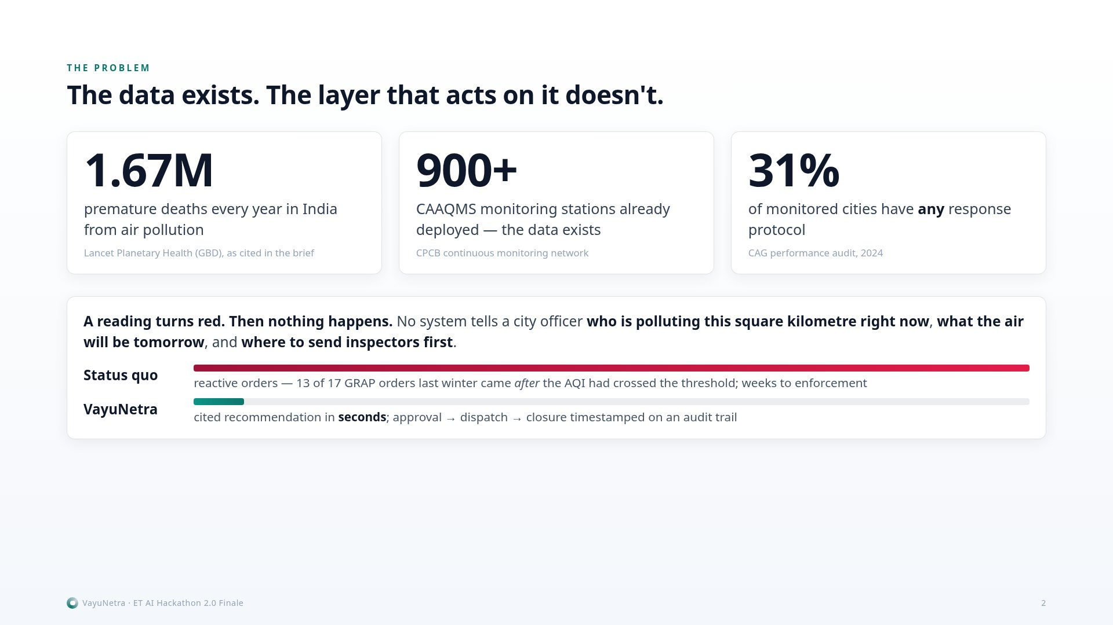
Notes:
[A · 0:25] The data exists — nine hundred CAAQMS stations, satellites overhead — and 1.67 million Indians still die early each year. Why? A reading turns red and nothing happens: no system tells an officer who is polluting this square kilometre now, what the air does tomorrow, where to send inspectors first. The CAG found 31 percent of monitored cities have any response protocol at all. Cities don't need another dashboard; they need the layer that turns a reading into an intervention.

Slide 3
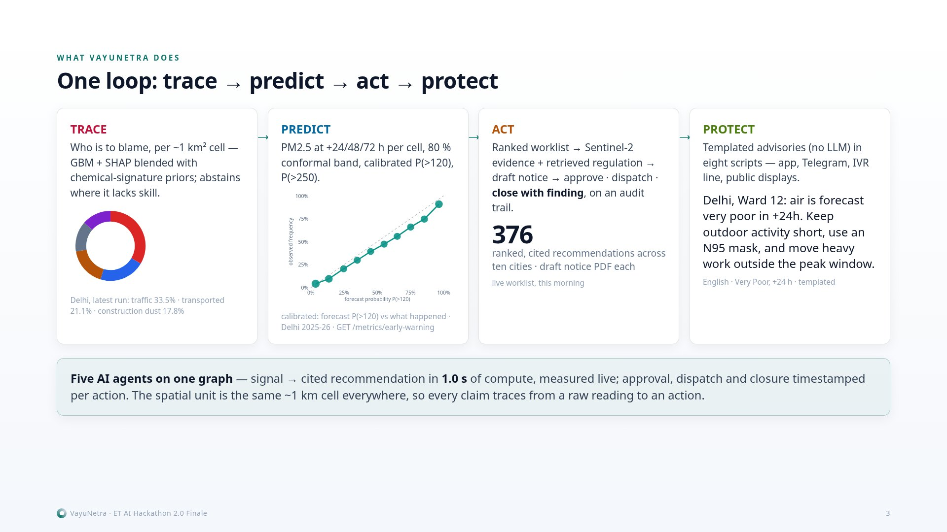
Notes:
[A · 0:55] One loop, four verbs. Trace: who is to blame in each square kilometre — and it says so where it lacks skill. Predict: the next 72 hours, with each cell's chance of turning Very Poor. Act: sites ranked by contribution, people exposed and confidence — real satellite image, the regulation, a draft notice; the officer approves, dispatches, closes the case on an audit trail. Protect: advisories in eight scripts. Five agents on one graph, seconds of compute — every human step timestamped.

Slide 4
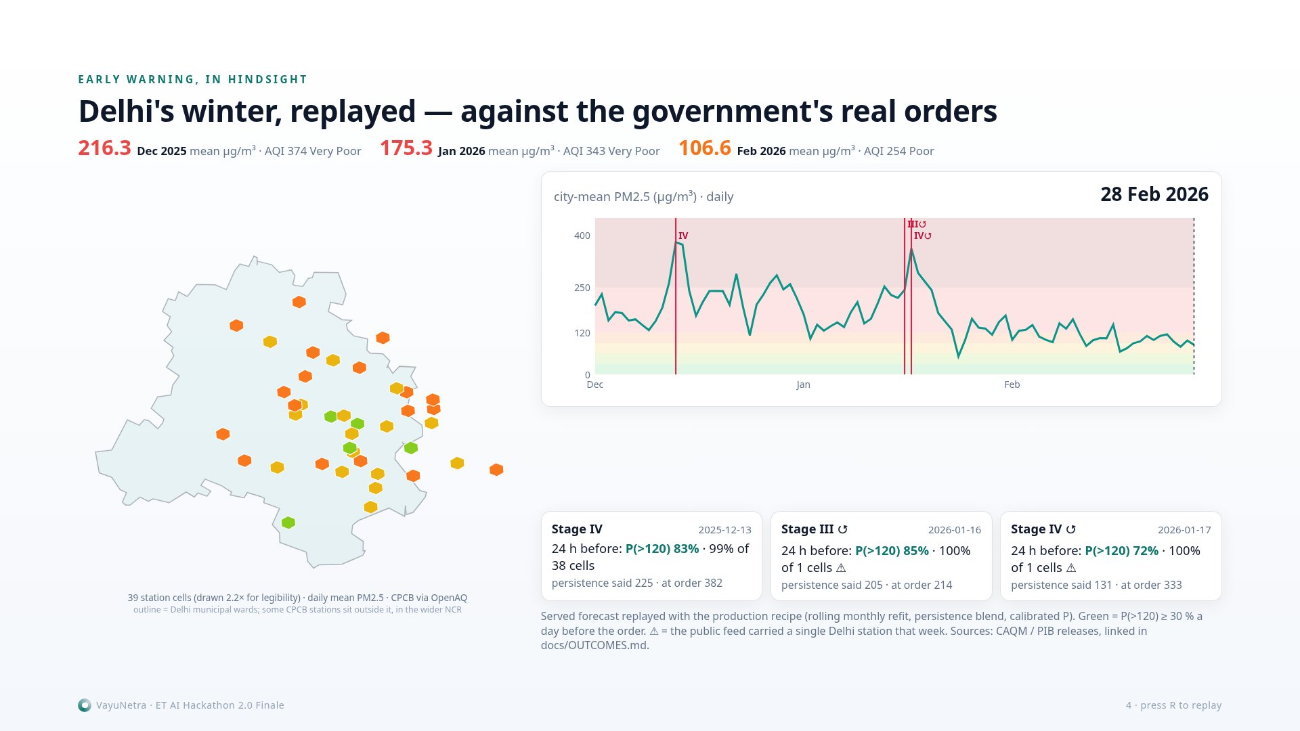
Notes:
[A · 1:35 — say the first sentence, then silence for the 9-second replay, then continue] This is Delhi's last winter, day by day, on 39 station cells — real CPCB data. The markers are the government's actual GRAP orders. Under each: what our forecast said 24 hours before the order was signed. Stage III on 11 November and Stage IV on 13 December — flagged a full day ahead across essentially the whole network, probability above 80 percent, when persistence said 225 and the city measured 407. The two October orders we did not foresee — and it says so on the slide.

Slide 5
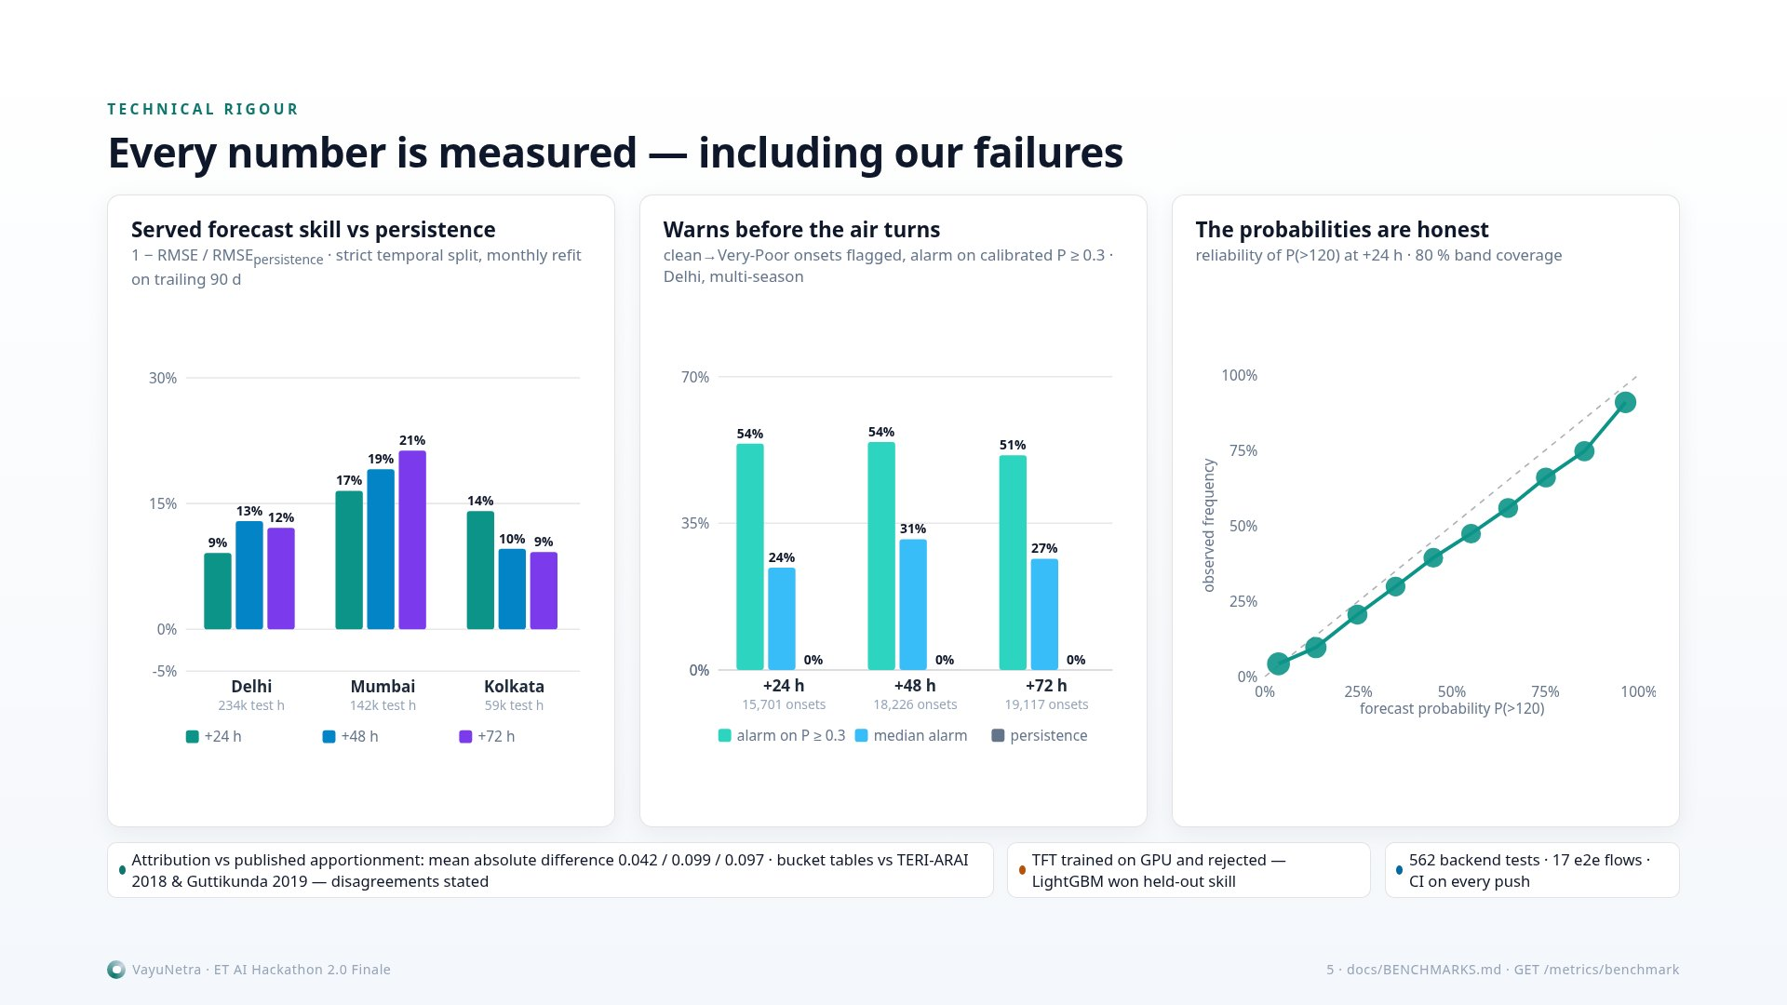
Notes:
[A · 2:20] Every number is measured — including the ones that hurt. Skill over persistence on a strict temporal split: Delhi plus 9, 13, 12 percent at one, two, three days. Of the clean-to-Very-Poor onsets, our calibrated alarm catches about half, days ahead — persistence catches none. The probabilities are honest: the reliability curve sits on the diagonal. Attribution is checked against the published studies — disagreements on the record. SAFAR and the DSS forecast the air; nothing turns a forecast into a traced, cited, delivered, closed action. We do — here it is. (hand over)

Slide 6
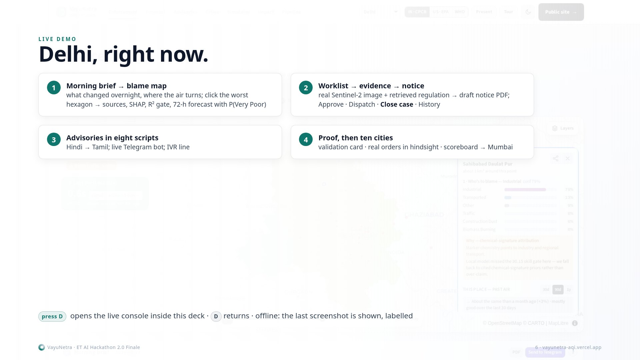
Notes:
[B · 3:00 → 7:00 — press D] STOP 1: This is Delhi, right now. The Morning brief is the one page a commissioner reads: the city mean against yesterday, where the air is about to turn — with the probability, not a guess — the top three actions with their notice links, and yesterday's dispatches. One click gives the PDF; one click sends it to every Telegram subscriber. Nothing on this page is written by a language model — every line is a template over stored numbers. STOP 2: Every hexagon is a square kilometre. This one: who is to blame — the sources, the SHAP drivers that moved the number, and the model's own out-of-sample R². Where it lacks skill it says so and falls back to cited chemical-signature priors, in amber. Below: the 72-hour forecast for this cell with the calibrated probability of Very Poor. Click any other cell — same story, its own numbers. STOP 3: The worklist ranks sources by contribution, people exposed, actionability and confidence — nothing under two percent gets in. Open the dossier: the real Sentinel-2 image of this site, the regulation retrieved verbatim — GRAP only where it legally binds, CPCB norms and NCAP elsewhere — and a draft notice with the projected effect of compliance. Stamped pending officer authorisation. Never auto-sent. STOP 4: The officer approves — it lands in the ward's field queue. Dispatches — the cell's seven-day baseline freezes and the before/after measurement is armed automatically. Closes the case with the field finding. And History: who did what, when, from what to what. That trail survives the nightly run and even the deletion of the record. This is the audit trail a court asks for. STOP 5: The same advisory in the reader's own script — Hindi, then Tamil — templated by design, so it cannot hallucinate medical advice. It goes out over the app, a live Telegram bot, an IVR line with a Hindi voice, and public display boards, targeted at five and a half thousand vulnerability-scored zones: hospitals, schools, elder care, outdoor work. STOP 6: The benchmark you saw on the slide lives here, per city, recomputed from the artifact — negatives included. And the winter replay: every GRAP order links to its government release, with what we carried a day before, and a weather-normalised check of whether the air changed. Where the honest answer is 'no detectable change', it says no. STOP 7: Ten cities on one scoreboard, one engine, one configuration file each — click Mumbai and the whole console follows: its own sources, its own forecast, its own worklist, its own languages. (D → back to the deck)

Slide 7
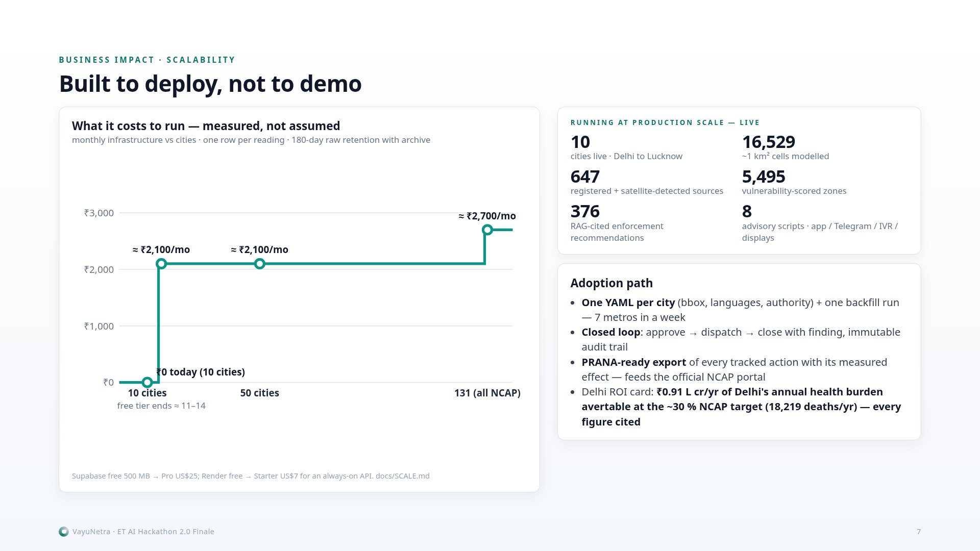
Notes:
[B · 7:00] Built to deploy, not to demo. Ten cities live, one YAML per city, no per-city code; seven metros onboarded in a week. We measured what a city costs — 0.2 megabytes of readings a day, one row per reading, 180-day retention with an archive: the free tier is sized for this deployment; all 131 NCAP cities would run for about ₹2,700 a month. Every dispatched action is tracked against its own cell and exported PRANA-ready — we feed the official system, we don't compete with it.

Slide 8
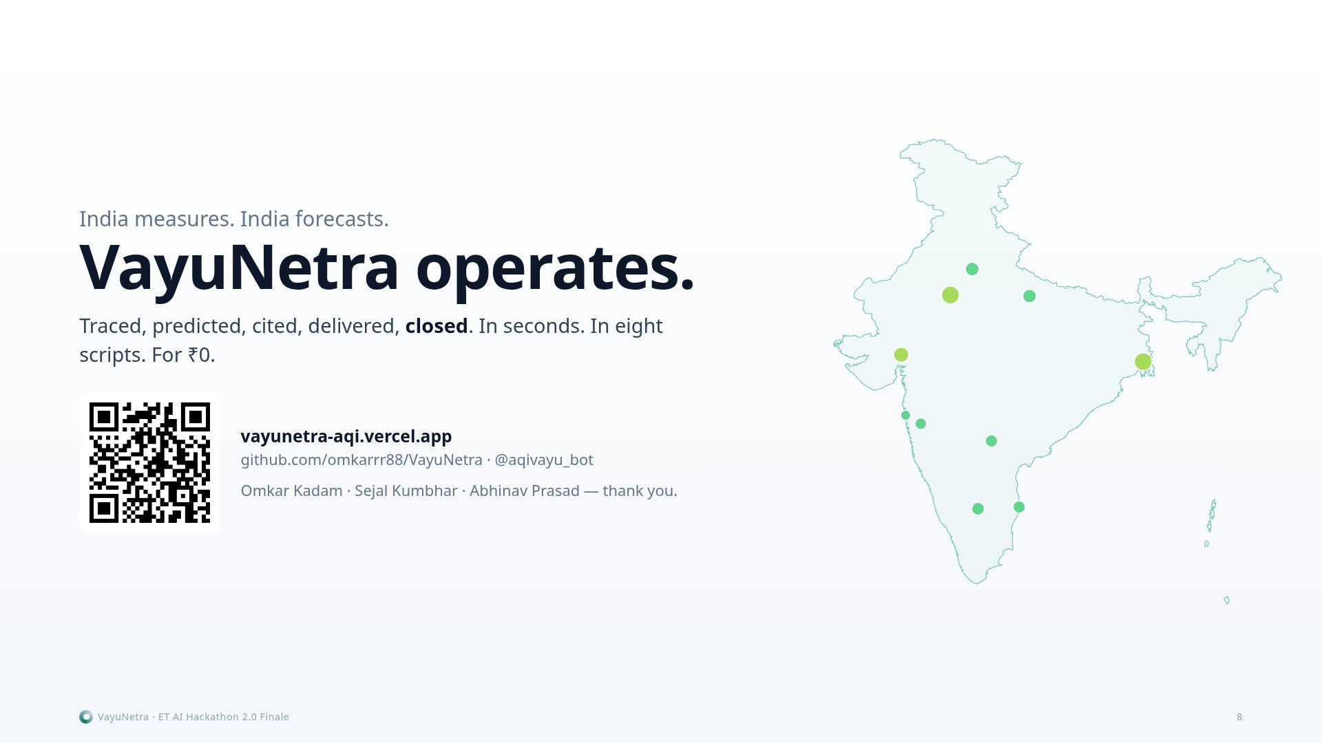
Notes:
[B · 7:30] India measures. India forecasts. VayuNetra operates — traced, predicted, cited, delivered, closed. In seconds, in eight scripts, for zero rupees today and 2,700 a month for every NCAP city. It is live now — the QR takes you there. We are ready to run it for the first city that says yes. Thank you.

Slide 9
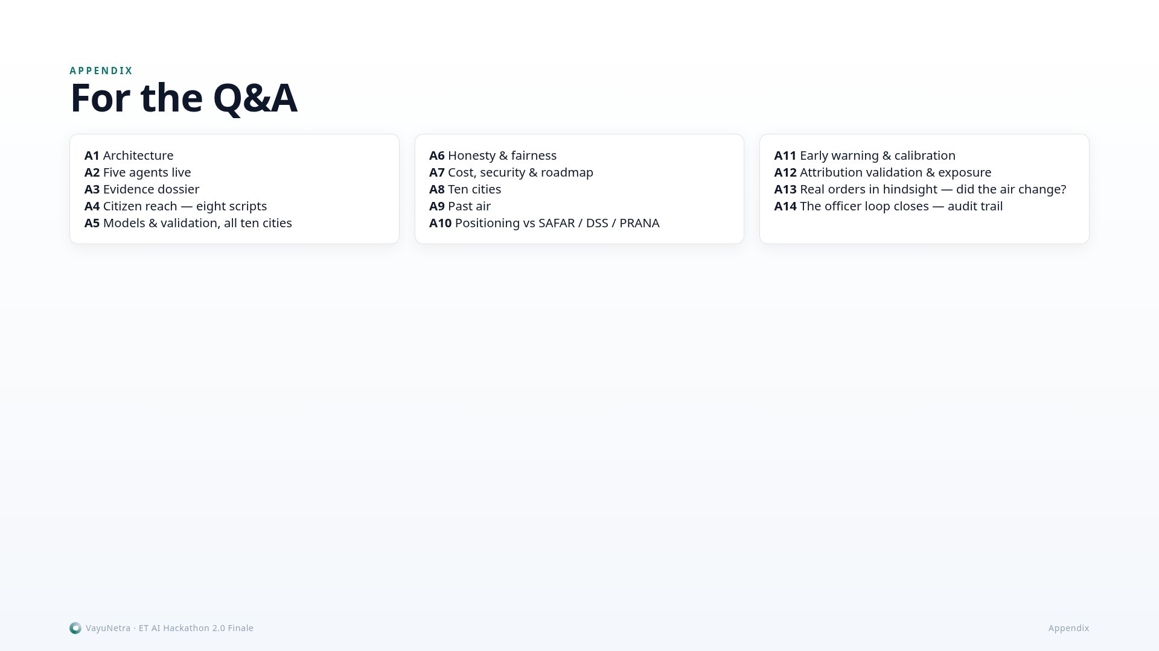
Notes:
Appendix for Q&A. Jump with the number keys is not supported — use arrows; the list here is the map.

Slide 10
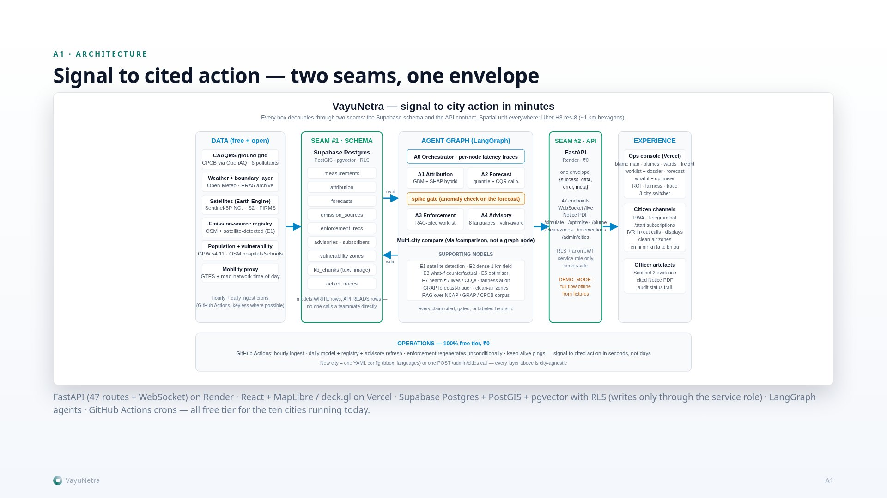
Notes:
A1. Two seams — the Supabase schema and the API contract — decouple every layer: models write rows, the API reads rows, the console reads the API. LangGraph orchestrates five agents; GitHub Actions run ingest, forecast, attribution, enforcement, brief and retention nightly.

Slide 11
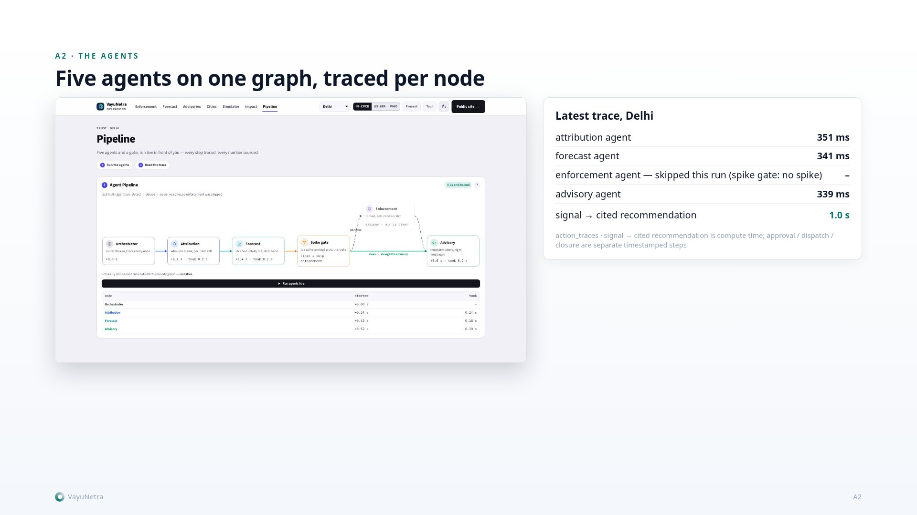
Notes:
A2. The pipeline view: each node's inputs, outputs and wall-clock, stamped per run in action_traces. The button really runs the graph against the live database; the latency widget on the console reads the same rows.

Slide 12
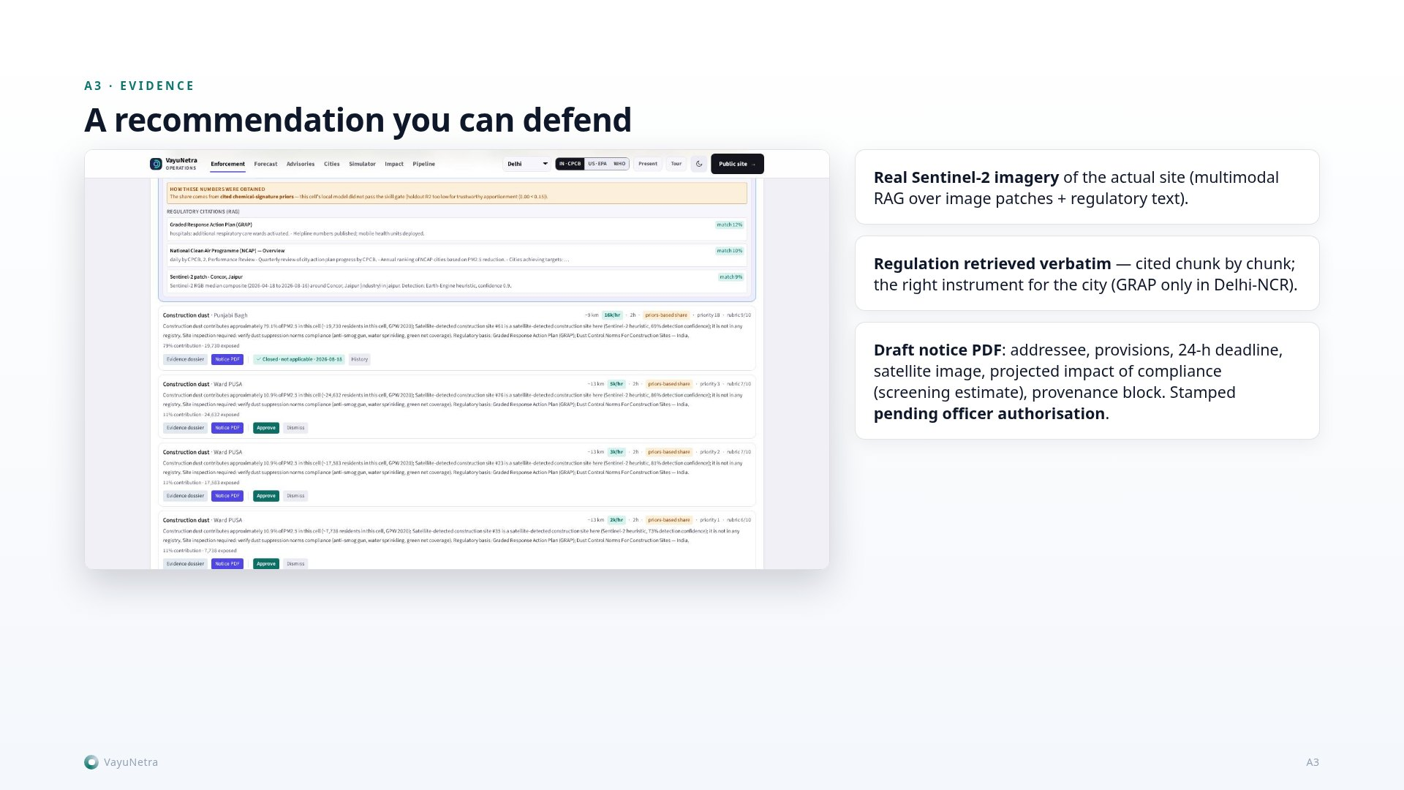
Notes:
A3. Every recommendation opens a dossier: the real Sentinel-2 image of the site, the retrieved regulatory text — GRAP/CAQM only where they legally bind, CPCB dust norms and NCAP elsewhere — and a draft notice PDF stamped pending officer authorisation. Never auto-sent.

Slide 13
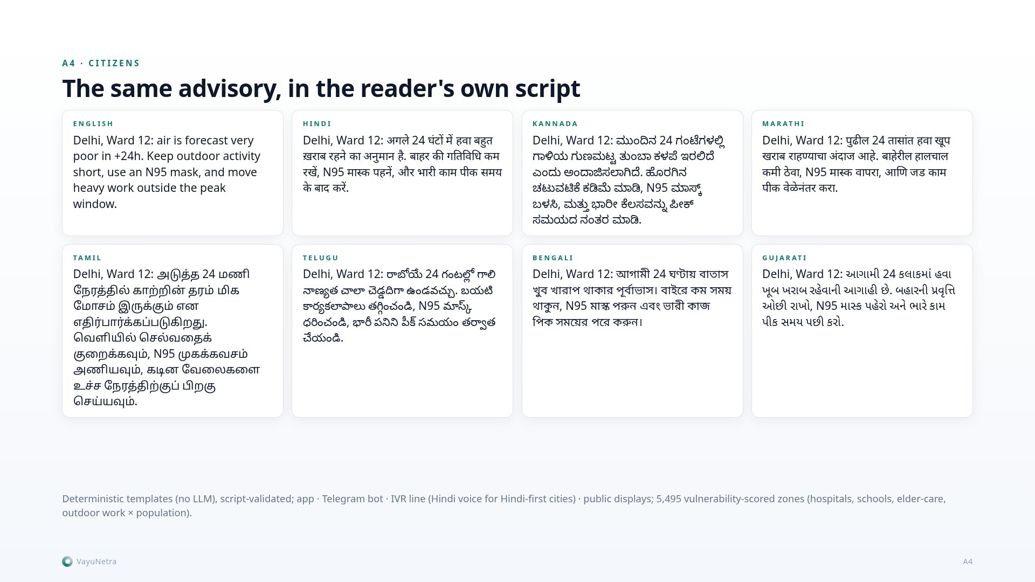
Notes:
A4. The same advisory in eight scripts. Templated by design so it cannot hallucinate medical guidance; script-validated in code; native-speaker review status is tracked per language in docs/ADVISORY_REVIEW.md. Channels: app, live Telegram bot, an IVR line with a Hindi voice, public displays; targeted by 5,495 vulnerability-scored zones.

Slide 14
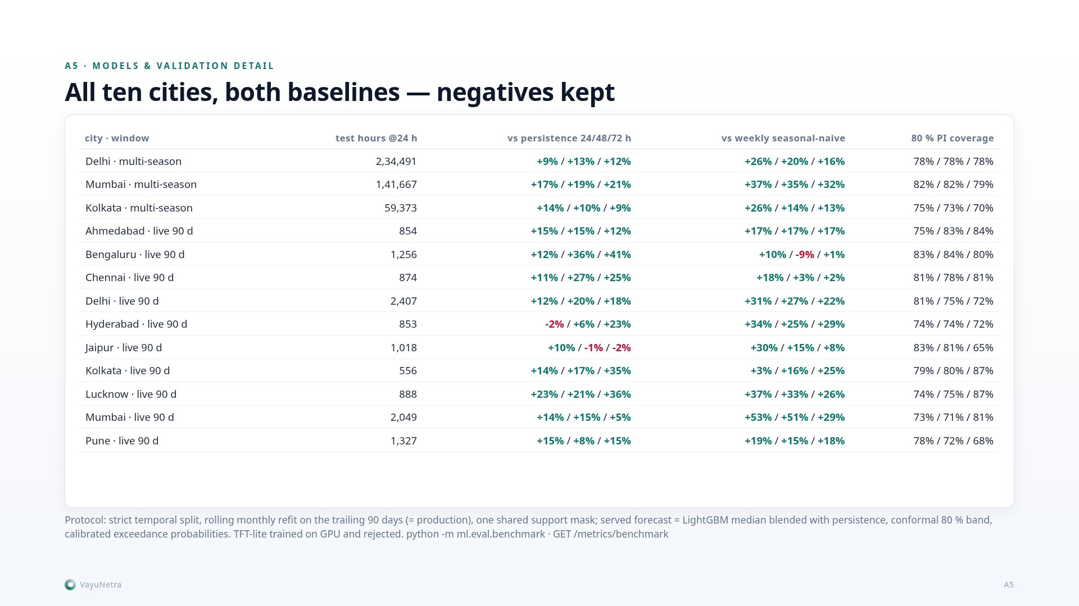
Notes:
A5. The full table: served-forecast skill versus persistence and seasonal-naive at 24/48/72 hours for every city, from the live recent-window benchmark, plus the multi-season Delhi/Mumbai/Kolkata runs. Negative numbers stay on the slide.

Slide 15
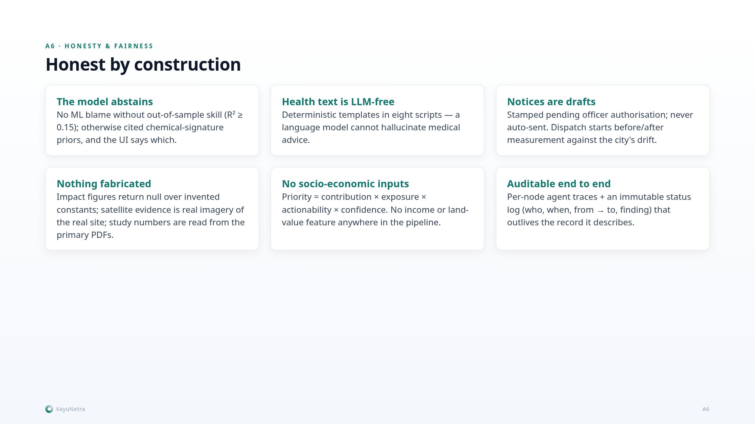
Notes:
A6. Honesty is a design constraint, not a slogan: the model abstains, health text is LLM-free, notices are drafts, nothing fabricated reaches production, no socio-economic inputs, and an immutable audit trail on every action.

Slide 16
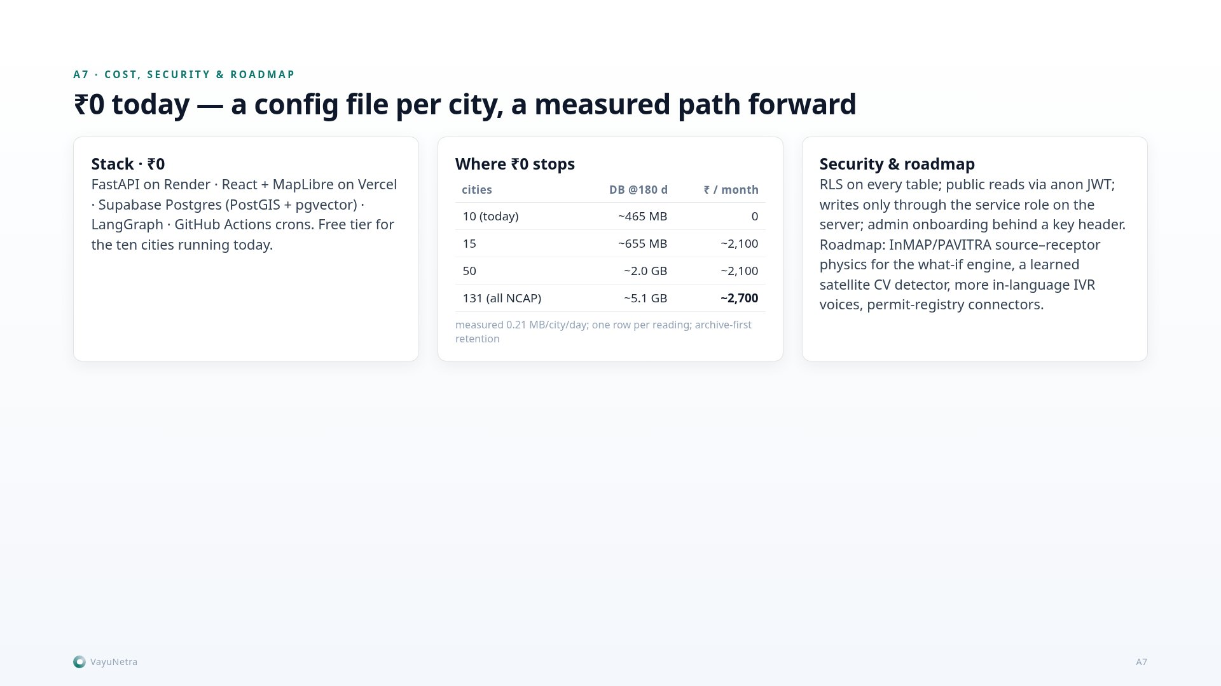
Notes:
A7. Stack, security, roadmap. Free tier is sized for the ten cities running today; the curve to 131 is published. Row-level security on every table; the anon role is read-only; the API writes with the service role; admin onboarding behind a key.

Slide 17
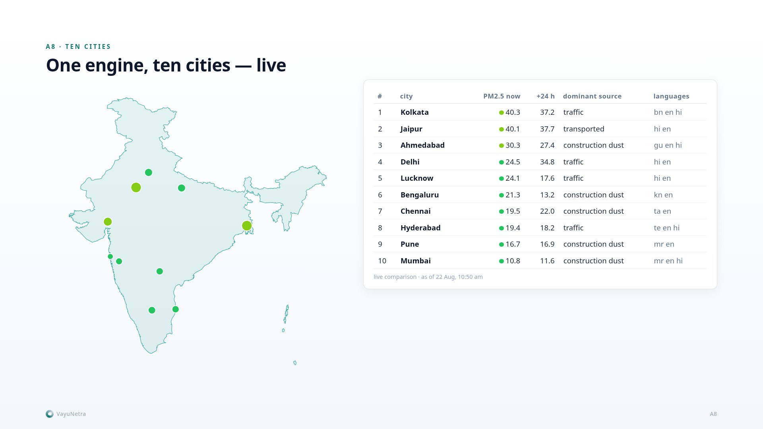
Notes:
A8. Ten cities live, ranked Swachh-Vayu style; the same engine, one YAML each. Dots are today's PM2.5; the table is the live comparison.

Slide 18
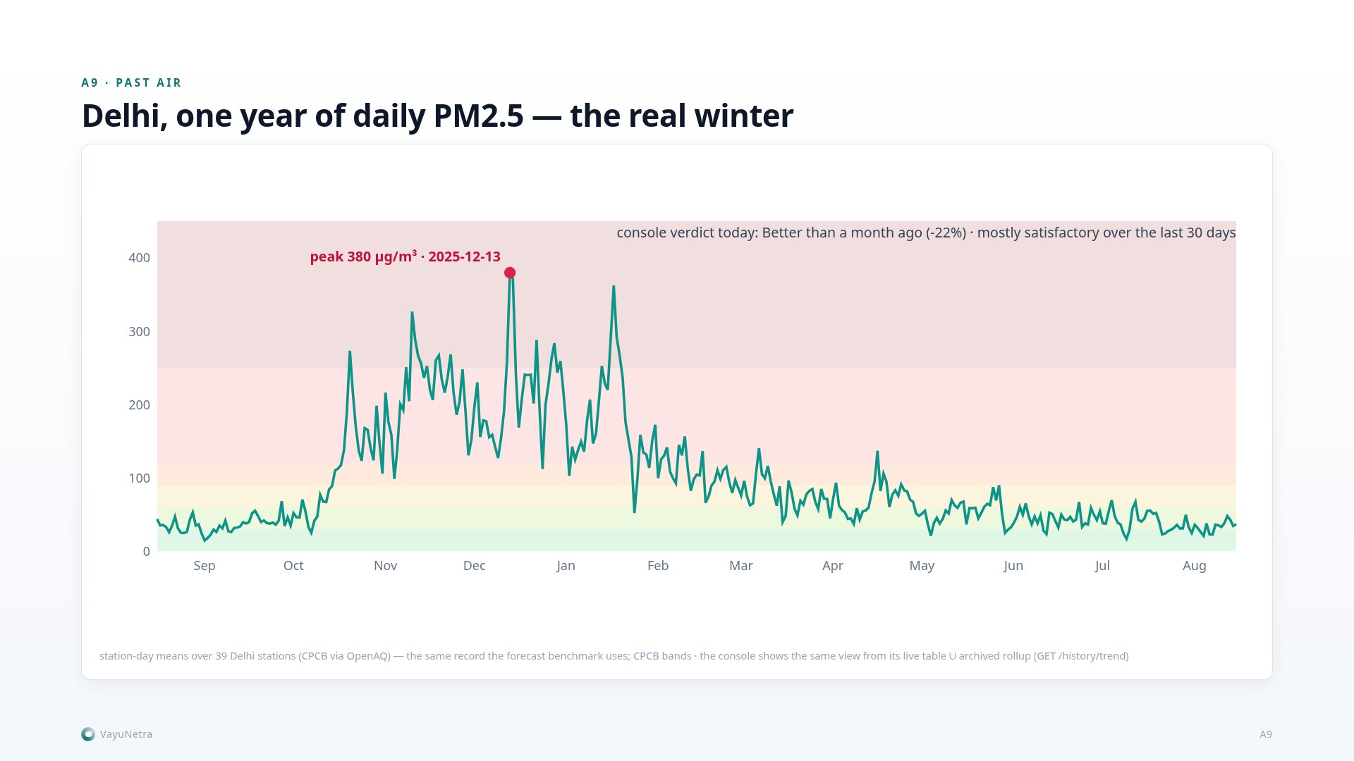
Notes:
A9. Every place carries its own history: daily PM2.5 over the CPCB bands for a year — Delhi's real smog season peaks above 400 in December — with a plain-language verdict and spike days. Raw rows older than 180 days live in the archive; the daily rollup keeps the chart.

Slide 19
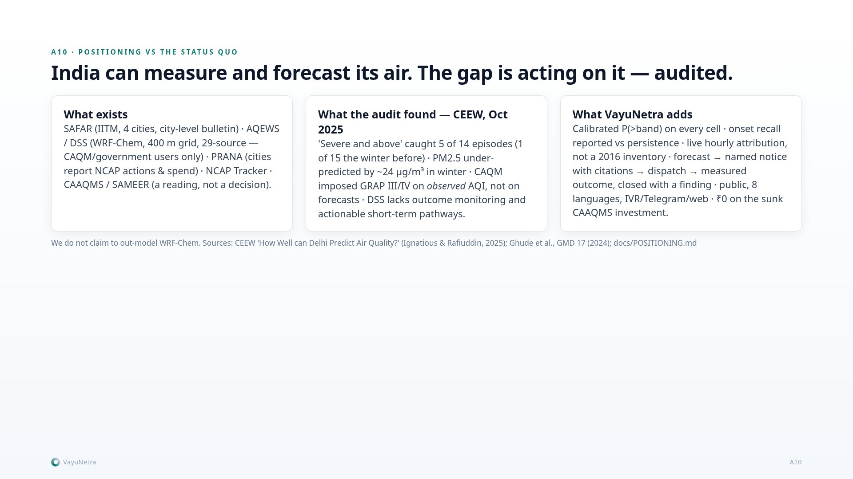
Notes:
A10. India already measures and forecasts; the gap is acting on it, and the CEEW audit says the official early-warning system caught 5 of 14 severe episodes in the 2024-25 winter. VayuNetra does not compete with WRF-Chem; it adds the operational layer and feeds PRANA.

Slide 20
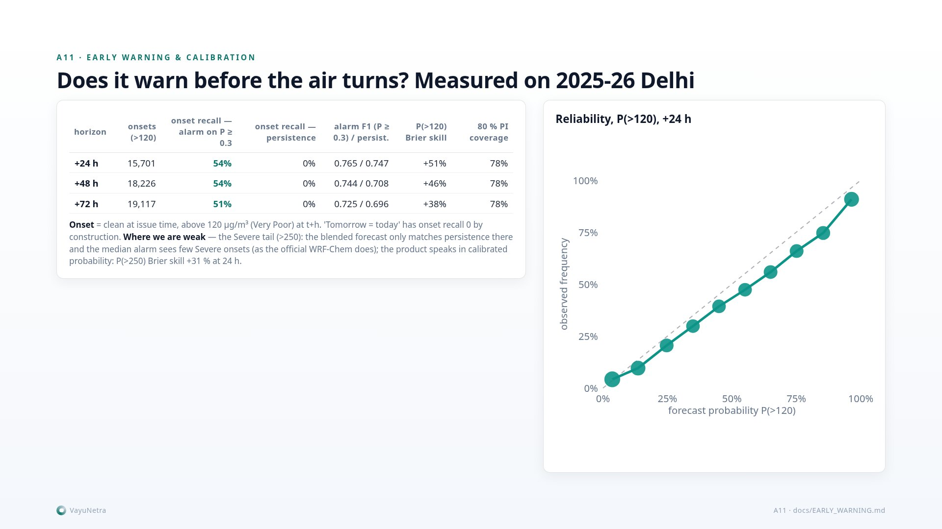
Notes:
A11. The early-warning table: onsets, recall of the median alarm versus the calibrated-probability alarm, F1 against persistence, Brier skill, and 80 % interval coverage — Delhi multi-season. Where we are weak: the Severe tail, and we say so.

Slide 21
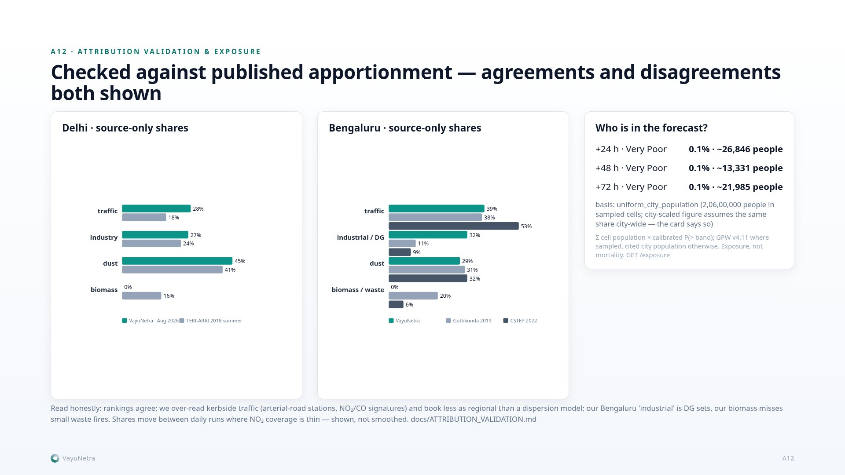
Notes:
A12. Attribution checked bucket by bucket against the published studies, read from the primary PDFs: Delhi vs TERI-ARAI 2018, Bengaluru vs Guttikunda 2019 and CSTEP 2022. Rankings agree — dust first in Delhi, traffic first in Bengaluru; kerbside traffic is over-read; small waste fires are invisible to FIRMS; the run-to-run movement with thin NO₂ coverage is stated. Exposure: expected people in Very Poor air, not mortality.

Slide 22
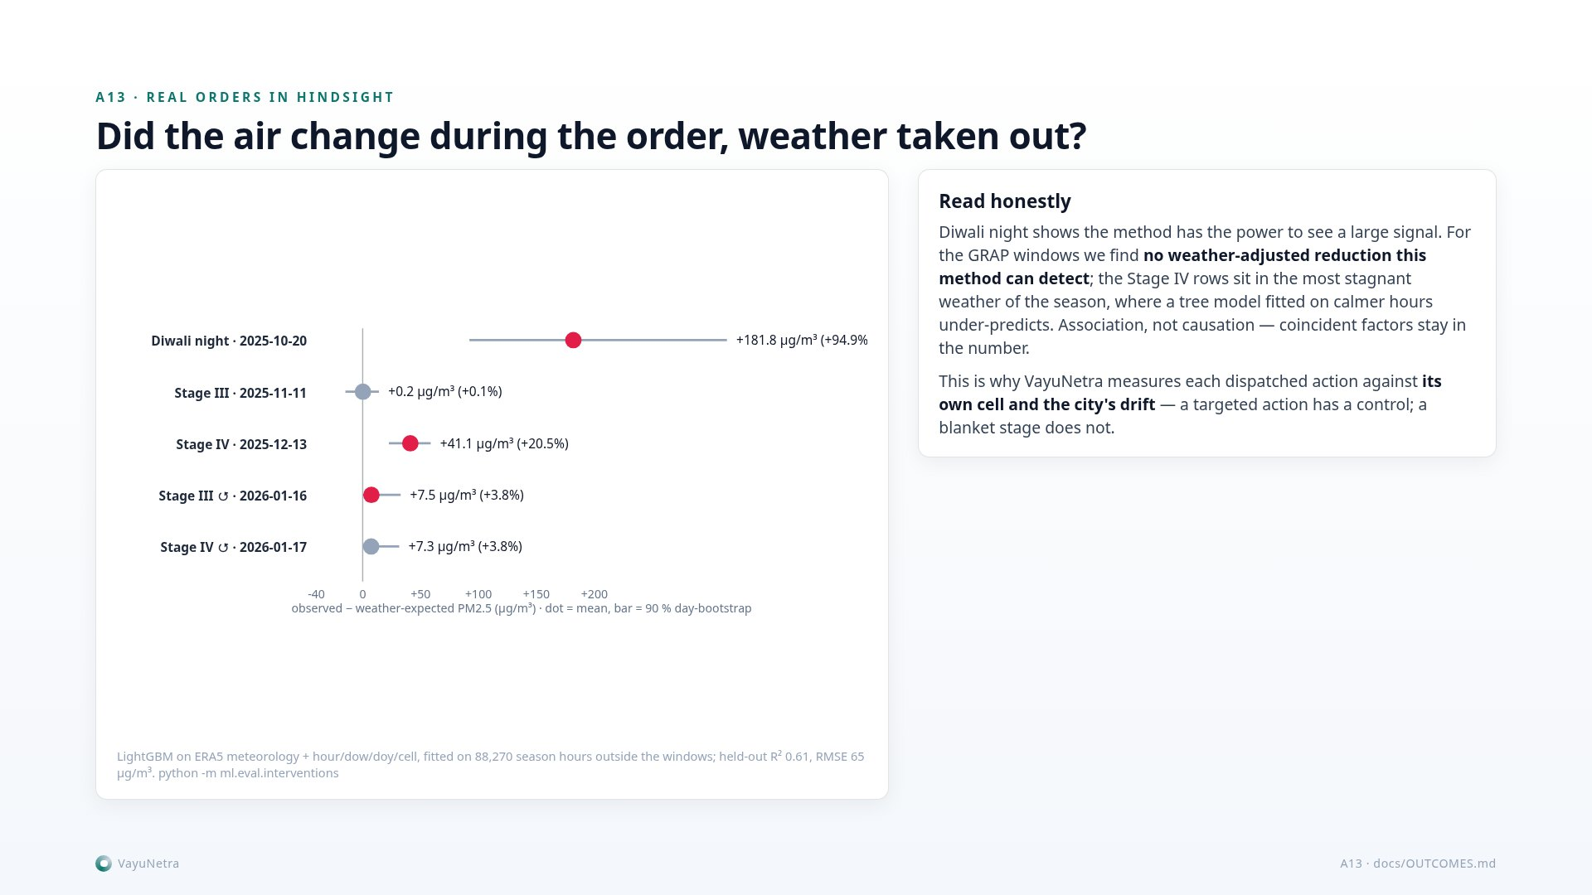
Notes:
A13. Did the air change during the orders, weather taken out? A city-wide order has no untreated control and is triggered by dirty air, so we deweather: LightGBM on ERA5 meteorology fitted outside the windows, held-out R² 0.61. Diwali night is the positive control, plus 182. The GRAP windows show no detectable reduction; Stage IV sits in the most stagnant weather where the model under-predicts. Association, not causation — and the reason VayuNetra tracks each action against its own cell.

Slide 23
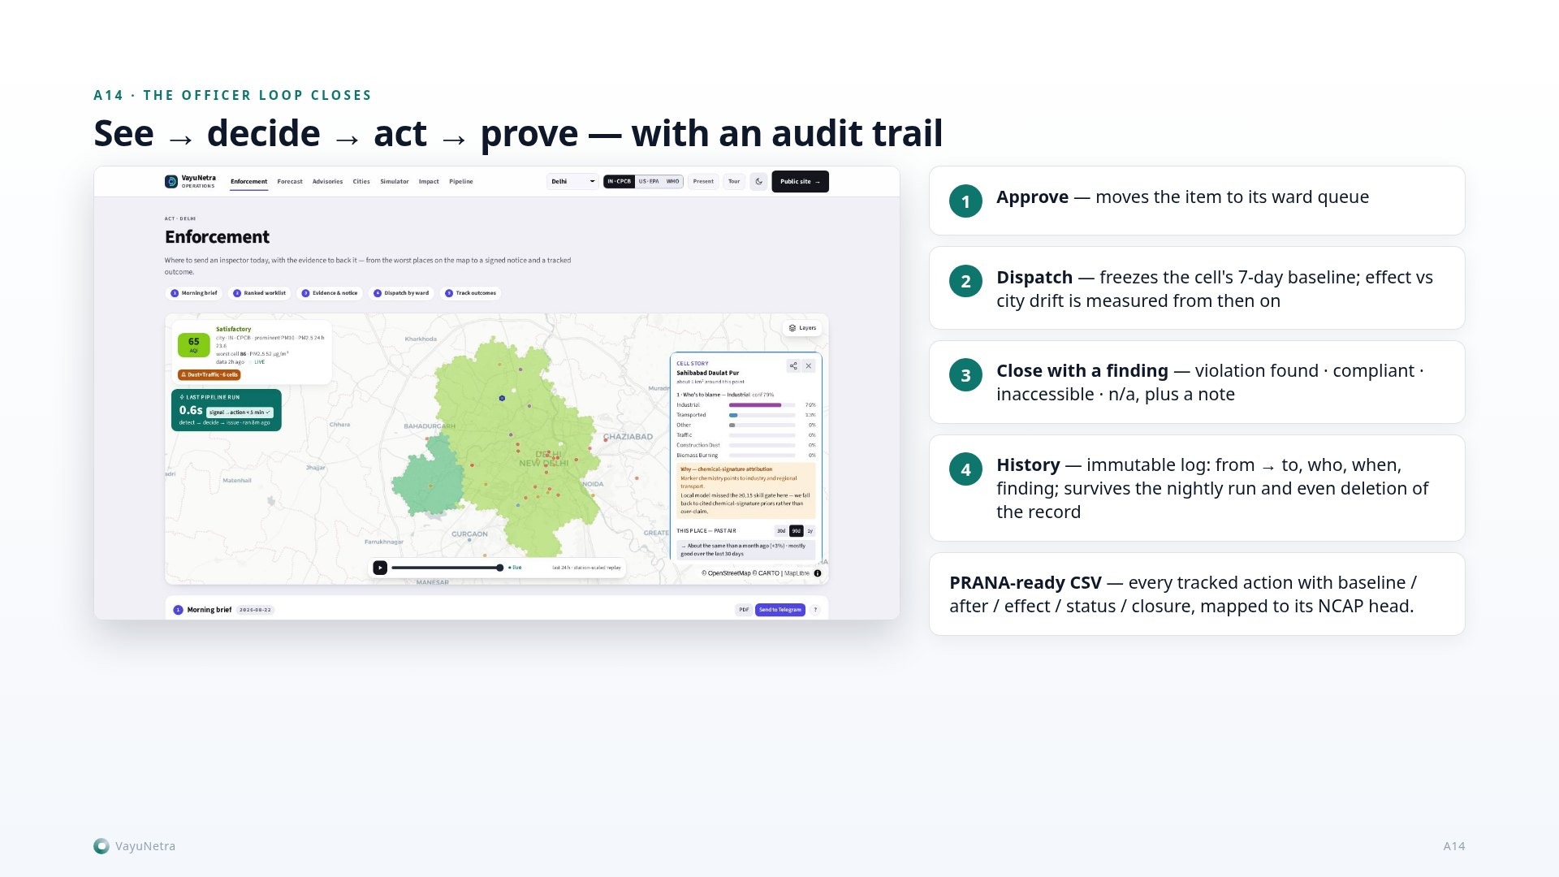
Notes:
A14. The officer loop closes: approve, dispatch (which freezes the cell's 7-day baseline and arms tracking), close with a field finding; every change is appended to an immutable status log with the acting officer, and the nightly run refreshes evidence in place without ever resetting a decision. PRANA export carries status and finding.

