Slide 1
ANALYZING TRAFFIC ACCIDENTS IN THE UNITED STATES
Presented By:
SHANKAR CHIMNANI
OMKAR SAPLE
SHRUTIKA BIRJE
SURAJ SHINDE
SAGAR TALEKAR
DIVYA GAJANGI
Project guide: PradeepTripathi
Project mentor: Sushrut Dhadwe

Slide 2
OBJECTIVE
The objective of the project is to analyze the US accidents data from 49 states to inform the US government agencies and the general public on trends and possible causes of traffic accidents and what could be done to reduce them.
The analysis include number of accidents by year, number of accidents by state,Number of accidents by day and hour, accident-prone area in each state,Traffic delay due to accidents, factors responsible of the accidents like weather, wind flow, temperature, location, etc.

Slide 3
TOOLS USED
PYTHON:
•Python is a high-level, interpreted, interactive and object-oriented scripting language.
•Python is more straightforward as the English language, i.e., simple
coding.
• Python has a syntax that allows developers to write programs with fewer
lines than some other programming languages.
• Python runs on an interpreter system, meaning that code can be
executed as soon as it is written. This means that prototyping can be
rapid.
HADOOP:
•The Apache Hadoop is a framework that allows for the distributed processing of large data sets across clusters of computers using simple programming models.
•It is designed to scale up from single servers to thousands of machines, each offering local computation and storage.

Slide 4
SPARK:
•Spark is a general-purpose, in-memory, fault-tolerant, distributed processing engine that allows you to process data efficiently in a distributed fashion.
•Applications running on Spark are 100x faster than traditional systems.
You will get great benefits using Spark for data ingestion pipelines.
•Using Spark we can process data from Hadoop HDFS, AWS S3, Databricks DBFS and many file systems.
TABLEAU:
•Tableau is heavily used in business intelligence.
•Users can make and disperse an intelligent and shareable dashboard, which delineate the patterns, varieties, and thickness of the information as graphs and charts. Tableau can
associate with files, relational, and Big Data sources to get and process information.

Slide 5
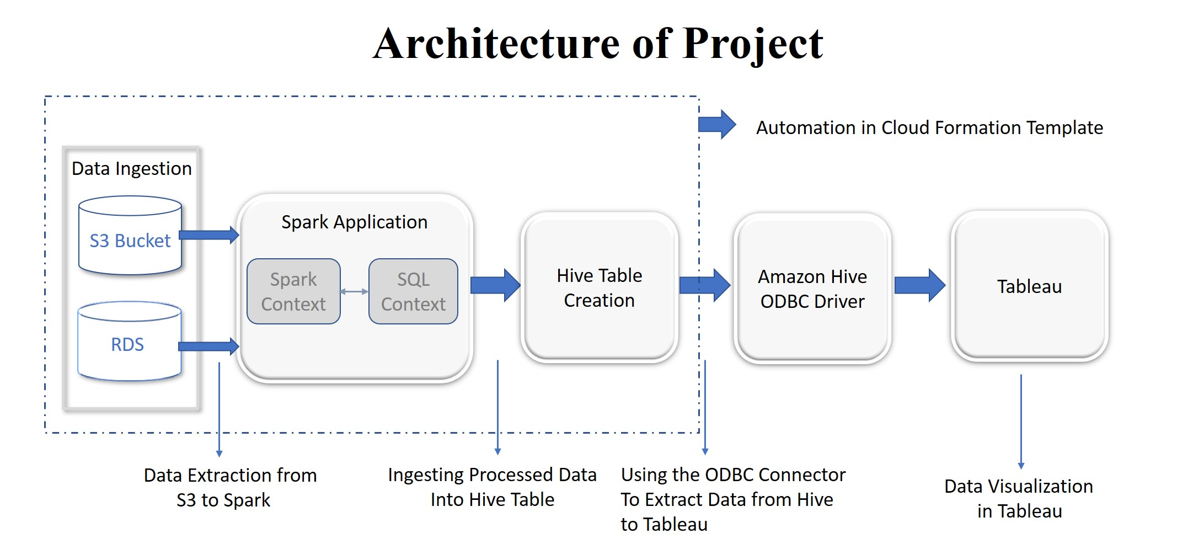

Slide 6
FEATURES OF OUR DATA
ID: This is a unique identifier of the accident record.
Source: Indicates source of the accident report (i.e. the API which reported the accident.).
Severity: Shows the severity of the accident, a number between 1 and 4, where 1 indicates
the least impact on traffic (i.e., short delay as a result of the accident) and
4 indicates a significant impact on traffic (i.e., long delay).
Start_Time: Shows start time of the accident in local time zone.
End_Time: Shows end time of the accident in local time zone.
End time here refers to when the impact of accident on traffic flow was dismissed.
Start_Lat: Shows latitude in GPS coordinate of the start point.
Start_Lng: Shows longitude in GPS coordinate of the start point.
Distance(mi): The length of the road extent affected by the accident.
Description: Shows natural language description of the accident.
Street: Shows the street name in address field.

Slide 7
Side: Shows the relative side of the street (Right/Left) in address field.
City: Shows the city in address field.
County: Shows the county in address field.
State : Shows the state in address field.
Zipcode: Shows the zipcode in address field.
Country: Shows the country in address field.
Timezone: Shows timezone based on the location of the accident (eastern, central, etc.).
Airport_Code: Denotes an airport-based weather station which is the closest one to location of the accident.
Weather_Timestamp: Shows the time-stamp of weather observation record (in local time).
Temperature(F): Shows the temperature (in Fahrenheit).
Wind_Chill(F): Shows the wind chill (in Fahrenheit))

Slide 8
Visibility(mi): Shows visibility (in miles).
Wind_Direction: Shows wind direction.
Wind_Speed(mph): Shows wind speed (in miles per hour).
Weather_Condition: Shows the weather condition (rain, snow, thunderstorm, fog, etc.)
Bump: A POI annotation which indicates presence of speed bump or hump in a nearby location.
Crossing: A POI annotation which indicates presence of crossing in a nearby location.
Junction: A POI annotation which indicates presence of junction in a nearby location.
Railway: A POI annotation which indicates presence of railway in a nearby location.
Station: A POI annotation which indicates presence of station in a nearby location.
Traffic_Calming: A POI annotation which indicates presence of traffic_calming in a nearby location.
Traffic_Signal: A POI annotation which indicates presence of traffic_signal in a nearby location.
Sunrise_Sunset : Shows the period of day (i.e. day or night) based on sunrise/sunset

Slide 9
DATA PRE-PROCESSING
•The need to derive meaningful insights from our data.As data is most likely to be imperfect, inconsistent and sometimes redundant it cannot be directly used for visualizing.
•Features related to road conditions and accidents include Severity, Amenity, Bump, Crossing, GiveWay, Junction, NoExit, Railway, Station, Stop, TrafficSignal.
Features related to weather conditions include Temperature(F), WindChill(F), Humidity, Pressure(in), Visibility(mi), WindDirection, WindSpeed(mph), Precipitation(in), WeatherCondition, SunriseSunset,Months,Date..
•The data cleaning was done in pyspark.

Slide 10
EXTRACTING DATA FROM S3
•Amazon S3 has a simple web services interface that you can use to store and retrieve any amount of data, at any time, from anywhere on the web.
•Data file was uploaded to Amazon S3 and it was extracted by the command given below.
hdfs dfs -cp s3n://us-accident/US_Accidents_June20.csv ProjectData/
•The ProjectData here is the directory made in HDFS.

Slide 11
DATA CLEANING
•While the data set has 3 million records, it is not ready to use for analysis.
•There are many anomalies in the dataset like:
• Null records
• Data transformation
• Improper column names
•To Address all these anomalies in data, data cleaning is the most important and mandatory step.
The next slide shows the data cleaning:

Slide 12
DATA CLEANING
• Null records
Considering the percentage of null records depending on the category.
Some of the null records have been deleted from the dataset and been
replaced with appropriate values.
• Data Transformation
Features were in string so they were converted in their respective format i.e. boolean,integer,string.
• Improper columns
Some names of the features were not proper so they were renamed.
Eg:df=df.withColumnRenamed("Distance(mi)","Distance").

Slide 13
CFT
AWS CloudFormation provides users with a simple way to create and manage a collection of Amazon Web Services (AWS) resources by provisioning and updating them in a predictable way. AWS CloudFormation enables you to manage your complete infrastructure or AWS resources in a text file.
In simple terms, it allows you to create and model your infrastructure and applications without having to perform actions manually.
Steps for creating CFT:
1.Create a new template or use an existing CloudFormation template using the JSON or YAML format.
2.Save your code template locally or in an S3 bucket.
3.Use AWS CloudFormation to build a stack on your template.
4.AWS CloudFormation constructs and configures the stack resources that you have specified in your template.

Slide 14
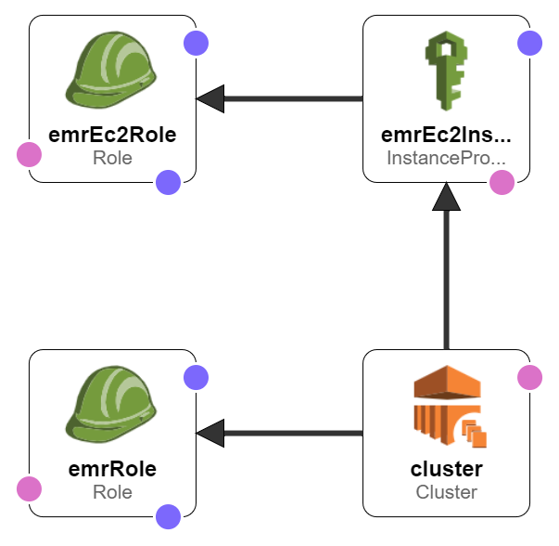

Slide 15
SQL CONTEXT
•Spark SQL is a Spark module for structured data processing. Unlike the basic Spark RDD API, the interfaces provided by Spark SQL provide Spark with more information about the structure of both the data and the computation being performed.
•Spark SQL context was created using following commands:
from pyspark.sql import SQLContext
df = sqlContext.read.format('com.databricks.spark.csv').options(header='true',inferschema='true').
load("ProjectData/US_Accidents_June20.csv")
•Infer schema will automatically guess the data types for each field. If we set this option to TRUE, the API will read some sample records from the file to infer the schema.

Slide 16
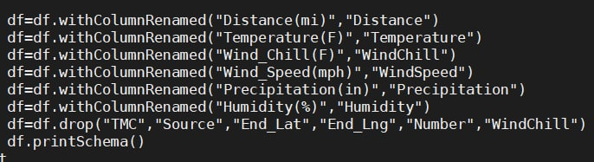
Renaming Columns

Slide 17
Dropping Irrelevant Features
There were certain columns which were not required so they were dropped.
df.drop("TMC","Source","End_Lat","End_Lng","Number","County","Precipitation")

Slide 18
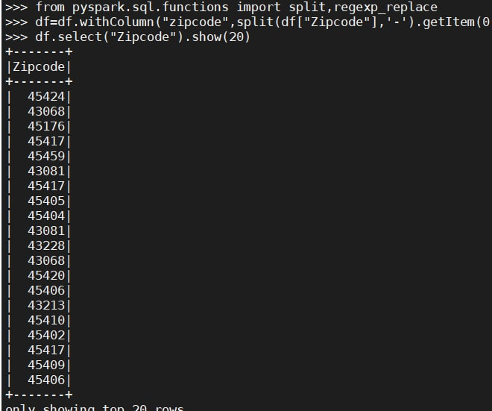
Standardizing the zip code column because the values were not consistent.

Slide 19
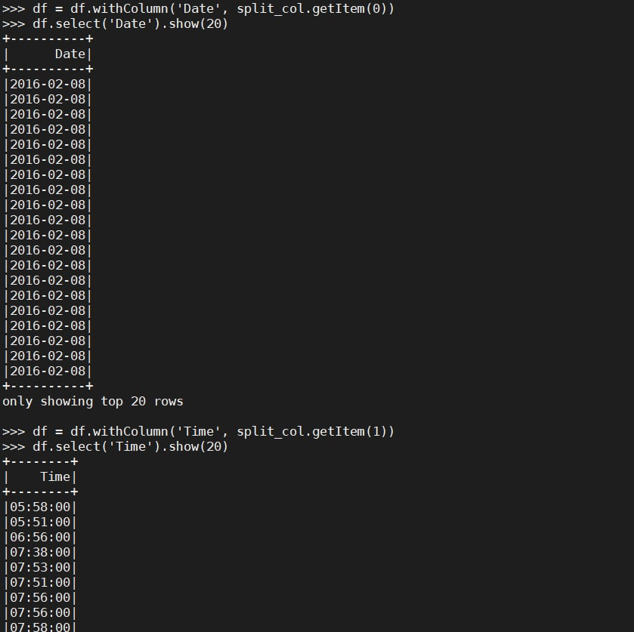
Converting date and time into individual features

Slide 20
WRITING DATAFRAME TO PARQUET
Parquet is an open source file format available to any project in the Hadoop ecosystem. Apache Parquet is designed for efficient as well as performant flat columnar storage format of data compared to row based files like CSV or TSV files.
Parquet is optimized to work with complex data in bulk and features different ways for efficient data compression and encoding types. This approach is best especially for those queries that need to read certain columns from a large table. Parquet can only read the needed columns therefore greatly minimizing the IO.
df.write.parquet("s3://us-accidents-output/output/clean.parquet/")
The us_accidents is the folder in which the file is written.

Slide 21
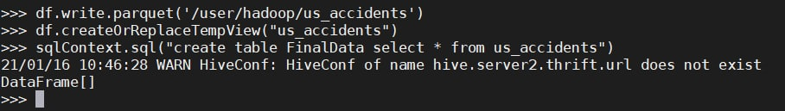

Slide 22
EXTRACTING DATA TO HIVE
The cleaned data was extracted from S3 to HIVE using script.
import pyspark
from pyspark.sql.functions import *
from pyspark.context import SparkContext
from pyspark.sql import SQLContext
from pyspark.sql.session import SparkSession
sc = SparkContext()
sqlContext = SQLContext(sc)
spark = SparkSession.builder.master("local").appName("app name").config("spark.some.config.option", 'true').getOrCreate()
df = spark.read.parquet("s3://us-accidents-output/output/clean.parquet/")
df.createOrReplaceTempView("final_data")
sqlContext.sql("create table us_accidents select * from final_data")

Slide 23
Connecting HIVE with Tableau
Use the connector for Other Databases (ODBC).
We used AmazonHiveODBC64.msi
Open ODBC administrator 64 bit.
Copy Master DNS of EMR, set user as hive.
Open your tableau desktop
Select connection of Amazon EMR Hive.
Enter your master DNS and username as hive and establish your connection.
Your Live connection will be ready.
Keep your connection as extract so that you can use it anytime you want.

Slide 24
RECOMMENDATIONS
Measures that can be taken to reduce accidents:
As the weather cannot be controlled, human behavior is essential in these
situations. With self-discipline, accidents can be reduced.
The school curriculum should incorporate safety control measures at the
primary school level, a great deal of awareness will be reached in instilling
safety measures to the younger generation so that they can acquire the
discipline of road safety measures right from the childhood.
The government should consider the designing of roads as per new
vehicles coming into the market, which can withhold high speed.

Slide 25
CONCLUSION
The USA accidents dataset, taken from Kaggle, was analyzed, and results were discussed above.
We came to a lot of exciting things like we came to know which city or state witnessed the most number of accidents in the USA, we even plotted the results on a map and also considered the severity of an accident.
Traffic accidents are a main public safety issue, with much research
devoted to the analysis and prediction of these rare events.
The study helped us to derive factors that are responsible for accidents. From this dataset, a variety of insights concerning the location, time, weather, and points-of-interest of an accident are found. The analysis helps us understand the best month, day, and
hour of the day to travel. Also, it can help us to predict what are the accidentprone areas in each state.

Slide 26
THANK YOU

Slide 27
RDS TO SPARK
Loading data from rds to pyspark
Step1:Download the jar_files.zip
step2:unzip the file
step3:sudo cp mysql-connector-java-5.1.49.jar /lib/spark/jars/
step4:go to pyspark
step5:establish the connection
from pyspark.sql import SparkSession
from pyspark.sql import SQLContext
spark = SparkSession.builder.config(conf=SparkConf()).getOrCreate()
sqlContext = SQLContext(spark)
hostname='shnakidb.cqb3dula51ug.us-east-1.rds.amazonaws.com'
jdbcPort=3306
dbname='test'
username='admin'
password='admin123'
jdbc_url = "jdbc:mysql://{0}:{1}/{2}".format(hostname, jdbcPort, dbname)
connectionProperties = {
"user" : username,
"password" : password
}
step6:read the csv file
df=spark.read.jdbc(url=jdbc_url,table='project',properties= connectionProperties)
step7:show the records
df.show()

