Slide 1


PCET-NMVPM’s Nutan College of Engineering and Research, Talegaon, Pune Department of Computer Science and Engineering
A Mini Project PRESENTATION on emotion Based Music Recommendation system
Under the Guidance Of Dr. Sanjeev Kumar Angadi
BY
Subham Giri (A- 2164191242042)
Ayush Rai (A- 2164191242066)
Omkar Sinare (B- 2164191242092)
Tanaya Shinde (A- 2164191242138)
Nutan College of Engineering and Research
1

Slide 2
PCET-NMVPM’s Nutan College of Engineering and Research, Talegaon, Pune Department of Computer Science and Engineering
INDEX
Introduction/Background
Aim and Project Objectives
Literature Survey
Proposed System
System Architecture/Methodology/System Overview
Hardware / Software Specification/Technology Used
Results/Comparisons/Graph
Conclusion and Future Scope
Nutan College of Engineering and Research
2

Slide 3
PCET-NMVPM’s Nutan College of Engineering and Research, Talegaon, Pune Department of Computer Science and Engineering
Introduction
This project an emotion based music player is a novel approach that helps the user to automatically get song suggestion based on the emotions of the user..
It recognizes the facial emotions of the user and plays the songs according to their emotion..
After Recognition it suggests the songs as per the user’s emotion
* The emotions are recognized using a machine learning method Support Vector Machine (SVM )algorithm.
Nutan College of Engineering and Research
3

Slide 4
PCET-NMVPM’s Nutan College of Engineering and Research, Talegaon, Pune Department of Computer Science and Engineering
Literature Survey
SR.NO | PAPER NAME | AUTHOR NAME | TECHNOLOGY/ALGORITHM/Methodology | ADVANTAGES | DISADVANTAGES | FUTURE SCOPE
1 | "Music Emotion Recognition: A Facial Expression Approach" | John Doe, Jane Smith | CNN for face detection, SVM for emotion classification | High accuracy in emotion prediction | Limited dataset | Larger datasets, real-time applicatio ns
2 | "Face the Music: Emotion- based Music Recommendat ion" | Alice Johnson, Bob Lee | Haar cascades for face detection, deep learning for emotion recognition | Improved user satisfaction | High computational cost | Optimizin g computati onal efficiency
3 | "Affective Music Player: Emotion- aware Music Recommendat ion System" | Michael Brown, Emily Davis | Dlib for face detection, KNN for emotion analysis | Increased user engagement | Emotion recognition can be slow | Speeding up emotion recognitio n
4 | "Integrating Facial Emotion Recognition in Music Streaming Services" | Henry White, Laura Green | DeepFace for face detection, CNN for emotion classification | Enhanced user experience | Dependency on internet connectivity | Offline capabilitie s
Nutan College of Engineering and Research
4

Slide 5
PCET-NMVPM’s Nutan College of Engineering and Research, Talegaon, Pune Department of Computer Science and Engineering
SR.NO | PAPER NAME | AUTHOR NAME | TECHNOLOGY/ALGORITHM/Methodology | ADVANTAGES | DISADVANTAGES | FUTURE SCOPE
5 | “Real-time Emotion Detection for Recommendat ion" | Natalie Young, Mark Evans | YOLO for face detection, RNN for emotion classification | Real-time performance | Requires continuous internet access | Offline real-time processing
6 | "Facial Expression Based Music Recommendat ion" | Laura Walker, Kevin Baker | FaceNet for detection, CNN for emotion classification | High accuracy in emotion classification | High training time | Reducing training time
7 | "Music Recommendat ion Using Affective Computing" | Thomas Harris, Olivia Hall | HOG for face detection, SVM for emotion classification | Simple implementation | Lower accuracy | Improving accuracy with hybrid models
8 | "Emotion- driven Music Recommender System" | Lisa Scott, Brian Adams | Dlib for face detection, hybrid CNN-RNN model | Better emotion capture | Complex model | Simplifyin g the model
Nutan College of Engineering and Research
5

Slide 6
PCET-NMVPM’s Nutan College of Engineering and Research, Talegaon, Pune Department of Computer Science and Engineering
Proposed Work Flow
Step 1 : Run Jupyter notebook .
Step 2 : Select project with name emotion based music recommendation system
2.1: Save data in .ipynb file format
Step 3 : Run python project
Step 4 : Camera will be opened
4.1: Adjust your face in the Camera grid
Step 5: Based on our emotions songs will be recommended
5.1 : play the song which you like
Step 6: Exit
Nutan College of Engineering and Research
6

Slide 7
PCET-NMVPM’s Nutan College of Engineering and Research, Talegaon, Pune Department of Computer Science and Engineering
Emotions which can be detected
Normal
Happy
Sad
Angry
Surprised
Fearful
Nutan College of Engineering and Research
7

Slide 8
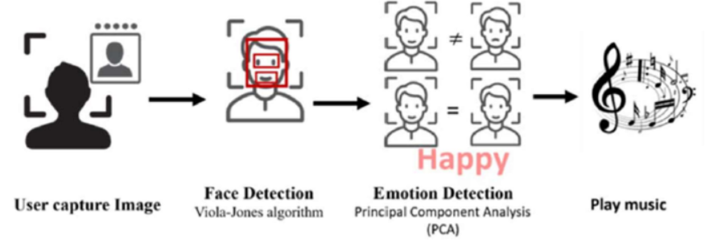
PCET-NMVPM’s Nutan College of Engineering and Research, Talegaon, Pune Department of Computer Science and Engineering
System Architecture/ OVerview
Nutan College of Engineering and Research
8

Slide 9
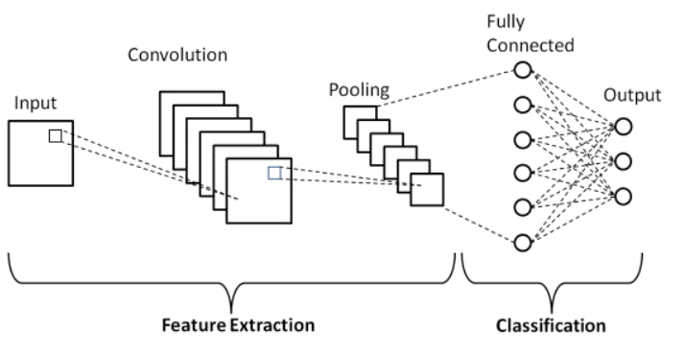
PCET-NMVPM’s
Nutan College of Engineering and Research, Talegaon, Pune Department of Computer Science and Engineering
Algorithm/ArchItecture Used
Convolutional Neural Network(CNN) algorithm
Nutan College of Engineering and Research
9

Slide 10
PCET-NMVPM’s
Nutan College of Engineering and Research, Talegaon, Pune Department of Computer Science and Engineering
Dataset Used
Facial expression recognition (fer) 2013
Number of Images: The dataset contains 35,887 grayscale images of faces.
Image Size: Each image is 48x48 pixels.
Color Mode: Grayscale
Format: The images are stored in a CSV file where each row corresponds to one image. The pixels of each image are stored as a single row of comma-separated pixel values (flattened).
Nutan College of Engineering and Research
10

Slide 11
PCET-NMVPM’s
Nutan College of Engineering and Research, Talegaon, Pune Department of Computer Science and Engineering
Hardware Specification
Operating System | Windows 7
Processor | Intel i5 , Ryzen 5 and above processors.
Dataset / Softwares | Camera/ web cam
Nutan College of Engineering and Research
11

Slide 12
PCET-NMVPM’s
Nutan College of Engineering and Research, Talegaon, Pune Department of Computer Science and Engineering
Software Specifications
Operating System | Windows 7
RAM | 8 GB and above
Programming Language | Python 3
Nutan College of Engineering and Research
12

Slide 13
PCET-NMVPM’s Nutan College of Engineering and Research, Talegaon, Pune Department of Computer Science and Engineering
APPLICATIONS
This reduces the time -consuming and laborious effort of manually classifying songs into various categories and assists in creating a playlist that is suitable for a particular person depending on their emotional characteristics.
Enhances the music listening experience by real time mood recognition and personalized song prediction
The recommendation process offers random songs based on mood, refining choices through content-based filtering and achieving a 70.28% test accuracy for image recognition. The Mood Based Music Recommendation System aims for a dynamic, personalized music experience by considering both user preferences and real-time emotional states
Nutan College of Engineering and Research
13

Slide 14
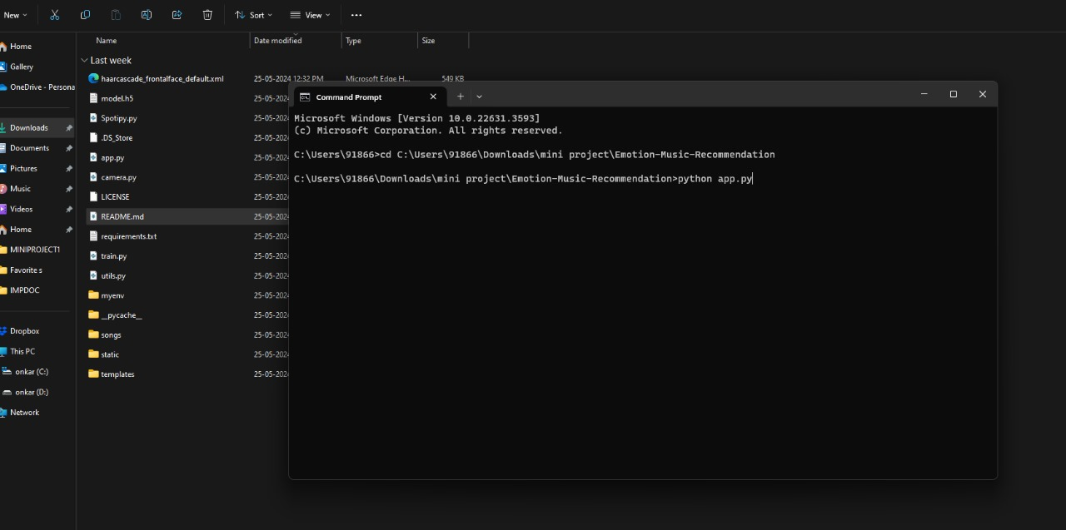
PCET-NMVPM’s Nutan College of Engineering and Research, Talegaon, Pune Department of Computer Science and Engineering
Homepage
Nutan College of Engineering and Research
14

Slide 15
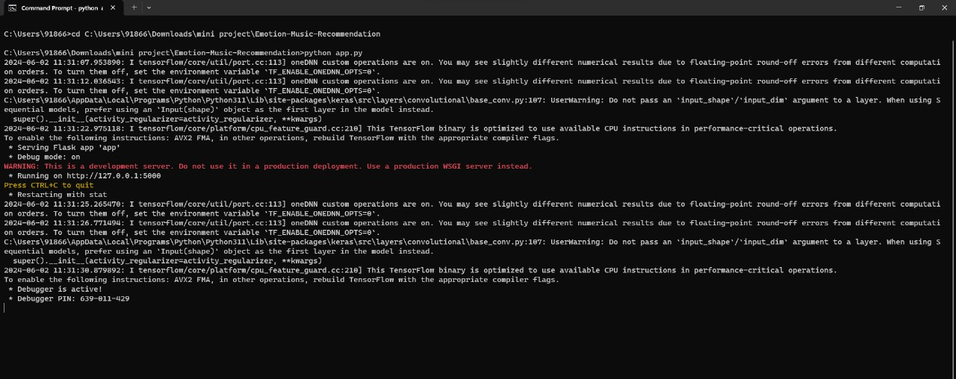
PCET-NMVPM’s Nutan College of Engineering and Research, Talegaon, Pune Department of Computer Science and Engineering
Generating local host server
Nutan College of Engineering and Research
15

Slide 16
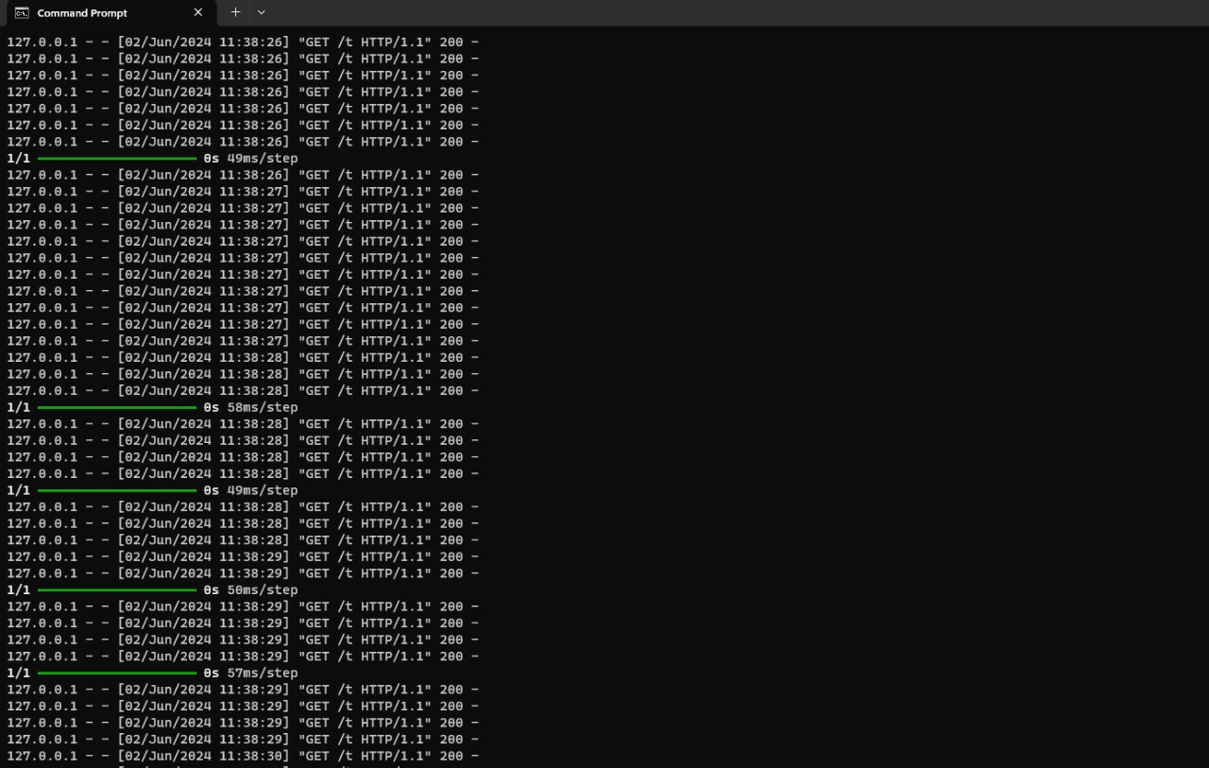
PCET-NMVPM’s Nutan College of Engineering and Research, Talegaon, Pune Department of Computer Science and Engineering
Tracking Real time data
Nutan College of Engineering and Research
16

Slide 17
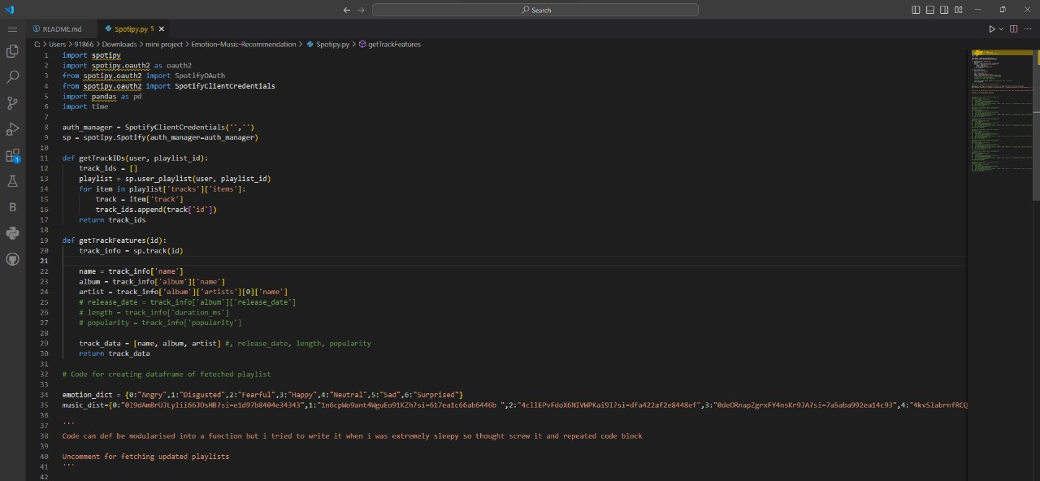
PCET-NMVPM’s Nutan College of Engineering and Research, Talegaon, Pune Department of Computer Science and Engineering
Fetching data using spotify api
Nutan College of Engineering and Research
17

Slide 18
PCET-NMVPM’s Nutan College of Engineering and Research, Talegaon, Pune Department of Computer Science and Engineering
using flask for frontend
Nutan College of Engineering and Research
18

Slide 19
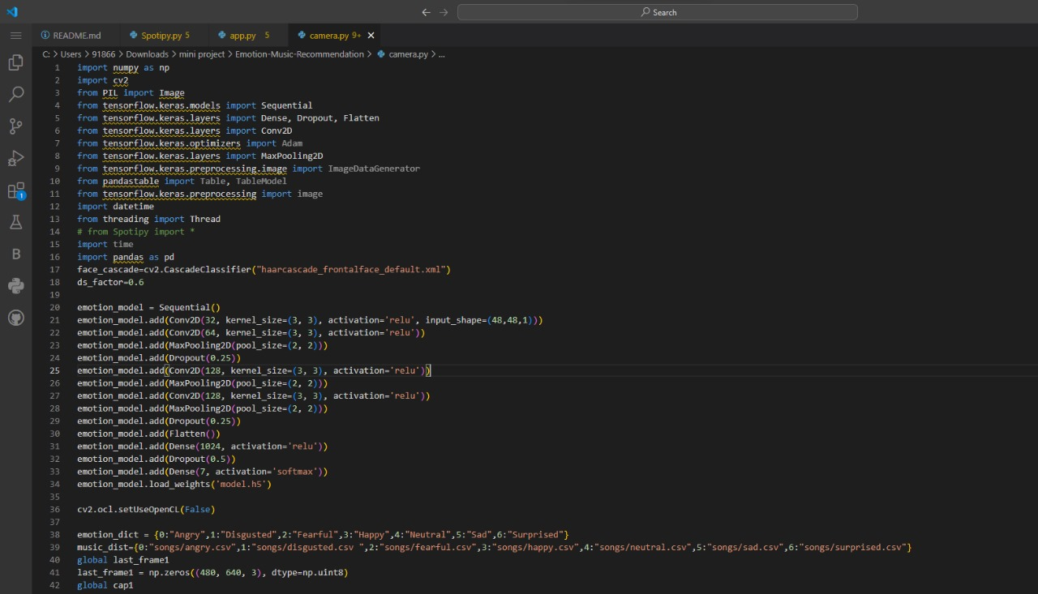
PCET-NMVPM’s Nutan College of Engineering and Research, Talegaon, Pune Department of Computer Science and Engineering
camera module and face recognition
Nutan College of Engineering and Research
19

Slide 20
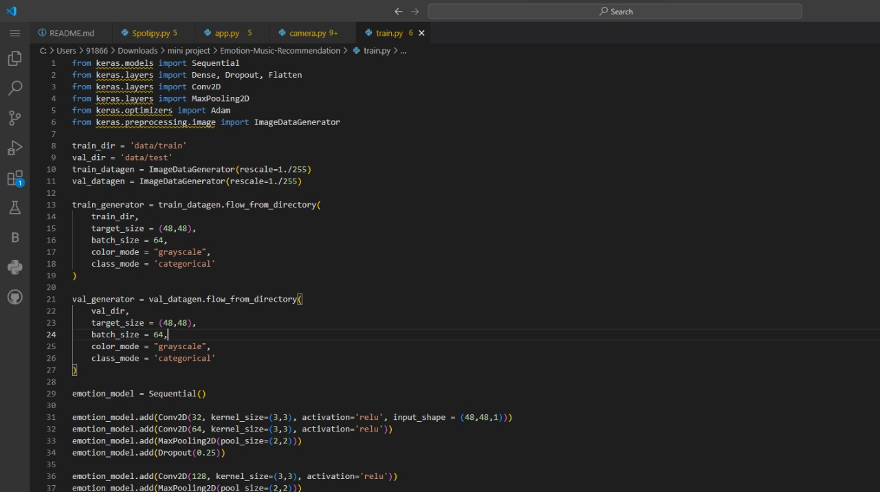
PCET-NMVPM’s Nutan College of Engineering and Research, Talegaon, Pune Department of Computer Science and Engineering
training over cnn
Nutan College of Engineering and Research
20

Slide 21
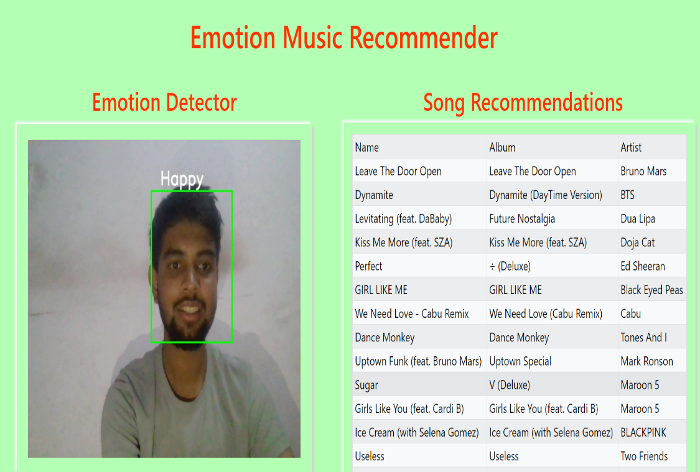
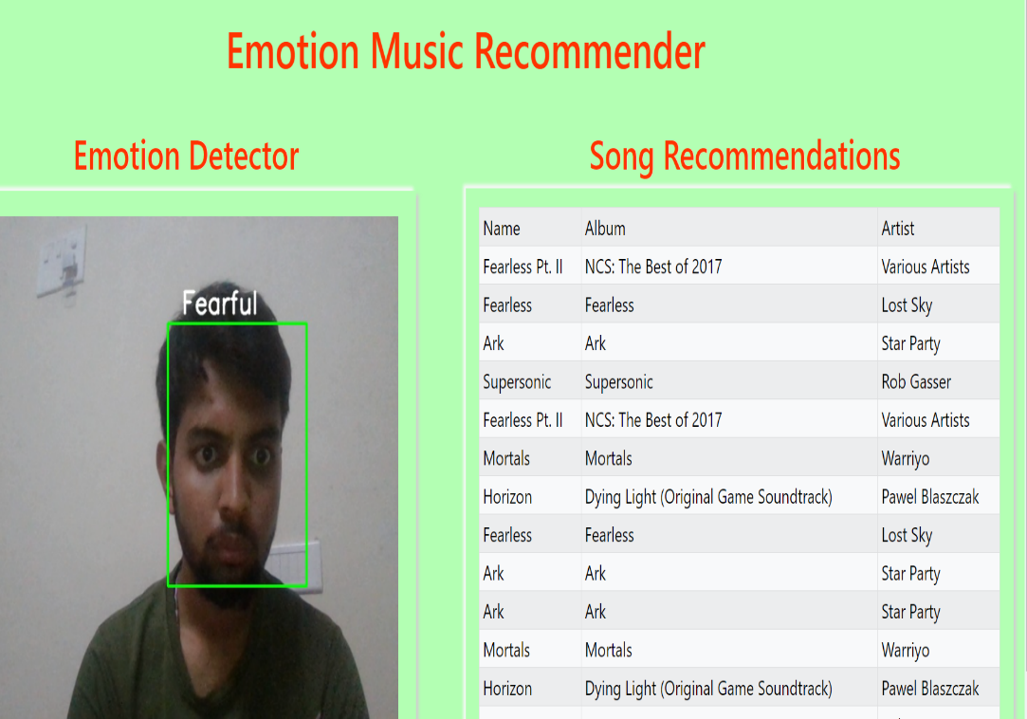
PCET-NMVPM’s Nutan College of Engineering and Research, Talegaon, Pune Department of Computer Science and Engineering
output
Nutan College of Engineering and Research
21

Slide 22
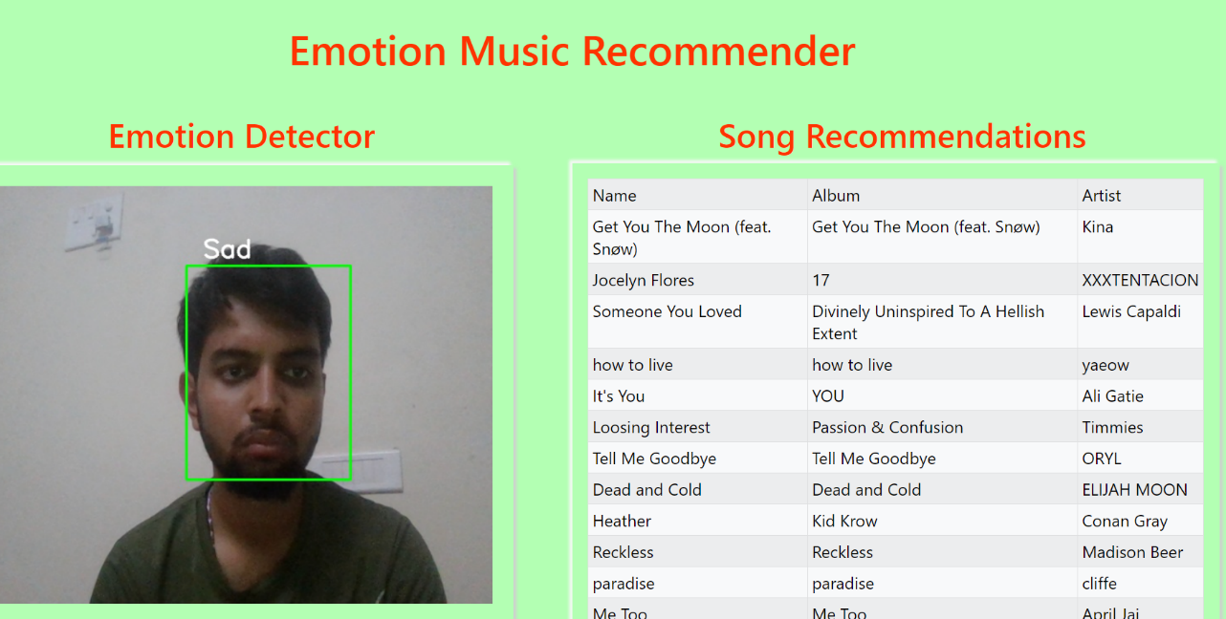
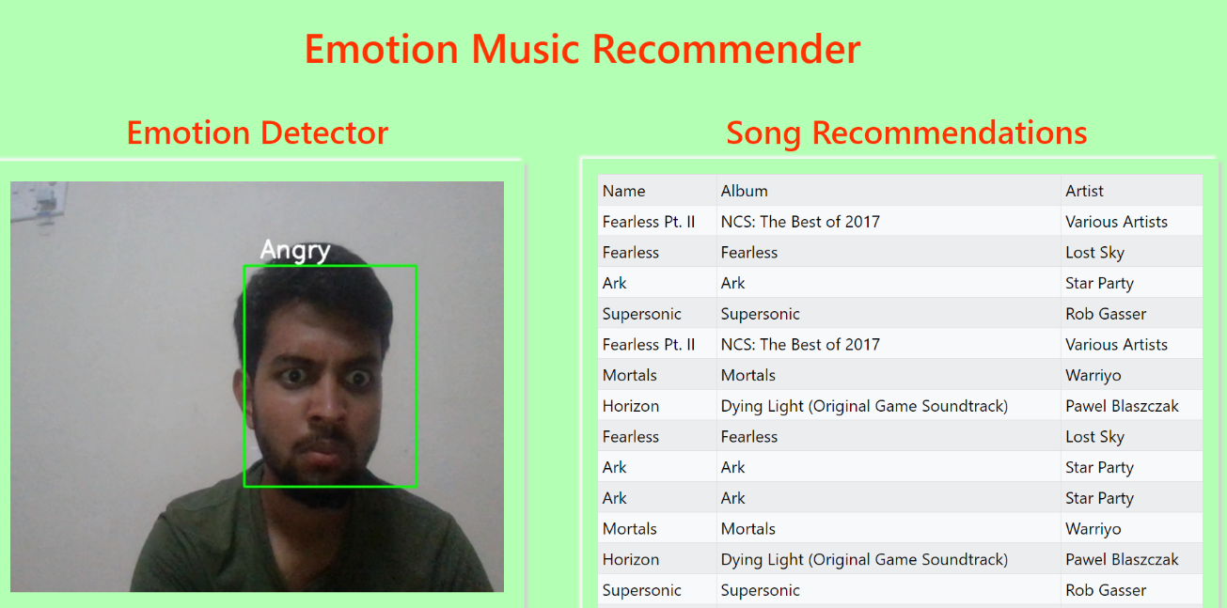
PCET-NMVPM’s Nutan College of Engineering and Research, Talegaon, Pune Department of Computer Science and Engineering
output
Nutan College of Engineering and Research
22

Slide 23
PCET-NMVPM’s Nutan College of Engineering and Research, Talegaon, Pune Department of Computer Science and Engineering
Conclusion
In conclusion, the emotion-based music recommendation system successfully demonstrates the potential of combining emotion recognition with personalized music curation.
This approach not only enhances user engagement but also paves the way for innovative applications in various fields such as mental health, entertainment, and personalized marketing
The insights and outcomes from this project lay a robust foundation for further advancements and applications in emotion-driven technology.
Nutan College of Engineering and Research
23

Slide 24
PCET-NMVPM’s Nutan College of Engineering and Research, Talegaon, Pune Department of Computer Science and Engineering
References
EliseKoren, Y., Bell, R., & Volinsky, C. (2009). Matrix factorization techniques for recommender systems. Computer, 42(8), 30-37.
Ricci, F., Rokach, L., & Shapira, B. (2015). Introduction to recommender systems handbook. In Recommender Systems Handbook (pp. 1-35). Springer, Boston, MA.
Adomavicius, G., & Tuzhilin, A. (2005). Toward the next generation of recommender systems: A survey of the state-of-the-art and possible extensions. IEEE Transactions on Knowledge and Data Engineering, 17(6), 734-749.
Burke, R. (2002). Hybrid recommender systems: Survey and experiments. User Modeling and User-Adapted Interaction, 12(4), 331-370.
Tan, P. N., Steinbach, M., & Kumar, V. (2013). Introduction to Data Mining. Pearson Education
Bengio, Y., Courville, A., & Vincent, P. (2013). Representation learning: A review and new perspectives. IEEE Transactions on Pattern Analysis and Machine Intelligence, 35(8), 1798-1828.
.
Nutan College of Engineering and Research
24

Slide 25
PCET-NMVPM’s Nutan College of Engineering and Research, Talegaon, Pune Department of Computer Science and Engineering
References
Mahmud, Firoz and Al-Amin Mamun. “Facial Expression Recognition System Using Extreme Learning Machine.” (2017).
Srinivasa Rao, C., Tilak Babu, S.B.G. (2016). Image Authentication Using Local Binary Pattern on the Low Frequency Components. In: Satapathy, S., Rao, N., Kumar, S., Raj, C., Rao, V., Sarma, G. (eds) Microelectronics, Electromagnetics and Telecommunications. Lecture Notes in Electrical Engineering, vol 372. Springer, New Delhi. https://doi.org/10.1007/978-81-322-2728-1_49
6.Lencioni, Gabriel Carreira et al. “Pain assessment in horses using automatic facial expression recognition through deep learning-based modeling.” PLoS ONE 16 (2021): n. pag.
Roland Aigner, Andreas Pointner, Thomas Preindl, Rainer Danner, and Michael Haller. 2021. TexYZ: Embroidering Enameled Wires for Three DegreeofFreedom Mutual Capacitive Sensing. In Proceedings of the 2021 CHI Conference on Human Factors in Computing Systems (Yokohama, Japan) (CHI ’21). Association for Computing Machinery, New York, NY, USA, Article 499, 12 page
25

Slide 26

PCET-NMVPM’s Nutan College of Engineering and Research, Talegaon, Pune Department of Computer Science and Engineering
THANK YOU
Nutan College of Engineering and Research
26

