Slide 1
Load/Edit visualize data on Power BI

Slide 2
Power BI
Load and Edit Data
Dashboards/reports etc
Publish

Slide 3
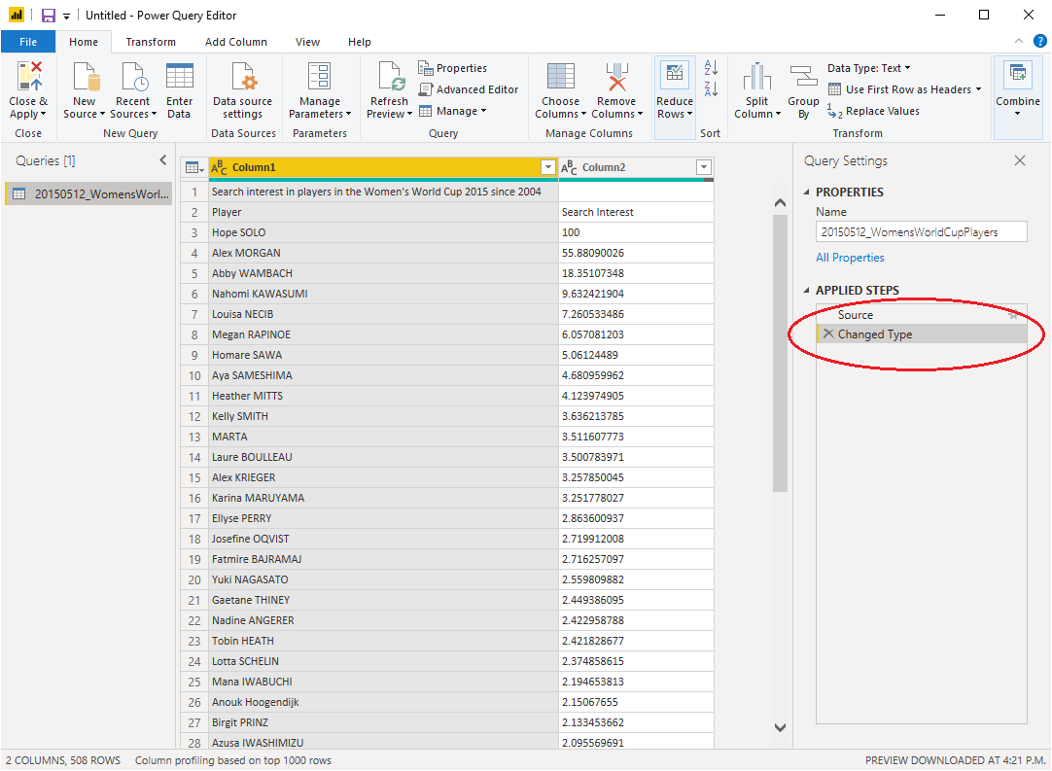
Loading un-curated data and curate
Load 20150512_WomensWorldCupPlayers data from last week.
Click Transform Data.
Remove Changed Type

Slide 4

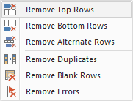
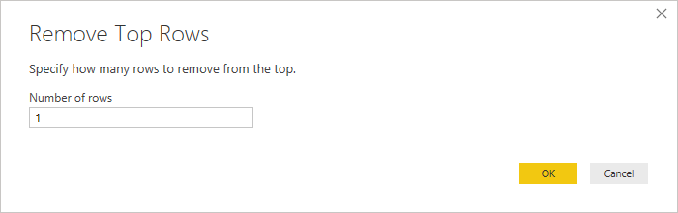
Remove Headers
Click Reduce Rows.

Slide 5

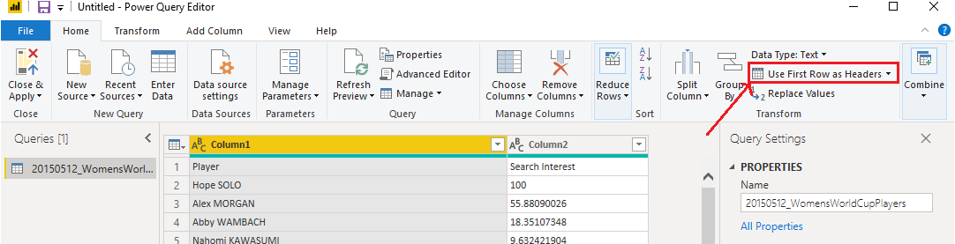
Assigned our headers

Slide 6
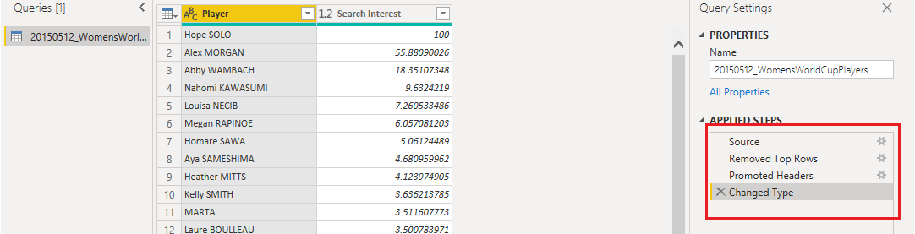
Steps of edits?
Remove (undo) any previous changes.
Easier way to remember previous edits.
Very convenient to undo or even edit any edits.

Slide 7
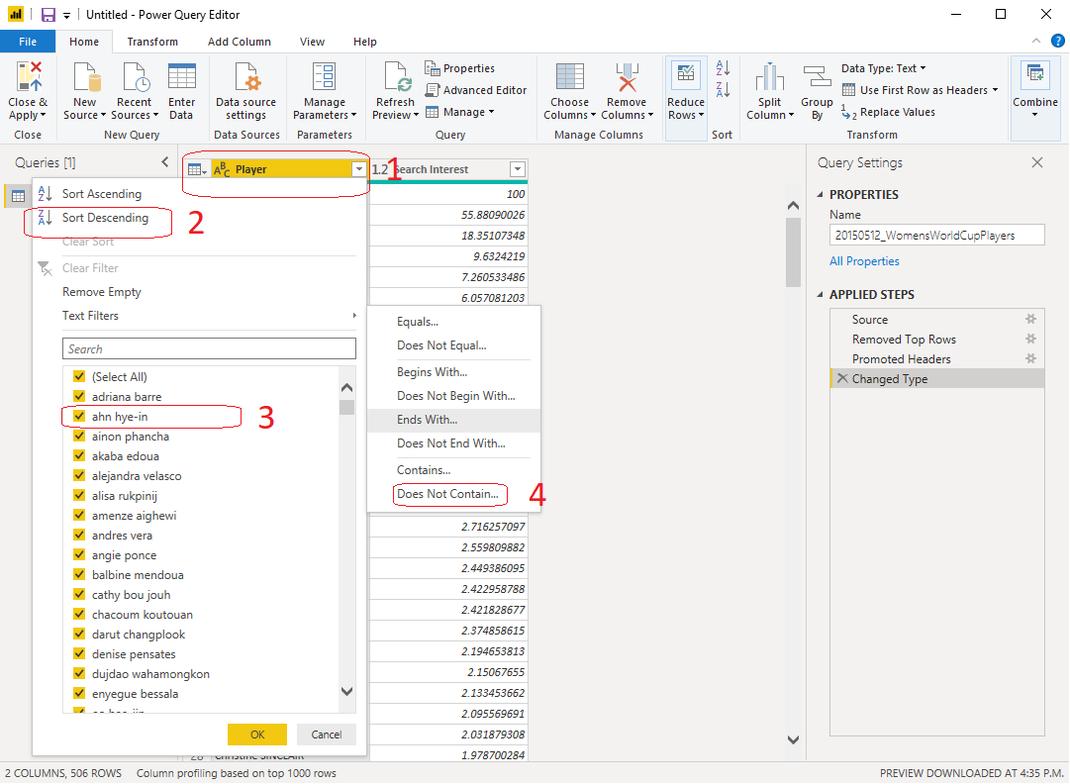
Filter Textual data
If there was some data like “null” that you want to remove?
Try remove “Marta”

Slide 8
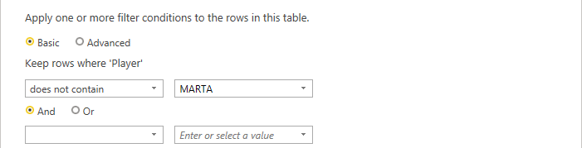
Remember, these keywords are case-sensitive

Slide 9
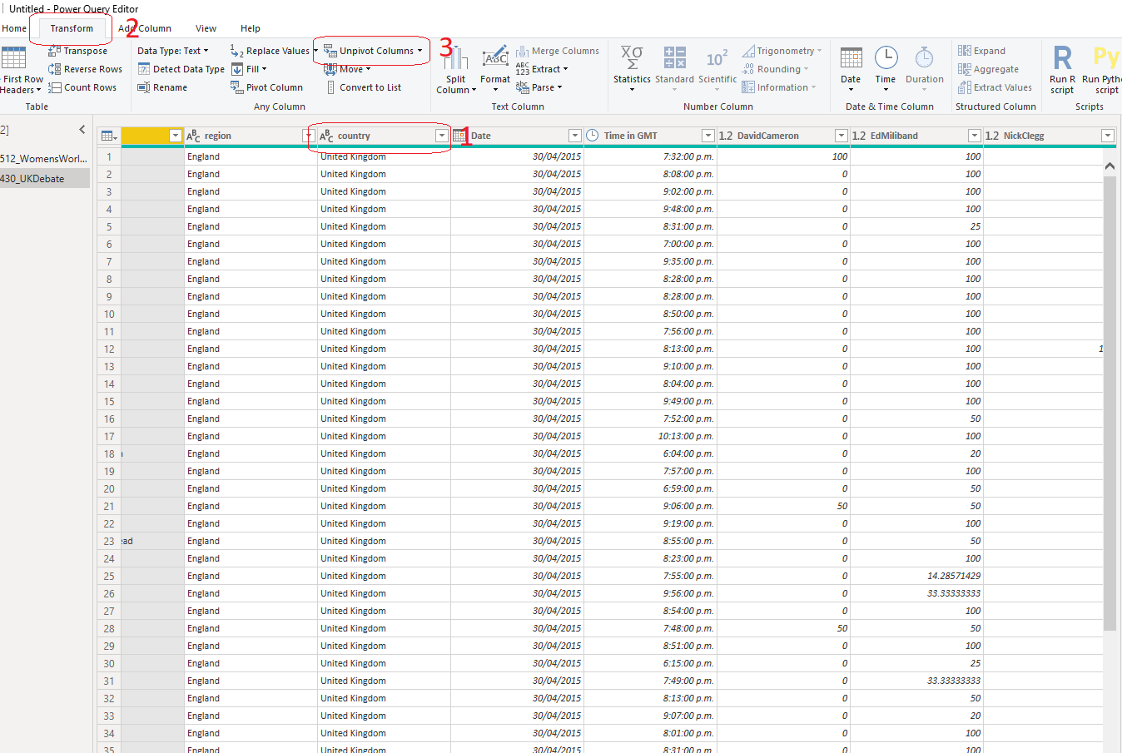
Load UK Debate Data: From Column to a row. https://www.newtechdojo.com/unpivot-columns-in-power-bi/

Slide 10
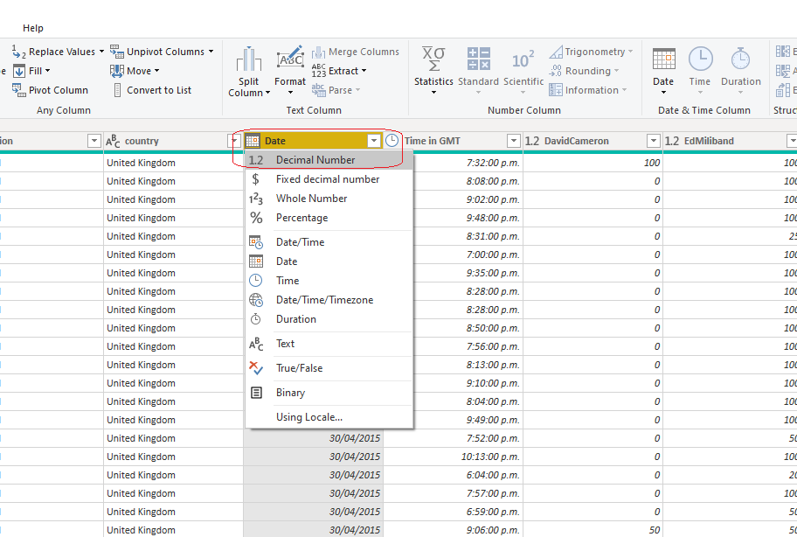
Change data types?
Close and Apply
&
Make sure to Refresh

Slide 11
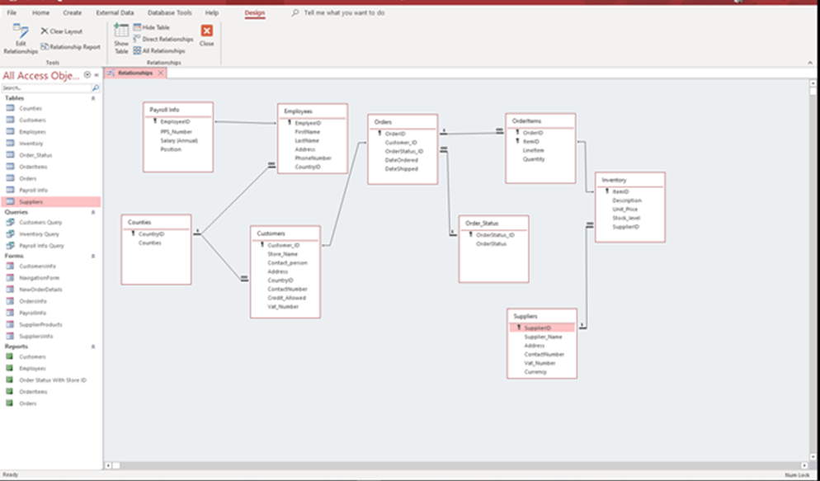
Data with relationships? Please download the excel sheets from Moodle.

Slide 12
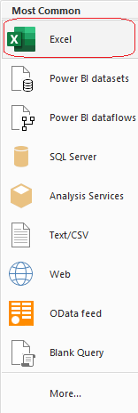
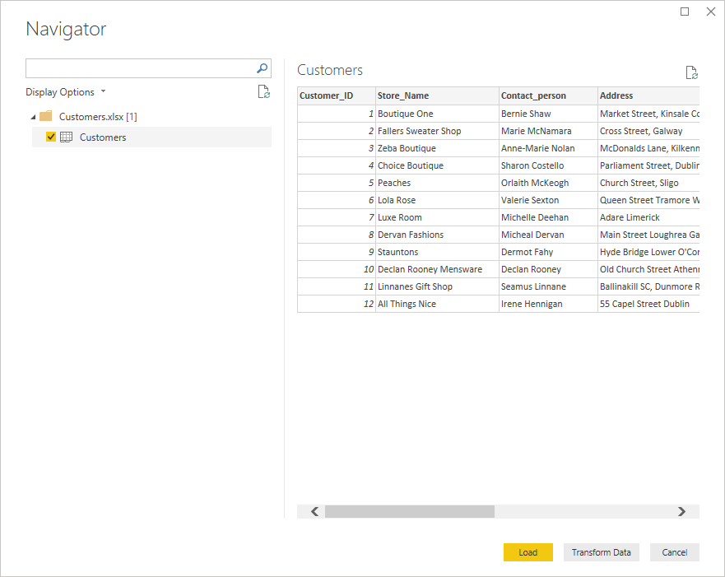
Load each individual excel file

Slide 13
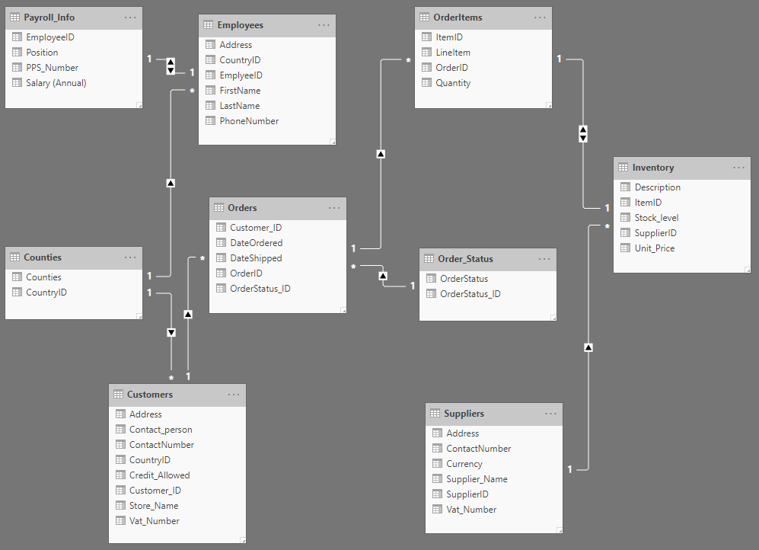
Relationships
Try order the tables similar to Slide number 12.
Try to add any missing relationships by drag and drop.

Slide 14
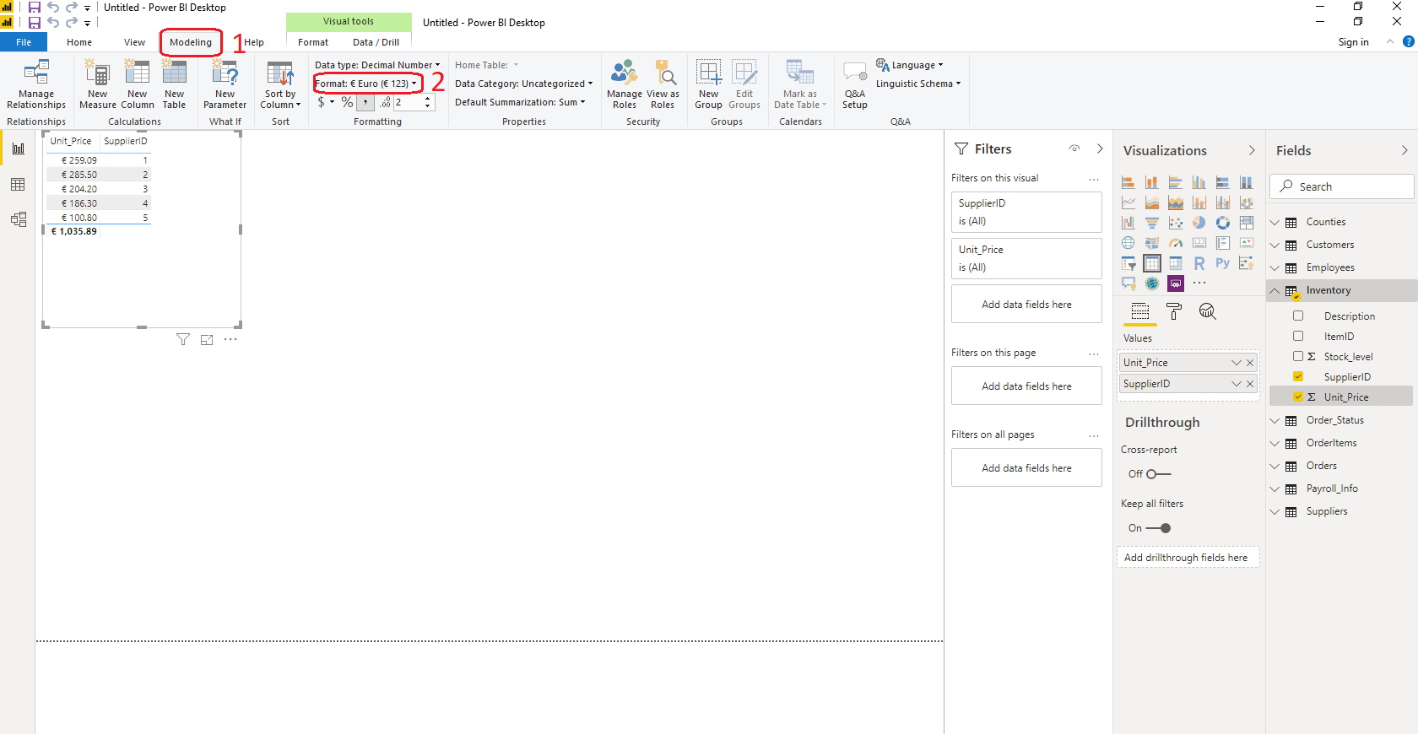
Changing data types
Implicit measures

Slide 15

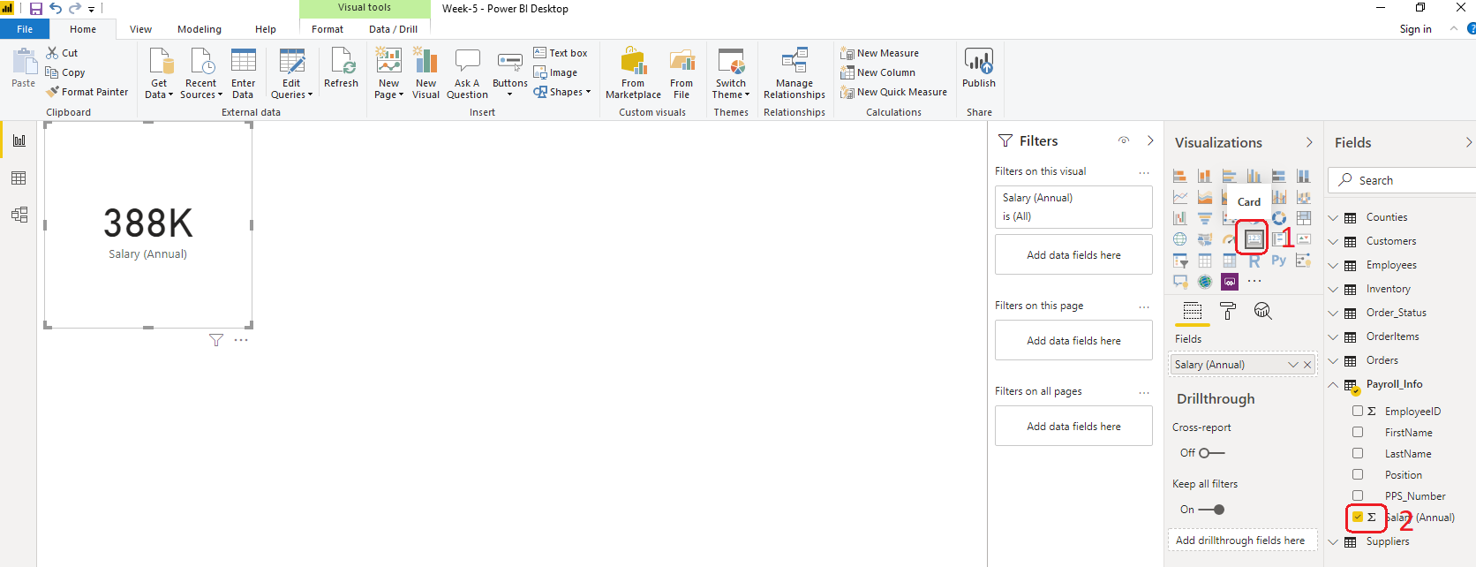
Visualisation

Slide 16
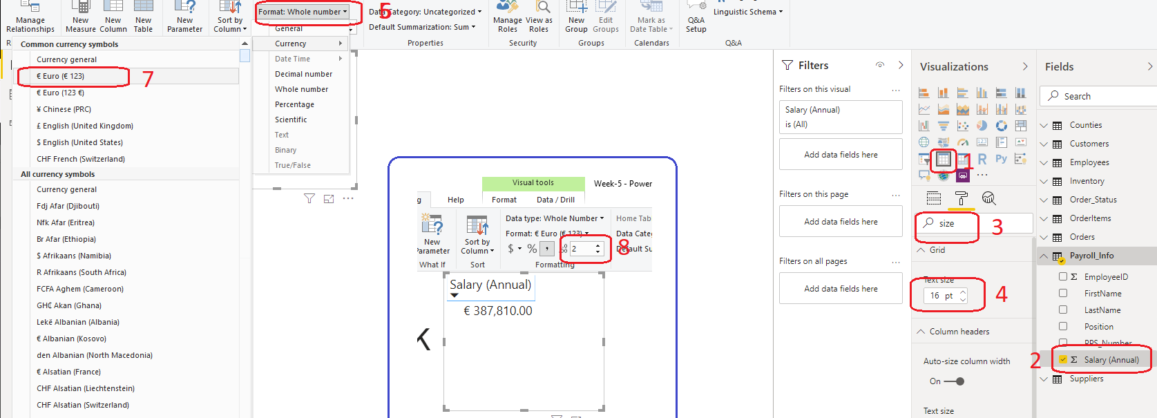
Table, font size, data type and decimal places.
Make sure click on the white space before clicking table.

Slide 17
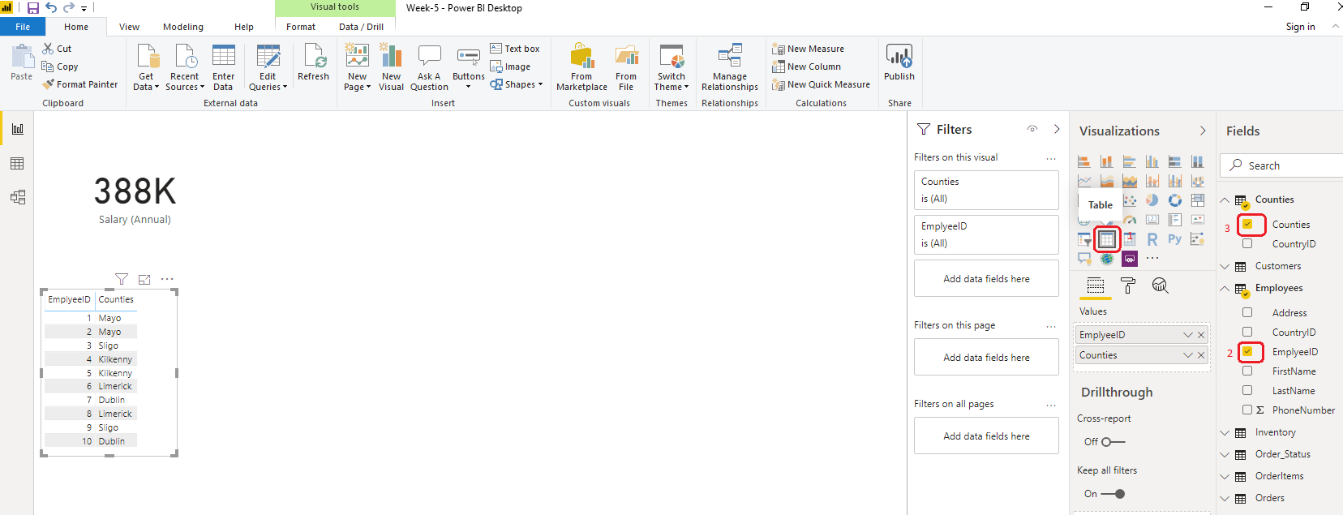
Slice and Dice from more than one table?
Can be used to view results from connected tables.

Slide 18
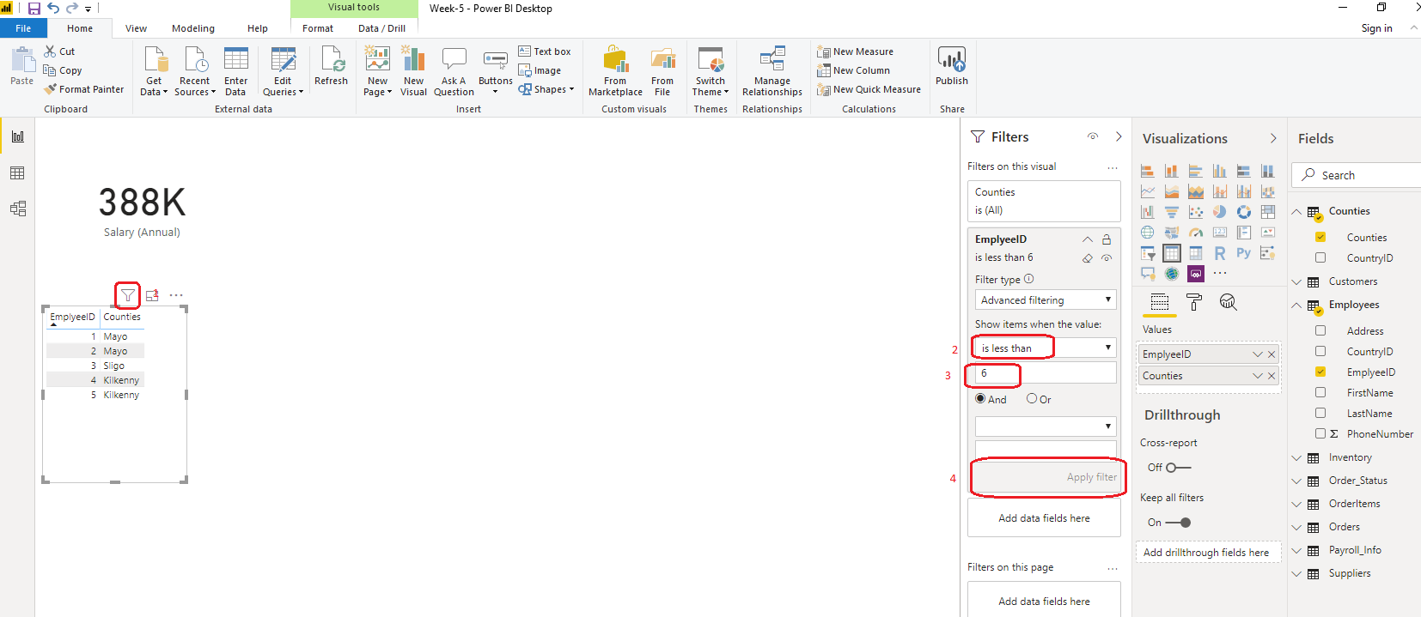
Apply Filter

Slide 19
Data Analysis Expressions (DAX)

Slide 20
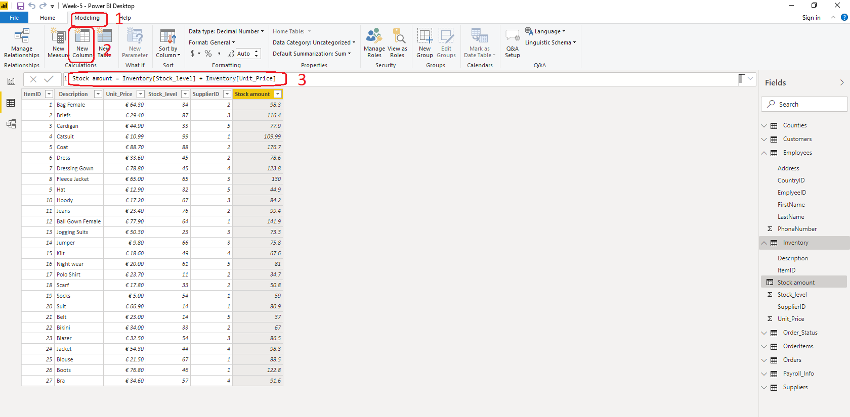
New calculated column

Slide 21
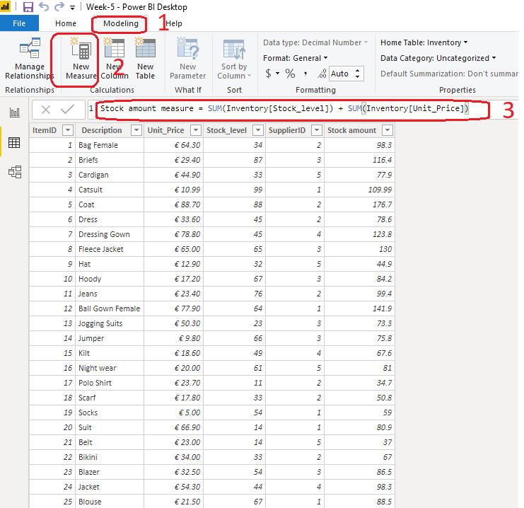
Measures

Slide 22
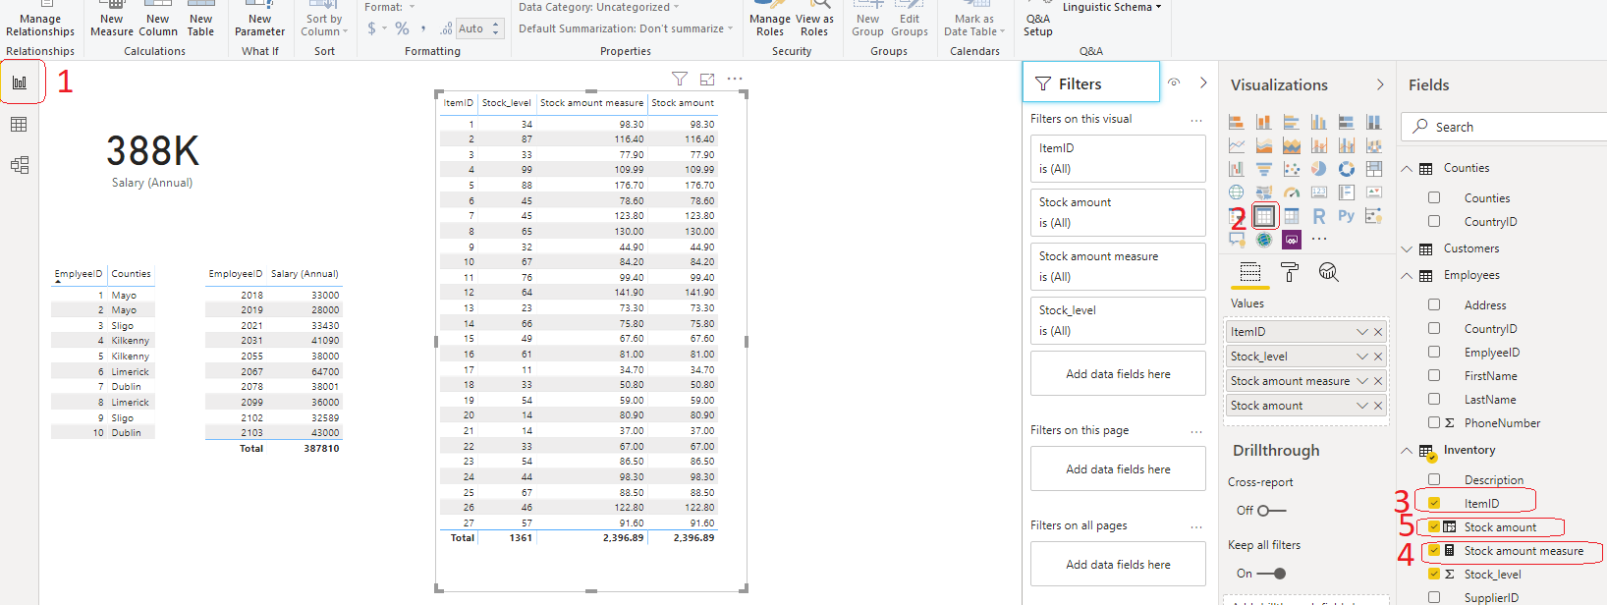
Measures Continue …
Why explicit measure is better than a new column?

Slide 23
Data Visualization

Slide 24
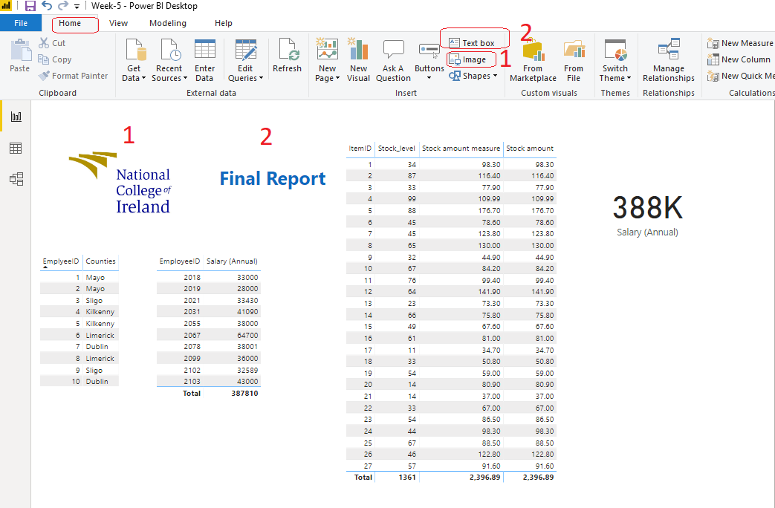
Add text and images to a report

Slide 25
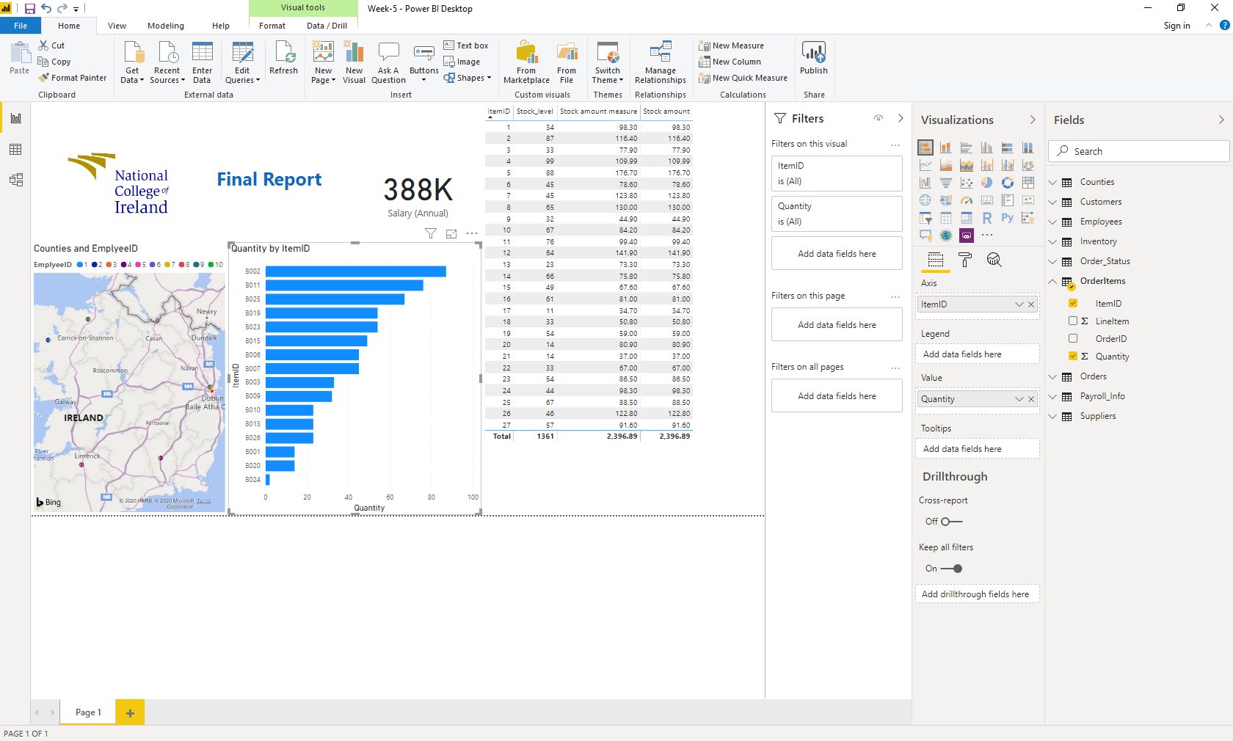

Slide 26
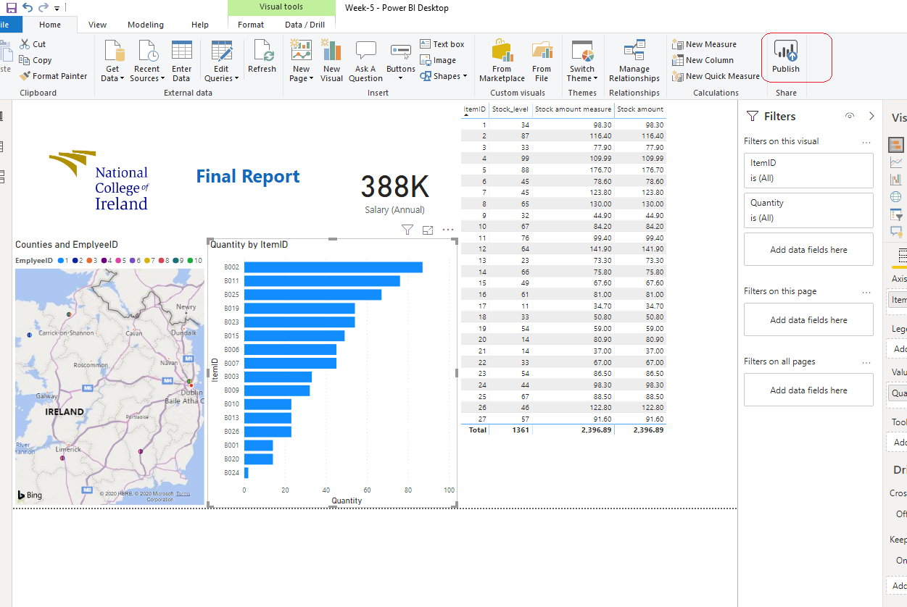
Publish

Slide 27
Thank you!

