Slide 1
Business Intelligence & Business Analytics (MSCDAD_A) Group Project
Michael Dunne – x15420892
Omkar Tawade – X19232136
Vivek Kumar – X19201885

Slide 2






Company Overview

Slide 3
Nike: Background
American Multinational organisation that is involved in the Design, Development, Manufacturing and distribution of Footwear, Apparel and sporting equipment
Founded in 1964 by Bill Bowerman and Phil Knight
Nike has become one of the biggest brands in the world using strategic marketing strategies with celebrity endorsements

Slide 4
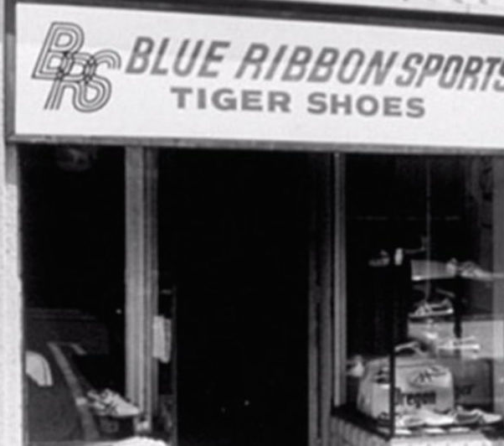
First Nike Store

Slide 5
Goals and Objectives of Nike
Gather Info on Trends Occurring
Visualise the data in a clear and concise way
To increase Profit over the financial year
To Innovate and design new products
Increase Presence in Developing Countries

Slide 6
What we hope to get from our new system
Improved organizational skills
Identify what products are performing
Highlight how certain stores are doing compared to others
Analyse our revenue in total generated

Slide 7
DATA DESCRIPTION
WE USED MOCKED UP DATA IN OUR PROJECT.
FOR MOCKING UP THE DATA WE USE QUALTRICS.COM.
WE HAVE THREE TABLES IN OUR DATASET:
NIKE_STORE
NIKE_DATASET
NIKE_SHOE

Slide 8
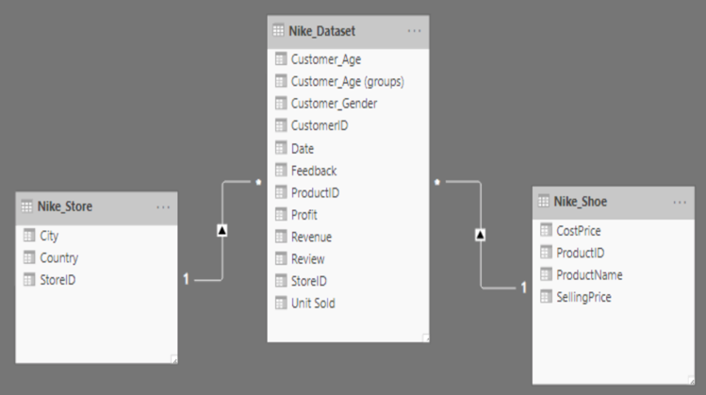
ENTITY RELATIONSHIP DIAGRAM

Slide 9
Report – Power BI

Slide 10
Solutions from findings
Finances Fluctuating across year, sales team to consider pricing changes and deals
Analyse effectiveness of strategies implemented over the year
Consider dropping products that are underperforming (Lebron X)
Boost Production on higher selling products (Air Max) Find relationship to other products to boost spread
Based on sales of particular product, Model new innovations after these products

Slide 11
Thank You!

