Slide 1

NBA Game Forecasting & Visualization

Slide 2
Table of Contents
Points to discuss:
INTRODUCTION
01
OBSERVATIONS AND FINDINGS
05
BACKGROUND
02
DASHBOARDS
06
OBJECTIVES
03
LIMITATIONS
07
METHODOLOGY
04
CONCLUSIONS AND FUTURE WORKS
08

Slide 3
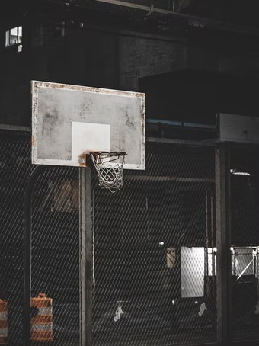
Introduction
Basketball is a team sport in which two teams, most commonly of five players each, opposing one another on a rectangular court, compete with the primary objective of shooting a basketball through the defender's hoop while preventing the opposing team from shooting through their hoop.
No doubt, basketball is one of the most followed games on the planet and one name that surely strikes our mind when we talk about basketball is, NBA.
National Basketball Association (NBA) is a professional basketball league formed in the United States in 1949 by the merger of two rival organizations, the National Basketball League (founded 1937) and the Basketball Association of America (founded 1946). At present, there are 30 teams taking part and more than 4000 players have played for the biggest league. So, we decided to blend the craze for the game with some analysis models and visualization techniques to choose as a topic for our project.

Slide 4
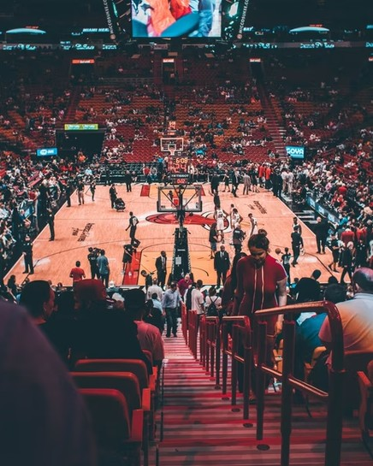
Background
Professional basketball has looked very different over the past ten years thanks to the use of data analytics. It is almost as if these Analytics models have inputted the conventional NBA and outputted an entirely new game. A game where every team now has at least one data analyst. A game where every move is calculated with the aim to optimize for a winning strategy
Data has become front and center for NBA games where almost every decision is now based on analytics. This data is being analyzed by machine learning models to recommend the winning strategy accordingly and helps the team perform efficiently
Teams have been using high-tech analytics mainly in three ways:
Designing winning strategies
Predicting and avoiding player injury
Scouting.
As basketball enthusiasts we follow this game often, and this motivated us in selecting this topic for our mini project. The knowledge about the game and the statistical measures used, really helped us in understanding the problem statement and building the machine learning model.

Slide 5

The goal of this project is to predict upcoming NBA game
result based on team stats and ELO Ratings. On our research we found that the already built predicting models were using different features like FGA, FGM, 3ptPct, 3pA etc (other than Elo rating and recent team performances) have low accuracy. So we are looking to develop a model that used ELO ratings as well as other features to predict the game outcome as the win % depends on the individual team performance as well.
To compare the players more easily based on their past performances we will use different data visualizing techniques using tableau .By this we can sort or filter players and rank them according to their various features.
Objectives

Slide 6
Methodology

Slide 7
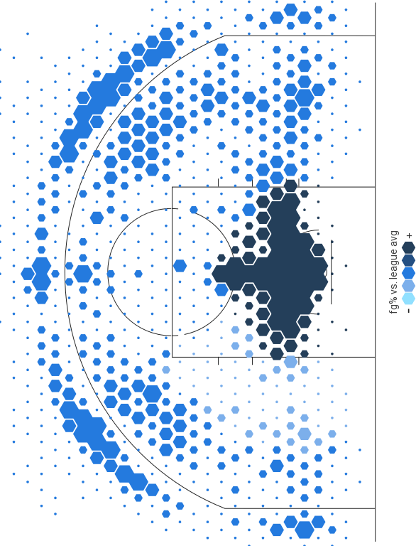
1.Collection of Data
We downloaded the data of 30 teams and various NBA players of season from 2003-2004 to the 2020- 2021 from the website.
https://www.basketball-reference.com/
https://www.synergysportstech.com/Synergy
https://www.nba.com/
https://www.kaggle.com/

Slide 8

2. Cleaning of Data
We read the dataset and combined it into large dataframe which contained all the team stats and player stats for the past seasons. As the dataset was very large and included many features, we had to study and clean the dataset before using it in the machine learning model.
We used Tableau Prep that provided various cleaning operations that were used to clean and shape the Player Stats dataset. We cleaned the data by applying cleaning operations such as filtering, adding, renaming, splitting, grouping, or removing fields. Cleaning up dirty data made it easier to combine and analyze our dataset.
We used Python libraries like Pandas and numpy to clean the team stats dataset like dropping unnecessary columns, removing null values, and improving column formatting/labels.

Slide 9

3. Feature Engineering
We need some reliable features to make predictions about future games. Our primary goal was to make all of the available data understandable. For example - Game-by-game rebounds of an entire team don’t help us much unless we can use that data in a higher-level analysis that leads us to our ultimate goal – predicting wins and losses. To that end, we sought to create 2 different features which we would use in understanding how our teams progressed and regressed throughout each season.
ELO Rating
Recent Team performance

Slide 10




Elo Ratings
The first feature we will add is Elo ratings. The Elo rating system can be used to calculate the relative skill and quality of teams in a league. Each team will start with the same Elo rating and it will be updated with each game a team plays.

Slide 11
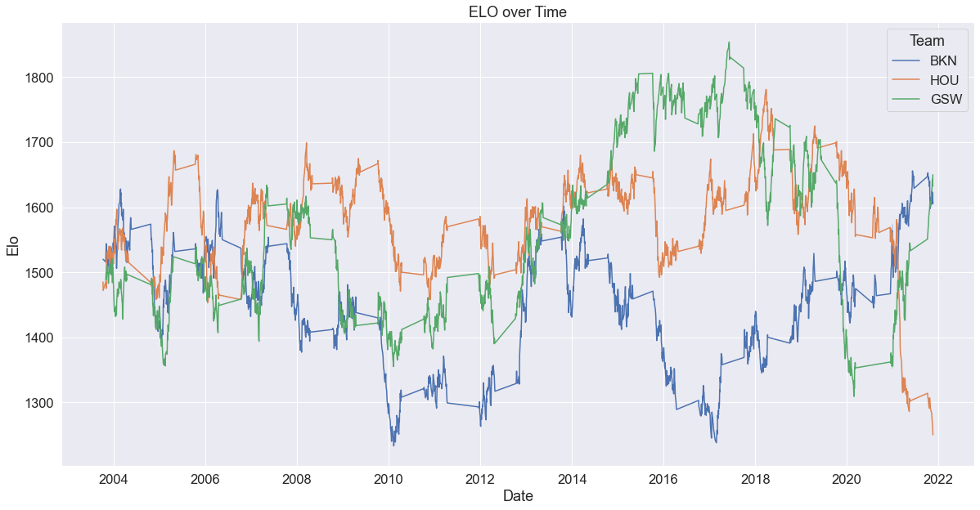

Slide 12
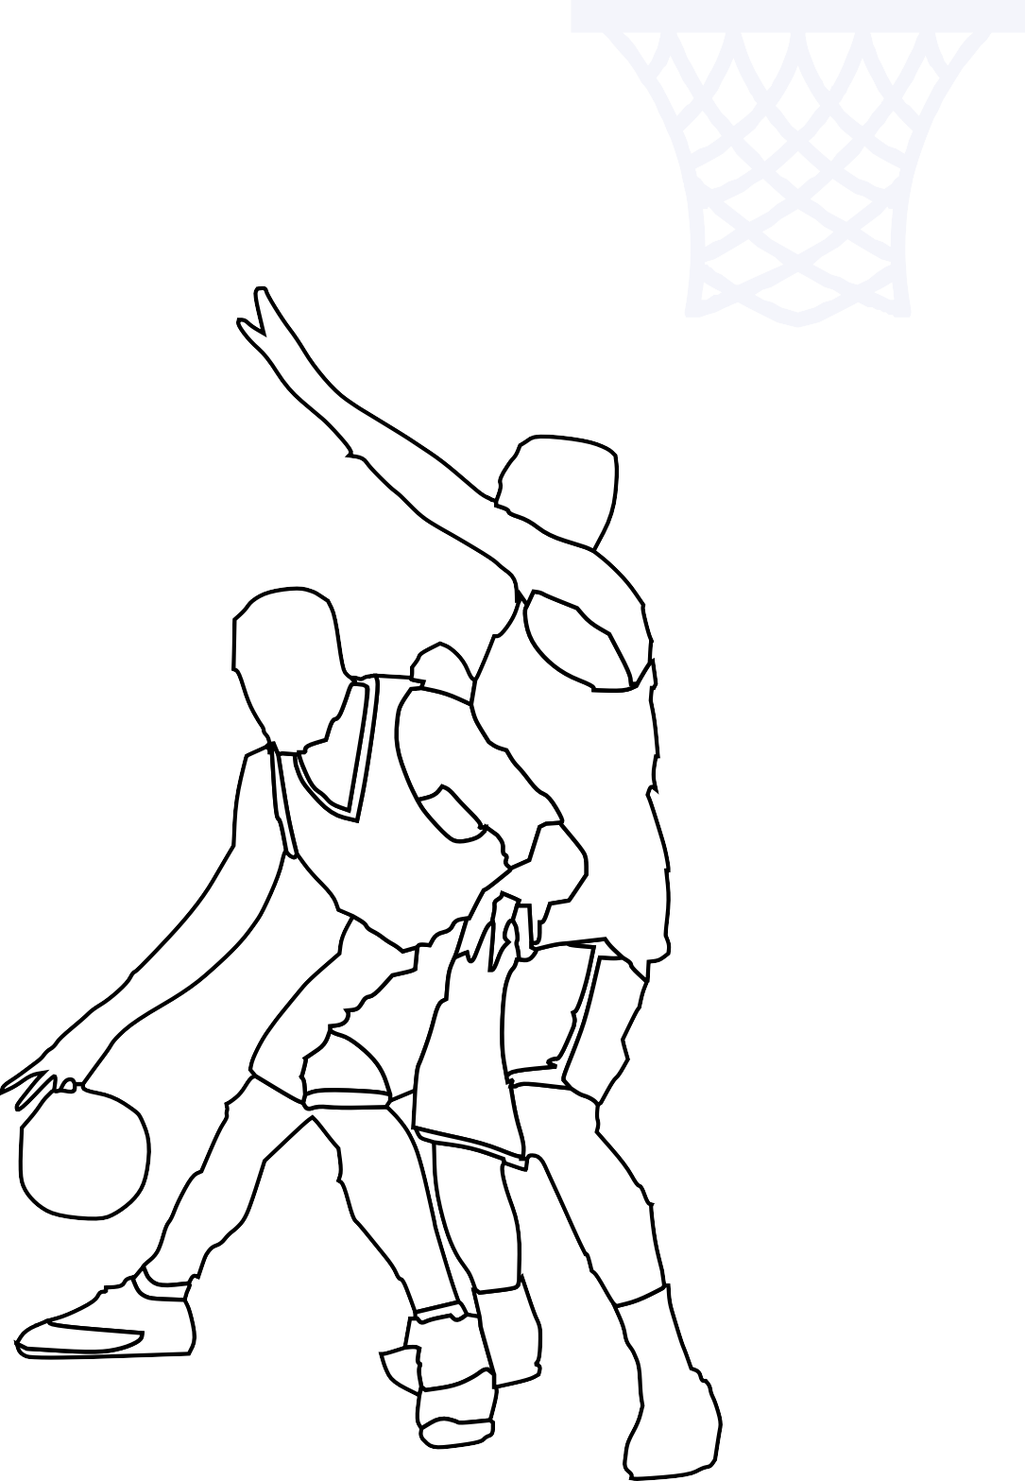
Recent Team Performances
How a team has been performing recently is likely a good indicator of how they will perform in an upcoming game. Thus, for every game we have in the team stats data that we scraped, we will keep track of the sliding averages of each team's stats over their previous 10 games.
The following are the calculated columns: 'H_Last_10_Avg_PTS', 'H_Last_10_Avg_FG_PCT', 'H_Last_10_Avg_FT_PCT', 'H_Last_10_Avg_FG3_PCT', 'H_Last_10_Avg_AST', 'H_Last_10_Avg_REB', 'H_Last_10_Avg_PREV_ELO', 'H_Last_10_Avg_AFTER_ELO', 'A_Last_10_Avg_PTS', 'A_Last_10_Avg_FG_PCT', 'A_Last_10_Avg_FT_PCT', 'A_Last_10_Avg_FG3_PCT', 'A_Last_10_Avg_AST', 'A_Last_10_Avg_REB', 'A_Last_10_Avg_PREV_ELO', 'A_Last_10_Avg_AFTER_ELO'

Slide 13
MODELING

Slide 14
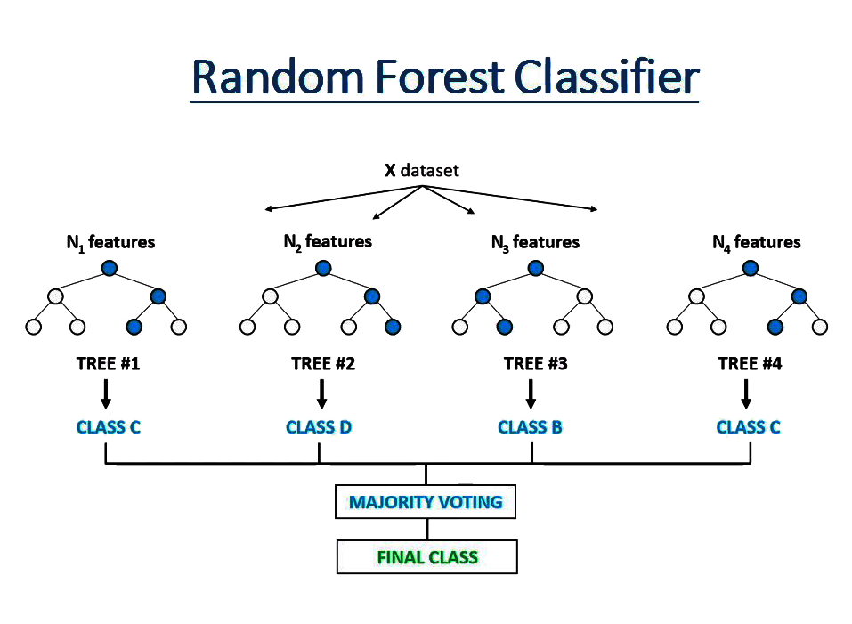
Random forests or random decision forests are an ensemble learning method for classification, regression, and other tasks that operates by constructing a multitude of decision trees at training time.

Slide 15
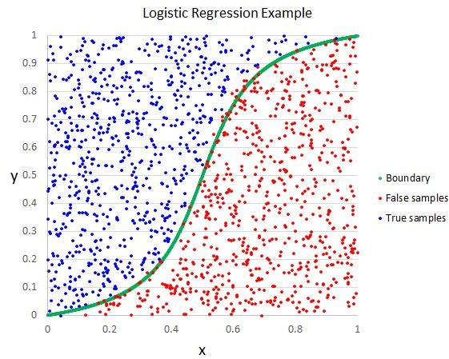
Logistic regression is a statistical model that in its basic form uses a logistic function to model a binary dependent variable

Slide 16
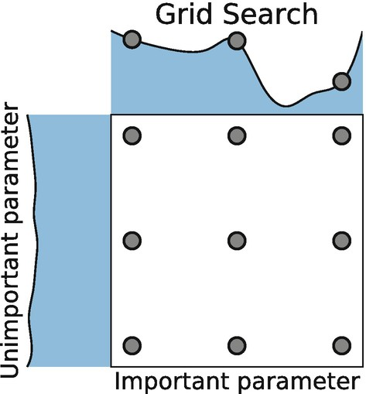
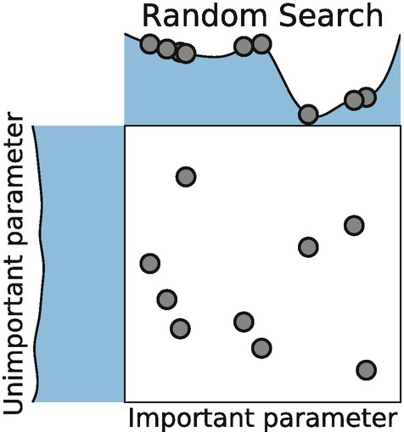
Hyperparameter Tuning

Slide 17

Observations and Findings

Slide 18
We trained our features using Logistic Regression Classifier And Random Forest Classifier with Randomized search CV and Grid Search CV and the following were the accuracies obtained
Logistic Regression Classifier – 65.8
Logistic Regression Classifier With Hyperparameter Tunning Using Random Search CV- 66.8
Logistic Regression Classifier With Hyperparameter Tunning Using Grid Search CV- 66.8
Random Forest Classifier – 64.8
Random Forest Classifier With Hyperparameter Tunning Using Random Search CV- 65.7
Random Forest Classifier With Hyperparameter Tunning Using Grid Search CV- 66.6
MODEL ACCURACY

Slide 19
DASHBOARDS

Slide 20
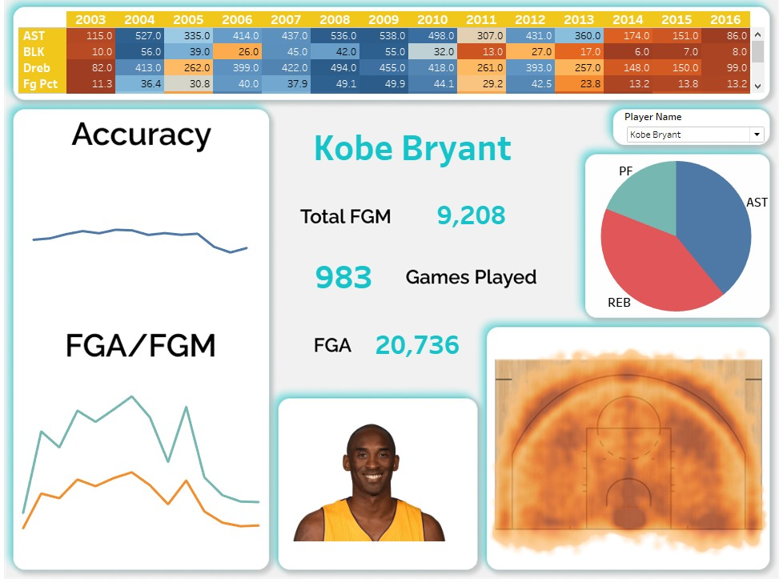

Slide 21
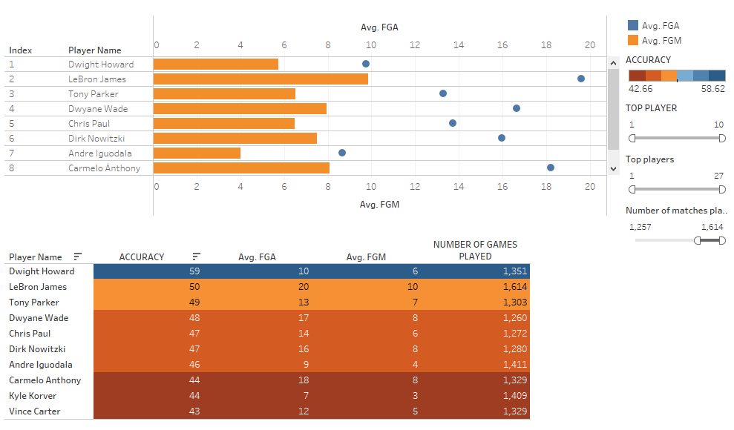

Slide 22
We developed the models to predict the wins and losses on basis of the team stats ignoring the individual player performance.
Our model is biased towards some factors like player injuries, unavailability, newer drafts, and roster.
We are also assuming that the ELO ratings of the players will gradually increase or decrease. No sudden changes will occur over time, whereas in the real world scenario, there are chances of a sudden change in the ELO due to player transfer, retirement, age factor, etc.
Limitations

Slide 23

The goal was to see if it was possible to predict game result based on just previous game result. Both models predicting the result achieved good results given that the team scores vary at around .
Conclusions and Future work
The results were affected by various factors. Team rosters/coaches change between seasons so the team’s scoring is not consistent from season to season.Our model works on assumption that players and team staff donot varies much between consecutive seasons.
For future work, given more features like players rating, to train the models, the results could be improved.
We could also use models like SVM, Artificial Neural Networks(ANN), Naive Bias Classifier, Convolutional Networks.

Slide 24
THANK YOU

