Slide 1
CSN-371
Assignment Evaluation Phase - 3
SRITAM BEHERA 18116077
MOHIT KUMAR 18114049
OM KATIYAR 18116057
IIT ROORKEE

Slide 2
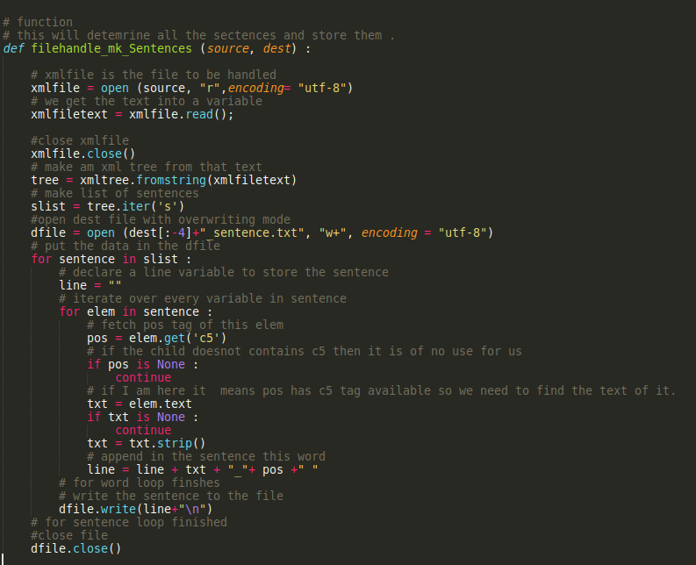
CODE FILE : Sentence Processing
The Above is the main function which processes xml files into sentences.

Slide 3
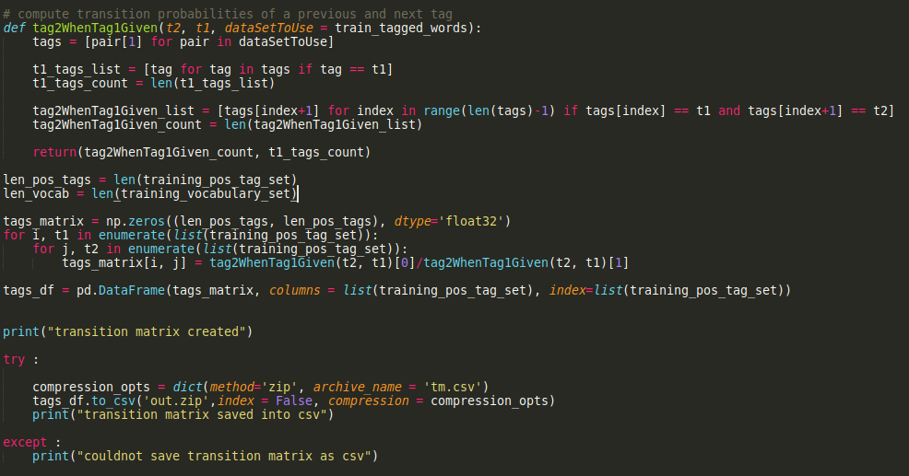
CODE : Transition Probability Calculation

Slide 4
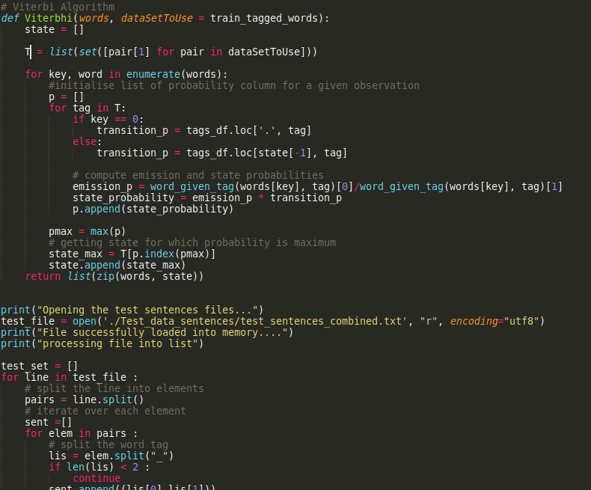
CODE : Emission Probability & Viterbhi

Slide 5
ANALYSIS
We designed an HMM model with around 87 tags from the train data set that we had.
Roughly There were about 2 crore word_tag pairs (Overall in the date Set) .
Due to Bugs in our Code We were Not able to Make the ends meet. We left our code running for hours still we could not see any output and this happened many-a-times with us from past three days.
If You allow us mam, please give us a time period of 2 days, we want to re-implement this phase from scratch.
Thankyou.

