Slide 1
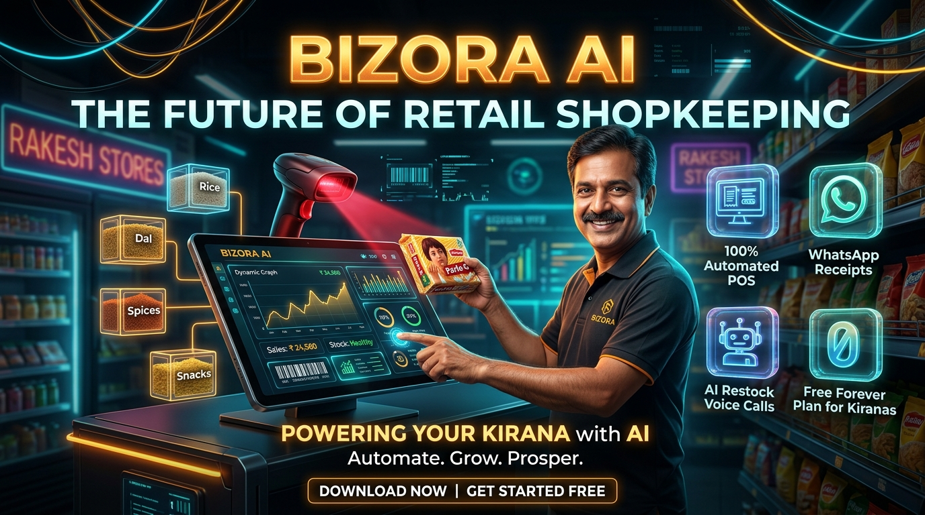
BIZORA AI
Autonomous Retail Operating System for 13M Indian Kiranas
Hardware-free camera barcode POS, automated WhatsApp receipts, and autonomous Hindi Voice AI restocking in one unified multi-portal ecosystem.
● 100% Code Complete ● Zero Hardware Cost ● Live on Render
Live Demo: https://bizora-owner.onrender.com | Founder: Om Khade

Slide 2
THE PROBLEM
The Crisis in Indian Retail: $1.1T Market Operating on Paper
₹35,000+ Monthly Shrinkage
Perishables expire on shelves unnoticed due to zero FIFO batch tracking. Retailers lose 4.2% of gross margins to silent spoilage.
₹45,000 Hardware Cost Barrier
Traditional ERPs (Tally, Busy) demand bulky desktop computers, barcode laser guns, and UPS power backups that small kiranas cannot afford.
Quick-Commerce Disruption
Blinkit and Zepto are pulling urban shoppers away with 10-minute delivery. Local store owners have zero online catalog or delivery presence.
💡 The Bottom Line: Over 90% of India's retail commerce is powered by 13 million neighborhood stores, yet 95% run on manual calculators and paper diaries.

Slide 3
THE SOLUTION
Bizora AI: The Complete Autonomous Retail Solution
⚡ Camera Barcode POS
Turns any smartphone or tablet camera into an ultra-fast barcode checkout terminal in 60 seconds. Zero expensive scanner guns needed.
📱 1-Tap WhatsApp Receipts
Itemized digital invoices sent instantly to customer WhatsApp. Saves up to ₹1,800/mo on physical thermal paper rolls.
🤖 Hindi Voice AI Restocking
Conversational AI voice agents call distributors directly in natural Hindi and English to reorder goods before stockouts occur.
🛍️ 10-Min Hyperlocal Storefront
Every shopkeeper gets an instant neighborhood online storefront. Local customers order online, store fulfills in 10 minutes.

Slide 4
PRODUCT ARCHITECTURE
One Unified Core: 5 Synchronized Portals
👑 Store Owner Portal — bizora-owner.onrender.com
12-Core Shopkeeper Dashboard: POS billing, camera barcode scan, inventory FIFO, daily P&L accounting, and anomaly radar.
🛍️ Customer Storefront — bizora-customer.onrender.com
Hyperlocal neighborhood shopping catalog, 10-min essentials ordering, digital bill wallet, and loyalty points.
🚚 Supplier Hub — bizora-supplier.onrender.com
Direct vendor portal for reviewing inbound digital Purchase Orders, shipment tracking, and invoice matching.
🛡️ Super Admin Console — bizora-admin.onrender.com
Platform verification console for reviewing store registrations, tenant provisioning, and 5-min server health watchdog.
🌐 Web Marketing Portal — bizora-web.onrender.com
Public showcase, interactive merchant ROI calculator, transparent SaaS pricing, and instant self-onboarding.

Slide 5
MARKET SIZE & TAM
Market Opportunity: India's $1.1 Trillion Retail Landscape
TAM: TOTAL MARKET
$1.1 Trillion
Total Indian retail commerce, expanding at 12% CAGR to cross $2.0 Trillion by 2030.
SAM: TARGET STORES
13 Million+
Total Kirana stores across Tier 1, 2, and 3 Indian cities powering 90% of food & grocery commerce.
SOM: ADDRESSABLE SAAS
$4.8 Billion
Serviceable SaaS and value-added fintech revenue from tech-adopting urban & semi-urban retailers.
MERCHANT VALUE
₹35,000 / mo
Net monthly economic savings delivered per store via shrinkage prevention and faster checkout.

Slide 6
COMPETITIVE MOAT
Competitive Advantage: Deep Moats vs Legacy & Generic Apps
Capability / Feature | Bizora AI (OmniMind) | Legacy POS (Tally/Busy) | Generic Apps (Khatabook/Vyapar)
Hardware Requirement | Zero (Camera on Phone) | ₹45,000+ PC & Laser Gun | Basic Mobile Screen Only
Voice AI Supplier Restock | Autonomous Hindi Calling | ❌ None | ❌ None
Customer Storefront | 10-Min Local Delivery | ❌ None | Static WhatsApp Catalog
FIFO Expiry & Markdown Radar | Automated Loss Prevention | Manual Audits Only | ❌ None
Multi-Portal Synchronization | 5 Portals Live Synced | Single PC Database | Single User Mobile App

Slide 7
BUSINESS MODEL
Monetization: Modular High-Margin SaaS Subscriptions
Kirana / Starter
₹0 / Free Forever
Single-counter kiranas
✓ Camera Barcode POS
✓ Up to 200 Products
✓ Hindi & English UI
✓ 1 Counter User
Retailer / Growth
₹699 / month
Supermarkets, apparel & retail
✓ Unlimited Billing & Products
✓ 500 WhatsApp Bills/mo
✓ 10 Vapi Voice Calls/mo
✓ FIFO Expiry Radar
✓ 3 Staff Accounts
Enterprise Chain
₹1,999 / month
Multi-store franchises
✓ Multi-Branch Control
✓ Unlimited WhatsApp Receipts
✓ 100 Vapi Voice Mins/mo
✓ 10 Staff User Roles
📈 SAAS UNIT ECONOMICS HIGHLIGHTS
Blended ARPU: ₹699/mo | Blended CAC: ₹850 | Customer LTV: ₹14,500 | LTV/CAC Ratio: 17.0x | Gross Margin: 82%+

Slide 8
INVESTMENT
The Ask: Transitioning from Staging to Commercial Launch
Capital Requirement: Seed Infrastructure & Merchant Expansion
The product code is 100% complete across all 5 portals with zero technical debt. Capital is strictly deployed for production infrastructure (Render Paid Web Services, MongoDB Atlas M10 dedicated cluster) and merchant onboarding acquisition.
Cloud Infrastructure (30%)
Render paid web services, MongoDB Atlas dedicated cluster, auto-scaling, and Redis caching.
Voice AI & Telephony (25%)
Vapi AI conversational voice calling minutes and Twilio WhatsApp messaging quotas.
Merchant Acquisition (35%)
Direct kirana onboarding drives, wholesale mandi partnerships, and merchant trade shows.
DevOps & Reliability (10%)
Security penetration testing, SOC2 compliance preparation, and 24/7 reliability operations.

Slide 9
EXPERIENCE BIZORA AI LIVE TODAY
Transforming Indian Retail, One Kirana Store At A Time.
• Store Owner Portal: https://bizora-owner.onrender.com
• Customer Storefront: https://bizora-customer.onrender.com
• Supplier Hub: https://bizora-supplier.onrender.com
• Super Admin Console: https://bizora-admin.onrender.com
Founder Contact: khade8915@gmail.com | Thank You & Open for Questions

