Slide 1
Lending Case Study

Slide 2
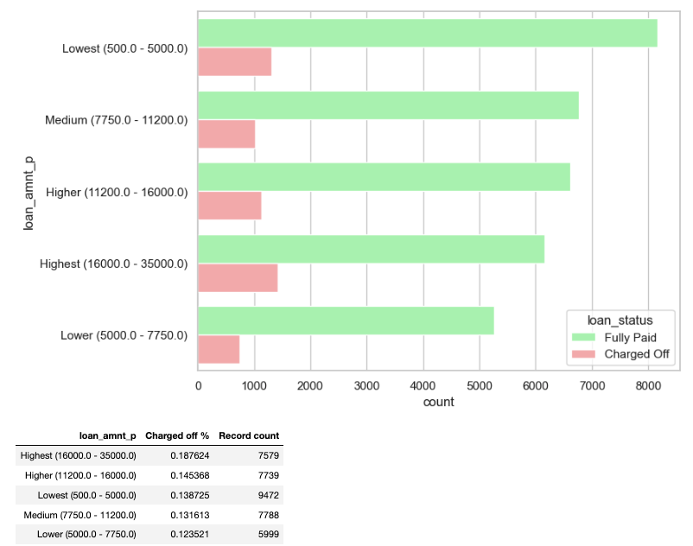
Univariative Categorical Analysis on Loan Amount
Higher the loan amount, greater the chance of the loan getting default.

Slide 3
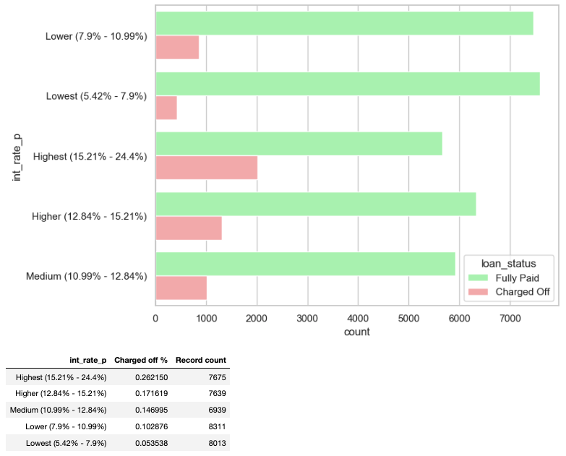
Univariative Categorical Analysis on Interest Rate
Higher the interest rate leads to higher charged off%

Slide 4
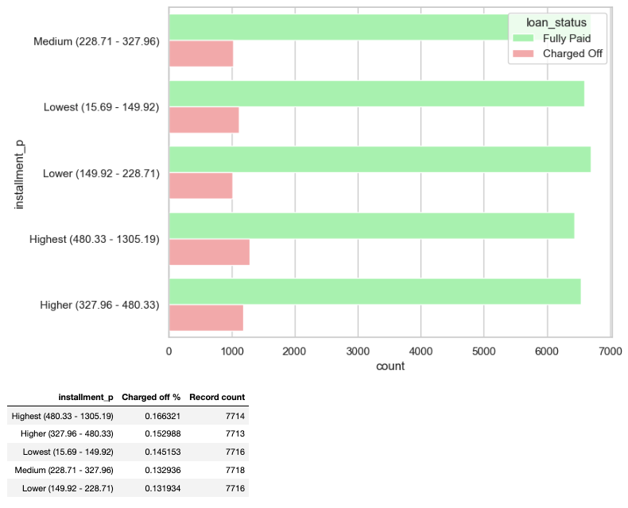
Univariative Categorical Analysis on installement
Above data and plot shows that higher installment amounts shows higher default percentages.

Slide 5
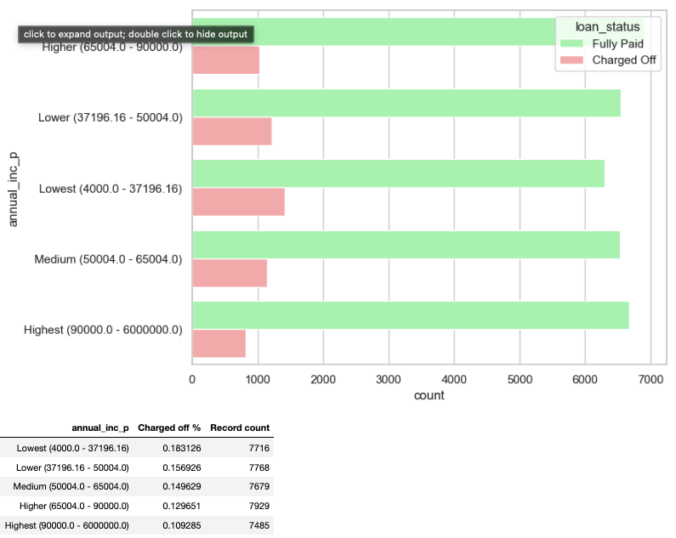
Univariative Categorical Analysis on Income
Higher the income hiegher the repayment %

Slide 6
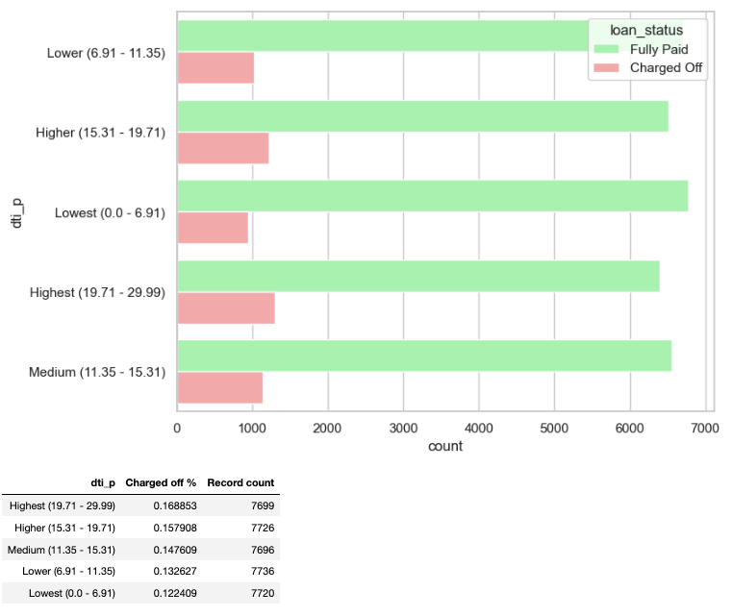
Univariative Categorical Analysis on Debt to Income
higher DTI ( debt to income ratio) will lead to higher charged off %

Slide 7
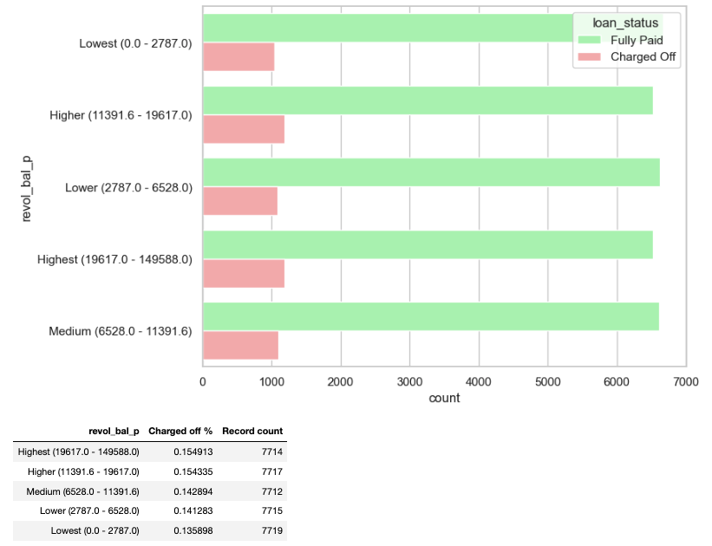
Univariative Categorical Analysis on Revolving Balance
This shows the total credit revolving balances slightly influence the default percentage. Higher the revolving balance, bigger the chance of the loan getting defaulted.

Slide 8
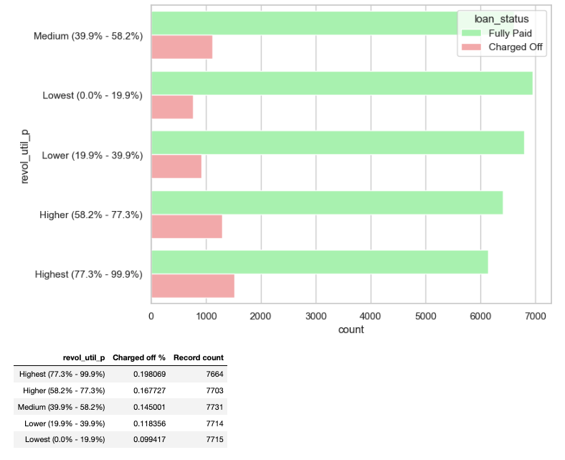
Univariative Categorical Analysis on Utilization Rate
This data shows that the revolving line utilization rate has a large impact to the default percentage. When this increases, the charged off percentage rises

Slide 9
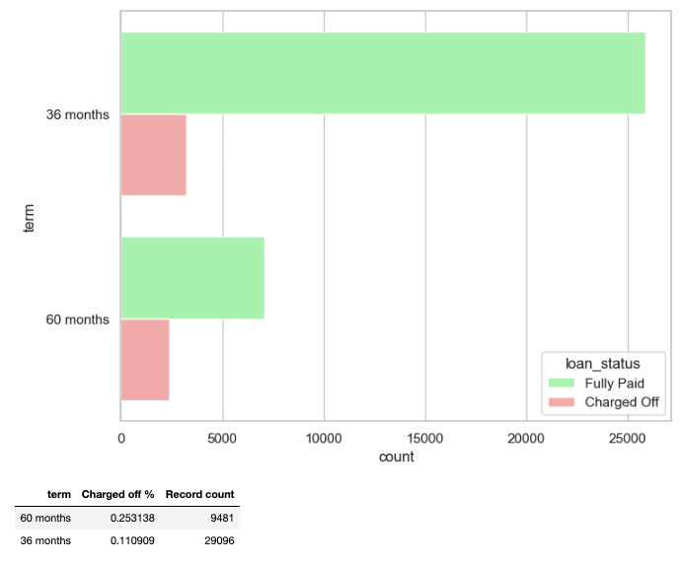
Univariative Categorical Analysis on Term
For loans with 5 year repayment term, the default percent is 25%. And for 3 year loan repayment term, the default is only for 11% of the cases. Therefore, loan repayment term plays a factor in judging the default rate.

Slide 10
Univariative Categorical Analysis on Repayment
For loans with 5 year repayment term, the default percent is 25%. And for 3 year loan repayment term, the default is only for 11% of the cases. Therefore, loan repayment term plays a factor in judging the default rate.

Slide 11
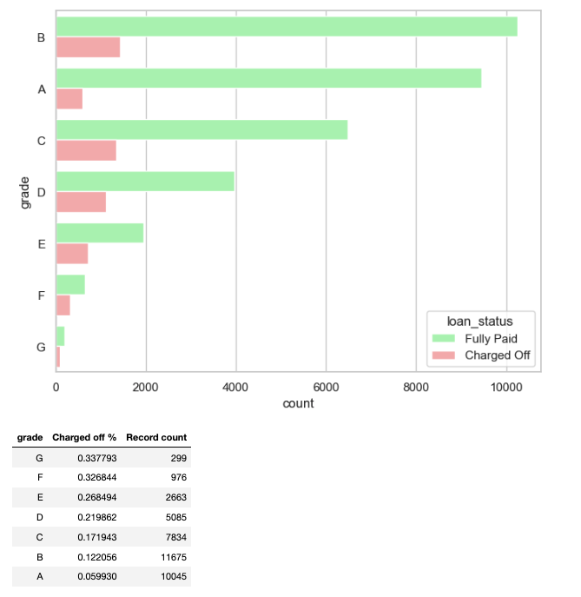
Univariative Categorical Analysis on Grade
We can clearly see that loan grades having highest default percentages. G, F, E and D form grades where default rate is much higher than others.

Slide 12
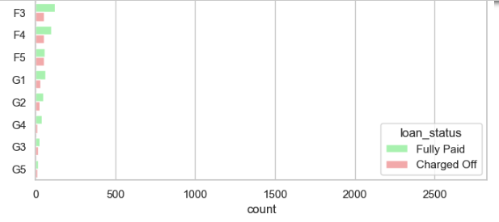
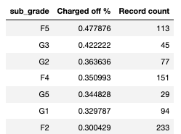
Univariative Categorical Analysis on Sub Grade
The above table shows the loan sub-grade versus the default percentage. The G3 and F5 sub categories have above 40% default rate. This field is a clear indicator of the default percent.

Slide 13
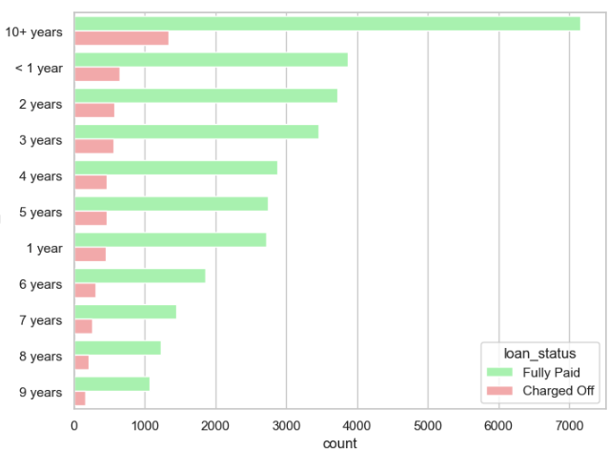
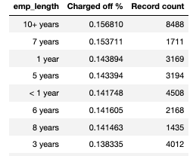
Univariative Categorical Analysis on Employee Length
although there is nothing much to conclude from above data, we can see having no employment will lead to Defaulted payment

Slide 14
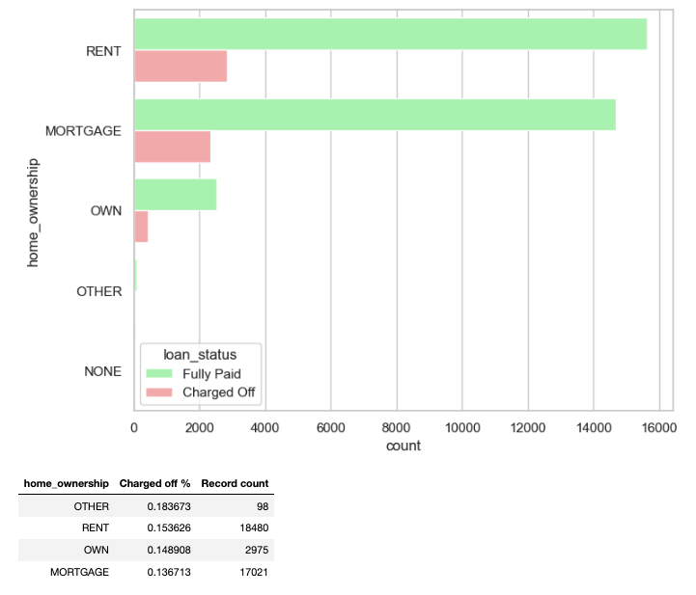
Univariative Categorical Analysis on Home Ownership
we have not much info to conclude as it says "OTHER",

Slide 15
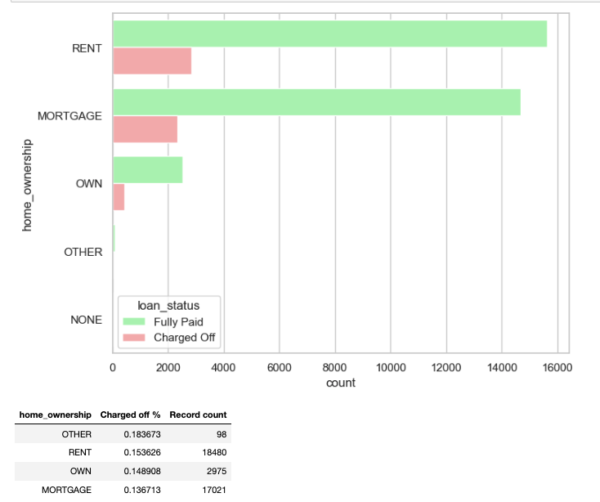
Univariative Categorical Analysis on Home Ownership
we have not much info to conclude as it says "OTHER",

Slide 16
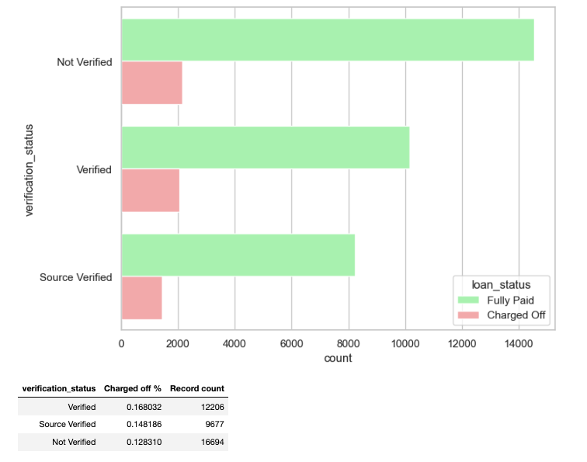
Univariative Categorical Analysis on Verification
interestingly verified applicants have more defaulted % which means the verifiaction process is not correct.

Slide 17
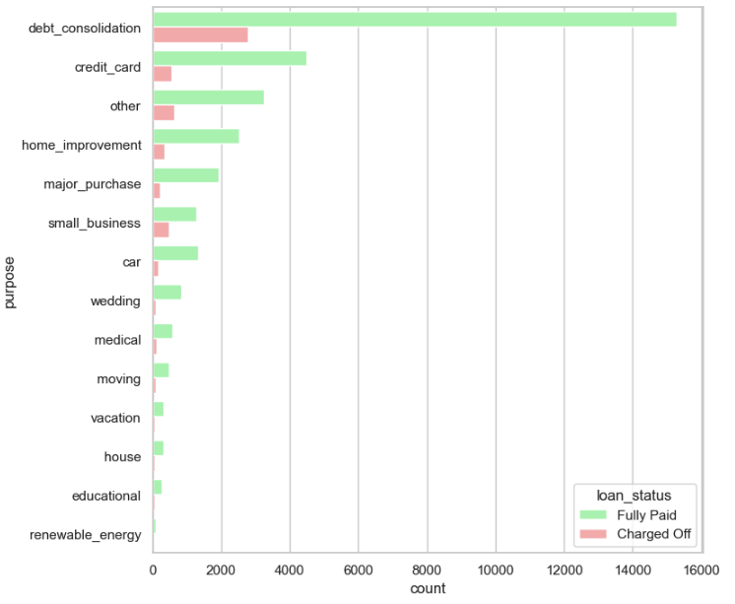
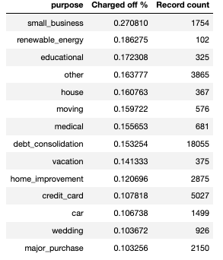
Univariative Categorical Analysis on Purpose
From the above analysis it is evidend that the loans taken for small_business, renewable_energy and educational are the riskier ones.

Slide 18
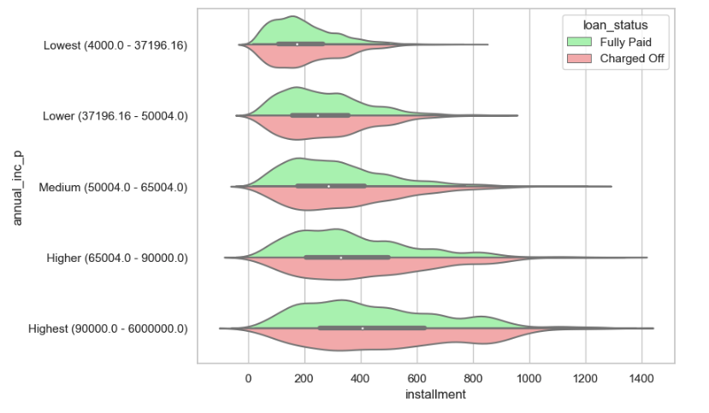
Bivariative Analysis on Installment & Annual Income
Above figure shows that for higher installments for any income group have more number of defaults.

Slide 19
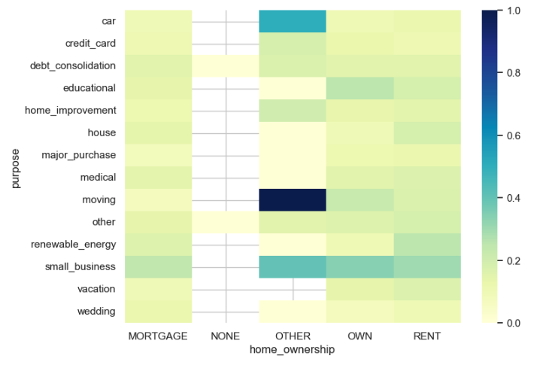
Bivariative Analysis for Home ownership and purpose
Nothing much information as it is under OTHER

Slide 20
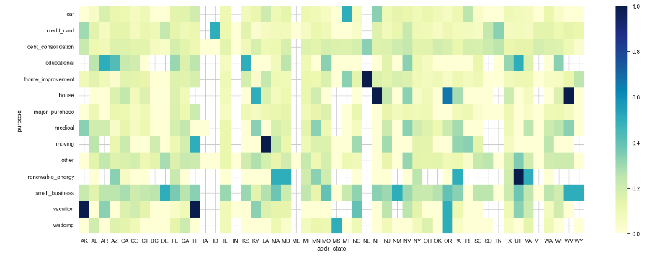
Bivariative Analysis for State and Purpose
As per the above plot, the darker the intersection of addr_state has with the purpose of the loan, the risker the loan application is. Some of the examples are below: •vacation loans in AK, HI, OR •education loans in AR, KS, UT •small business loans in DE, NM, WV, wY •wedding loans in MS, OR

Slide 21
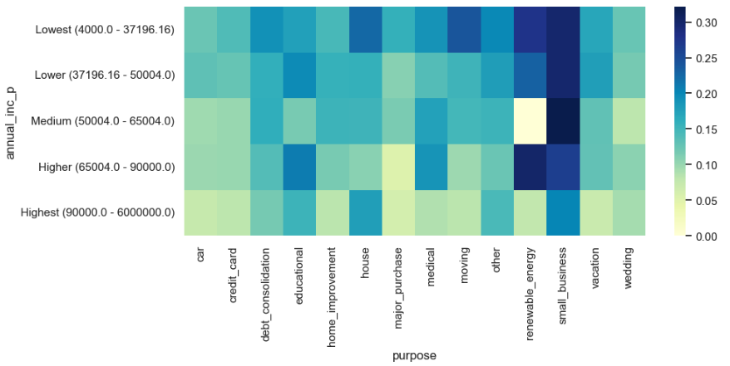
Bivariative Analysis for Annual Income and purpose
Plot of various income groups versus the risky purposes of loans for them. Some examples are: •small business loans for lowest and medium income groups •renewable energy loans for higher income group

Slide 22
Bivariative Analysis for Home ownership and purpose
Medium debt-to-income group in the lowest income range is the most risky when it comes to loan repayment.

Slide 23
Conclusion:
Hereby we come to an end of the EDA of the loan data set and finding some of the drivers for loan default. Apart from the ones highlighted below, I am sure there will be multiple others too; however, according to me, these are the most impactful ones.
Minor Impact .Higher loan amount (above 16K) •Higher installment amount (above 327) •Lower annual income (below 37K) •Higher debt to income ratio (above 15%) •Applicant’s address state (NV, SD, AK, FL, etc.) •Loan issue month (Dec, May, Sep)

Slide 24
Heavy impact
•Higher interest rate (above 13%)
•Higher revolving line utilization rate (above 58%)
•Repayment term (5 years)
•Loan grade & sub-grade (D to G)
•Missing employment record
•Loan purpose (small business, renewable energy, educational)
•Derogatory public records (1 or 2)
•Public bankruptcy records (1 or 2)

Slide 25
Combined impact
•High loan amount & interest rate for lower income group
•High installment and longer repayment term
•Home ownership (other) and loan purpose (car, moving or small business)
•Residential state and loan purpose
•Income group and loan purpose

