Slide 1
Prompt Studio
AI-Powered Chatbot & Prompt Review Platform
Under Guidance of: Prof. </Faculty Name>
Group Members

Slide 2
Outline
Introduction
Problem Statement
Objectives
Literature Survey
System Architecture
Chatbot Workflow
Database Design
Prompt Review Workflow
Technologies Used
Results and Output
Conclusion
Future Scope

Slide 3
Introduction
Prompt Studio is an intelligent conversational AI platform built to manage and analyze prompts.
It combines a persistent chat interface with seamless AI interaction.
The system bridges the gap between casual AI chat and structured prompt evaluation.

Slide 4
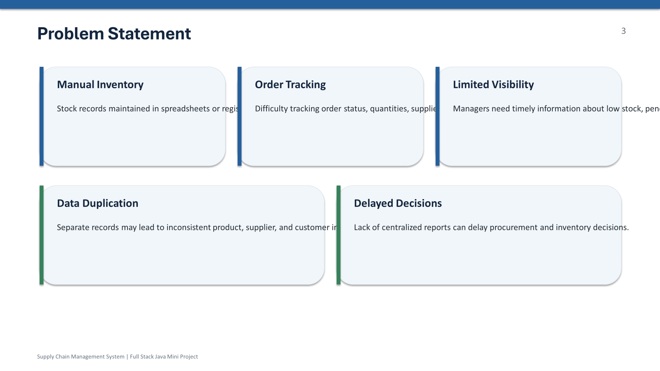
Problem Statement
Generic chatbot interfaces lack persistent, user-specific conversation history management.
Users struggle with the lack of structured prompt review and evaluation.
There is a separation between AI interactions and persistent project data storage.

Slide 5
Objectives
Develop a centralized, responsive web application for AI interactions.
Implement persistent database storage for users, conversations, and messages.
Integrate Gemini API (gemini-2.5-flash) for real-time generative responses.
Create a dedicated workflow for contextual prompt review and feedback.

Slide 6
Literature Survey
Summary of existing AI conversational models and prompt engineering techniques.
Reference | Topic | Relevance | Merits | Demerits
Attention Is All You Need (Vaswani et al.) | Transformer architectures | Foundational for LLMs
A Prompt Pattern Catalog (White et al., 2023) | Prompt engineering structures | Guides our prompt review logic

Slide 7
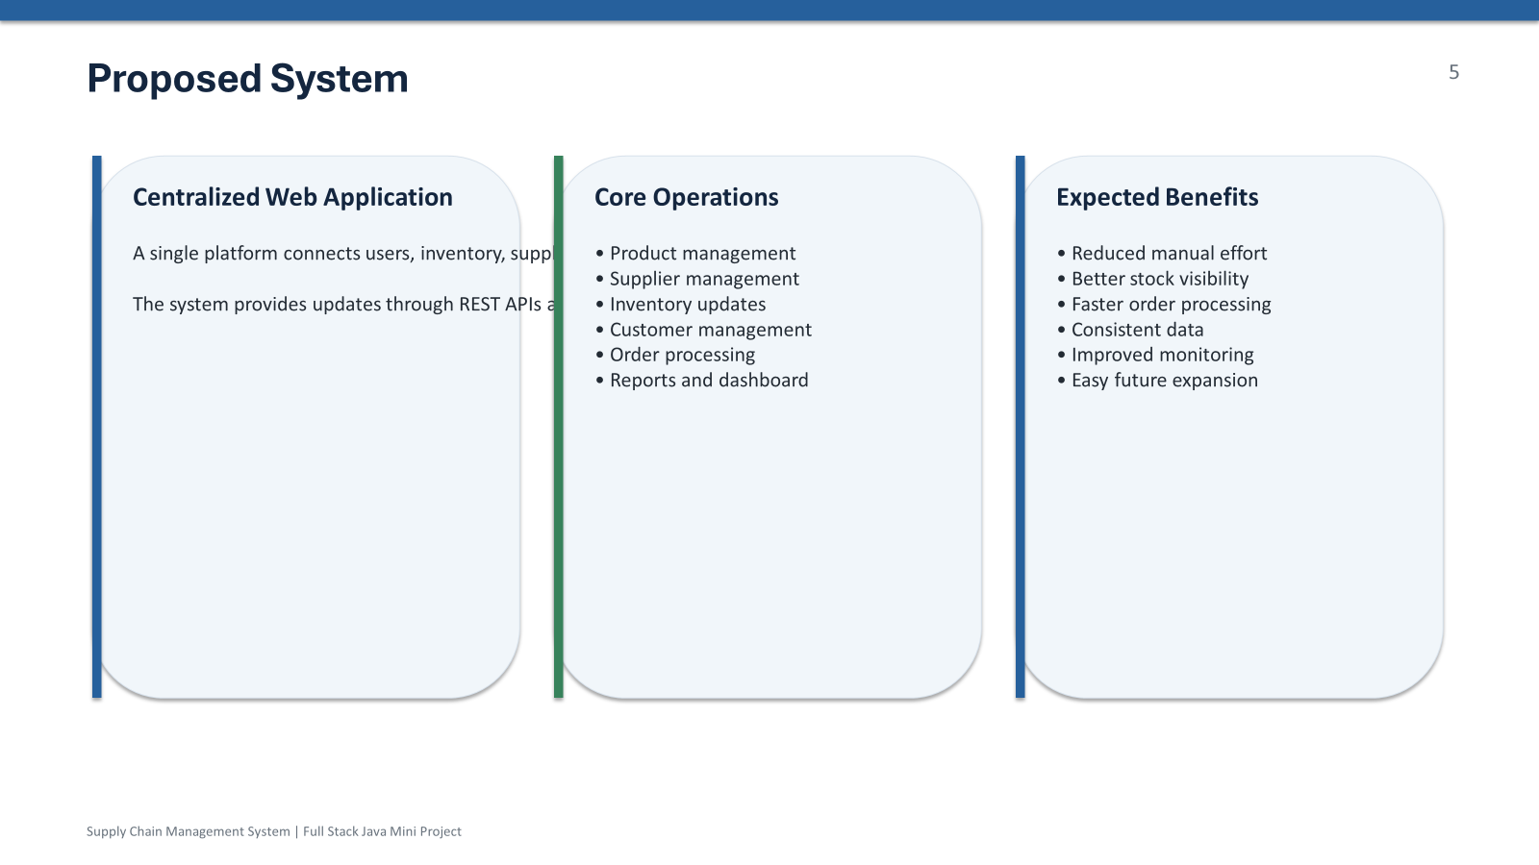
Literature Survey
Summary of 2 to 3 base papers, existing methods, or similar systems.
Prompt Studio improves on generic interfaces by allowing targeted prompt evaluation and persistence, moving beyond temporary chats.

Slide 8
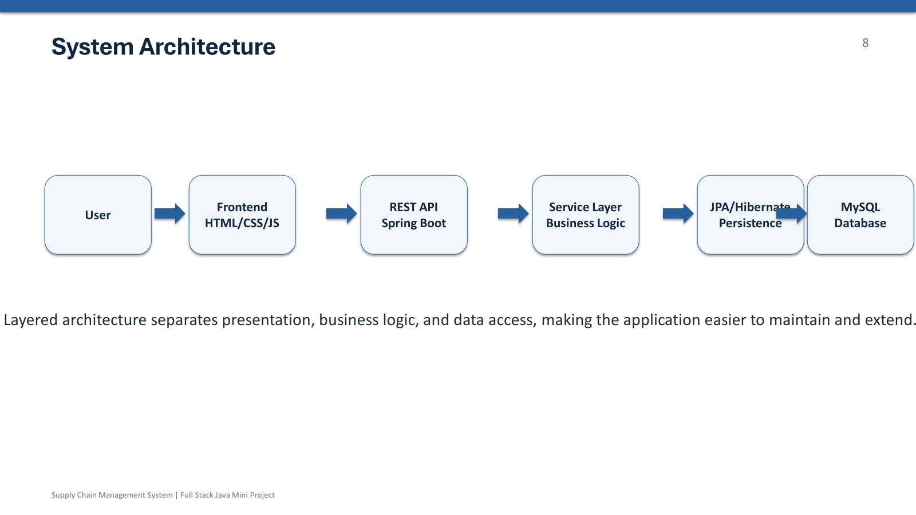
System Architecture
Frontend Chat Interface
(HTML / CSS / JS)
Spring Boot REST API
(Java 17 / Auth / Services)
PostgreSQL Database
(Neon)
Gemini API
(gemini-2.5-flash)

Slide 9
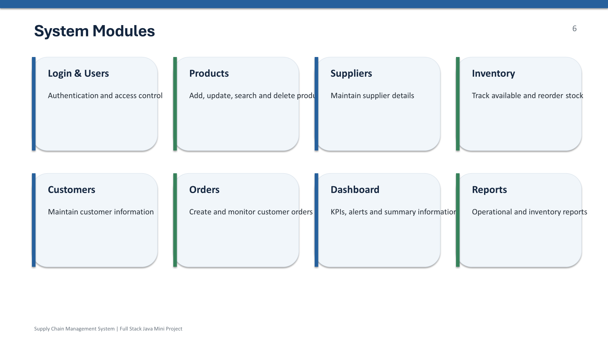
Chatbot Workflow
User Sends Message
Authenticate & Identify Conversation
Retrieve History & Send to Gemini
Save Assistant Response & Display

Slide 10
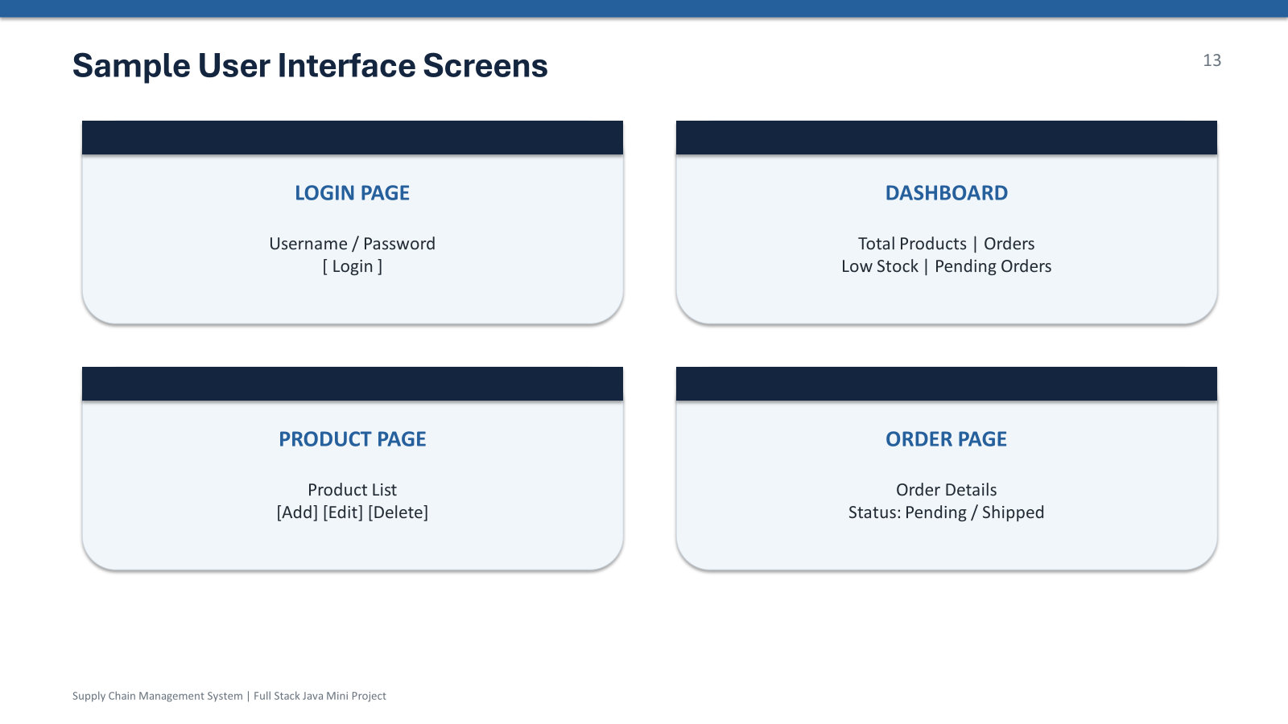
Database Design (ER Diagram)
USERS
- id
- email
- name
CONVERSATIONS
- id
- user_id
- title
MESSAGES
- id
- conv_id
- role
- content

Slide 11
Prompt Review Workflow
User requests review
Prompt provided?
Review Prompt (Future Scope)
Ask user to upload

Slide 12
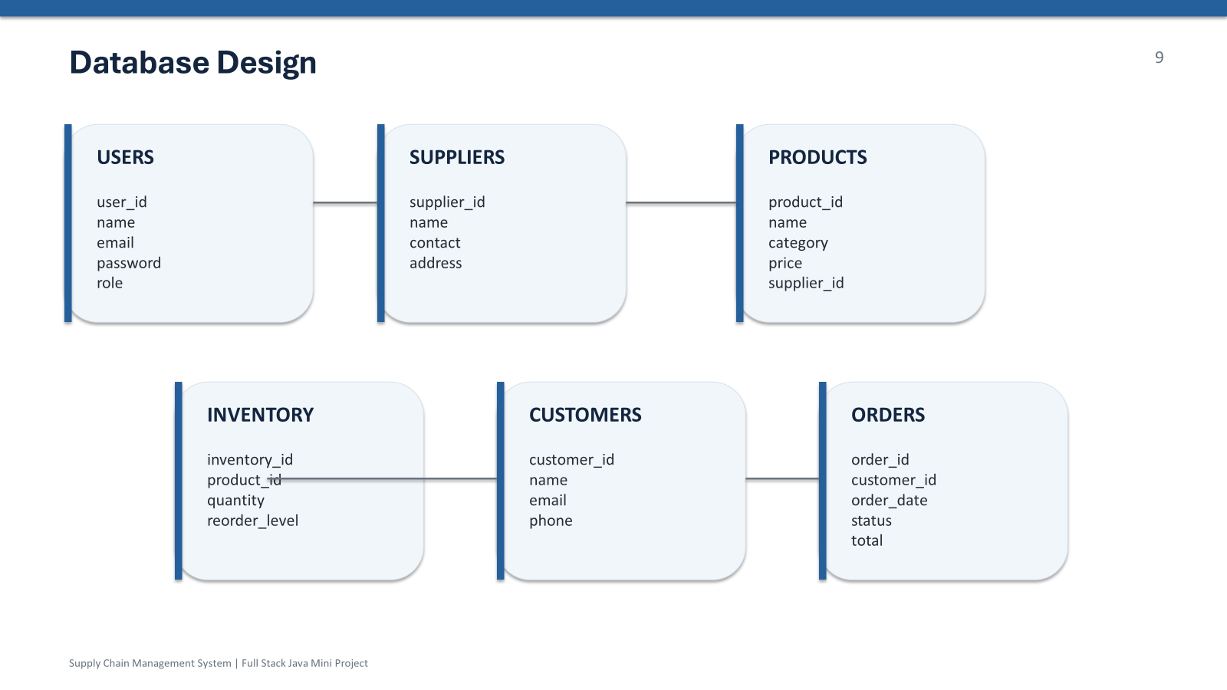

Slide 13
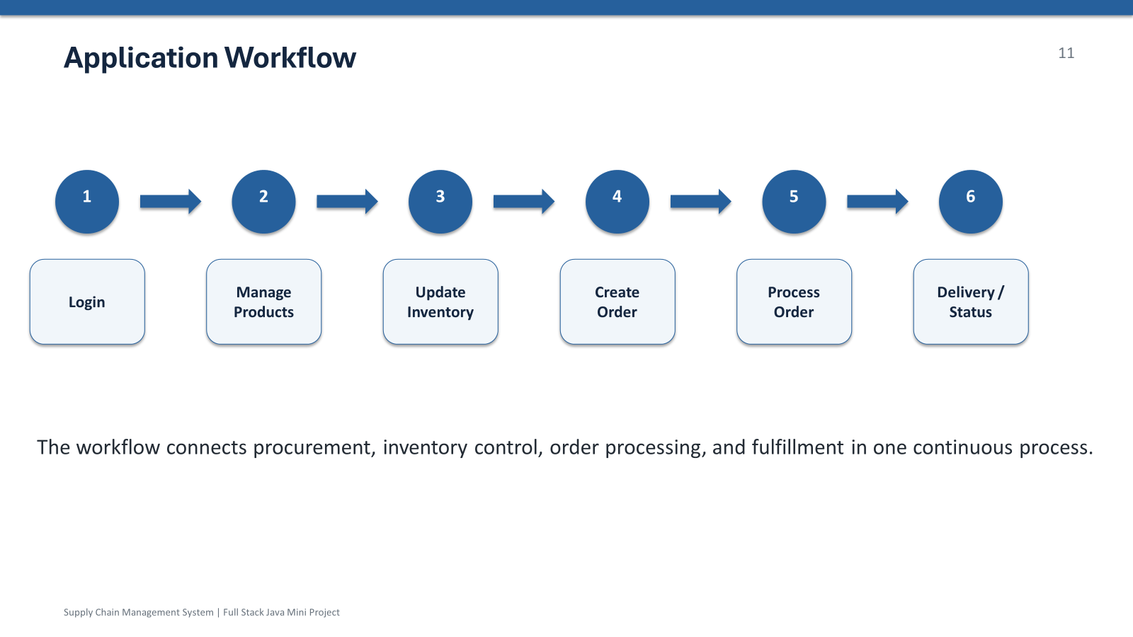

Slide 14
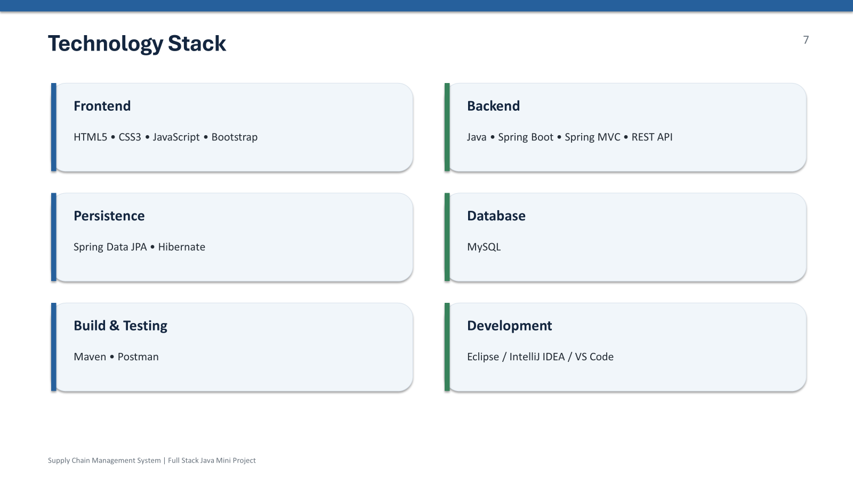
Requirements / Technologies Used
Backend: Java 17, Spring Boot, JPA/Hibernate, Maven
Database: PostgreSQL (Neon)
AI Integration: Gemini API (gemini-2.5-flash)
Frontend: HTML, CSS, JavaScript (Vanilla)
Auth: Google OAuth & Dev Session Auth

Slide 15
Results and Output
Chat interface and conversation management successfully implemented.
Real-time Gemini integration working.
UI for Prompt Upload isolated and ready for backend hooks.
[PASTE SCREENSHOTS OF LOCALHOST:8000 CHAT UI HERE]

Slide 16
Conclusion
Prompt Studio successfully implements a full-stack conversational AI platform.
The Java/Spring Boot backend effectively manages state in a Neon PostgreSQL database.
The foundation is laid for advanced prompt review and scoring capabilities.

Slide 17
Future Scope
Full prompt analysis and scoring engine.
File/document-based backend parsing for prompts.
Analytics dashboard for conversation metrics.
Prompt versioning and history tracking.

Slide 18
References
Gemini API Documentation
Spring Boot & Hibernate Documentation
White et al. (2023) - A Prompt Pattern Catalog

Slide 19
Thank You!
Questions?

